Slide 1



DS BOOTCAM PPROJECT 2
Item 5
20%
Item 1
20%
Item 4
20%
Item 2
20%
DATA
PREPROCESSING
AND ANALYSIS
Item 3
20%
NJOOD ALJURAID
ARWA ALTHIYAB
YARA ALRABAH

Slide 2




Objectives
1
2
Collect data
Cleaning
5
4
3
Insights
Visualization
anslysis

Slide 3


DATASET OVERVIEW
Bank Customers Data
This Dataset source is INE training website

Slide 4
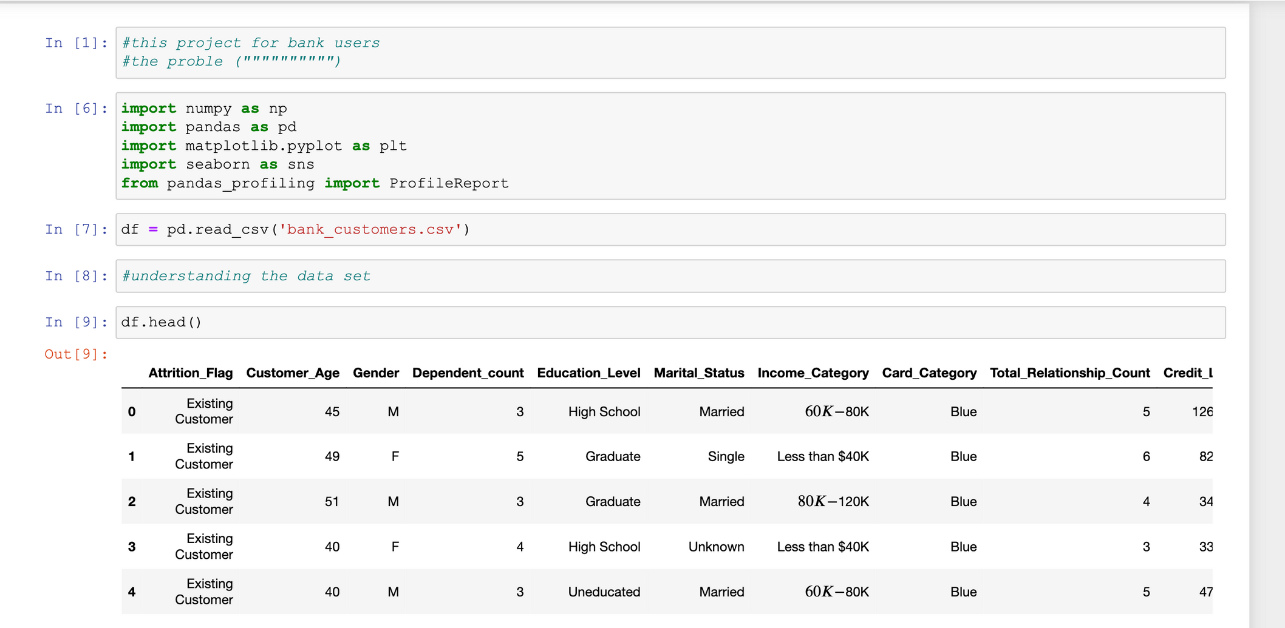
DATASET OVERVIEW

Slide 5
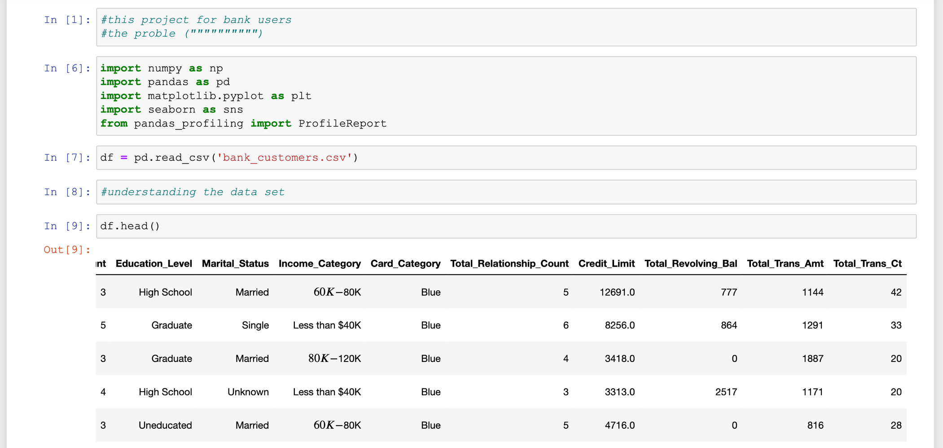
DATASET OVERVIEW

Slide 6
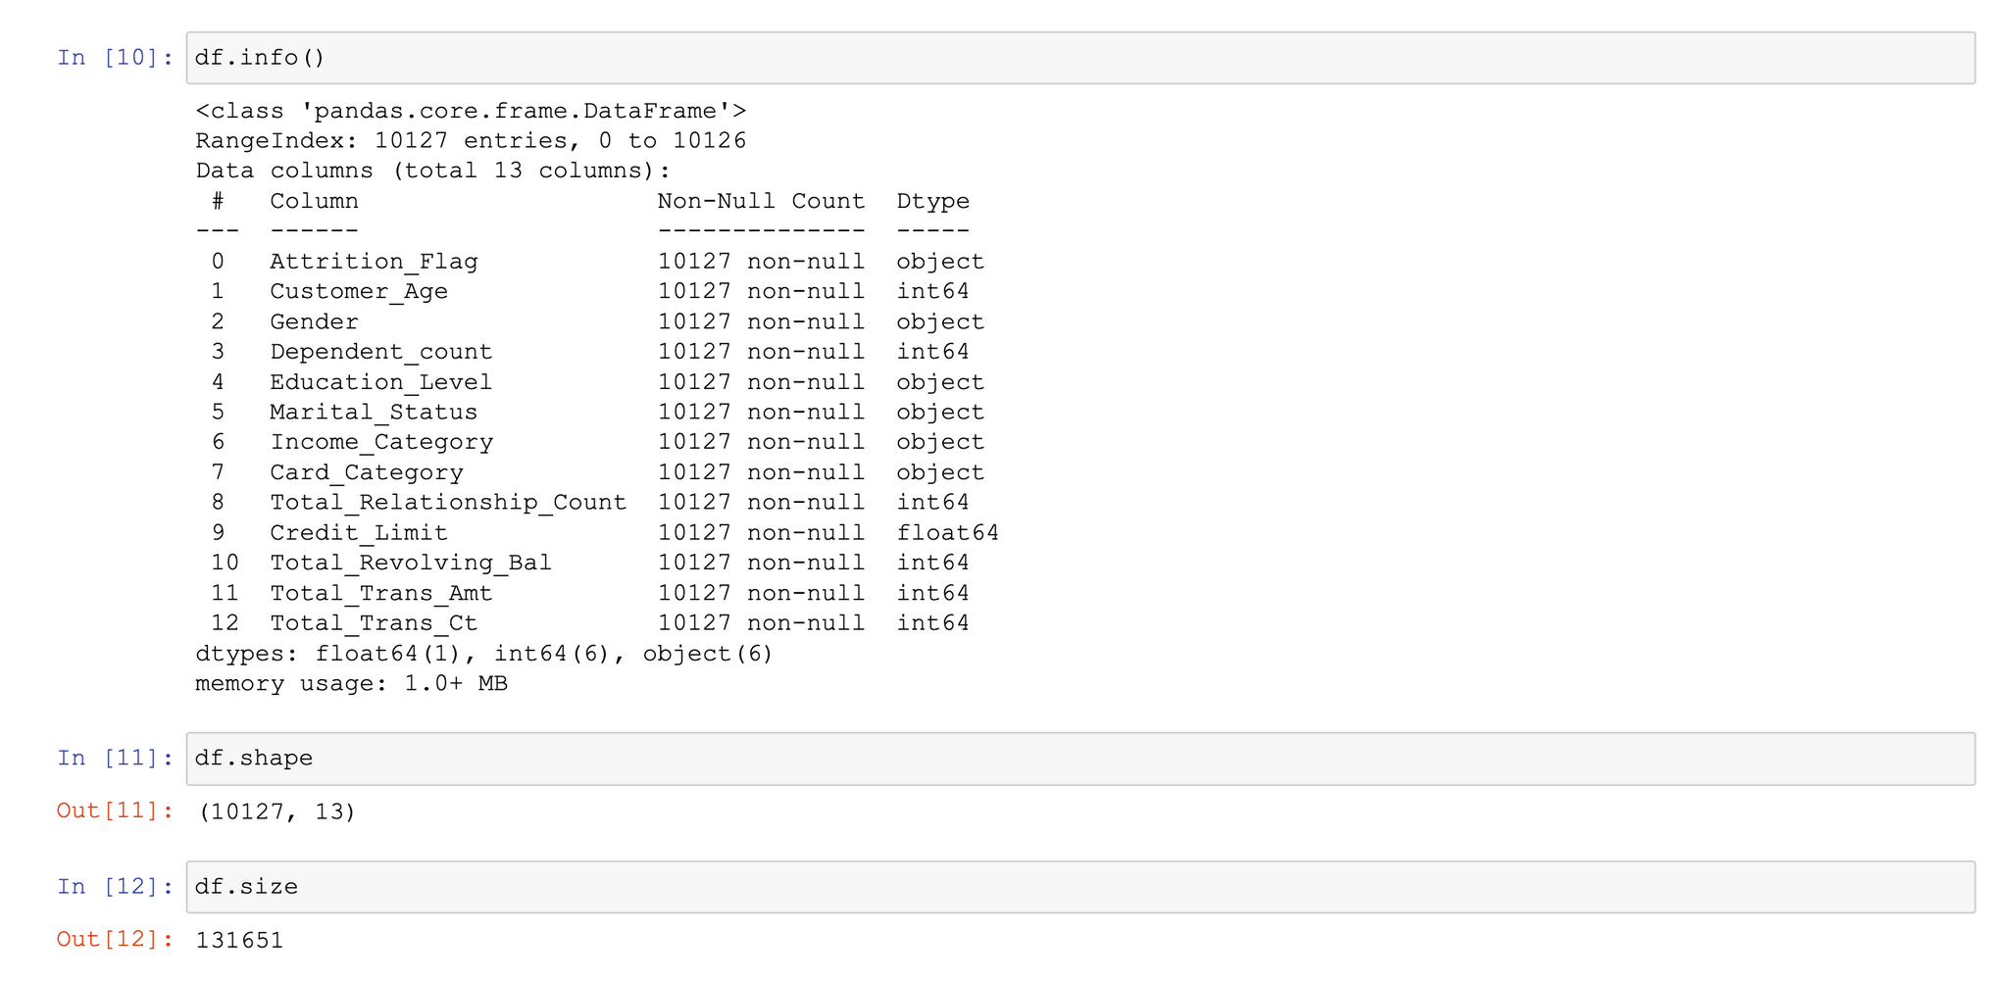
DATASET OVERVIEW

Slide 7
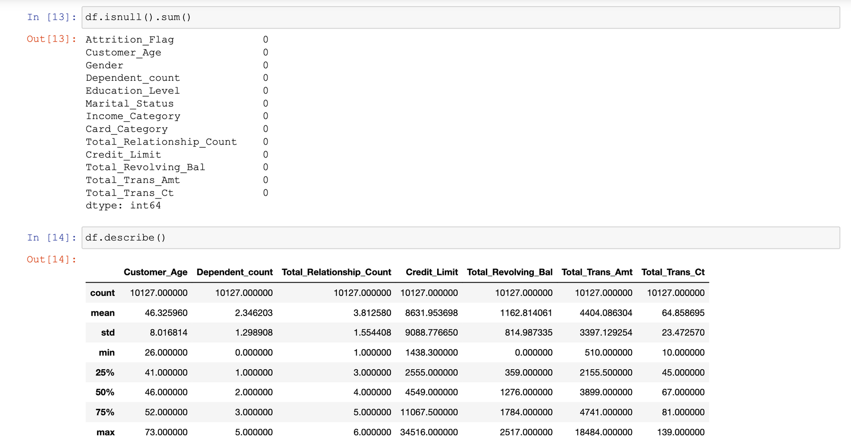
DATASET OVERVIEW

Slide 8
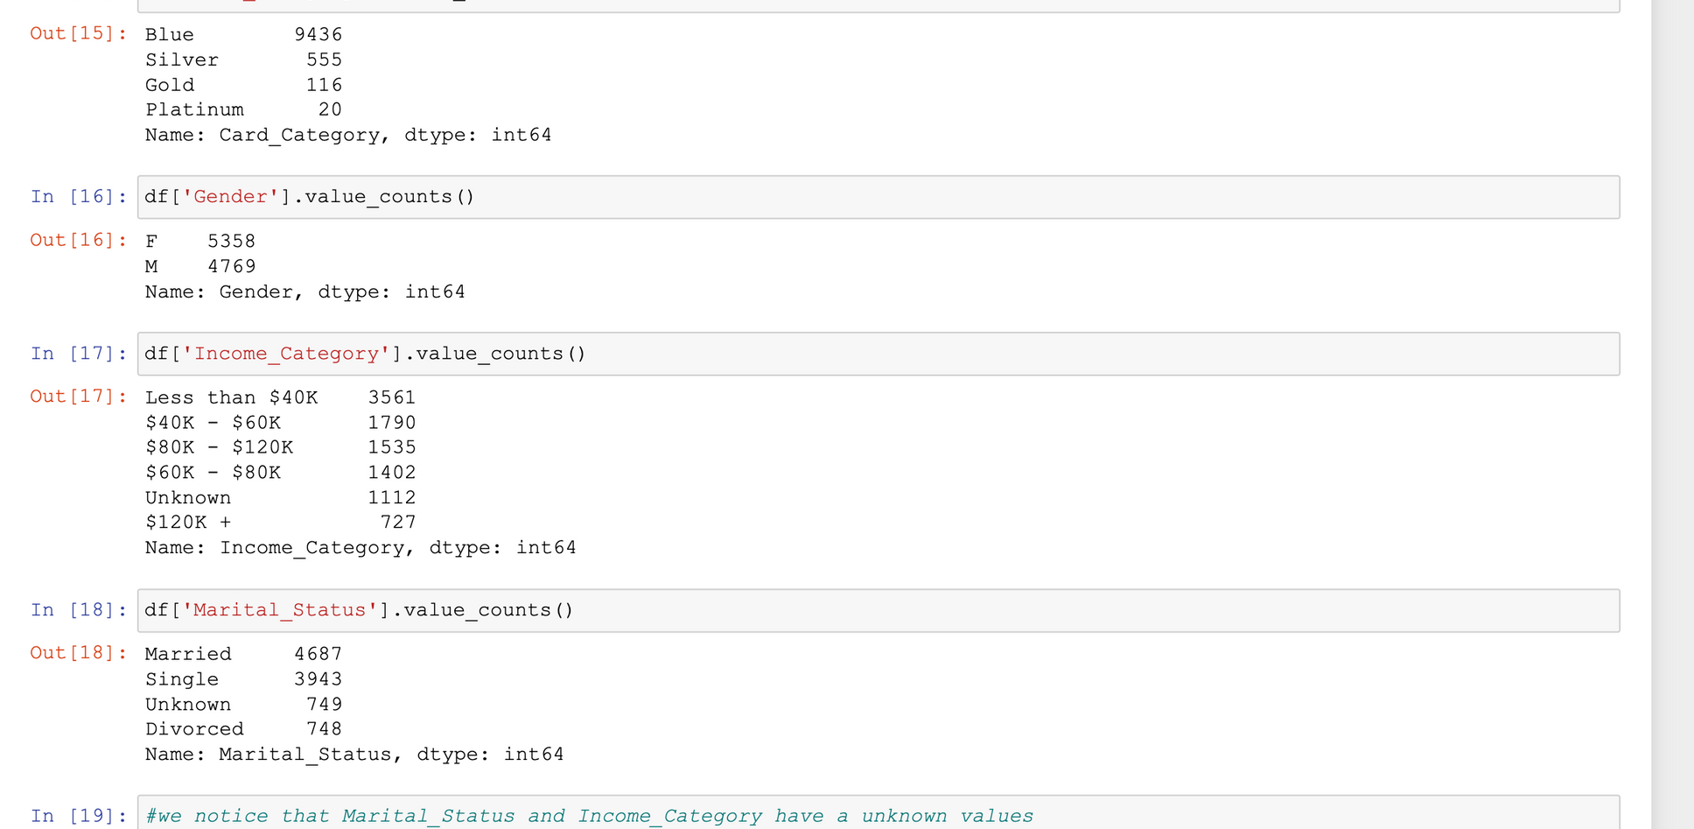
DATASET OVERVIEW

Slide 9



Unknown values
Income Category Education level
Unknown values
Marital Status
PROBLEM

Slide 10
THANK YOU
7 Nov 2022

