Slide 1
Circ
By: Vinh Doan and Yuta Arai

Slide 2
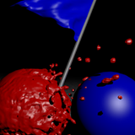
Introduction
Circ is based on the web game, Tag Pro
Circ is a multiplayer top down game, in which each player is a ball.
Each player can move in 4 directions
There are 2 different game modes which put players against each other
For athletes to practice their jukes

Slide 3
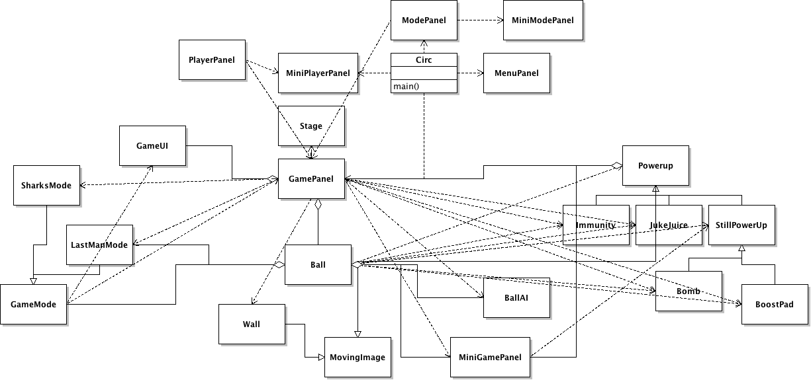
Code Overview

Slide 4

Code Challenges
Ball Collisions
  Ball to Ball
  Ball to Wall
Stage Creator
Game Modes
GUI (tedious)

Slide 5
Code Design
Ball - contains all Ball related things
Game Modes
  LastManMode
  SharkMode
GamePanel: depends on almost all other classes besides other JPanels
MiniPanels: Most Panels contain smaller panels that are similar
GameUI - Contains all additional GameUI (timer)

Slide 6

Let’s begin Circ!
Controls:
  Mouse to navigate Menu
  Keys:
    Player 1: WASD
    Player 2 : TFGH
    Player 3: IJKL
    Player 4: Arrow Keys
Known Bugs:
  Collisions are not perfect
  You may spawn in a wrong area

Slide 7

Game Mode - Last Man Mode
Each time specified round, a set number of the players are marked
They can collide with other non-marked players to pass on their “mark”
At the end of each round, those still marked lose and die.
The rounds continue until there is one last winner!

Slide 8


Game Mode - Shark Mode
This mode is based off “Sharks and Minnows”
In this game, the stage has two ends, red and blue.
At the beginning, one player is made the “shark”
On the first round, non-shark players try to make it from red to blue.
If the shark touches one of these players they die and become a shark the next round along with the others.
After time runs out, the next round begins with those who made it
The next round, remaining non-sharks go from blue to red, as sharks try to tag them.

Slide 9




Power Ups
-BoostPad: Quick speed boost
-Bomb: You get blasted!
-JukeJuice: You get a temporary speed boost
-Immunity: You become immune from balls that can tag you. If you can’t get immunity nothing happens

Slide 10


if (hadMoreTime)
{
addNetworking();
fixCollisions();
addMusicAndSound();
for (int i = 0; i < aLotMore; i++)
addStages();
}

