Slide 1
Status
Have a general .stan code that will accommodate simple/multiple regression for J0 and b as a function of input variables
Have done some trimming and expanding the dataset
Decided we should focus on a Location x Month x Year ID (too much cross-profile variability)
Added climatological surface nutrient, subsurface temperature and oxygen, cell size
Plan
Everyone choose a variable, or two:
Net primary productivity (<name>), sea surface temperature (<name>), surface nutrient concentration (<name>), mineral ballast (<name>), phytoplankton cell size (<name>), subsurface temperature (<name>), subsurface oxygen (<name>)
Fit the global model and fit to regional subsets of the data
Show results in two weeks
I’ve started a Word manuscript in the GitHub repo

Slide 2
Tips for analysis

Slide 3
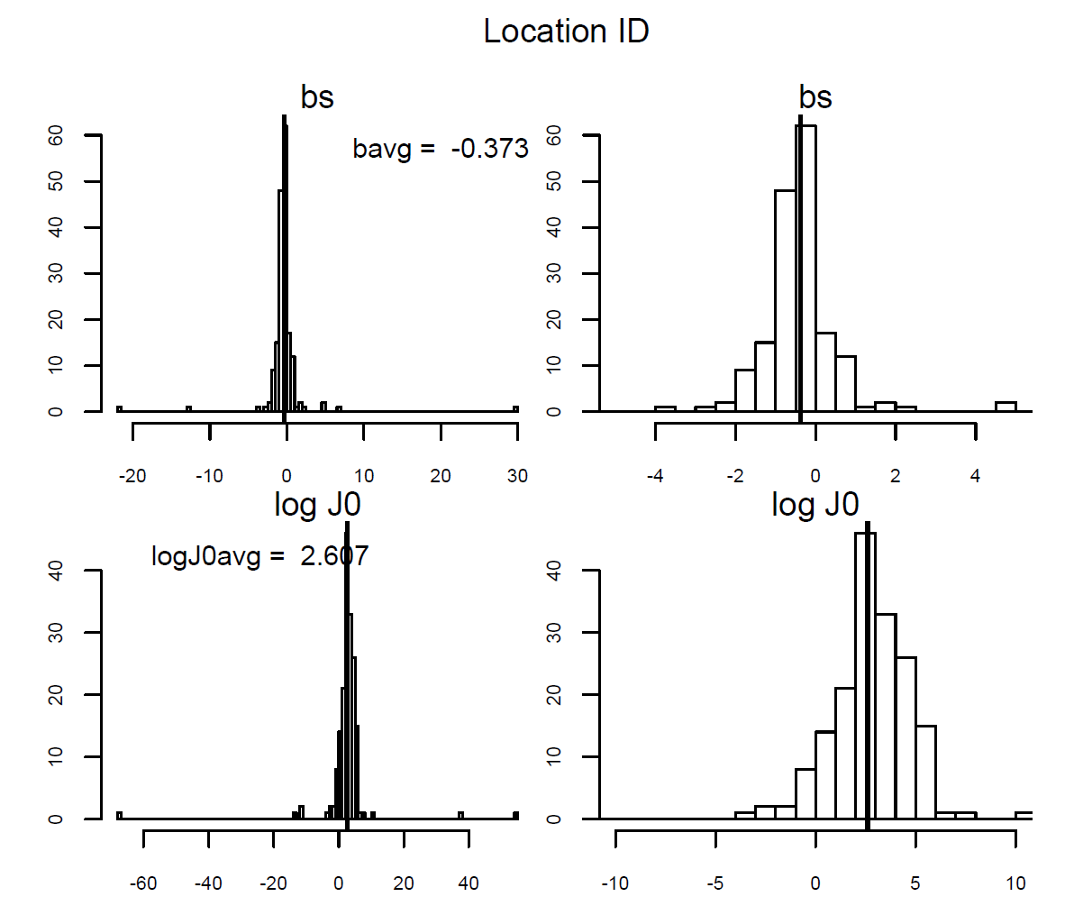
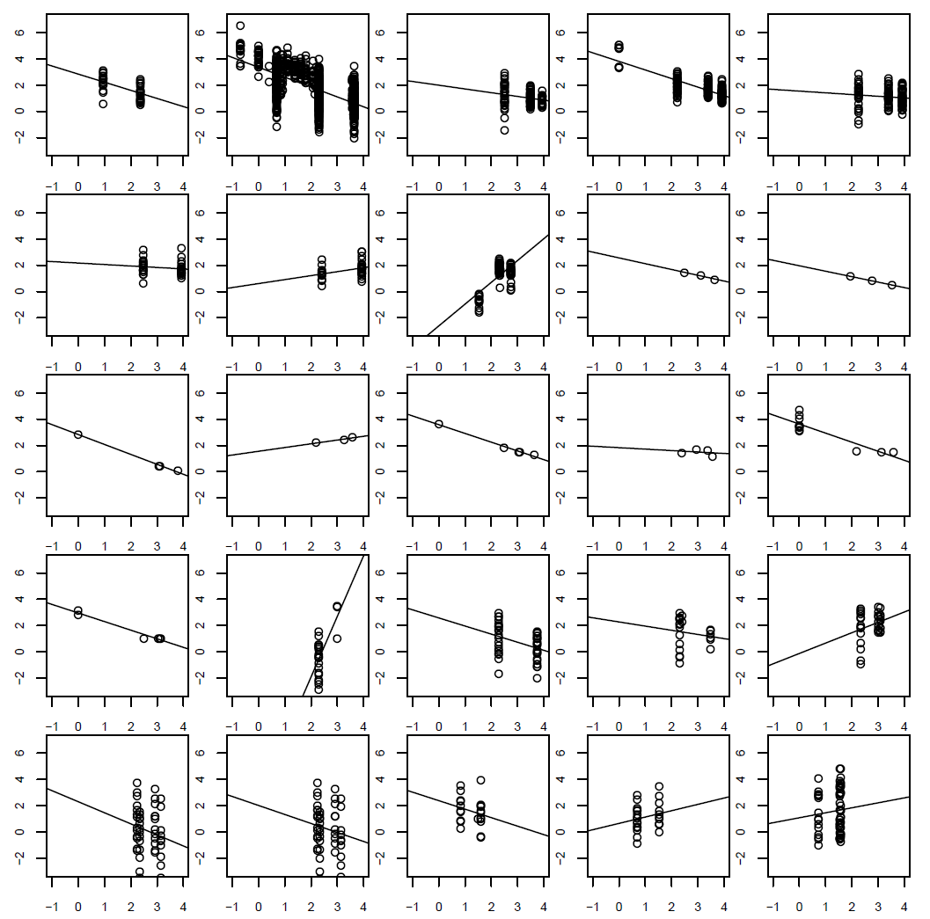
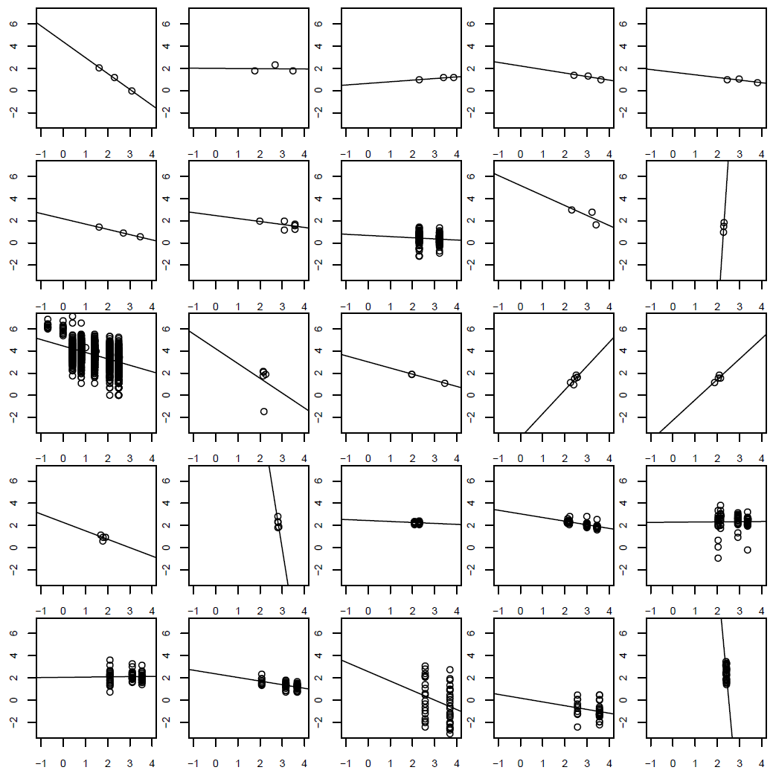
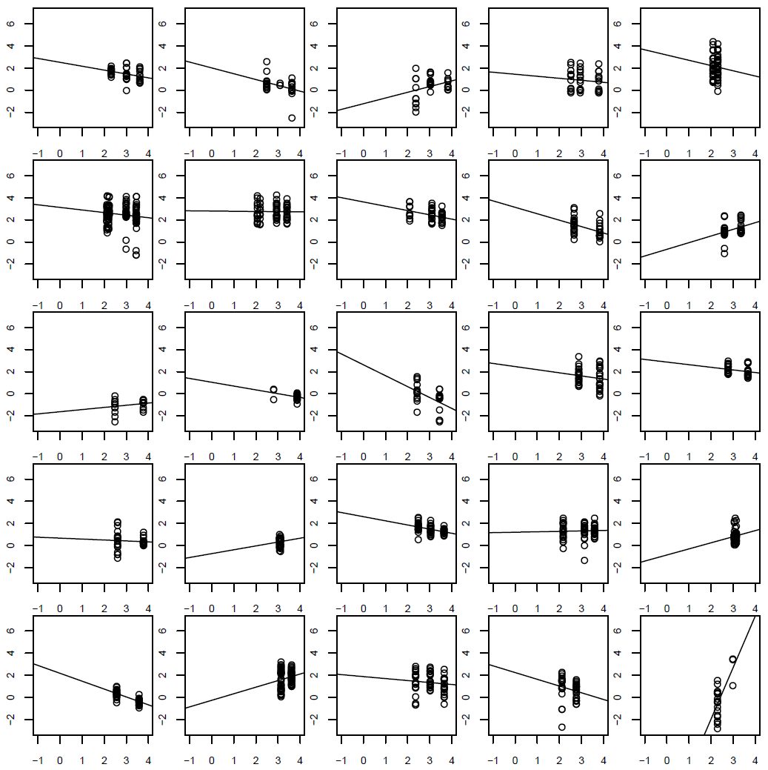
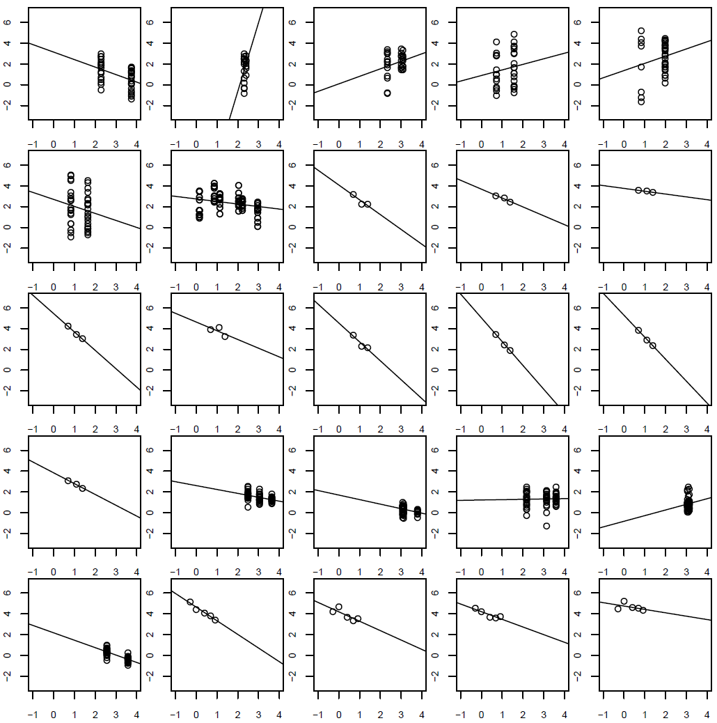
Stations 1-100 of 562

Slide 4
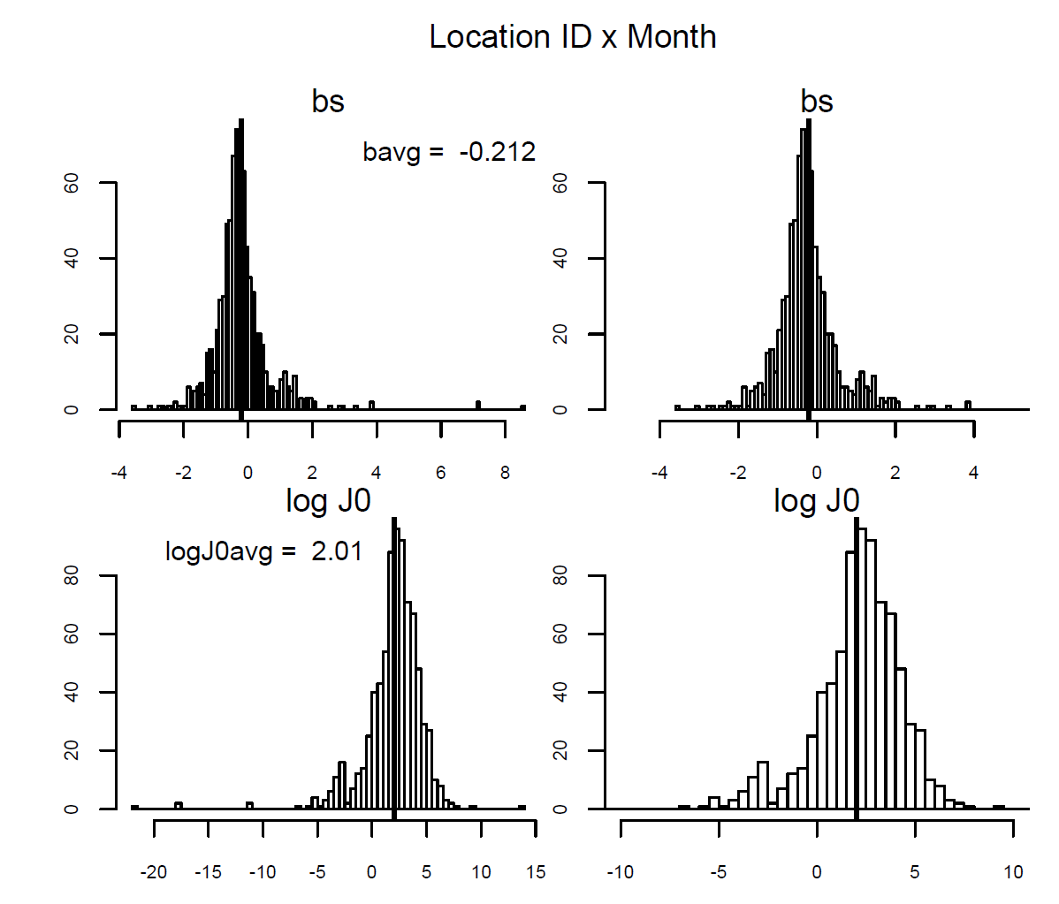
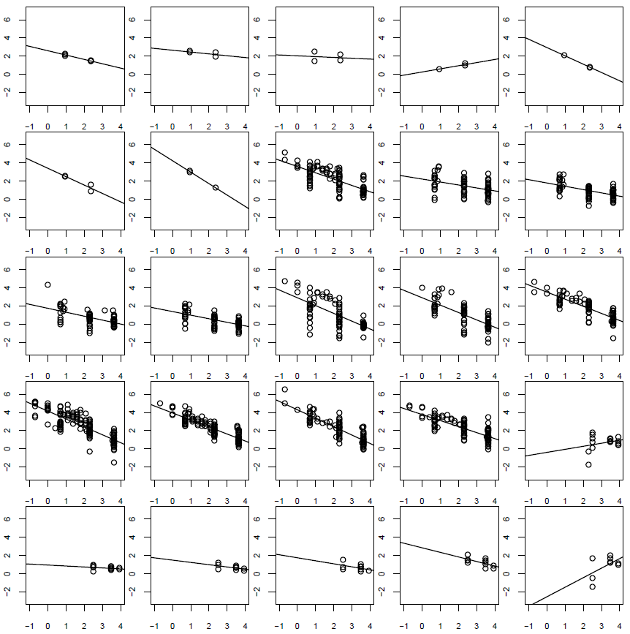
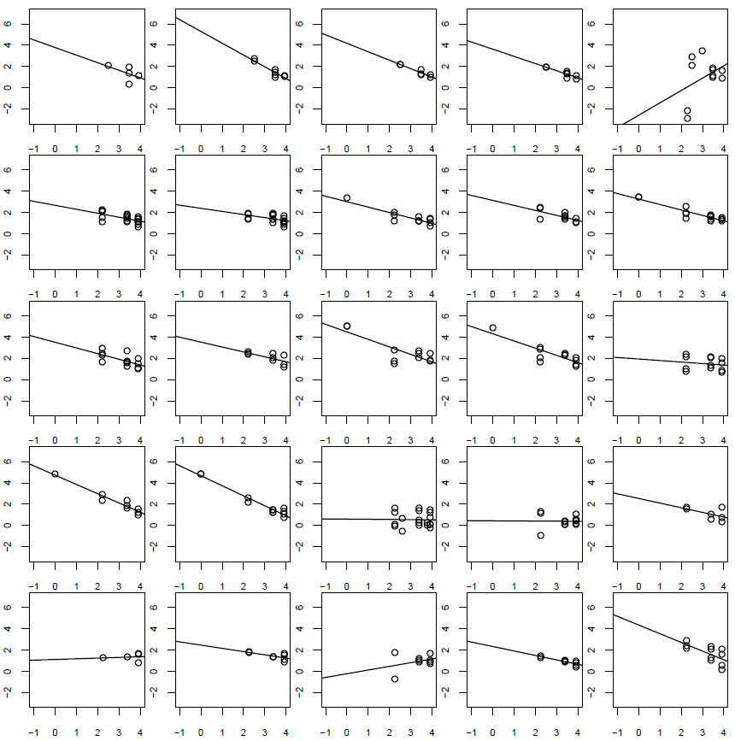
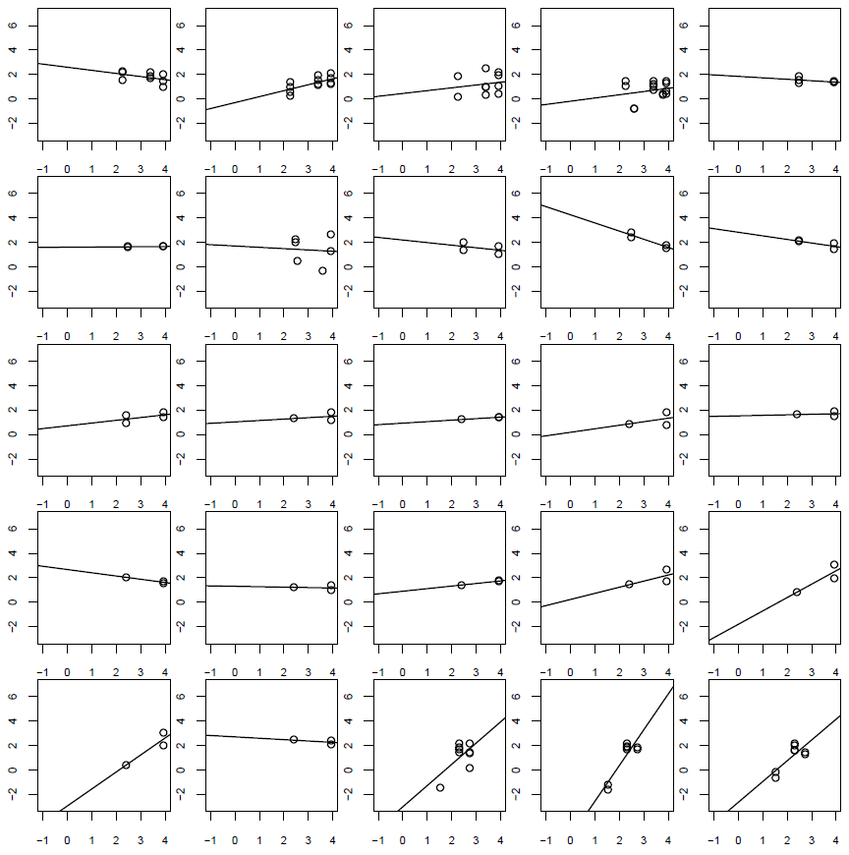
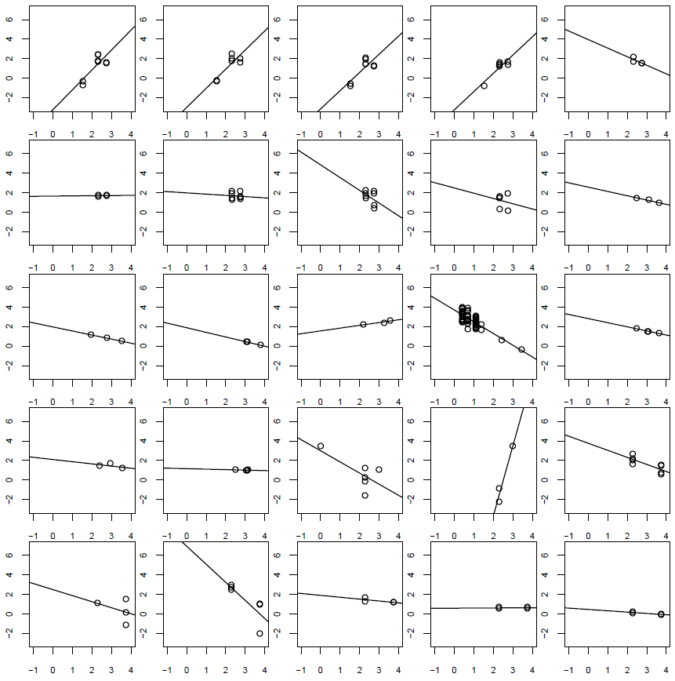
Stations 1-100 of 2040

Slide 5
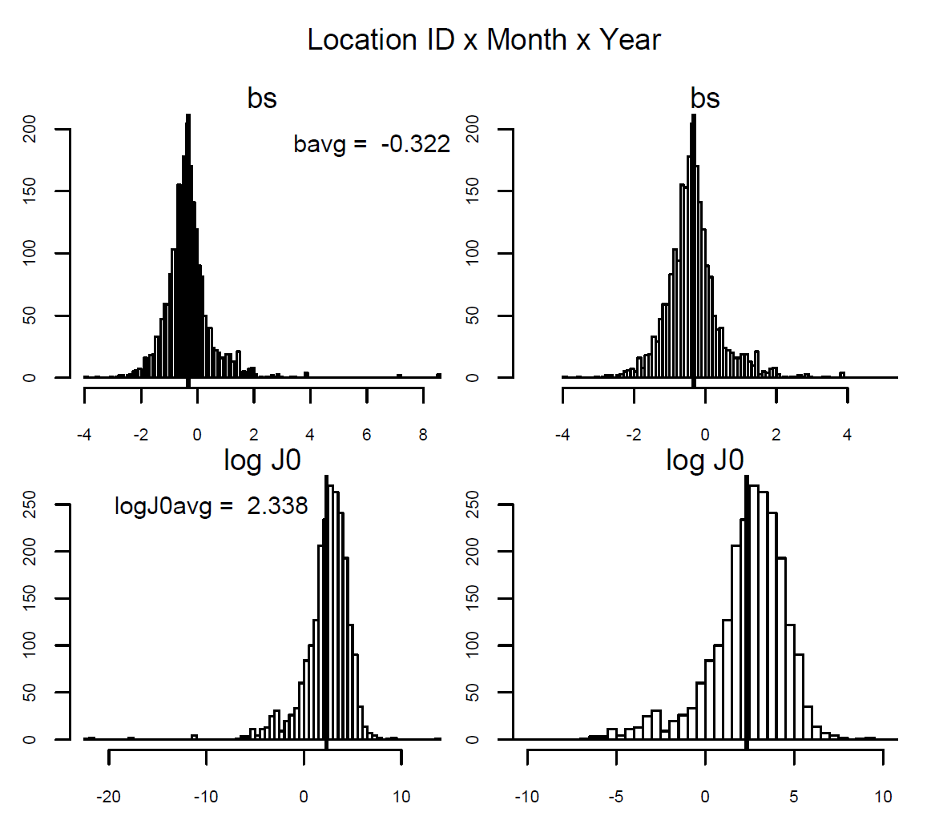
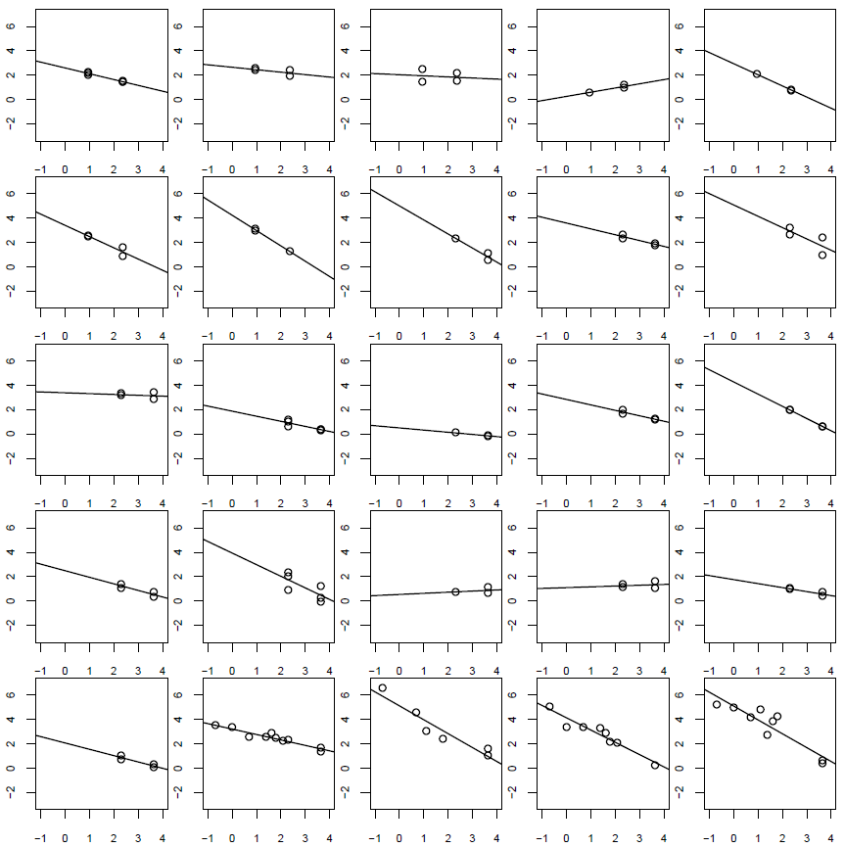
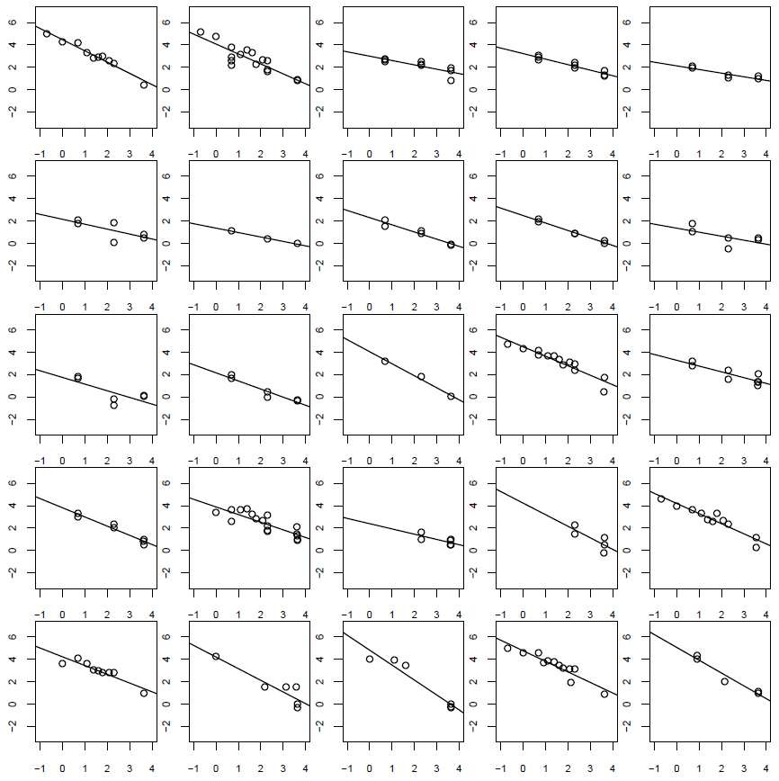
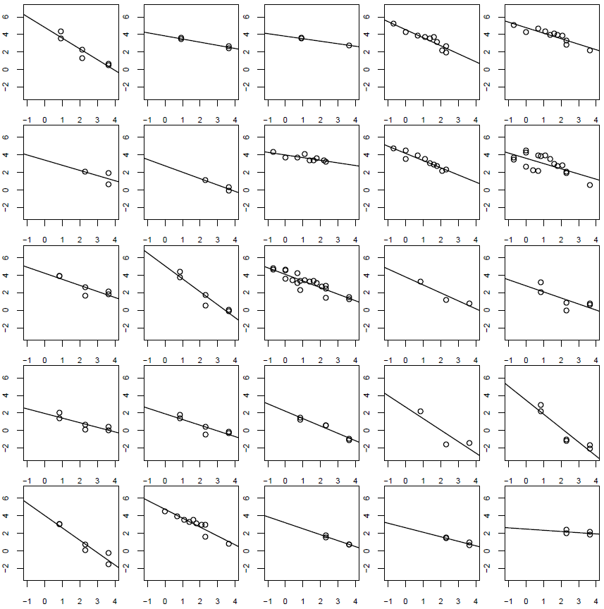
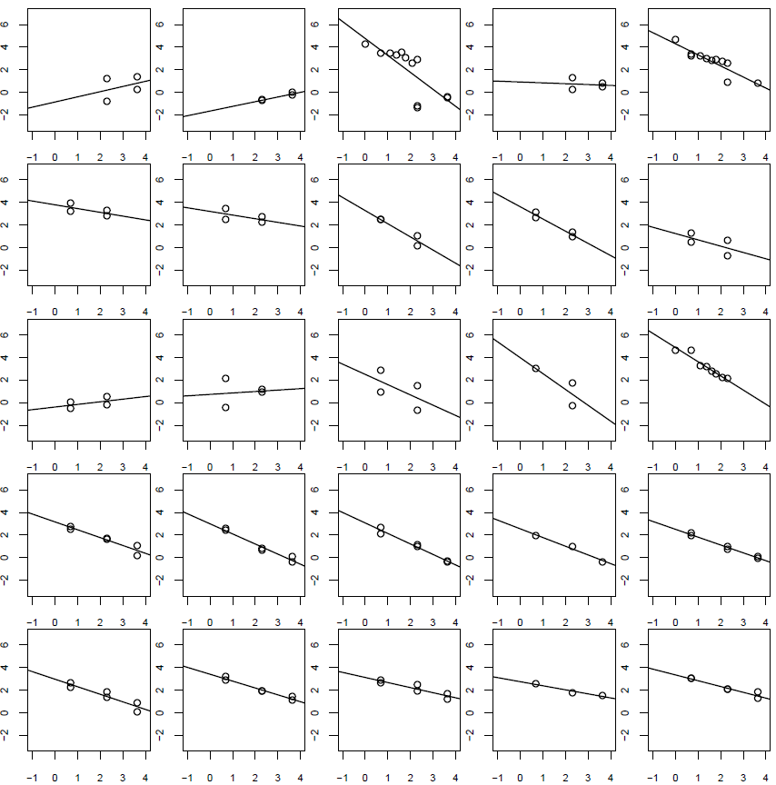
Stations 1-100 of 3344

Slide 7
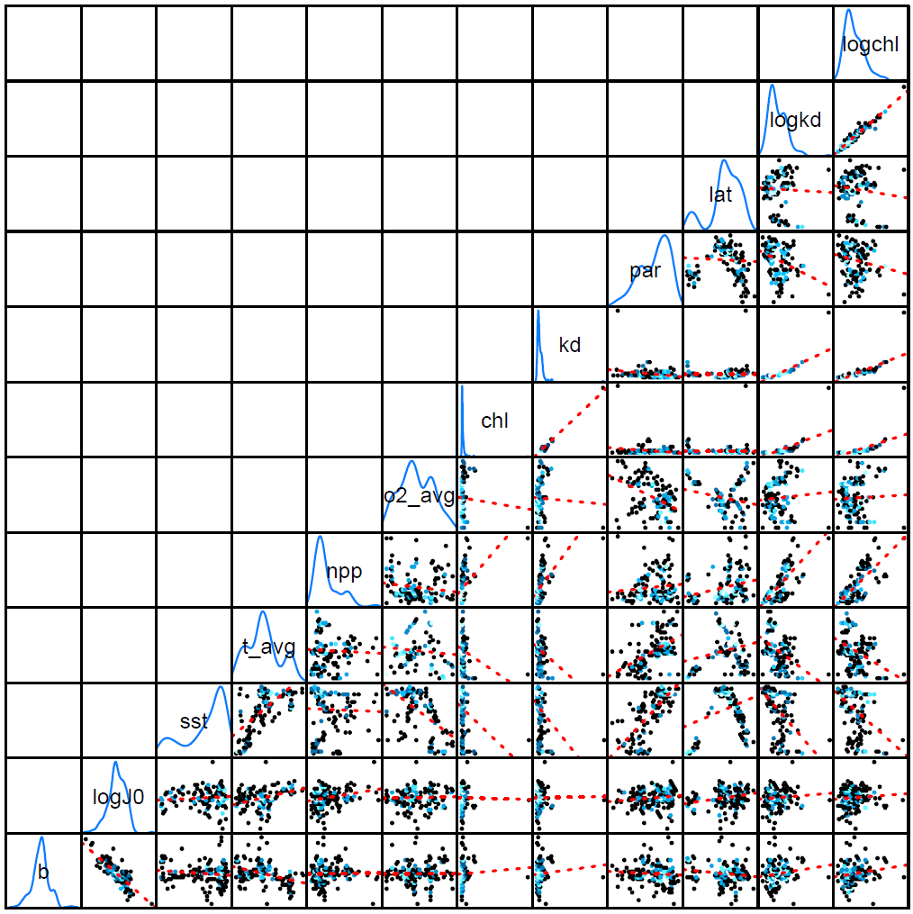

Slide 8
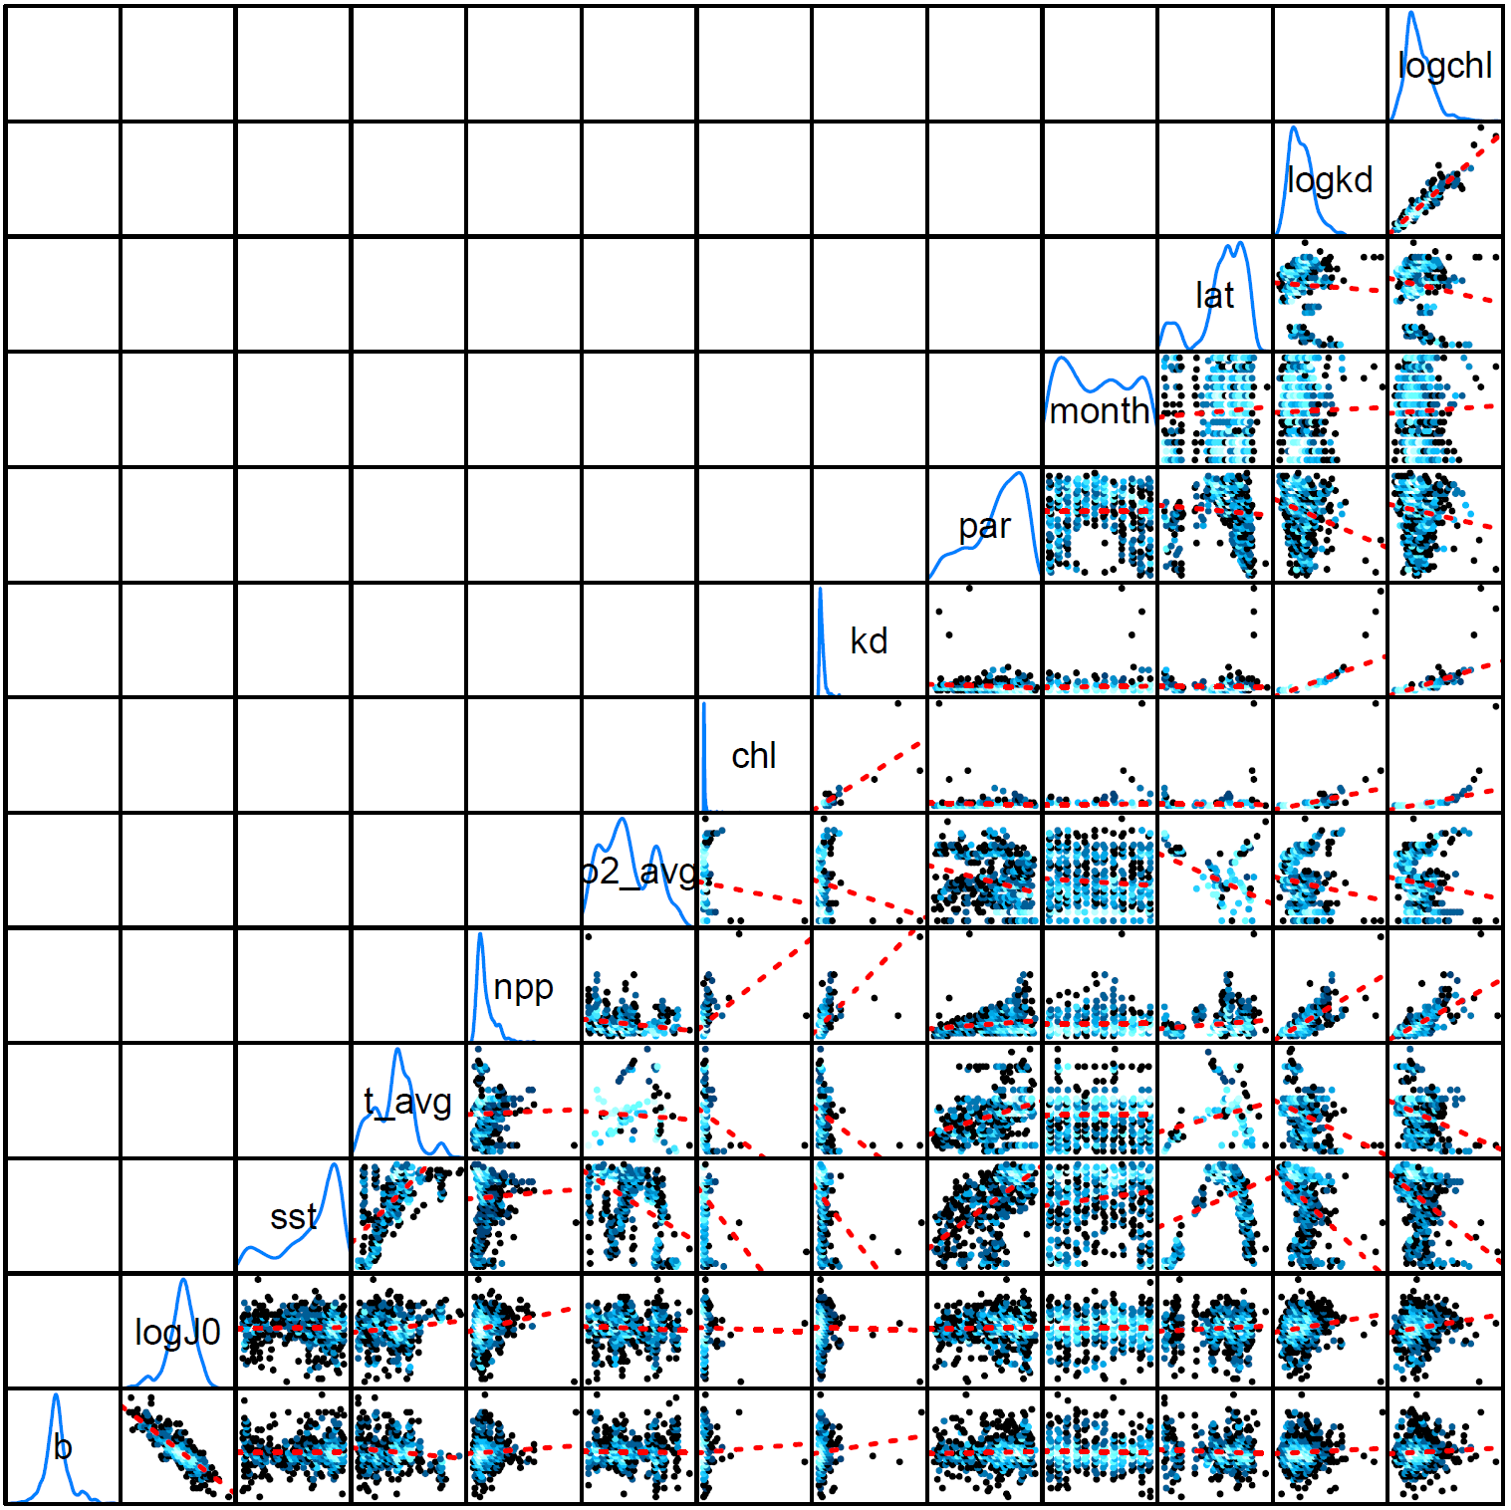

Slide 9
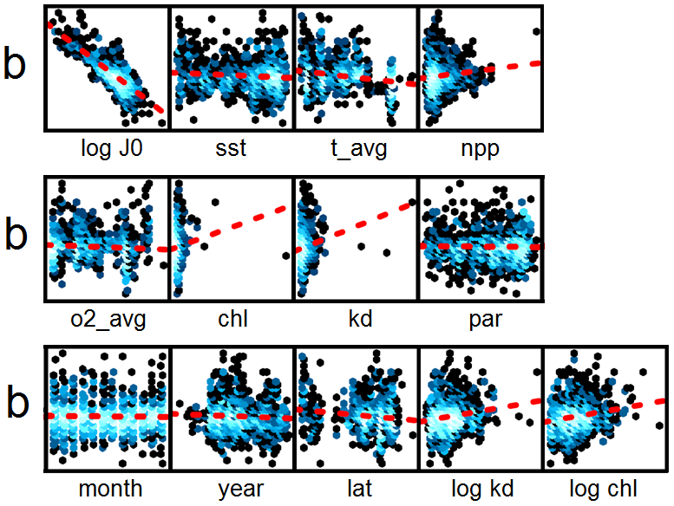

Slide 11
Remarks
A lot of time variability across stations
Need more than 2 or 3 to draw a line with the individual analysis

