Slide 1
How good is our model, and how do we know if one model is better than the other?
Many ways to compare models
One common and intuitive way is to test them according to their predictive accuracy
Best case scenarios, rarely met in practice:
i) know the true data-generating model
ii) have lots of new validation data to compare fitted model to
Alternative: Cross-validation
Evaluate
But: a Bayesian model yields a predictive distribution (from uncertainty in the parameters0 so we have to propagate distribution through to the predictions

Slide 2

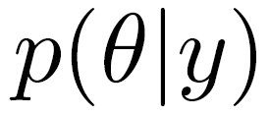
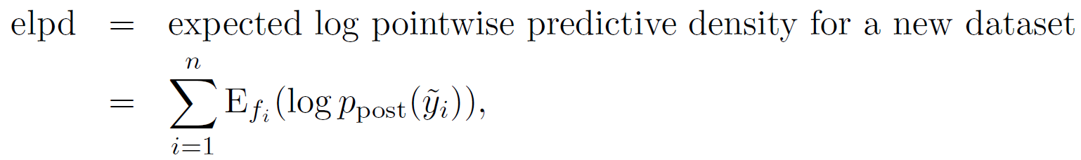
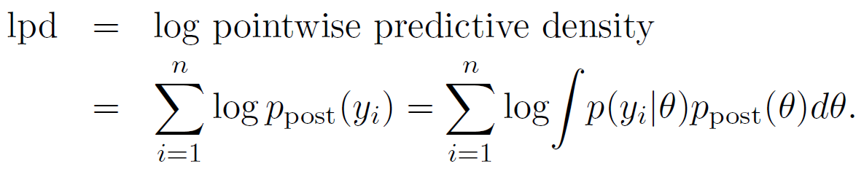
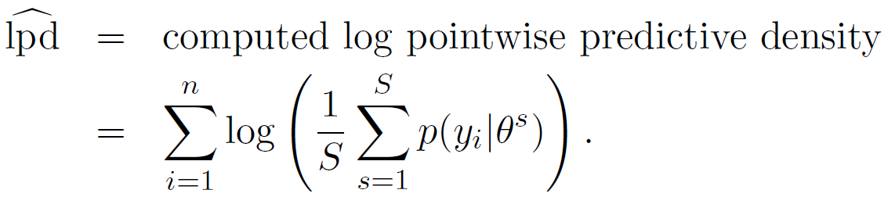
After estimating the parameters of a model using Bayes theorem we have a posterior distribution for the parameters, given the data
The predictive distribution for a new data point after integrating over parameter uncertainty:
What is the best test for its accuracy? We would know the true model from which we can generate data and compare to the predictions. The model that perform best in this exercise is then the ‘best model’.
This is not the case in practice. We CAN compute the within-sample data, but that is an overestimate
Using MCMC samples:
The WAIC and related ‘information criteria’ try to correct this quantity for model uncertainty

Slide 3

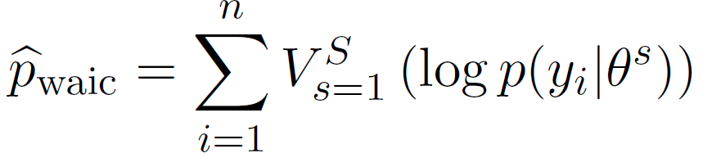


A correction for unknown model bias from Watanabe 2010 (Watanabe Information Criterion)
Bias term related to model complexity
The WAIC approximates this bias by the sample variance of the predictive distribution
Seems weird

Slide 4
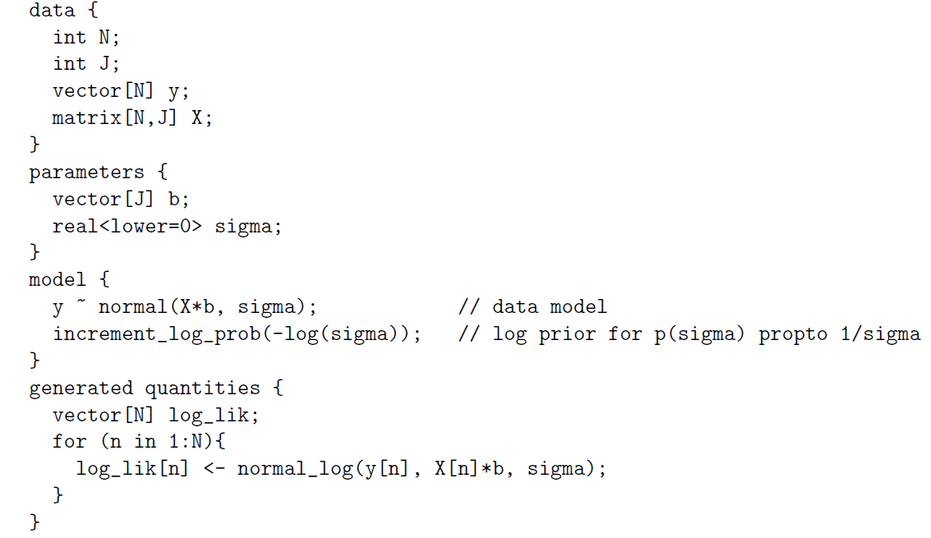
log_lik will contain point-wise log likelihood samples, from which we sum the point-wise mean likelihood and sum the point-wise variances

Slide 5
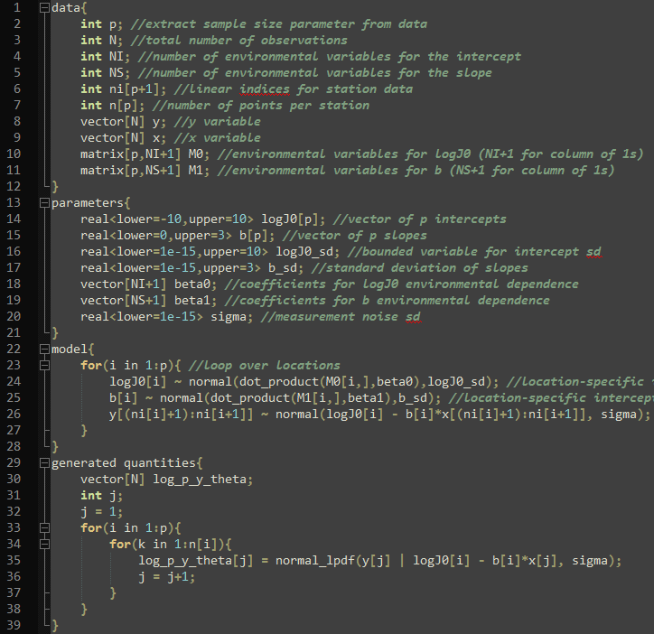
Pass number of data points per station
Loop over individual data points j, keeping track of station-specific parameters i

Slide 6
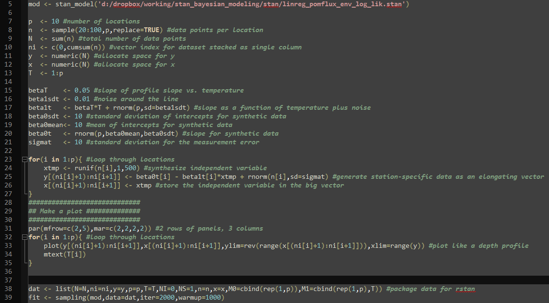

Slide 7
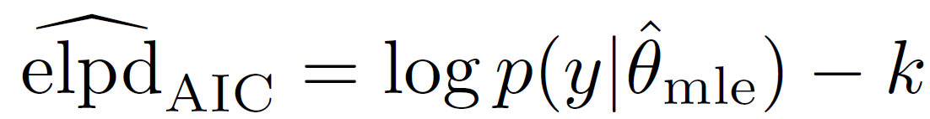

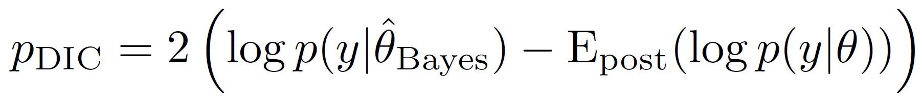
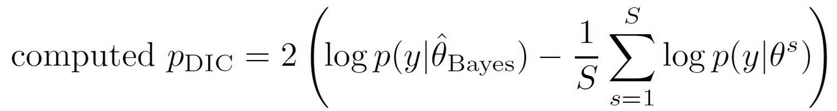
Two more diagnostics we can calculate with the likelihood: AIC and DIC
theta_MLE: Choose the value of the parameters that maximize the likelihood
theta_Bayes: Choose the value of the parameters that maximize the posterior; theta_MLE and theta_Bayes converge for n -> infinity

Slide 8
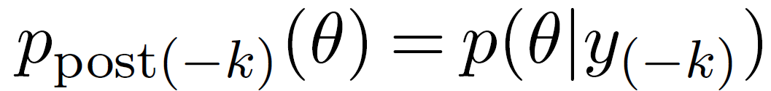
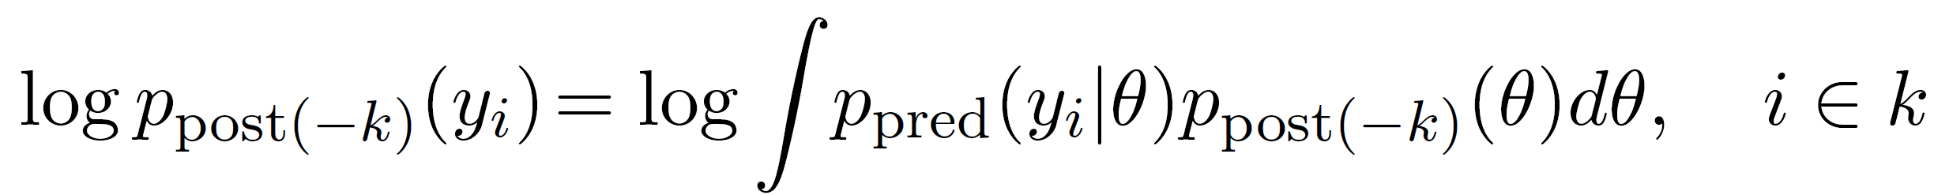
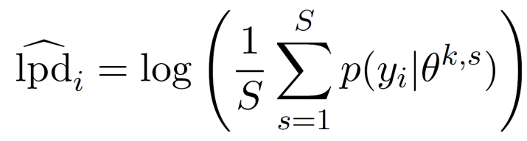
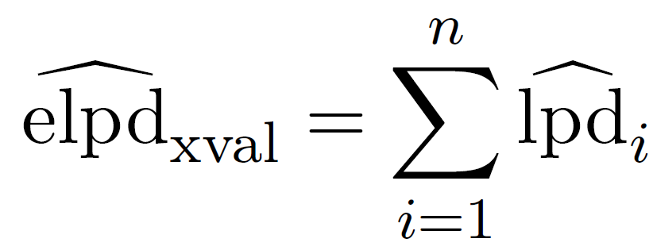
Additionally, we can compute the cross-validation directly:
We take K subsets of a size n, where a particular subset is y_k. We fit the model leaving y_k out and get the positerior
Then we have the predictive distribution for each data point in the validation set
We take the average of the predictive density for point i across MCMC samples S
Then we have our model selection diagnostic; the ‘best’ model maximizes this quantity for a validation set

Slide 9
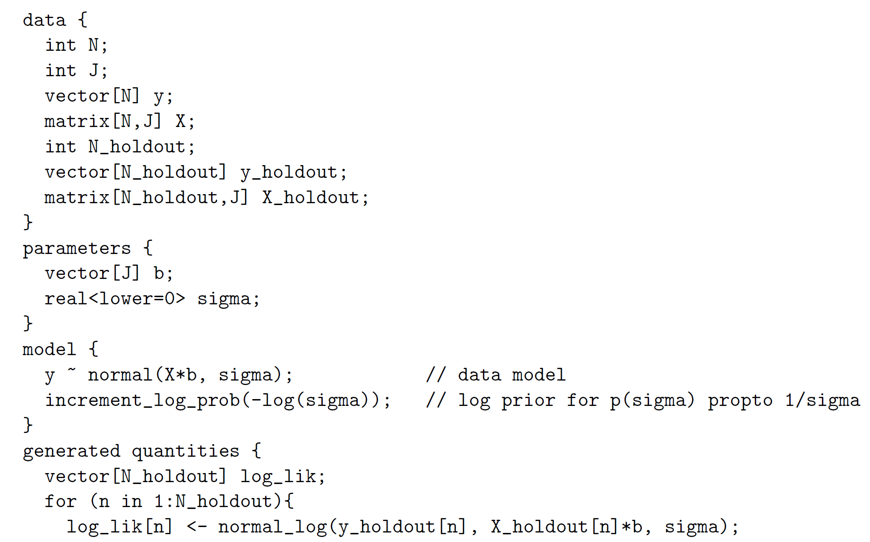

Separate the validation (‘holdout’) dataset in advance
Fit the model to the training set
Evaluate the predictive density with the validation set

