Slide 1

Basics of Regression analysis
Data on the number of hours students of a certain school
spend studying and their grades:
100
75
Grade
50
25
2
4
6
Hours studying

Slide 2
Basics of Regression analysis
There is clearly a positive correlation here: On average, the more hours a student spends studying the better their grades are
100
75
Grade
50
25
2
4
6
Hours studying

Slide 3
Basics of Regression analysis
Is there a concise way to describe this positive relationship and how strong it is?
100
75
Grade
50
25
2
4
6
Hours studying

Slide 4
Basics of Regression analysis
Not all lines are equally good.
100
75
Grade
50
25
2
4
6
Hours studying

Slide 5
Basics of Regression analysis
Not all lines are equally good.
100
75
Grade
50
25
2
4
6
Hours studying

Slide 6
Basics of Regression analysis
The best line minimizes the sum of the errors:
Sum of Errors = sum( |observed grade – predicted grade| )
100
75
Grade
50
25
2
4
6
Hours studying

Slide 7
Basics of Regression analysis
The best line minimizes the sum of the errors:
Sum of Errors = sum( |observed grade – predicted grade| )
100
75
Grade
50
25
2
4
6
Hours studying

Slide 8
Basics of Regression analysis
We can keep trying manually, or we can let R do it for us.
100
75
Grade
50
25
2
4
6
Hours studying

Slide 9
Basics of Regression analysis
The equation of any straight line is: Y = A + BX
A: The intercept (where the line cuts the y-axis) B: The slope or the coefficient (how steep or flat the line is, it‘s angle)
100
75
B
Grade
50
25
A
2
4
6
Hours studying

Slide 10
Basics of Regression analysis
The equation of our line here:
Grade = A + B * Number of hours
100
75
B
Grade
50
25
A
2
4
6
Hours studying

Slide 11
Basics of Regression analysis
R keeps trying different vaues of A and B until it finds the values with the
Minimum sum of errors
100
75
B
Grade
50
25
A
2
4
6
Hours studying

Slide 12
Basics of Regression analysis
The slope B is crucial for understanding the relatonship between x and y
In the steeper line, one extra hour of studying increases the grades by 20
In the flatter line, one extra hour of studying increases the grades by 10
80
B
60
Grade
40
Class 2
B
20
Class 1
2
4
6
Hours studying

Slide 13
Basics of Regression analysis
The slope (coefficient) of Class 1 is double that of Class 2
Class 1 students study doubly more efficient than Class 2
80
B
60
Grade
40
Class 2
B
20
Class 1
2
4
6
Hours studying

Slide 14
Complication 1: Estimation uncertainty
You have a class of 12 students (population), you asked 8 students (sample) who were present about how many hours they study
100
Present
Absent
75
Grade
50
25
2
4
6
Hours studying

Slide 15
Complication 1: Estimation uncertainty
In our example, these four students were absent,
what if different four students were absent?
100
Present
Absent
75
B
Grade
50
25
A
2
4
6
Hours studying

Slide 16
Complication 1: Estimation uncertainty
what if different four students were absent?
100
Present
Absent
75
B
Grade
50
25
A
2
4
6
Hours studying

Slide 17
Complication 1: Estimation uncertainty
The values of A and B keep changing depending on my sample! The uncertainty around the values of A and B due to relying on a sample is know as Estimation uncertainity
100
Present
Absent
75
B
Grade
50
25
A
2
4
6
Hours studying

Slide 18
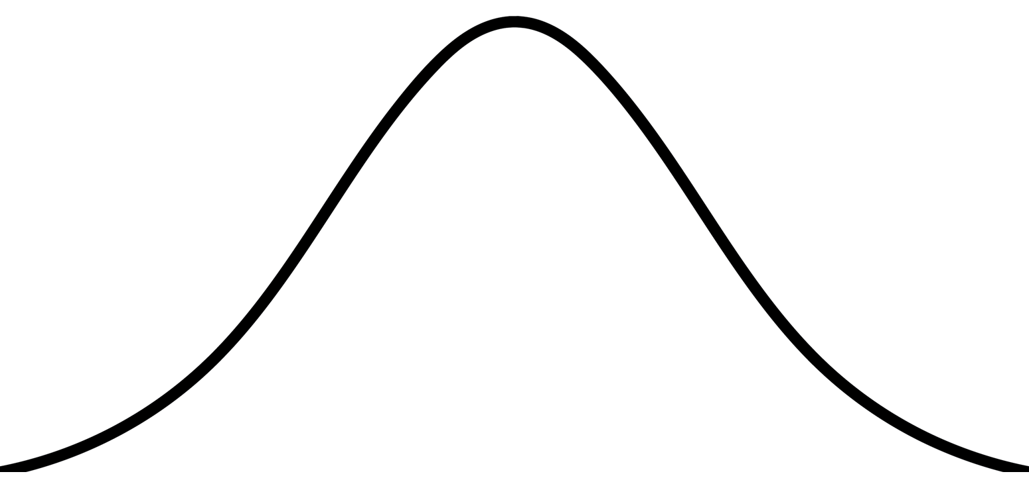
Complication 1: Estimation uncertainty
From the Centeral Limit Theorem (in statistics):
Our estimated paremeters are not just values, they are the mean of a normal distribution
The width of this ditribution tells us about how certain we are about our estimates
Frequency (Density)
Estimated B
Frequency (Density)
Estimated B
B values
B values
More Certain
Less Certain

Slide 19
Complication 1: Estimation uncertainty
Maybe you heard of the term 95% Confidence interval before?
If I take the sample 100 different times and each time I estimate B,
Then the true value of B will be within my confidence interval 95% of the time
Frequency (Density)
Estimated B
Frequency (Density)
Estimated B
B values
B values
More Certain
Less Certain

Slide 20
Complication 1: Estimation uncertainty
Sometimes it is simpler to plot the distribution of B as:
1) A dot for the mean value (estimated B)
2) A horizontal line representing the bounds of the 95% confidence interval
Frequency (Density)
Frequency (Density)
Estimated B
Estimated B
B values
B values

Slide 21
Complication 1: Estimation uncertainty
If the line of the 95% confidence interval cuts the zero:
Then the coefficient of B is not statistically significant
In other words, there is no statistical difference between B and zero
Class 4
Statistically not significant (p-value > 0.05)
Class 3
Statistically significant (p-value < 0.05)
-10
10
20
Coefficient of hours studying

Slide 22
Complication 1: Estimation uncertainty
If the line of the 95% confidence interval cuts the zero:
Then the coefficient of B is not statistically significant
In other words, there is no statistical difference between B and zero
P-value: the probability of observing this confidence interval if your true B was zero
Class 4
Statistically not significant (p-value > 0.05)
Class 3
Statistically significant (p-value < 0.05)
-10
10
20
Coefficient of hours studying

Slide 23
Complication 1: Estimation uncertainty
If the line of the 95% confidence interval cuts the zero:
Then the coefficient of B is not statistically significant
In other words, there is no statistical difference between B and zero
P-value: the probability of observing this confidence interval if your true B was zero
Take home message: Always report the uncertainity of your estimates!
Class 4
Statistically not significant (p-value > 0.05)
Class 3
Statistically significant (p-value < 0.05)
-10
10
20
Coefficient of hours studying

Slide 24
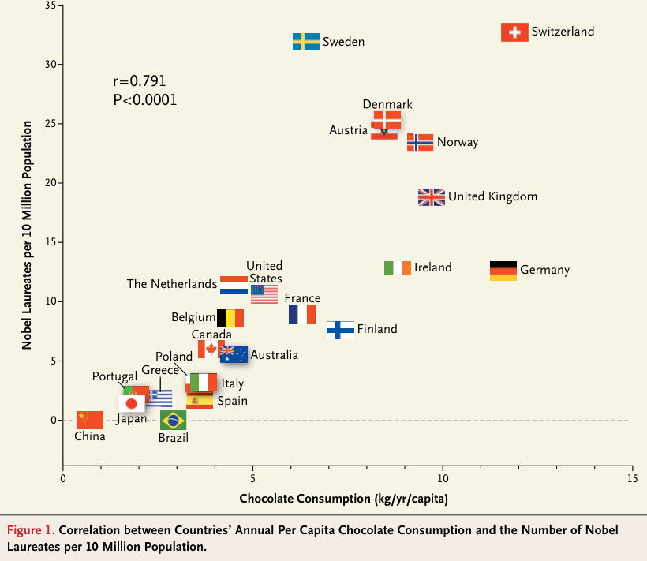
Complication 2: Confounders
The world is actually more compelx than just 2 dimensions

Slide 25
Complication 2: Confounders
The world is actually more complex than just 2 dimensions
Consuming Chocolate
Nobel prizes

Slide 26
Complication 2: Confounders
The world is actually more complex than just 2 dimensions
National (historical) Wealth
Consuming Chocolate
Nobel prizes

Slide 27
Complication 2: Confounders
The world is actually more complex than just 2 dimensions
National (historical) Wealth
More resources for research
Historically establish research institutes
More consumption of luxury goods
Afford to establish high quality chocolate industry
Consuming Chocolate
Nobel prizes

Slide 28
Complication 2: Confounders
The world is actually more complex than just 2 dimensions
Correlation does not imply causation!!
National (historical) Wealth
More resources for research
Historically establish research institutes
More consumption of luxury goods
Afford to establish high quality chocolate industry
Consuming Chocolate
Nobel prizes

Slide 29
Complication 2: Confounders
At first glance, seems like ice cream makes people more violent??
Our model: Crime = A + B * Ice cream
Attack/million capita
100
75
Violent Crime
Ice cream
Violent Crime
50
25
1
2
3
Kg/month/capita
Ice cream consumption

Slide 30
Complication 2: Confounders
At first glance, seems like ice cream makes people more violent??
What if we account for (control for) temperature?
Our model: Crime = A + B * Ice cream
Attack/million capita
Temperature
100
People stay outside at night more careless tourists
Heat increases demand for ice cream
75
Violent Crime
Ice cream
Violent Crime
50
25
1
2
3
Kg/month/capita
Ice cream consumption

Slide 31
Complication 2: Confounders
At first glance, seems like ice cream makes people more violent??
What if we account for (control for) temperature?
Our model: Crime = A + B1 * Ice cream + B2 * Temperature
Attack/million capita
Temperature
100
People stay outside at night more careless tourists
T = 28
Heat increases demand for ice cream
75
T = 26
Violent Crime
T = 24
Ice cream
Violent Crime
50
T = 22
25
1
2
3
Kg/month/capita
Ice cream consumption

Slide 32
Complication 2: Confounders
After controlling for Temperature (including it in the model) B1 for Ice cream became virtually zero And Temperature (B2) is what is actually affecting crime
Attack/million capita
Confounder
100
T = 28
75
T = 26
Violent Crime
T = 24
50
T = 22
Independent Variable (X)
Dependent Variable (Y)
25
1
2
3
Kg/month/capita
Ice cream consumption

Slide 33
Complication 2: Confounders
After controlling for Temperature (including it in the model) B1 for Ice cream became virtually zero And Temperature (B2) is what is actually affecting crime
Take home message: Always control for potential confounders!!
Attack/million capita
Confounder
100
T = 28
75
T = 26
Violent Crime
T = 24
50
T = 22
Independent Variable (X)
Dependent Variable (Y)
25
1
2
3
Kg/month/capita
Ice cream consumption

