Slide 1
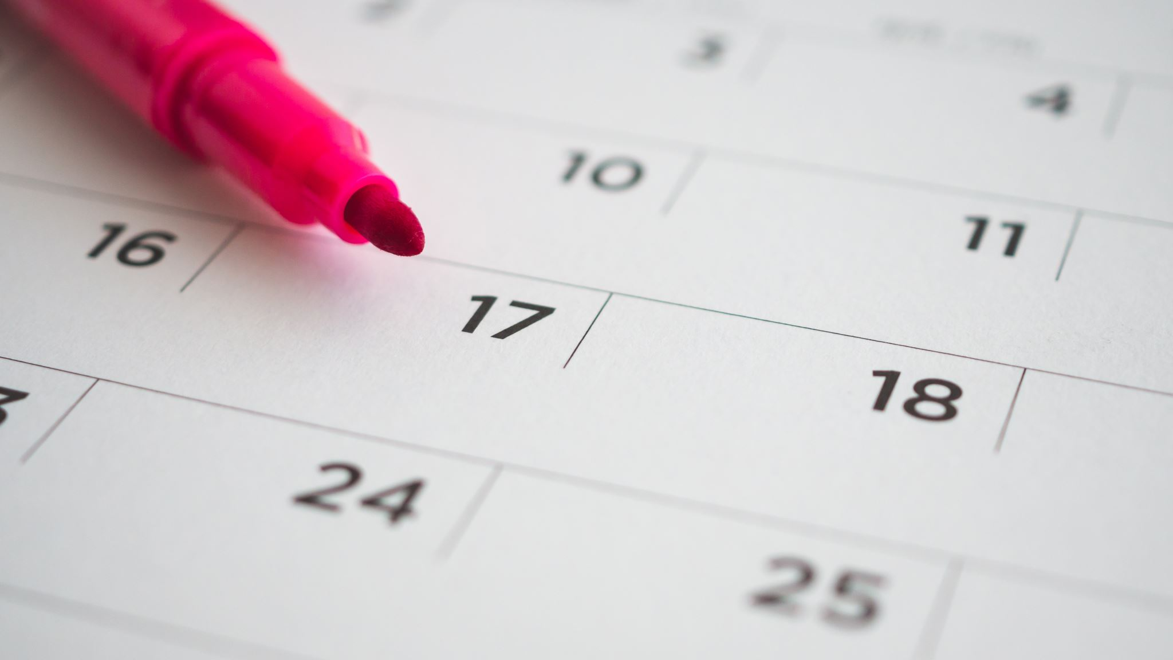
Cardinal and Ordinal Numbers
Osnovni i redni brojevi

Slide 2
Osnovni brojevi 1-10
1
2
3
4
5
6
7
8
9
10
jedan* , jedna, jedno (adjective!!!)*fleeting A
dva, dve/dvije
tri
četiri
pet
šest
sedam
osam
devet
deset

Slide 3
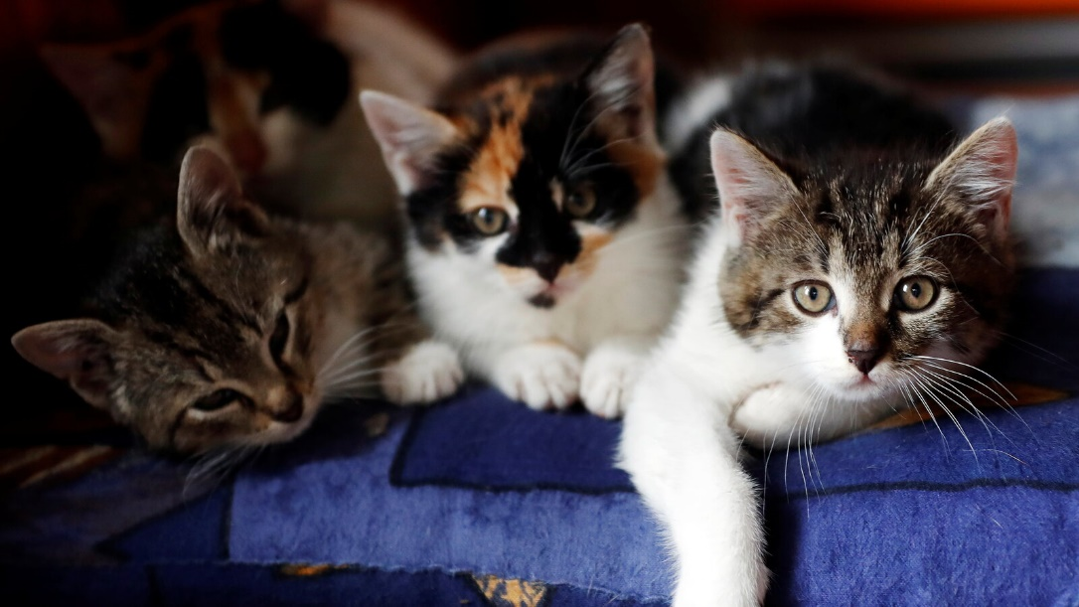
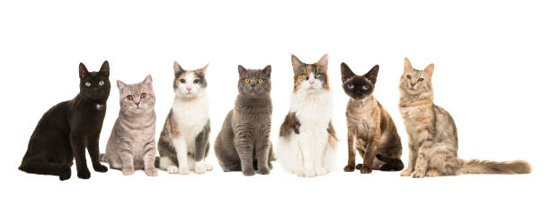
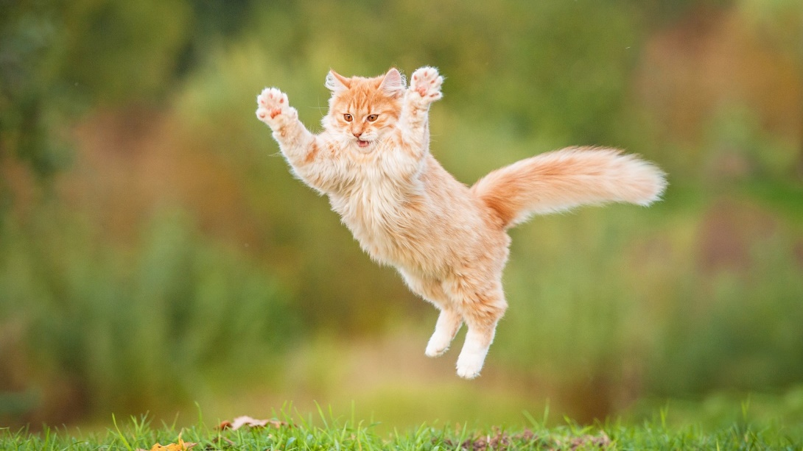
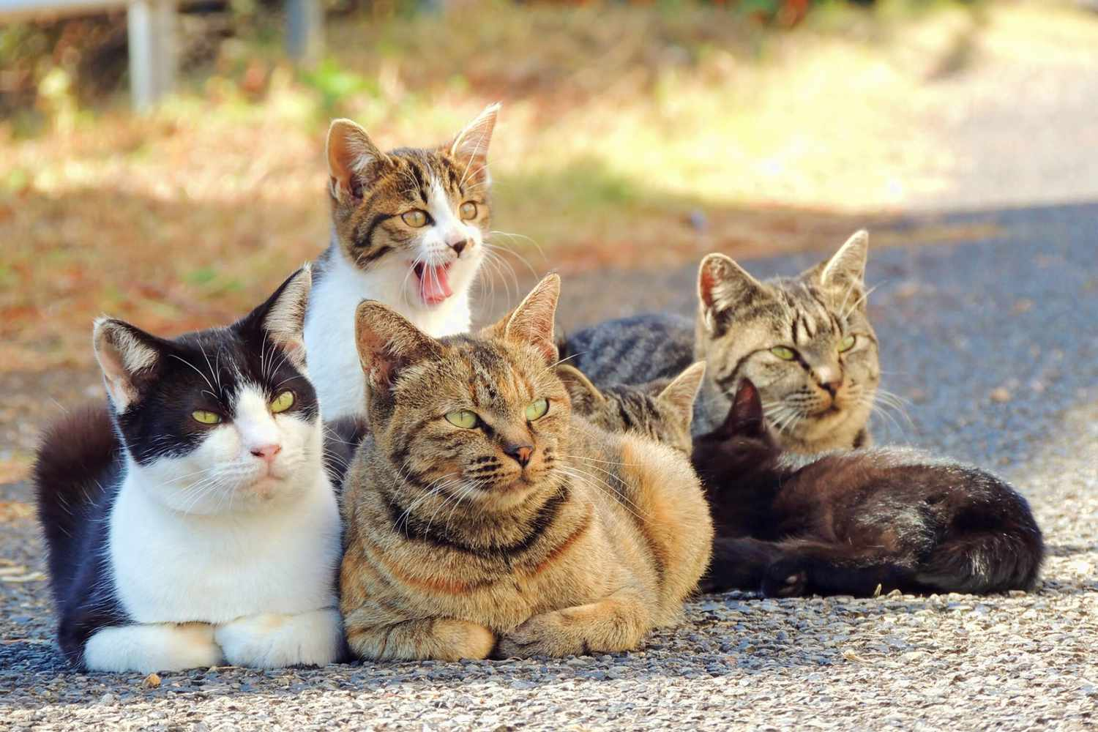

Slide 4
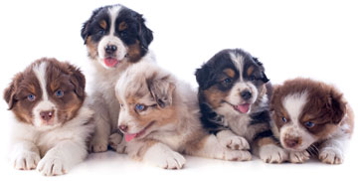
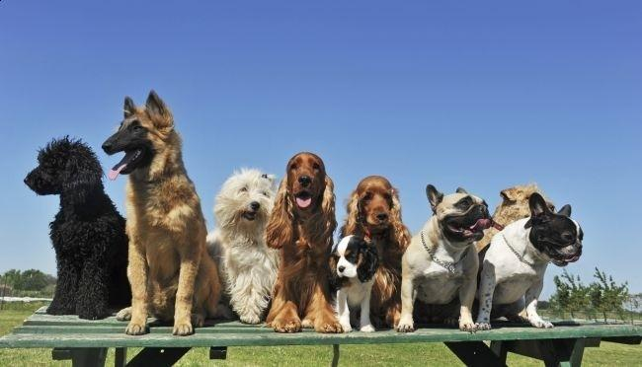
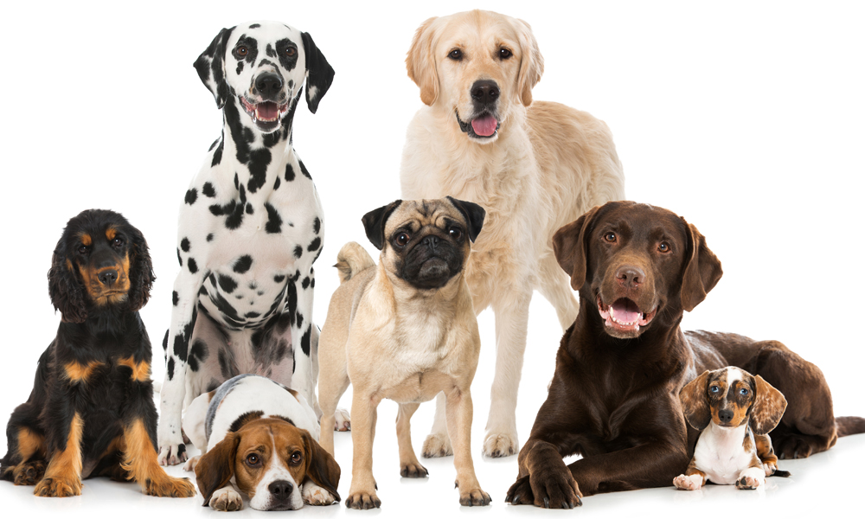
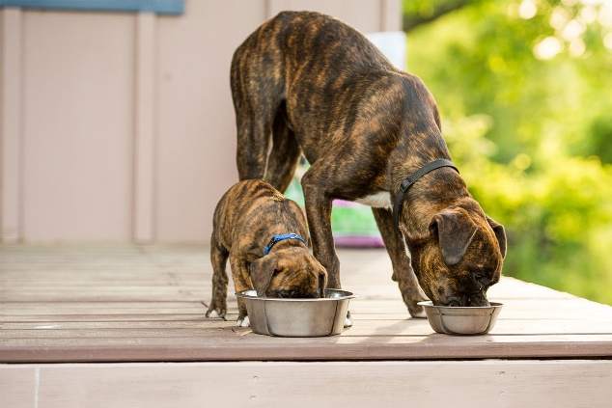
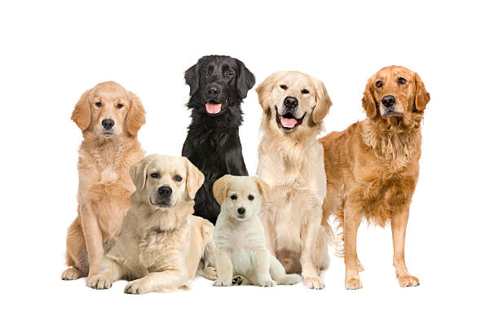

Slide 5
Osnovni brojevi 11-20
11
12
13
14
15
16
17
18
19
20
jedanaest
dvanaest
trinaest
četrnaest
petnaest
šesnaest
sedamnaest
osamnaest
devetnaest
dvadeset

Slide 6
Osnovni brojevi 21-100
21
22
23
30
40
50
60
70
80
90
100
dvadeset jedan
dvadeset dva
dvadeset tri
trideset
četrdeset
pedeset
šezdeset
sedamdeset
osamdeset
devedeset
sto

Slide 7
Osnovni brojevi 200-900
200
300
400
500
600
700
800
900
dvesta/dvjesto (Cr: also dvjesta (older))
trista/tristo (Cr: also trista older))
četiristo
petsto
šesto
sedamsto
osamsto
devetsto

Slide 8
Osnovni brojevi 1000….
1000
2000
1.OOO.OOO
hiljadu / Croatian: tisuću
(one thousand: hiljada/tisuća)
2000 dve hiljade /dvije tisuće
1,000,000 milion/milijun

Slide 9
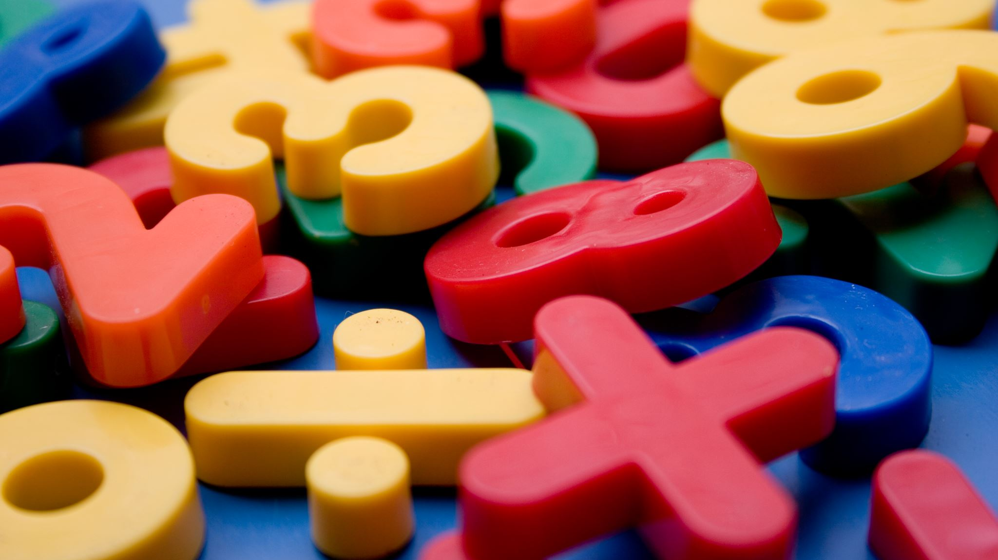
Agreement of Numbers

Slide 10
NUMBER 1
Number 1 is an adjective and as such it must agree with the gender and the case of the noun (JEDAN, JEDNA, JEDNO).
Nominative: Jedna knjiga, jedan student, jedno pismo
Accusative: Ja čitam jednu knjigu. On zna jednog studenta. Mi pišemo jedno pismo.
Excercise: Go to Google Doc and fill out the table

Slide 11
NUMBER 2
Number 2 agrees with the gender of the nouns. It does not follow the agreement with the case!
Feminine form of number 2 is - DVE/DVIJE; masculine and neuter- DVA
Dve/dvije knjige; dva studenta; dva pisma

Slide 12
Special agreement
2 does not change through cases, but word that follows it has special ending
Numbers 3 and 4, and all the rest (5 and up) do NOT CHANGE!!!!!! They do not agree with the gender and the case of the nouns!!! These numbers stay the same in all cases.
However, numbers 2, 3, 4 require A SPECIAL AGREEMENT of the nouns and adjectives:
feminine noun + adjective –E ;
F2 nouns ending –I ;
masculine and neuter noun + adjective –A

Slide 13
Numerals 2, 3, and 4
In BCS numerals 2, 3, and 4 require a special form of adjectives and of the nouns counted. They behave differently than 5, 6, 7, etc. which require genitive plural.
These special forms are remnants of Old Church Slavic dual, and they should not be confused with genitive singular which they are not!!! Dual was an old gramm. category that referred to precisely two of the entities/pairs (objects or persons) identified by the noun: door -vrata, mouth- usta, back- leđa

Slide 14
Numerals 2, 3, and 4
The numeral 2 has two forms in BCS:
DVA precedes Masculine and Neuter nouns and adjectives
DVE (S)/DVIJE (BC) precedes Feminine nouns and adjectives
The Numerals 3 and 4 have the same form regardless of the gender of the nouns and adjectives they precede: TRI, ČETIRI.

Slide 15
.
Masculine and neuter nouns and adjectives following dva, tri, četiri take a form ending
in –A :
Dv-a, tri, četiri visoka čov(j)eka
Dv-a, tri, četiri pametna studenta
Dv-a, tri, četiri duga pisma
Dv-a, tri, četiri velika polja

Slide 16
Regular Feminine and F2 nouns
Regular Feminine nouns and ALL feminine adjectives following dve/dvije, tri, četiri take a form ending in -E
F2 nouns (just nouns not adjectives!!!) take a form ending in -i
Dv-e/dv-ije, tri, četiri lepe/lijepe žene
Dv-e/dv-ije, tri, četiri visoke lampe
Dv-e/dv-ije, tri, četiri crvene ruže
Dv-e/dv-ije, tri, četiri tople noći
Dv-e/dv-ije, tri, četiri hladne jeseni

Slide 17
.
Any numeral ending in dva/dve/dvije, tri, četiri behaves the same way:
Sto dva lepa/lijepa čov(j)eka
Sto dve dvije lepe/lijepe žene
Četrdeset tri duga pisma
Pedeset četiri tople noći
Trideset tri hladne jeseni

Slide 18
Numerals 5-10, 11-19 and all other numerals ending in 5, 6, 7, 8, 9, and 0 take genitive plural:
Pet dobrih studenata
Deset dobrih žena
Dvanaest dugih emailova
Devetnaest novih kompjutera/kompjutora
Dvadeset pet crvenih jabuka
Trideset devet zelenih krušaka
Sedamdeset novih bicikala

Slide 19
Translate to BCS
I see 81 bottles.
Ana has 36 hot chocolates.
I want to buy 2 coffees.
He has 4 beers.
She has 12 sandwiches.
I see 2 big cakes.
We have 5 small cats.
They see 71 restaurants.

Slide 20
Translate to BCS
I see 81 bottles. Vidim osamdeset jednu flašu.
Ana has 36 hot chocolates. Ana ima trideset šest toplih čokolada.
I want to buy 2 coffees. Želim da kupim dve/dvije kafe.
He has 4 beers. On ima četiri piva.
She has 12 sandwiches. Ona ima dvanaest sendviča.
I see 2 big cakes. Vidim dva velika kolača.
We have 5 small cats. Imamo pet malih mačaka.
They see 71 restaurants. Vide sedamdeset jedan restoran.

Slide 21
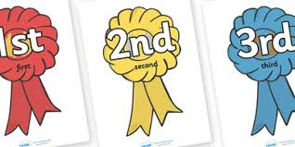
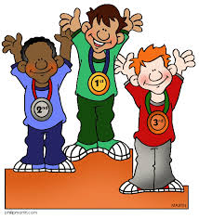
Redni brojevi

Slide 22
Redni brojevi 1st-10th
NOTE
1ST
2ND
3RD
4TH
5TH
6TH
7TH
8TH
9TH
10TH
grammatically ordinal numbers are adjectives!!!
Prvi, prva, prvo
Drugi, druga drugo
Treći, treća, treće
Četrvrti, četvrta četvrto
Peti, peta, peto
Šesti, šesta, šesto
Sedmi, sedma, sedmo
Osmi, osma, osmo
Deveti, deveta, deveto
Deseti, deseta, deseto

Slide 23
Redni brojevi 11th-90th
11TH
12TH
13TH
17TH
21ST
30TH
40TH
50TH
60TH
70TH
80TH
90TH
Jedanaesti,jedanaesta, jedanaesto
Dvanaesti, dvanaesta,dvanaesto
Trinaesti, četrnaesti, petnaesti, šestnaesti, sedamnaesti, osmanaesti, devaetnaesti, dvadeseti.
Dvadeset prvi -21st dvadeset drugi (22nd), dvadeset treći (23rd)...
Trideseti
Četrdeseti
Pedeseti
Šezdeseti
Sedamdeseti
Osamdeseti
Devedeseti

Slide 24
Redni brojevi 100th …
Stoti- 100th but sto prvi (101st), sto drugi (102nd), sto treći (103rd)...
Dvestoti/dvjestoti but dvesta/dvjesto prvi, dvesta /dvjesto drugi, dvesta /dvjesto treći...
Tristoti but trista prvi, trista drugi, trista treći...
Četristoti but četristo prvi, četristo drugi, četristo treći....

Slide 25
Reading months and dates
Čitanje datuma

Slide 26
srpski/bosanski
 |  | januar
 |  | februar
 |  | mart
 |  | april
 |  | maj
 |  | jun/juni (doublets)
 |  | jul/juli (doublets)
 |  | avgust
 |  | septembar
 |  | oktobar
 |  | novembar
 |  | decembar

Slide 27
Hrvatski
siječanj | mjesec kada se seče/siječe (drvo)/ month when the wood is cut (januar)
veljača | mjesec promena (veljanja)/ month of changes in nature (februar)
ožujak | varljiv (lažljiv) mjesec / deceitful month (mart)
travanj | mjesec kada trava okopnjava i pojavljuje se ispod snijega/ grass begins to grow (april)
svibanj | mjesec kada pupe (svibe) pupoljci/ to start/cause to bud (maj)
lipanj | mjesec kada cvjetaju lipe/ month when linden trees are blossoming (jun)
srpanj | mjesec kada se kosi (srpom/) to cut grass with a chisel (jul)
kolovoz | mjesec kada se voze zaprežna kola (za vreme žetve)/ coach is driven for harvesting (avgust)
rujan | mjesec kada sve ruji (sazreva) i postaje crveno (rujno)/ to ripen, to mature (septembar)
listopad | mjesec kada opada lišće/ month when the leaves are falling (oktobar)
studeni | hladni (studeni) mjesec / cold month (novembar)
prosinac | mjesec kada sunce prosijava (počinje da sija)/ months when the sun starts to shine (decembar)

Slide 28
Expressing time months
In January, February… Use U+ Locative case
In January U januaru/ siječnju
In August U avgustu/kolovozu
Or Genitive case*:
januara/ siječnja
avgusta/kolovoza
*these are not always interchangeable-so if unsure, use the u + locative formula

Slide 29
How to read dates and months together:
In BSC dates are read as ordinal numbers! We start with date FIRST, then add month (NOT capitalized)
dvadeset prvi mart/ožujak (March 21st)
sedamnaesti januar/siječanj (January 17th)
devetnaesti septembar/rujan (September 19th)

Slide 30
How to read years:
1982 literally read:
one thousand (hiljadu/tisuću always in accusative case; two thousand: follows the agreement with No.2 dve/dvije hiljade/tisuće)
nine hundred (devetsto)
eighty second (year) (osamdeset druga godina); The last numeral MUST be Ordinal!!!
1982-hiljadu/tisuću devetsto osamdeset druga (godina)
The last ordinal number must agree with feminine noun godina therefore, ending is -a

Slide 31
Practice:
1425
Hiljadu/tisuću (accusative)
Četiristo
Dvadeset peta (year): ordinal number
Hiljadu/tisuću četristo dvadeset peta (godina)
1837
Hiljadu/tisuću
osamsto
Trideset sedma (year):ordinal number
: hiljadu/ tisuću osamsto trideset sedma (godina)

Slide 32
practice
2001
Dve/dvije hiljade/tisuće (agreement with No. 2: dve/dvije)
prva (ordinal number)
dve/dvije hiljade/tisuće prva (godina)
2012
Dve/dvije hiljade/tisuće (agreement with No. 2: dve/dvije)
dvanaesta (ordinal number)
dve/dvije hiljade/tisuće dvanaesta (godina)

Slide 33
In 1984, 2013,2008 1625…genitive case
To express when something happened the last number and godina must be in genitive case:
In 1984 hiljadu/tisuću devetsto osamdeset četvrte godine
In 2012 dve/dvije hiljade/tisuće dvanaeste godine
2008 dve/dvije hiljade/tisuće osme godine
1625 hiljadu/tisuću šesto dvadeset pete godine
Remember: NO preposition used!!!

Slide 34
How to read full date, month and year
On March 28th 1984 ….
Start with the date keep the last digit ordinal and in genitive case;
month has to be in genitive sg;
read the year where the last number has to be ordinal number in genitive sg
+ godina in genitive sg (like in English the word “year” can be omitted!!!)
Dvadeset osmog marta/ožujka hiljadu/ tisuću devetsto osamdeset četvrte (godine)
No preposition used!!!

Slide 35
On August 22 1948....
Day (last digit ordinal in genitive case)
Dvadeset drugog
Month in genitive case
Avgusta/kolovoza
Year (last digit ordinal and in genitive case)
hiljadu/tisuću devetsto četrdeset osme (godine)

Slide 36
On December 16, 2012...
Day (ordinal number in genitive case)
Šesnaestog
Month in genitive case
Decembra/prosinca
year (agreement with No 2; last number ordinal in genitive case)
dve/dvije hiljade/tisuće dvanaeste (godine)

Slide 37
V(j)ežba:
I was born on September 28th, 1962. (male speaker)
Rodio sam se dvadeset osmog septembra /rujna hiljadu/tisuću devetsto šezdeset druge (godine)
I was born on February 5th, 1999. (female speaker)
Rodila sam se petog februara/veljače hiljadu/ tisuću devetsto devedeset devete (godine)

Slide 38
Today is March 28th 1984
To read March 28th 1984 (without preposition “on”) no genitive in date and month; genitive only for the last digit in a year
Today is March 28th 1984:
Danas je dvanaesti mart/ožujak hiljadu/tisuću devetsto osamdeset četvrte godine.
(genitive only at the end including the word year)

Slide 39
V(j)ežba:
Today is December 28th, 1974
Danas je dvadeset osmi decembar/prosinac hiljadu/tisuću devetsto sedamdeset četvrte (godine)
But,
On December 28th 1974...
Dvadeset osmog decembra/prosinca hiljadu /tisuću devetsto sedamdeset četvrte (godine)...

