Slide 1
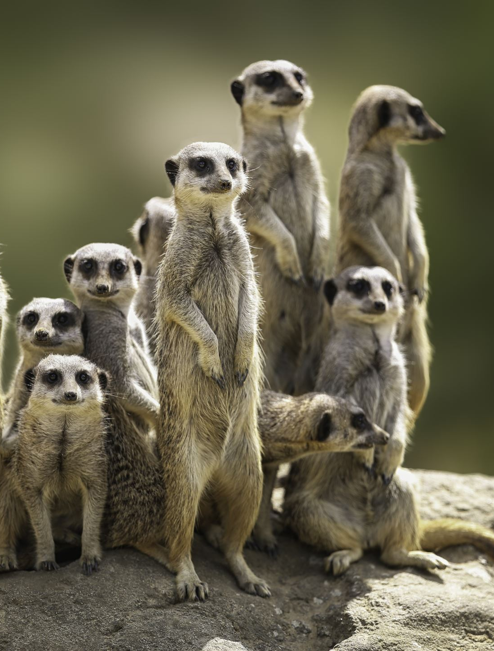
Vokativ
Vocative Case

Slide 2

meaning
A vocative case is a case of direct address. Etymology is Latin: verb vocare means to call (zvati)

Slide 3
Some examples of vocative case in English language:
1. I don't know, Mary.
Here, Mary is a vocative form indicating the party who is being addressed, as opposed to the sentence “I don't know Mary,” where Mary is the direct object of the verb "know."
2. Hey you, is this your book?
3. Ladies and gentlemen, allow me to open this discussion….

Slide 4
More example
4. I'll see you next Tuesday, Michael!
5. And that, your Honor, concludes our case. (The judge is being addressed as “your Honor”.)
6. John, you would know all about that wouldn't you, you little adventurer?
(“John” is being addressed by his name and as “you little adventurer”. Both “John” and “you little adventurer” are in the vocative case.)
7. You too, Brutus!
8. Where have you been, Charlie?
9. Jonathan, do not forget your shower gel!

Slide 5
.
Pay attention to the marker words Hey, Hi, Hello (used for direct address, and commas separating the vocative expressions)
Although it has been lost by many modern Indo-European languages, some languages have retained the vocative case to this day, such as: Modern Greek, Albanian, Baltic languages (Lithuanian and Latvian) Slavic languages (Polish, Czech, BCS, Macedonian, Bulgarian), etc.

Slide 6
English
Modern English lacks a formal (morphological) vocative case. English commonly uses the nominative case for vocative expressions, but sets them off from the rest of the sentences with pauses as interjections (rendered in writing as commas). Historically, or in poetic or rhetorical speech, the vocative role in English may also be shown by prefacing the noun or noun phrase with the English word "O". This is often seen in the King James Version of the Bible: for example, "O ye of little faith" (in Matthew 8:26).

Slide 7
Vocative Case in BSC
Vocative forms are commonly used in addressing people and animals, rather than inanimate objects. Still, sometimes in anger or despair one might employ the vocative to vent anger or similar feelings directly at the “offending” inanimate object. Thus, in theory at least, all BCS nouns have vocative forms.
In writing, the vocative case is ALWAYS separated by commas!!!

Slide 8
How to make vocative
DO NOT CHANGE:
Neuter nouns
Personal pronouns
Plural Nouns
Foreign names
Feminine nouns
The vocative ending for most polisyllabic nouns ending in –ica is –e:
feminine nouns that change their ending in the vocative case will take –o ending
Some do not change
F2 nouns: -i
Masculine nouns
-e is added to non-palatal (hard) stems:
–u is added to palatal (soft) stems in č, ć, đ, lj, nj, š, ž

Slide 9
Forms of the vocative case are as follows:
Plural Nouns:
Nouns with regular plural forms use the nominative plural as the form for direct address in vocative case:
Dragi studenti i studentkinje/studentice, … Dear students, ….
Naši dragi gosti, … Our dear guests…
Poštovane kolege i koleginice/kolegice,... Respected colleagues…

Slide 10
Singular F2 Nouns
In order to form the vocative case from F2 feminine nouns (ending in consonant: noć, ljubav, bol, so/sol, radost, mladost, starost, pamet) add -i to the nominative form:
Ljubavi moja! My love!
O, noći ! Oh, night!
O, mladosti srećna! Oh, happy youth!

Slide 11
Masculine Nouns
Masculine nouns ending in consonant add -e or –u to form the vocative.
-e is added to non-palatal (hard) stems:
Gospodine, doktore, Milane, Petre, brate, Aleksandre, sine, etc.
Be aware that before you add the ‘e’ stem- some final consonants morph: (K:Č, alternation: K, G, H+E=Č,Ž,Š)
–k, -c are replaced by č :čov(j)ek-čoveče/čovječe, otac- oče
- g and -z are replaced by ž :drug- druže, knez- kneže
-h is replaced by š: siromah- siromaše (siromahu also allowed), duh- duše

Slide 12
Soft palatal stems
To soft palatal stems (č, ć, đ, lj, nj, š, ž, j) add –u
Pevač/ pjevač: pevaču/ pjevaču (singer)
Mladić-Mladiću (young man)
Vođ: vođu (archaic form for leader)
Kralj: kralju (king)
Konj-konju (idiomatic: derogative for people)
Đilkoš- Đilkošu - older for vagabound
Morž- moržu -walrus idiomatic: derogatory for lazy people (don’t use it!)
Noj- noju (ostrich) –idiomatic derogatory for people with longer necks

Slide 13
doublets
After the stem final palatals č, ž, š and after “r” doublets are possible:
Puže- pužu, Miloše- Milošu (in epic poetry), care- caru, poštare- poštaru
The underlined words are modern usage. Remenber those!!!

Slide 14
Feminine nouns in -A
The vocative ending for most polysyllabic nouns ending in –ica is –e:
-Milica: Milice (female personal name)
-učiteljica: učiteljice (a female teacher in elementary school during the first four years)
-nastavnica: nastavnice (feamle teacher in elementary school during the final four years)
-studentica: studentice
-gospođica: gospođice (miss BS)/gospodična (C)
-Jovica: Jovice (masculine personal name)

Slide 15
Feminine nouns in –A:
Otherwise, all feminine nouns that change their ending in the vocative case will take an –o ending:
-Gospođa: gospođo (Mrs.)
-Majka: majko ; (mama does not change!)
-Žena: ženo; Sestra: sestro;
Ćerka: ćerko same as kćerka:kćerko; Baka:bako (grandma);
Devojka/djevojka: devojko/djevojko,
Zemlja: zemljo (country (state), soil)
Ruža: Ružo –Rosa
Deca/djeca: deco/ djeco (remember that deca/djeca is an exception since it has plural that behaves like feminine singular noun (like “Žena” type) with plural verb agreement)
Example in vocative case: Deco/ djeco, dođite ovamo. Children, come here!

Slide 16
Masculine nouns in -a
This group includes plural nouns in –a with masculine meaning :
Gospoda: gospodo* gentlemen
Braća: braćo brothers
Šaljivdžija: šaljivdžijo (joker) (singular)
*stress change

Slide 17
Nouns with no change in vocative
Quite a few feminine and masculine nouns in -a (especially personal names) do not change in vocative, that is, they keep their nominative form:
Feminine nouns in -a with masculine meaning:
tata (dady), sudija (judge), deda (Serbian, grandfather), Note:
judge: In Croatian the form is sudac (masculine noun) and the vocative form is unchanged: sudac
grandfather: in Croatian and Bosnian the noun grandfather is djed (regular masculine noun) with vocative form djede
Kolega-colleague
Gazda-landlord
Komšija (Serbian/Bosnian): neighbor ; Croatian: susjed (no change)

Slide 18
NO CHANGE in vocative for these feminine nouns:
mama, baba (grandmother) (however, the form baka (grandma) in vocative case changes to bako!!!) tetka (aunt)
female personal names: Sanja, Tijana, Ljiljana, Marija, Vera/Vjera, Branka, Dijana, Marina, Jasmina, Milena, Aleksandra, Jovana, Ana, Biljana, etc.
Masculine personal names: Nikola, Ilija, Saša, Vanja

Slide 19
Neuter nouns
In addition to the large number of feminine and masculine nouns in –a, all neuter nouns (selo, polje) and all masculine nouns ending in –o (Marko) or –e (Pavle, Stipe, Ivo), use the nominative form for direct address.

Slide 20
Personal Pronouns
All personal pronouns (ti, vi, etc.) also do not change in vocative case.
Hej, ti, dodji ovamo! Hey you, come here!
Vi, mladi ljudi, kupite mi koka-kolu!

Slide 21
Foreign names
Names of foreign origin tend to keep their nominative form, although there are some, very few (male names) exceptions.
-Rebeka, Ketrin, Roza, Barbara, En, etc. (Female names do not change in vocative)
-Džordž, Salvatore, Žan, Mišel, Pjer, Domeniko, etc.

Slide 22
Masculine foreign names that can change in vocative case
Some rare examples of change in vocative case (note that these are only masculine names) and that they are doublets:
John in vocative can be either Džon or Džone
Tom in vocative can be either Tom or Tome
Ethan in vocative can be either Itan or Itane
Sebastian in vocative can be either Sebastijan or Sebastijane
Michael in vocative can be either Majkl or Majkle
Jim in vocative can be either Džim or Džime
Richard in vocative can be either Ričarde or Ričard

Slide 23
Some exceptions:
Exceptionally, personal names and nicknames with two syllables and rising stress in the nominative singular have vocative forms in -o; their stress in the vocative changes to long falling:
Nom: Neda Mira Rada Desa Mika Pera Nada
Voc: Nedo Miro Rado Deso Miko Pero Nado, etc.

Slide 24
Excercises
Google Doc- underline vocative

