Slide 1
Group assignments for today
Group A: Ben, Rohan, Ayyad, Olek
Group B: Nick, Karin, Lauren
Group C: Matt, Oswaldo, Liam
Group D: Molly, Ankit, Linh

Slide 2
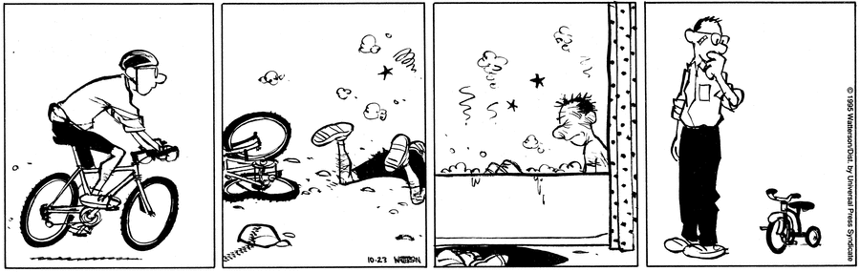
Huh? [10/23/95]

Slide 3
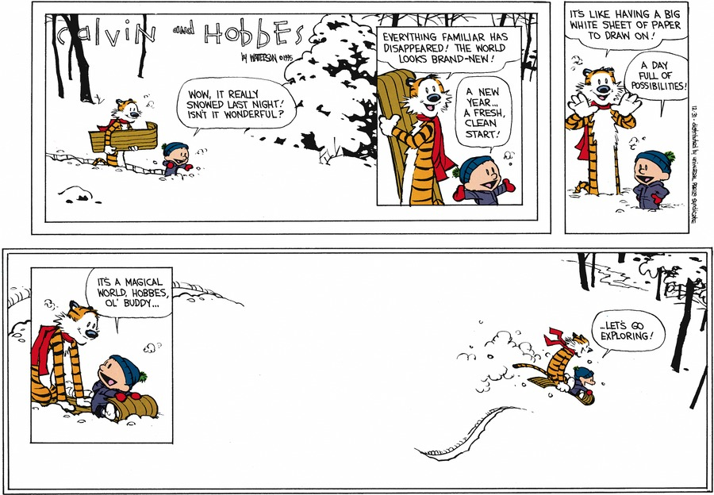
The final strip -- Dec. 31, 1995

Slide 4
From the board last class
Chronological progression of artistic style
A broader set of categories but focused on change over time (chronology)
Immortality of C & H illustrated through fan art
Philosophy
Absence of popular culture
Re-discovering C&H
Snow
Multiple-strip stories
Characters
Art
A single meaningful strip to each individual
The ending of C&H
Sunday strips
Is Hobbes real?/separate from Calvin
McCloud

Slide 5
From the board last class
Chronological progression of artistic style
A broader set of categories but focused on change over time (chronology)
Immortality of C & H illustrated through fan art
Philosophy
Absence of popular culture
Re-discovering C&H
Snow
Multiple-strip stories
Characters
Art
A single meaningful strip to each individual
The ending of C&H
Sunday strips
Is Hobbes real?/separate from Calvin
McCloud

Slide 6
Exhibition title?
Calvin and hobbes from Beginning to End
(It’s just a thought...)

Slide 7
Freewrite prompt
What topics might be interesting enough to you to serve as the focus of your portion of the exhibition?
Why do they strike you as interesting/ revealing/strange?

Slide 8
For class Thursday
Look through the entirety of C&H and identify strips that are relevant to your theme.
C&H search engine
Every single one? Depends…
Look across the strips you identify. Describe the essential features of your theme. How does it change over time?
Come to class prepared to talk about (have some notes written down!) your current thinking about your theme. Identify one strip that illustrates your thinking to show us. (2-3 minute presentation)

Slide 9
For class Thursday
There is also a short reading for Thursday and some assigned reading react-ers. Do the reading, if you are a react-er post your reaction by 5 PM tomorrow, if you are not an assigned react-er read the reactions before class.
FWIW, fb lets me see who has viewed each post in our group, so I can see if you haven’t looked at them.
Class will begin at 8 as usual

