Slide 1
Assigned discussion groups and…
Molly Liam Matt Linh
Oswaldo Rohan Karin Olek
Ankit Ayyad Lauren Ben
3 things you should have access to in class today
Understanding Comics
Vol. 2 of The Complete…
Gabby’s essay “Why Calvin and Hobbes is great literature”
If you are missing any of them please go get them

Slide 2
The “Weekly Sheet”
It has information I would like you to be familiar with on it.
I expect you to bring relevant texts to class with you.
I have gotten the Weekly Sheets out pretty late the past couple weeks. I will try harder to get them to you on Friday.

Slide 3
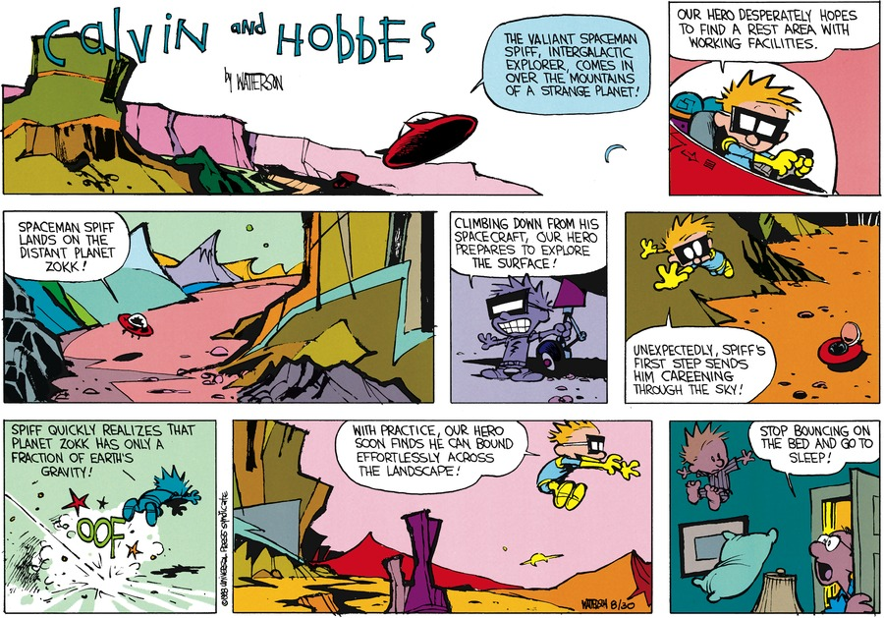
10/16/88

Slide 4
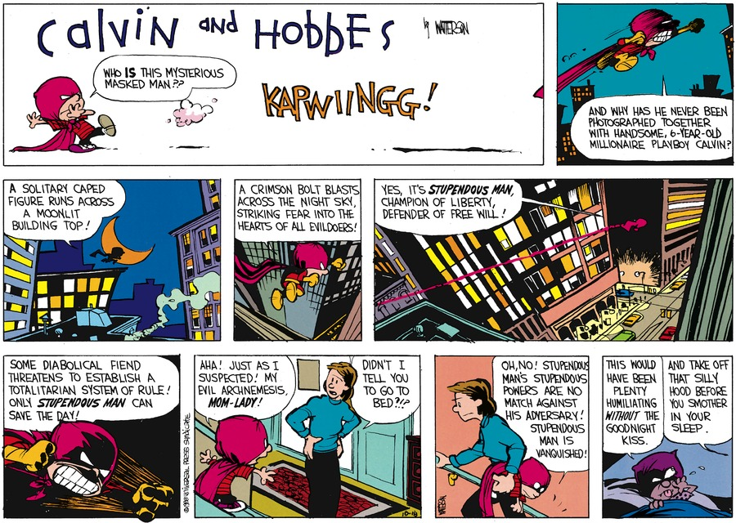
12/4/88

Slide 5
Discussion questions for Gabby’s essay
A question for the back of your mind: “Space, broadly speaking, is what defines Calvin and Hobbes.”
What is Gabby’s argument for why C and H is “great literature”?
What is the structure of her essay?
What are the parts? What is she saying in each part?
How does that constitute an argument that C and H is great literature?
Point to specific passages in the text.
What might she mean by “Space, broadly speaking…”?

