Slide 1
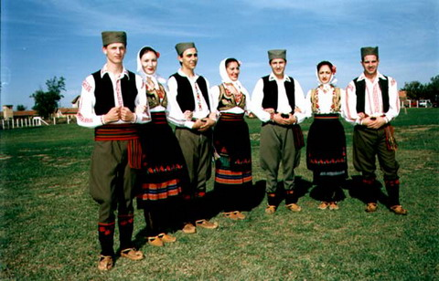
Kolo
коло

Slide 2
Kolo/circle
Kolo is a collective folk dance common in various South Slavic regions, named after the circle formed by the dancers. The Kolo is danced primarily by people from Bosnia and Herzegovina, Croatia, Macedonia, Montenegro, and Serbia. It is performed amongst groups of people (usually several dozen, at the very least three) holding each other's having their hands around each other's waists (ideally in a circle, hence the name). There is almost no movement above the waist. The basic steps are easy to learn, but experienced dancers dance kolo with great virtuosity due to different ornamental elements they add. Each region has at least one unique kolo. The dance is accompanied by instrumental two-beat music performed most often with an accordion, but also with other instruments: frula ,tamburica, or šargija.

Slide 3
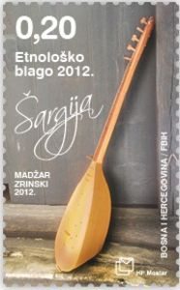
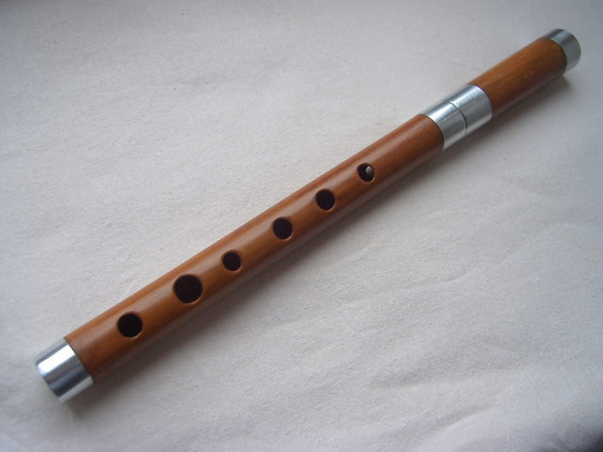
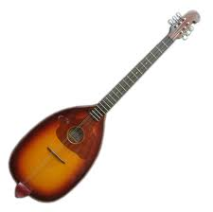
Frula /šargija/tamburica

Slide 4
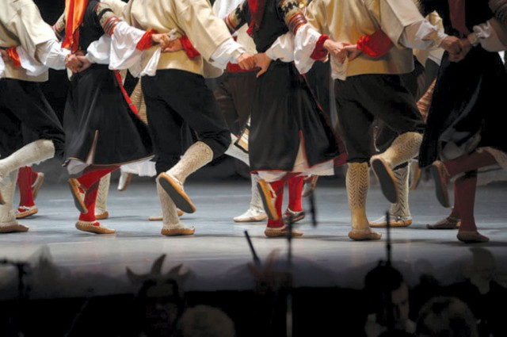
.
Many variations of Kolo are normally performed at weddings, social, cultural, and religious ceremonies. Kolo may be performed in a closed circle, a single chain or in two parallel lines. Both men and women dance together, however some dances require only men to dance and some dances are only for women. The music is generally fast paced and contains tricky steps

Slide 5
.
Throughout a large part of former Yugoslavia right up until World War II, the kolo had been the center of village social life. The kolo as a dance became a tool for social gathering, and was often the main place at which young women and men could get to know each other. With many dances, the singing of jocular verses during the performance served as a way to express feelings or tell a story. By singing, movement, and gestures one could express what was proscribed in ordinary speech. Many young men and women used this as an excuse for courting and teasing one another. Occasions where people may have performed a kolo outdoors on special occasions include harvests, weddings, and religious celebrations to honor a special saint.

Slide 6
hrvatsko kolo
Music is a very important part of Croatian folk dance, with of the most common instruments used are tamburica, šargija, bagpipe, and accordion. Today, kolo is danced at weddings, christenings, holidays such as Easter, and ethnic festivals. The circle dance is regarded as the oldest form of dance, and can be seen as an expression of community, especially in village life.

Slide 7
hrvatsko kolo
Kolo from Lika can have music and instruments, or it can be silent with no instrumental accompaniment or even singing. With the silent dances, the only sounds being made are when the feet make contact with the floor and the rhythmic clinking sound of the women's coin necklaces, and sometimes, the dancers' voices as they sing. Famous kolos: Šokačko kolo, Ličko kolo (traditional Lika dance), etc. On the island of Korčula in the Adriatic, the popular sword dance, the Moreška is still prevalent and performed at festivals and special events. In the nineteenth century, a new form of ballroom dancing emerged in Croatia. Elements of European ballroom spread throughout the region, and dances such as the polka soon became widespread all throughout the Croatian regions.

Slide 8
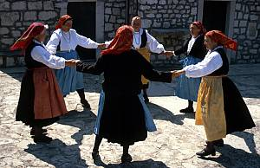
Nemo/nijemo kolo silent kolo

Slide 9
srpsko kolo
During the time of Ottoman Turkish rule of the Serbian lands, Serbs danced most often among the family, at weddings , at social gatherings of feast days in the evening, in churches and monasteries, during the Slava (Patron saint holyday) .They danced to vocal accompaniments. The instrumental music for indoor entertainment was used by the close of the 19th century. There was a belief that everyone must dance (to instrumental accompaniments) in order to gain and secure good health. Famous kolos: Užičko kolo, Čoček, Moravac, etc.

Slide 10
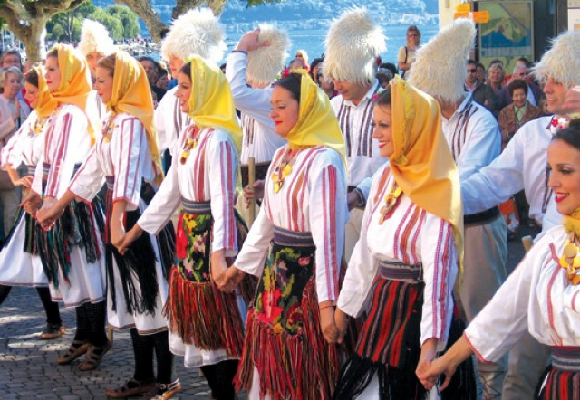
kolo

Slide 11
Mythology
Initially, the kolo was a part of a magic ritual. The formed circle was supposed to protect the community from evil spirits. South Slavs believed that with energetic body movements they will chase the demons and ensure the “joyful movement” revolution of the Sun (rotational period).

Slide 12
.
In earlier times the dance was initiated exclusively by men. Everybody who dances kolo is considered equal except for the leader (kolovođa) who is considered to be the best dancer ( therefore he must be the first to initiate and lead kolo).
If a guy decided to dance with a particular girl and offered to dance kolo with her and she refused the dance it was considered to be a great embarrassment for the guy. If a girl danced next to a guy and another man wanted to dance with her and she refused, she would “cut” the kolo chain and guys would usually get into a fight.

Slide 13
Communist Kolo
Kolo was danced during partisan times during and after the WWII. The partisan kolo originated from Bosnia. It was always accompanied with singing and a wide large circle had to be formed. The most famous partisan kolo is Kozaračko kolo. Partisan kolo symbolized the victory over Nazis, liberation and freedom.

Slide 14
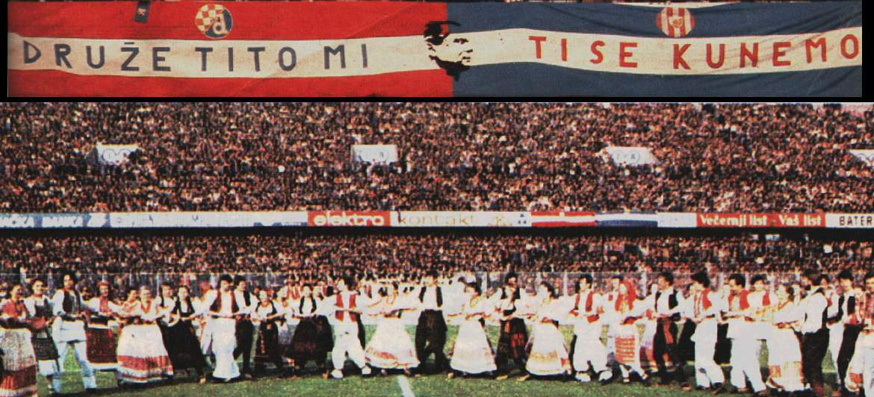
Kozaračko kolo

Slide 15
Kolo:Srbija, Hrvatska, Crna Gora,Bosna
https://www.youtube.com/watch?v=lUNmPdX33e4
https://www.youtube.com/watch?v=WbVwLvaUPdI&list=PL7E42BD5C035FC6F9&index=47
https://www.youtube.com/watch?v=3C1xaTbpgjw
https://www.youtube.com/watch?v=dsGRSEIO6vY
https://www.youtube.com/watch?v=tW8cCKb2JPI
https://www.youtube.com/watch?v=y1e9_B0gywA

