Slide 1



Pillow Palooza
NYC
Short-Term Rental Insights

Slide 2
Project Background
Why we think to launch this project?
What we want to achieve?
How we will do it?
Notes:
As a real estate start-up, which offering short-term rental options for travelers, Pillow Palooza has seen a significant increase in demand for short-term rentals in New York City.
in a mission to better understand the market in order to optimize their business strategy, our company has collected data from various sources on Airbnb listings in New York City to gain insight into the market.
In this project, we will analyze this data through an ordered process, in order to provide recommendations on how to maximize revenue and occupancy rates for their short-term rental properties.

Slide 3
We tried to answer the following questions:
What are the most popular neighborhoods for short-term rentals in New York City?
What is the average rental price for short-term rentals in New York City, and how does it vary by neighborhood and property type?
What are the most commonly rented property types on Airbnb in New York City, and how does this vary by neighborhood?
What is the average length of stay for short-term rentals in New York City, and how does this vary by neighborhood and property type?
How has demand for short-term rentals in New York City changed over time, and are there any seasonal trends that could impact business decisions?
Notes:
To guide me along the analysis and find the main important points for the company, I was asked to answer some questions, which you can see here. for example, first question is...
we will back to them later in the presentation.

Slide 4
The Process:
Data Wrangling and Cleaning Tools: Python, JupiterLite notebook
Data Analysis and Insights Generation Tools: Python, JupiterLite notebook, SQL
Summarizing all of the findings for business impact
Notes:
As our goal is to find out the key points that influence the listings of properties on the given data, we went through the following steps, which we will described in this presentation.
First we explored our date and cleaned it. In this step we used Python and JupiterLite notebook.
In the second step we dived into analysis our clean data. Here we used Python and JupiterLite notebook, but also SQL.
In the end we summarized all of our findings, and we will back here to our questions from the start.

Slide 5
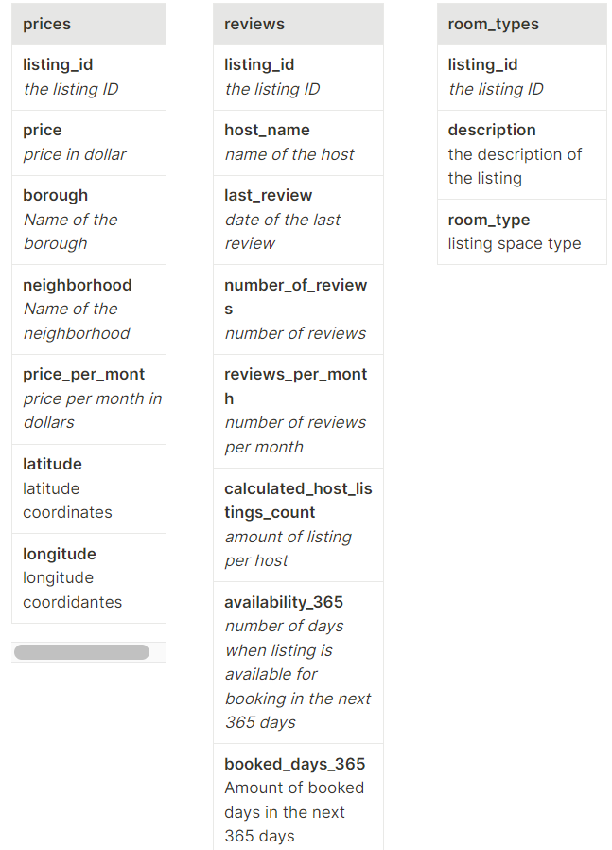
First Step-
Data Wrangling and Cleaning
understanding the data
what are the connections between our tables and features?
Notes:
understand our data, schema.. As a preparation step, please take a moment to examine the data and thoroughly understand it carefully. Pay close attention to each column and determine which information is relevant

Slide 6
This step also consider the necessary steps to clean and prepare the data for analysis, including identifying any outliers that require attention and updating any columns that need modification.
Tools: Python, JupiterLite Notebook
Libraries: pandas, numpy, matplotlib, seaborn
the cleaning process sets the foundation for the next steps in the analysis, which will involve identifying trends in the NYC Airbnb market.
what actions were taken here?
identifying missing or duplicate data, dealing with inconsistencies, and addressing any anomalies in the dataset.
Notes:
cleaning and preparation is critical to ensure that the data is reliable and accurate.
the cleaning process sets the foundation for the next steps in the analysis, which will involve identifying trends in the NYC Airbnb market.
To proceed, we created a list that outlines the specific actions you will take during each stage of the data cleaning process. This list should include all necessary steps, such as identifying missing or duplicate data, dealing with inconsistencies, and addressing any anomalies in the dataset.

Slide 7
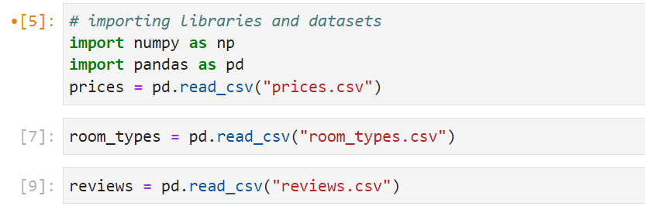
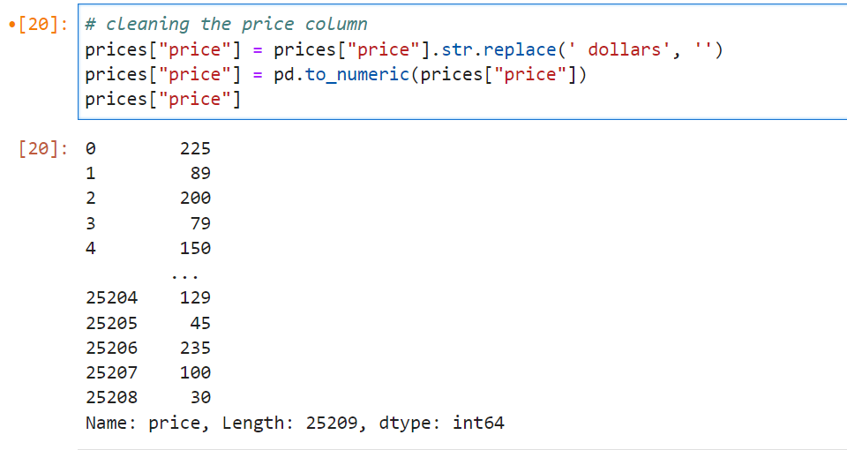
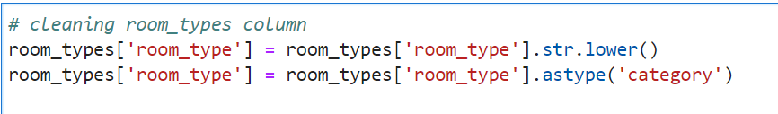
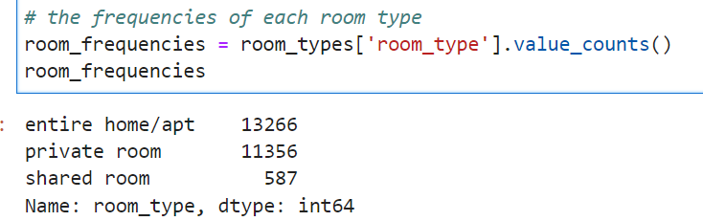
importing the necessary libraries for this stage.
importing our datasets and start to explore.
cleaning and update the price column.
room type column has several variations for the listings.
count the values for each room_type
Notes:
in the prices DataFrame currently records each value as a string with a currency, needed to update the column to numeric type.
room_type column- To make them uniform I first converted all string characters to lowercase, and converted the column to a ‘category’ type. we will need this later to be able to count the frequency of each room type.

Slide 8

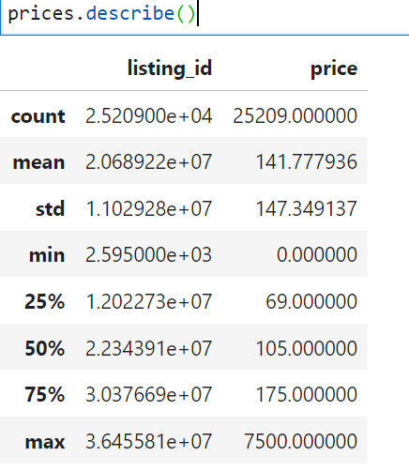
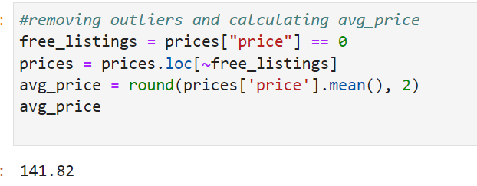
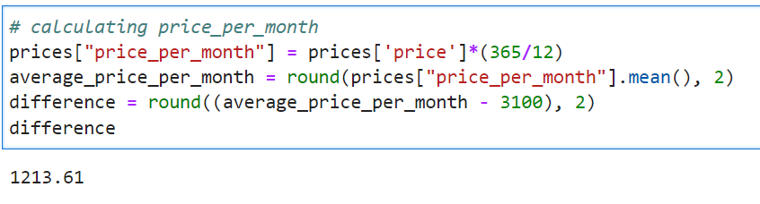
cleaning the last review column- needed to be changed to the right date format
exploring the datasets with describe method.
removing outliers from the price column and find the average price and price for month.
Notes:
last_review column- needed to be changed to the right date format. using pd.datetime method to convert the dates.

Slide 9
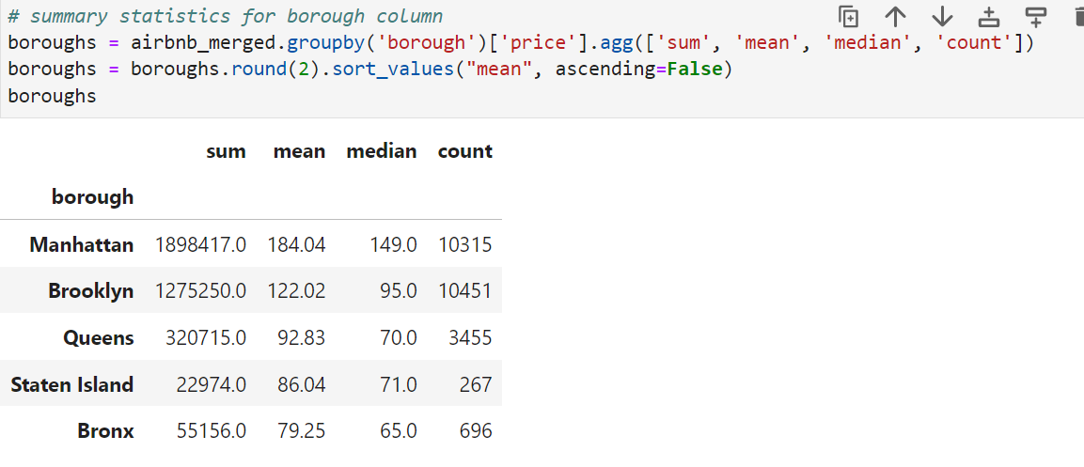
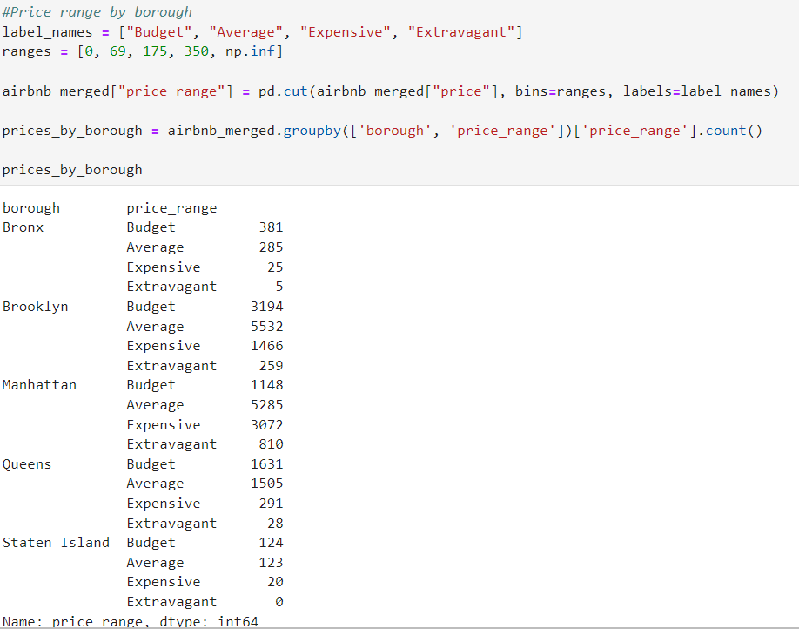
boroughs column- put attention to the difference in listing prices between NYC boroughs.
Then we find the price range in each of them.
For this purpose, we calculated a summary statistics using the groupby() method.
Then we wanted to categorize the listings based on whether they fall into specific price ranges, and view this by borough.
Notes:
boroughs column- For this purpose, I calculated summary statistics using the groupby() method.
Then we wanted to categorize the listings based on whether they fall into specific price ranges, and view this by borough.

Slide 10
Second Step- Data Analysis and Insights Generation
Now that the data is clean and I started to explore it a bit, I could dive into the main analysis process to find important insights
Tools: SQL, returning to Python for visualizations
Notes:
For this stage I moved to use SQL, after exporting the clean and preprocessed data, and with additional columns (from public data sources) that the team added to the data.
Then we will back to Python for the visualizations, which help to find more insights and see them easily and clearly.

Slide 11
Key Points:
The most common room type in the entire NYC Airbnb listings is Entire home/Apt. Following this, the average price for this room_type is about 197 dollars.
looking into boroughs, most entire home/apt listings are in Manhattan and Brooklyn. Those boroughs also have the most listings overall (in any room_type). In Staten Island- only a few hundred listings.
The most profitable borough in terms of revenue for hosts is Manhattan, with about 395,500,000$, followed by Brooklyn, with a little above 279,000,000$.
The highest price on average per month (neighborhoods): Entire home/apt- Sea Gate neighborhood Private room- West Village Shared room- Vinegar Hill
No correlation between estimated book days with the prices (below -0.1)
Notes:
Here we can see the main insights from this analysis:
The most common room type...
It looks like for people or families that want to rent an entire home/apt- a price around this amount looks reasonable and manageable. Also, we should consider focusing more on this room_type in our promotions.
looking into boroughs...
. It’s worth noting that those findings are also logical because it’s known that Manhattan is one of the most expensive places in the world to live in, where Staten Island or Bronx for example are on other hand appears to have lower standards of living.
The most profitable borough...
This is another strong evidence of the popularity of those two boroughs.
The highest price on average per month...
No correlation...
This means that for the estimated booked days there is no meaning when looking at the prices and vice versa.

Slide 12
what we learned from those key points:
For room types, It looks like for people or families that want to rent an entire home/apt- a price around 197$ looks reasonable and manageable. Also, we should consider focusing more on this room type in our promotions.
As a note for boroughs, It’s worth noting that those findings are also logical because it’s known that Manhattan is one of the most expensive places in the world to live in, where Staten Island or Bronx for example are on other hand appears to have lower standards of living.
The finding about the most profitable borough is another strong evidence of the popularity of Manhattan and Brooklyn.
Because there is no correlation between estimated book days with the prices This means that for the estimated booked days there is no meaning when looking at the prices and vice versa.
Notes:
Here we can see the main insights from this analysis:
The most common room type...
It looks like for people or families that want to rent an entire home/apt- a price around this amount looks reasonable and manageable. Also, we should consider focusing more on this room_type in our promotions.
looking into boroughs...
. It’s worth noting that those findings are also logical because it’s known that Manhattan is one of the most expensive places in the world to live in, where Staten Island or Bronx for example are on other hand appears to have lower standards of living.
The most profitable borough...
This is another strong evidence of the popularity of those two boroughs.
The highest price on average per month...
No correlation...
This means that for the estimated booked days there is no meaning when looking at the prices and vice versa.

Slide 13
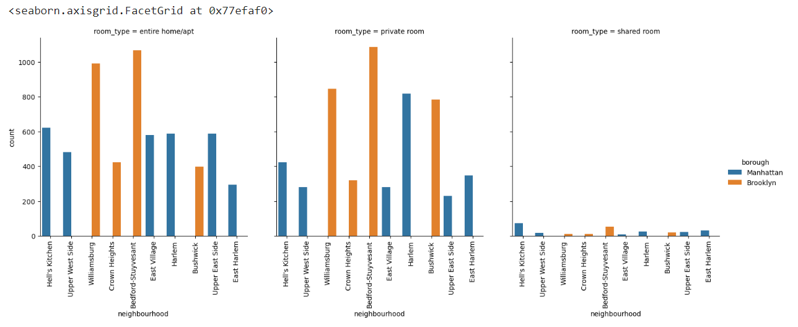
Top 10 Neighborhoods and their variability between room types, considering boroughs
Notes:
I thought it will also be valuable to look at things visually. I was interested to see which 10 neighborhoods have the most listings in the combined data (Top 10 neighborhoods), and how is their relativity/variability between the different room types.
To make this visualization I returned to the notebook and used Python to import the relevant modules to be able to receive the desired output. For this plot I used seaborn catborn visualization.
In the following viz, you can see the three subplots (one for each room type, and the color refers to the name of the borough, so each borough gets its own color-which is the same in all the subplots). Each subplot represents the top 10 neighborhoods we found on the x-axis, and their count in each room_type on the Y-axis.

Slide 14
what was used for the last visualization,
and how to interprets it?
To make the previews visualization, I returned to the notebook and used Python to import the relevant modules to be able to receive the desired output. For this plot I used seaborn catborn visualization.
In the viz you can see the three subplots (one for each room type, and the color refers to the name of the borough, so each borough gets its own color-which is the same in all the subplots). Each subplot represents the top 10 neighborhoods we found on the X-axis, and their count in each room type on the Y-axis.
Notes:
I thought it will also be valuable to look at things visually. I was interested to see which 10 neighborhoods have the most listings in the combined data (Top 10 neighborhoods), and how is their relativity/variability between the different room types.
To make this visualization I returned to the notebook and used Python to import the relevant modules to be able to receive the desired output. For this plot I used seaborn catborn visualization.
In the following viz, you can see the three subplots (one for each room type, and the color refers to the name of the borough, so each borough gets its own color-which is the same in all the subplots). Each subplot represents the top 10 neighborhoods we found on the x-axis, and their count in each room_type on the Y-axis.

Slide 15
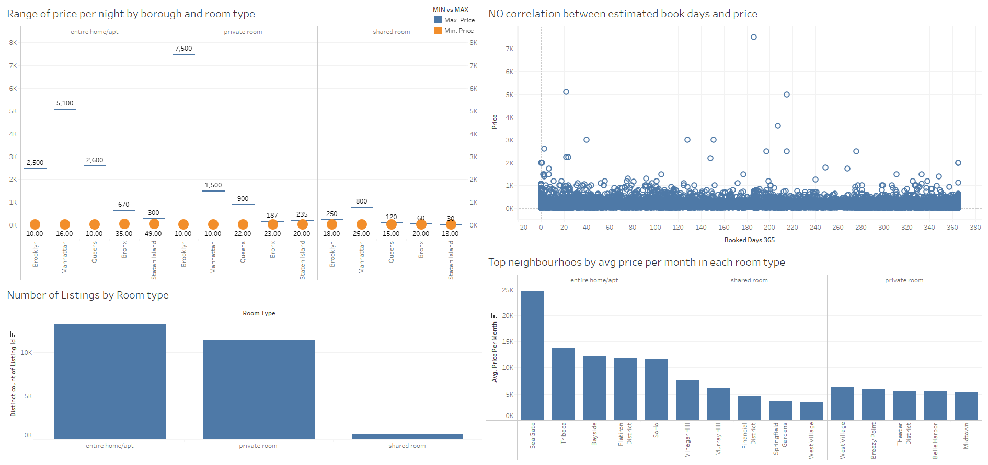
Analysis Summary- conclusions what are our findings for business impact:
Notes:
This dataset appeared to be a very rich dataset with a variety of columns that allowed us to do a deep data exploration with the aim to find meaningful insight and make the best decisions for the company to succeed.
First, we found that the price per night of all the listings in the data has a very wide range, with some extreme values. Later analysis showed us that those were due to a few areas like Manhattan and Brooklyn boroughs, which are the most expensive in this term. We could see it by categorizing the listings based on whether they fall into specific price ranges, and also by visualization, which added the neighborhood and room type aspects.
After that we found that using Airbnb is more expensive than the private market, but considering the different room types we saw that most of the listings are either entire rooms/apt or private rooms, which is an important mark when we think about what the hosts and tourist preferences, and what room types should we focus on.
Then we moved from Python and used SQL to query the merged dataset and deep more to find interesting insights. We found that the average revenue was the highest for Manhattan and Brooklyn, which is consistent with our last findings.
When looking into neighborhoods and room types, we saw that Sea Gate neighborhood has the highest price on average per month for an entire home/apt, for a shared room it is Vinegar Hill which is the highest, and for a private room- West Village.
Those neighborhoods could be targeted, considering the most popular room type in each of them.
In the last query in SQL, we searched for the correlation between the estimated book days with the price of an Airbnb listing in New York City, but we couldn’t find a strong correlation between those features, to be able to make smart decisions by considering those two together.

Slide 16
Analysis Summary- conclusions (continue)
price per night of all the listings in the data has a very wide range, with some extreme values. Later analysis showed us that those were due to a few areas like Manhattan and Brooklyn boroughs, which are the most expensive in this term.
Using Airbnb is more expensive than the private market, but considering the different room types we saw that most of the listings are either entire rooms/apt or private rooms, which is an important mark when we think about what the hosts and tourist preferences, and what room types should we focus on.
Moving to SQL- we found that the average revenue was the highest for Manhattan and Brooklyn, which is consistent with our last findings.
Sea Gate, Vinegar Hill and West Village neighborhoods can be targeted, considering the most popular room type in each of them.
we couldn’t find a strong correlation between estimated book days and price , to be able to make smart decisions by considering those two together.
Notes:
This dataset appeared to be a very rich dataset with a variety of columns that allowed us to do a deep data exploration with the aim to find meaningful insight and make the best decisions for the company to succeed.
First, we found that the price per night of all the listings in the data has a very wide range, with some extreme values. Later analysis showed us that those were due to a few areas like Manhattan and Brooklyn boroughs, which are the most expensive in this term. We could see it by categorizing the listings based on whether they fall into specific price ranges, and also by visualization, which added the neighborhood and room type aspects.
After that we found that using Airbnb is more expensive than the private market, but considering the different room types we saw that most of the listings are either entire rooms/apt or private rooms, which is an important mark when we think about what the hosts and tourist preferences, and what room types should we focus on.
Then we moved from Python and used SQL to query the merged dataset and deep more to find interesting insights. We found that the average revenue was the highest for Manhattan and Brooklyn, which is consistent with our last findings.
When looking into neighborhoods and room types, we saw that Sea Gate neighborhood has the highest price on average per month for an entire home/apt, for a shared room it is Vinegar Hill which is the highest, and for a private room- West Village.
Those neighborhoods could be targeted, considering the most popular room type in each of them.
In the last query in SQL, we searched for the correlation between the estimated book days with the price of an Airbnb listing in New York City, but we couldn’t find a strong correlation between those features, to be able to make smart decisions by considering those two together.

Slide 17
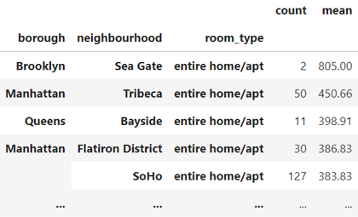
Back again to the 5 questions I got during the meeting:
most popular neighborhoods for short-term rentals in NYC:
Bedford-Stuyvesant, Williamsburg, Harlem, Bushwick, Hell's Kitchen, East Village, Upper East Side, Upper West Side, Crown Heights, and East Harlem.
average rental price for short-term rentals in New York City, and how does it vary by neighborhood and property type:
Sea Gate and Tribeca, when the room type is ‘Entire home/Apt’- are at the top with the highest average price. Furthermore, those two neighborhoods belong to the most popular boroughs in the data- Brooklyn and Manhattan.
the most commonly rented property types, and how does this vary by neighborhood:
most commonly rented properties are 'Private Rooms', and 'Entire homes/apt', which is supported by previous findings, but in each neighborhood the common property between those two is different.
Notes:
about second dot-
From the count and average price, we see clearly that those specific combinations aren’t a big part of the entire data, so it may be worth promoting those specific areas to the customer segment that has the ability to stand in those prices.
about third dot-
in Bedford-Stuyvesant for example, those two room types are common pretty evenly. In Bushwick on the other side, private rooms are rented twice as more as entire homes/apt. those findings (and about other neighborhoods) are crucial when we try to target the right customers for each place, and also for promotional campaigns.

Slide 18
Analysis Summary-
Recommendations
Manhattan is the place we should most focus on, following by Brooklyn.
considering neighborhoods, top places to invest in are Bedford and Williamsburg due to the fact that they are the most commonly rented when talking about entire homes and private rooms.
Looking in the average rental price- Sea Gate and Tribeca Located in Brooklyn and Manhattan boroughs respectively.
adding additional columns to keep the analysis and also answer the rest of the questions, so we could get even more useful insights about the data.
Notes:
Overall, we discovered a very good number of interesting relationships between the features and explained each step of the process.
Manhattan is the place we should most focus on..
people love to stay in those two places in NY, especially in Entire home. also, since Manhattan is even more expensive than Brooklyn, it will be preferable to increase the number of entire homes especially there.
considering neighborhoods...
top places to invest in are Bedford and Williamsburg.
about the least popular ones, like Staten Island- we can be in contact with the hosts there, to better understand their difficulties.
Looking in the average rental price-
Sea Gate and Tribeca Sea Gate and Tribeca Located in Brooklyn and Manhattan boroughs respectively.
Despite this, in terms of the amount of apartments, these neighborhoods are not at the top, so we should promote those specific areas to the customer segment that has the ability to stand in those prices.
adding additional columns..
it also would be nice to have a couple of additional features, such as the average review score for each listing (on a scale of 1-5, or 1-10), so we could look for the best-reviewed hosts in NYC.

Slide 19
Challenges
Reading the dataset and understanding the columns.
Handling NaN values, null values and duplicates.
Removing outliers from some of the columns.
Notes:
Q.4 :
The provided dataset doesn’t include data on the length of stay, which means we have partial information to answer this. However, it will be beneficial to have this information, to be able to go even deeper into the data we already have.
Q.5 :
The provided dataset doesn’t allow us to answer this question with full certainty. To answer this question we need to also have the information about the date of each booking-preferably in another table that includes the information, while every record (row) represents one booking and has its own unique id.
Nevertheless, with the existing data, we can see the changes in short-term rental in NYC over different boroughs or different neighborhoods.

Slide 20
Last two questions that were asked to answer have some missing data:
question 4- What is the average length of stay for short-term rentals in New York City, and how does this vary by neighborhood and property type?
The provided dataset doesn’t include data on the length of stay, which means we have partial information to answer this. However, it will be beneficial to have this information, to be able to go even deeper into the data we already have.
Question 5- How has demand for short-term rentals in New York City changed over time, and are there any seasonal trends that could impact business decisions?
The dataset doesn’t allow us to answer this question with full certainty. To answer this question we need to also have the information about the date of each booking-preferably in another table that includes the information, while every record (row) represents one booking and has its own unique id. Nevertheless, with the existing data, we can see the changes in short-term rental in NYC over different boroughs or different neighborhoods.
Notes:
Q.4 :
The provided dataset doesn’t include data on the length of stay, which means we have partial information to answer this. However, it will be beneficial to have this information, to be able to go even deeper into the data we already have.
Q.5 :
The provided dataset doesn’t allow us to answer this question with full certainty. To answer this question we need to also have the information about the date of each booking-preferably in another table that includes the information, while every record (row) represents one booking and has its own unique id.
Nevertheless, with the existing data, we can see the changes in short-term rental in NYC over different boroughs or different neighborhoods.

Slide 21
Thank You!

