Slide 2
New Sequence Container
Get Layer
Remaining Layers
Container
Remaining Layers Container
Get Remaining Layers

Slide 3
New Sequence Container
Get Layer
Remaining Layers
Container
Remaining Layers Container
Get Remaining Layers

Slide 4
New Sequence Container
Get Layer
Remaining Layers
Container
Remaining Layers Container
Get Remaining Layers

Slide 5
New Sequence
Get Next Layer
Remaining Layers
Remaining Layers
Remaining Layers

Slide 6
Folding a Sequence
val = 'c'
acc = False
a
b
c
d
e
f
g
h

Slide 7
Question: Is 'c' a member?
val = 'c'
acc = False
a
b
c
d
e
f
g
h

Slide 8
val = 'c'
acc = False
False
a
b
c
d
e
f
Think of the initial acc value as tacked on the front.
It represents the value of an empty list
g
h

Slide 9
val = 'c'
At each step, we fold the next two values together using the update rule
acc = False
False
a
b
c
d
e
f
g
h

Slide 10
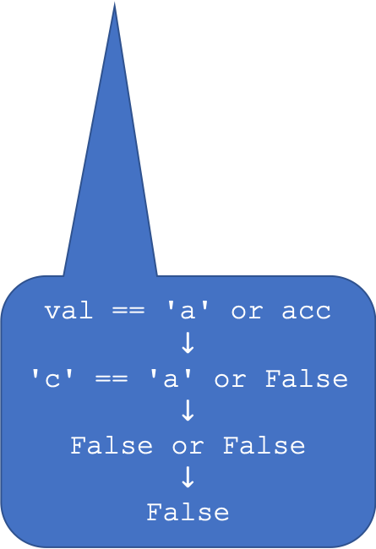
val = 'c'
acc = False
False
a
False
b
b
c
c
d
d
e
e
f
f
g
g
h
h
val == 'a' or acc
$$↓$$
'c' == 'a' or False
$$↓$$
False or False
$$↓$$
False

Slide 11
val = 'c'
val == 'b' or acc
False
acc = False
False
a
False
b
b
False
c
c
c
d
d
d
e
e
e
f
f
f
g
g
g
h
h
h

Slide 12
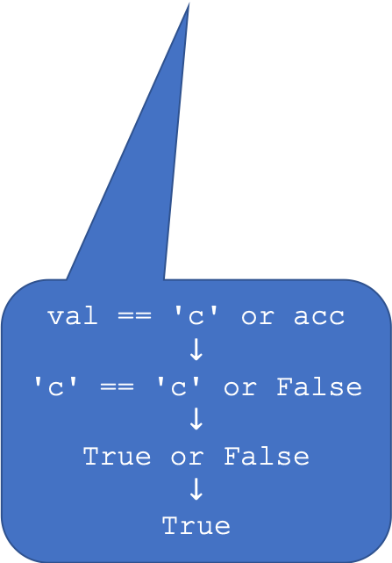
val = 'c'
acc = False
False
a
False
b
b
False
c
c
c
d
d
d
e
e
e
f
f
f
g
g
g
h
h
h
val == 'c' or acc
$$↓$$
'c' == 'c' or False
$$↓$$
True or False
$$↓$$
True

Slide 13
val = 'd'
acc = False
False
a
False
b
b
c
c
True
d
d
d
e
e
e
f
f
f
g
g
g
h
h
h

Slide 14
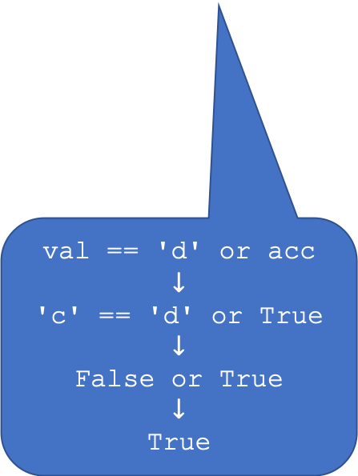
val = 'd'
acc = False
False
a
False
b
b
c
c
True
d
d
d
e
e
e
f
f
f
g
g
g
h
h
h
val == 'd' or acc
$$↓$$
'c' == 'd' or True
$$↓$$
False or True
$$↓$$
True

Slide 15
val = 'd'
acc = False
False
a
False
b
b
c
c
d
d
True
e
e
e
f
f
f
g
g
g
h
h
h

Slide 16
val = 'd'
acc = False
False
a
False
b
b
c
c
d
d
e
e
True
f
f
f
g
g
g
h
h
h

Slide 17
val = 'd'
acc = False
False
a
False
b
b
c
c
d
d
e
e
f
f
True
g
g
g
h
h
h

Slide 18
val = 'd'
acc = False
False
a
False
b
b
c
c
d
d
e
e
f
f
True
g
g
h
h
h

Slide 19
val = 'd'
acc = False
False
a
False
b
b
c
c
d
d
e
e
f
f
g
g
h
h
True

