Slide 1
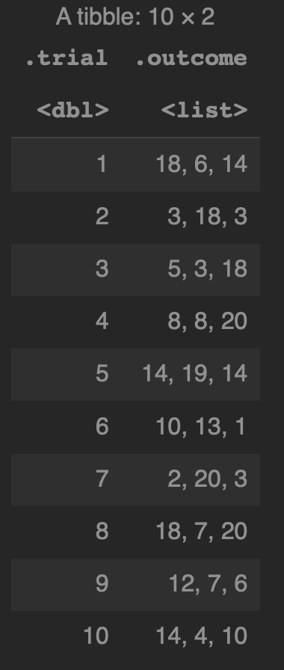
mutate(map(...))
mutate(map(map(...)))
mutate(…)

Slide 2
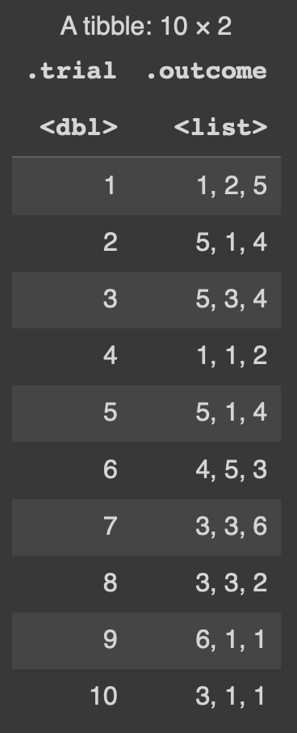
Levels of Abstraction
A dataframe/tibble
consists of columns
A list column
consists of vectors/lists
A vectors/lists
consists of data
Data structures can contain either data or other data structures. Each nested structure represents another level of abstraction

Slide 3
mutate & map pierce levels of abstraction
mutate(map(...)) to
change the vectors
inside a list column
mutate(…) to
change a column
mutate(map(map(...)) to
change the data
inside a vectors
inside a list column

Slide 4
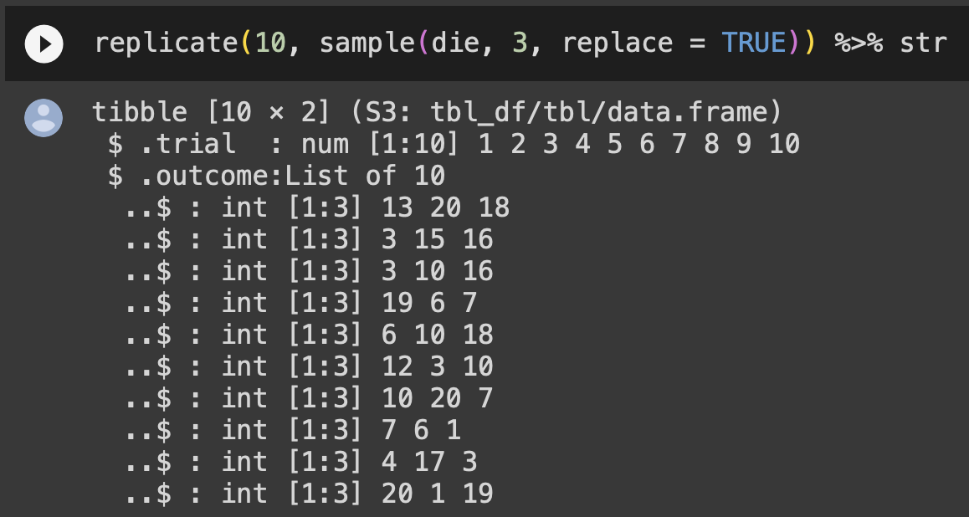
Use str to explore levels of abstraction
The tibble consists of .trial and .outcome columns
The .trial column
consists of numbers
The .trial column is a list
of int vectors
of integer values

