Slide 1
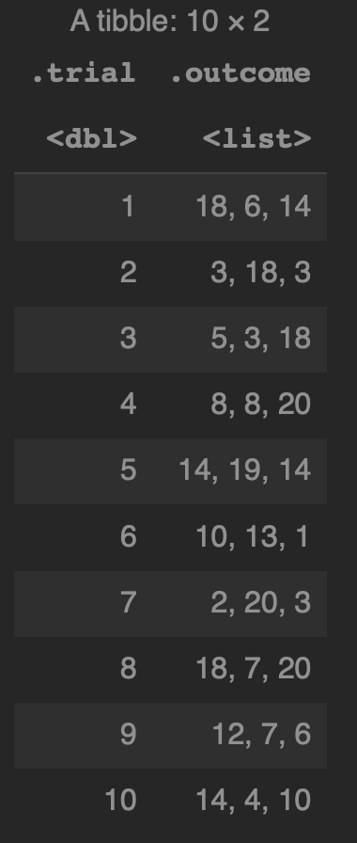
mutate(map(...))
mutate(map(map(...)))
mutate(…)

Slide 2
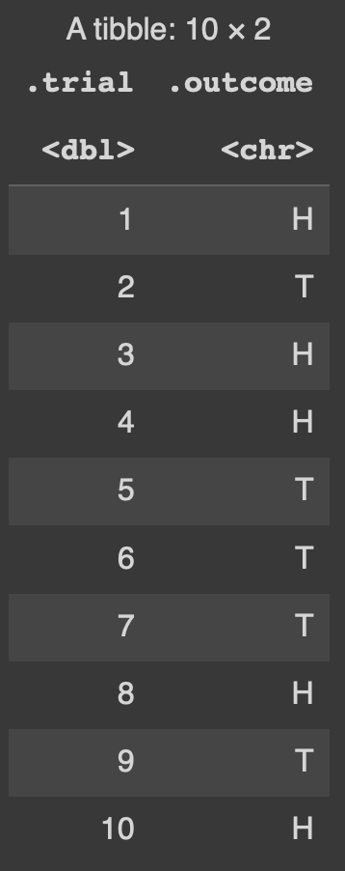
Levels of Abstraction for a chr column
A dataframe/tibble
consists of columns
A chr column
consists of individual chrs
Data structures can contain either data or other data structures. Each nested structure represents another level of abstraction

Slide 3
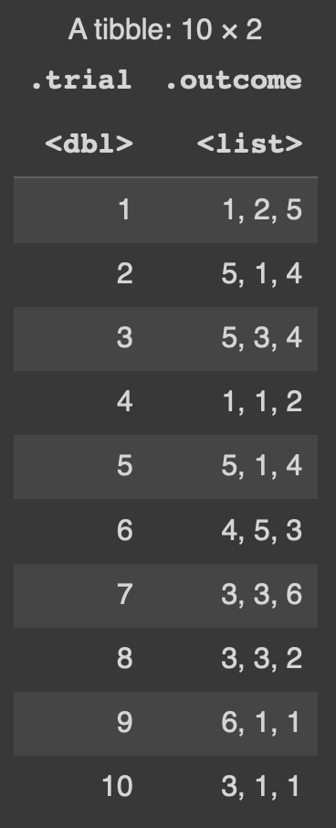
Levels of Abstraction for a list column
A dataframe/tibble
consists of columns
A list column
consists of vectors or lists
A vectors or lists
consists of data
Data structures can contain either data or other data structures. Each nested structure represents another level of abstraction

Slide 4
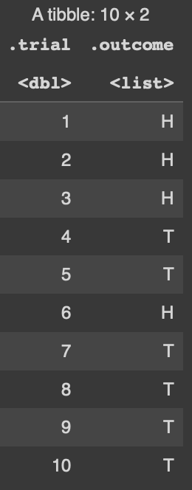
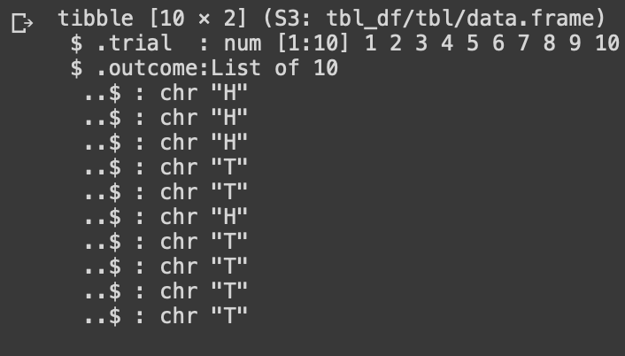
Simple Outcomes with replicate creates an extra level
replicate returns
a list column
of chr vectors
of a single chr

Slide 5
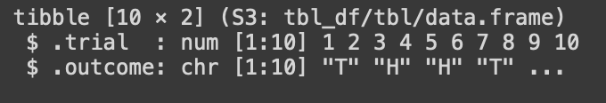
Simple Outcomes with replicate_chr creates an extra level
replicate_chr returns a list column
of single chr

Slide 6
replicate_chr versus replicate for simple outcomes
replicate
returns a list column
of chr vectors
of a single chr
replicate_chr returns a list column
of single chr

Slide 7
mutate & map pierce levels of abstraction – scalar column
mutate(X = map(.outcome, f)) to
change the individual chr
inside a chr column
where f is a scalar function
mutate(X = v(.outcome)) to
change a chr column
where v is a vectorized function

Slide 8
mutate & map pierce levels of abstraction – list column
mutate + map descends two levels
mutate(X = map(.outcome, f)) to
change the individual list
inside a list column
where f is a function designed for lists
mutate descends one level
mutate(X = v(.outcome))
to change a list column
where v is
a vectorized function
mutate + map + map descends three levels
mutate(X = map(.outcome, \(x) map(x, v)))
to change the data inside each vector inside a list column
where v is a vectorized function

Slide 9
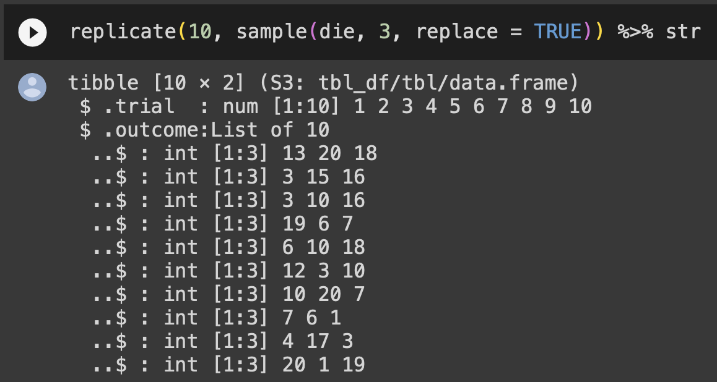
Use str to explore levels of abstraction
The tibble consists of .trial and .outcome columns
The .trial column
consists of numbers
The .trial column is a list
of int vectors
of integer values

