Slide 1
How do we organize facial identity in memory?
Yaren Koca, Chris Oriet
R.I.C.E. Lab
Experimental and Applied Psychology
University of Regina

Slide 2
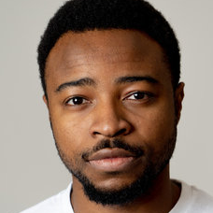
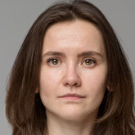
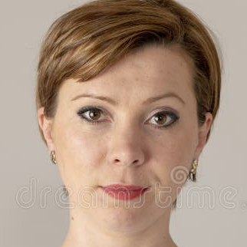



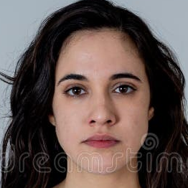
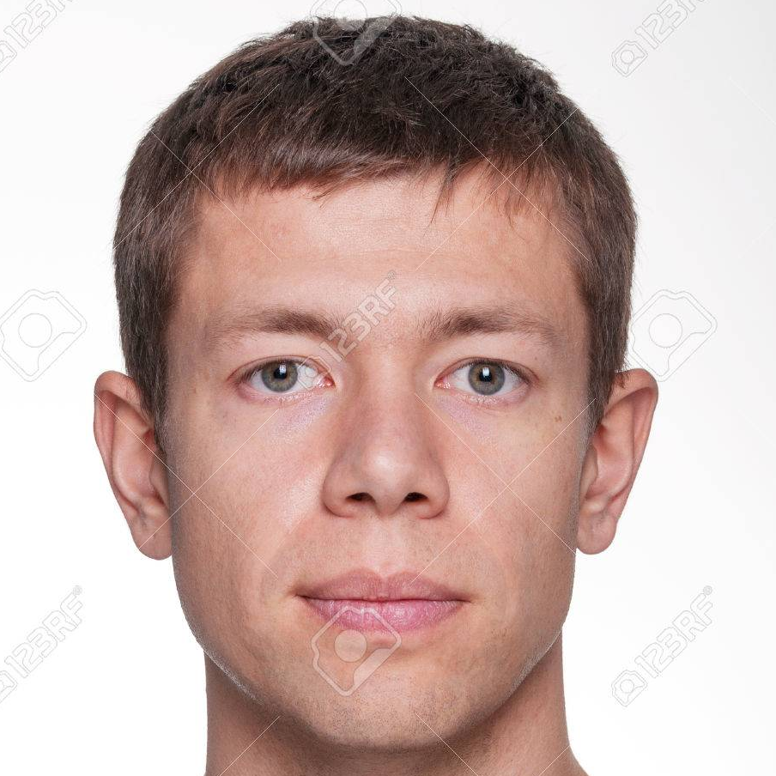

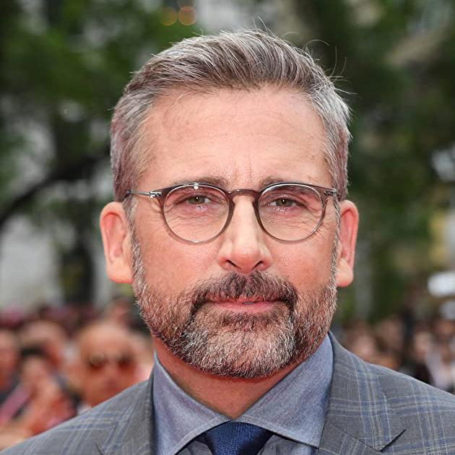



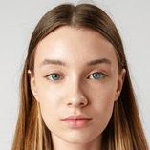


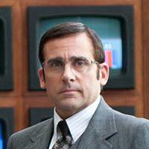
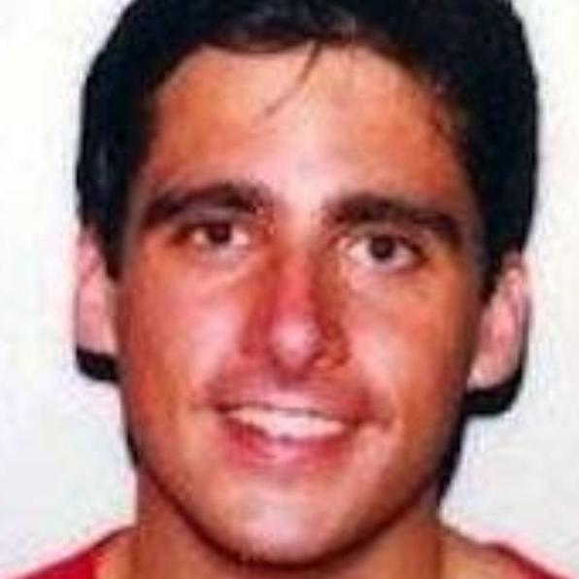
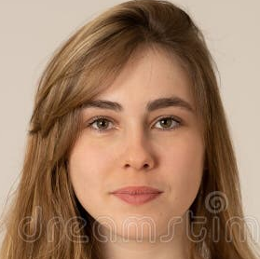

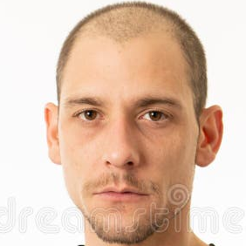
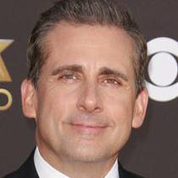

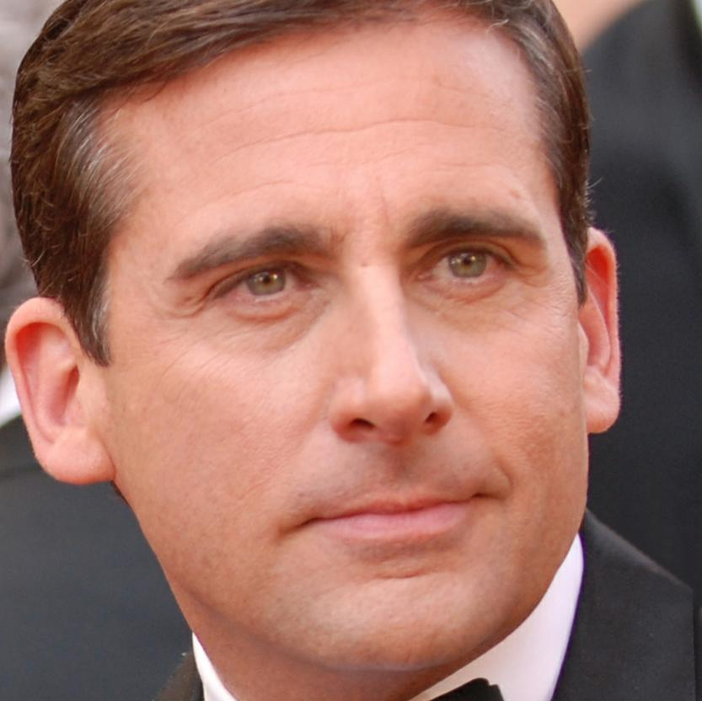
Between-people homogeneity
Within-person variability
Telling faces apart
Telling faces together

Slide 3
How do we organize faces in memory?

Slide 4
Between-people homogeneity
Within-person variability
Between-people similarity
Within-person dissimilarity
Telling faces apart
Telling faces together

Slide 5
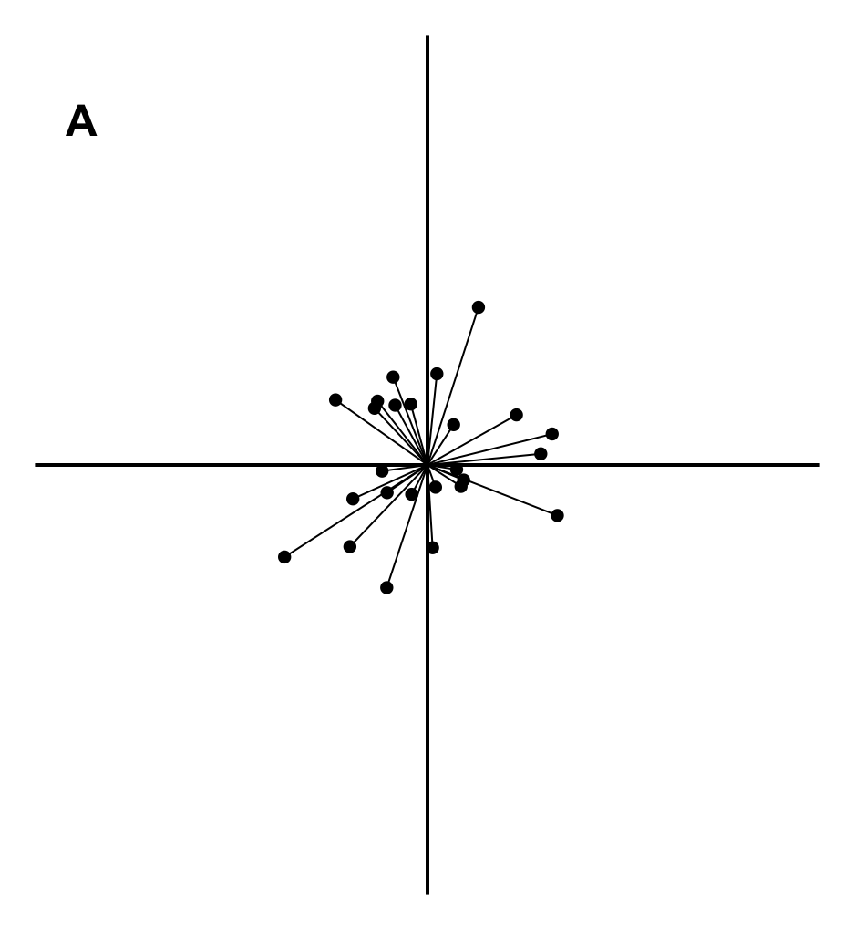
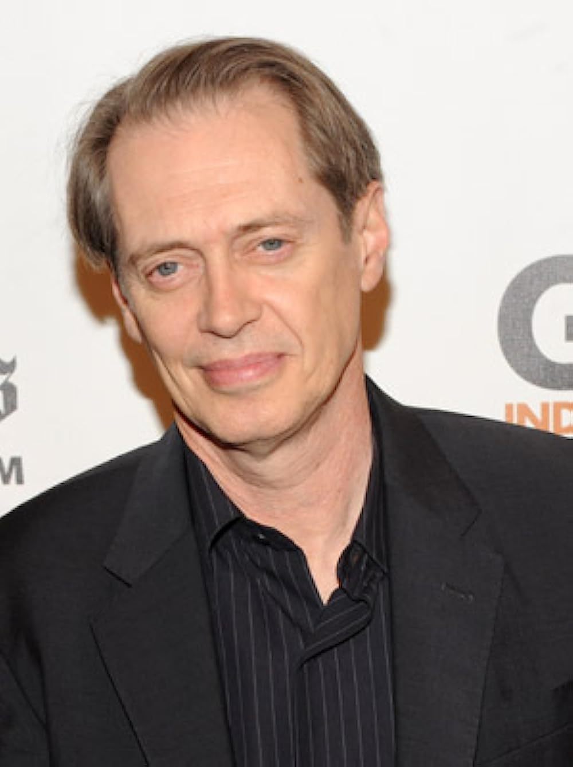
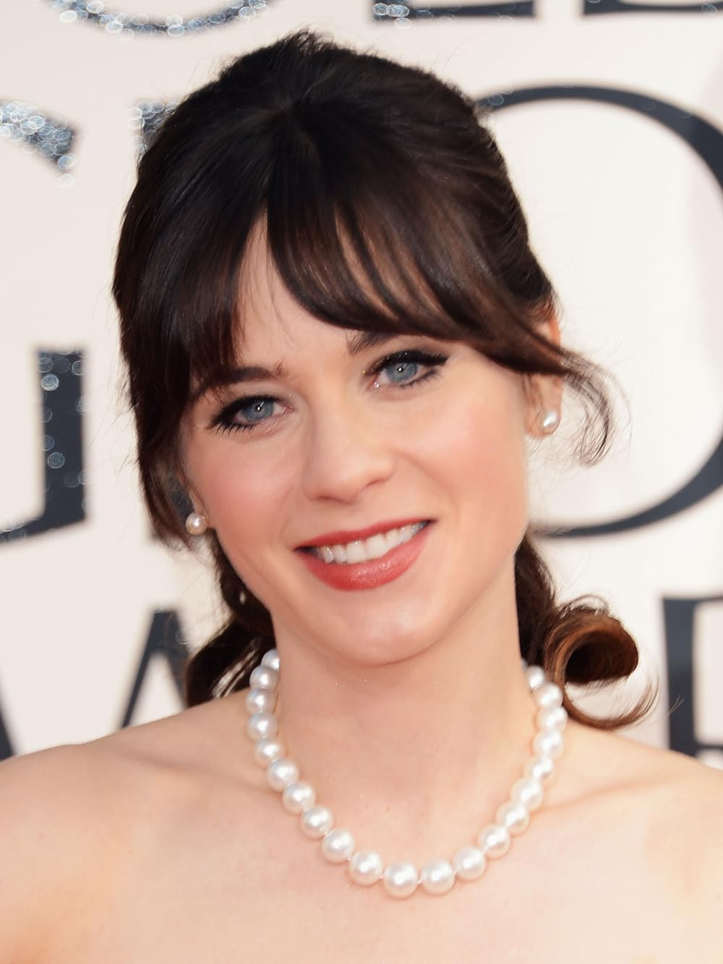
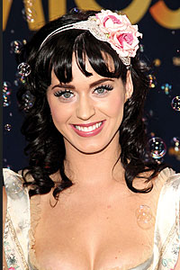
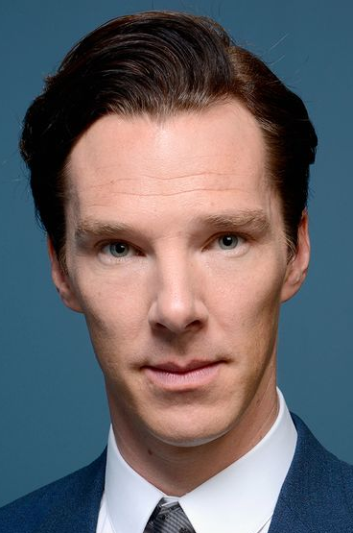
Similarity = Distance
Valentine, 1991

Slide 6
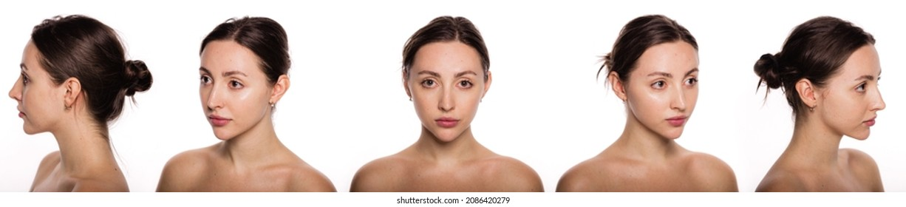
study
test

Slide 7
Familiarity
Jenkins et al., 2011

Slide 8
How is familiarity represented in the face space?

Slide 9
Similarity between different images of the same person (i.e., within-person distances) as a function of familiarity
Similarity between different identities (i.e., between-people distances) as a function of familiarity
Kramer et al., 2025; White et al., 2022

Slide 10
 | Male | Female
Familiar | 4 identities 6 images + average | 4 identities 6 images + average
Unfamiliar | 4 identities 6 images + average | 4 identities 6 images + average

Slide 11
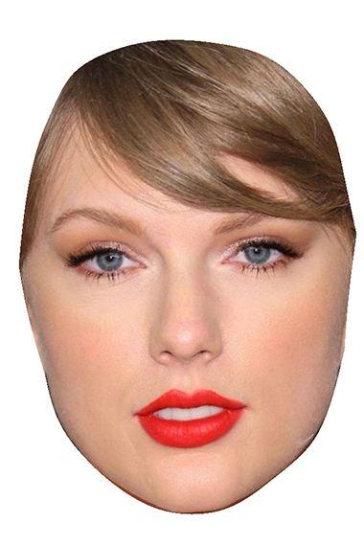
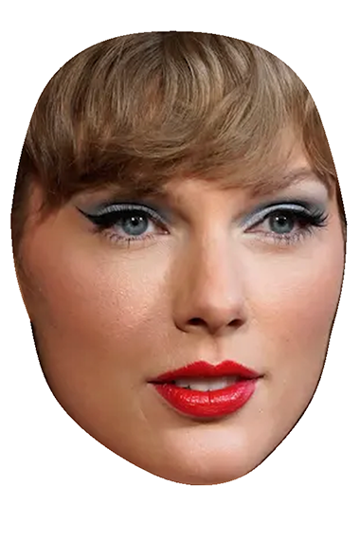
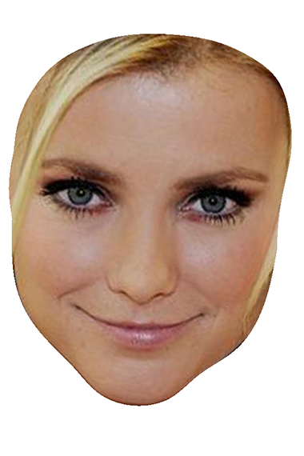
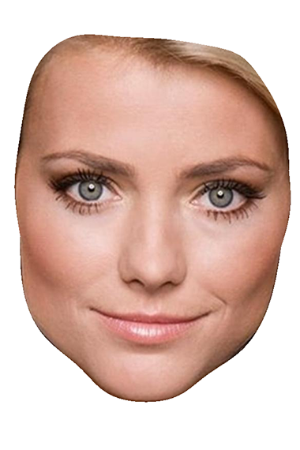
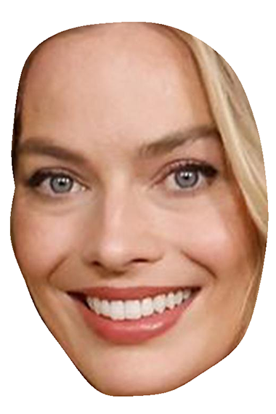
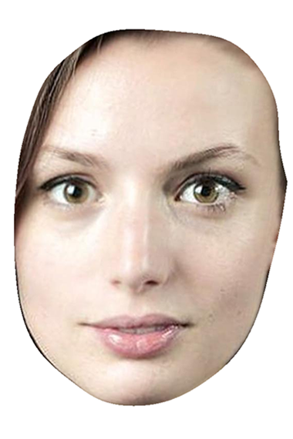
How similar are these faces?
Familiar
Unfamiliar
Familiar-Unfamiliar
Within
Between
N = 331

Slide 12
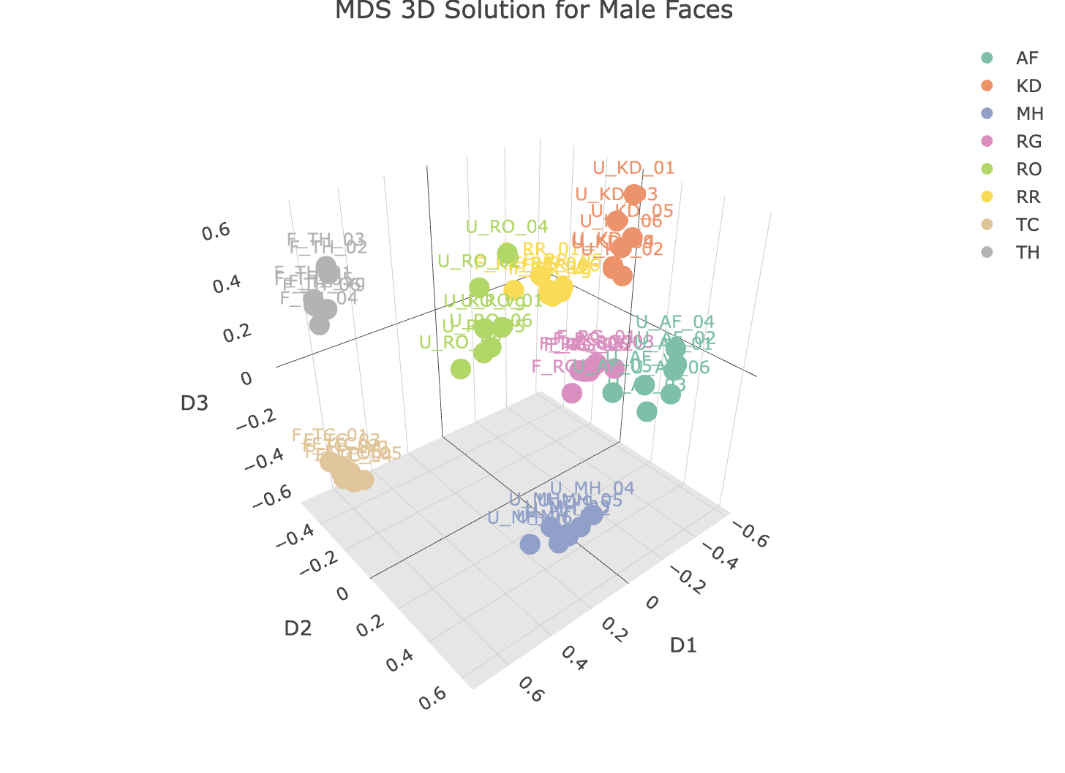
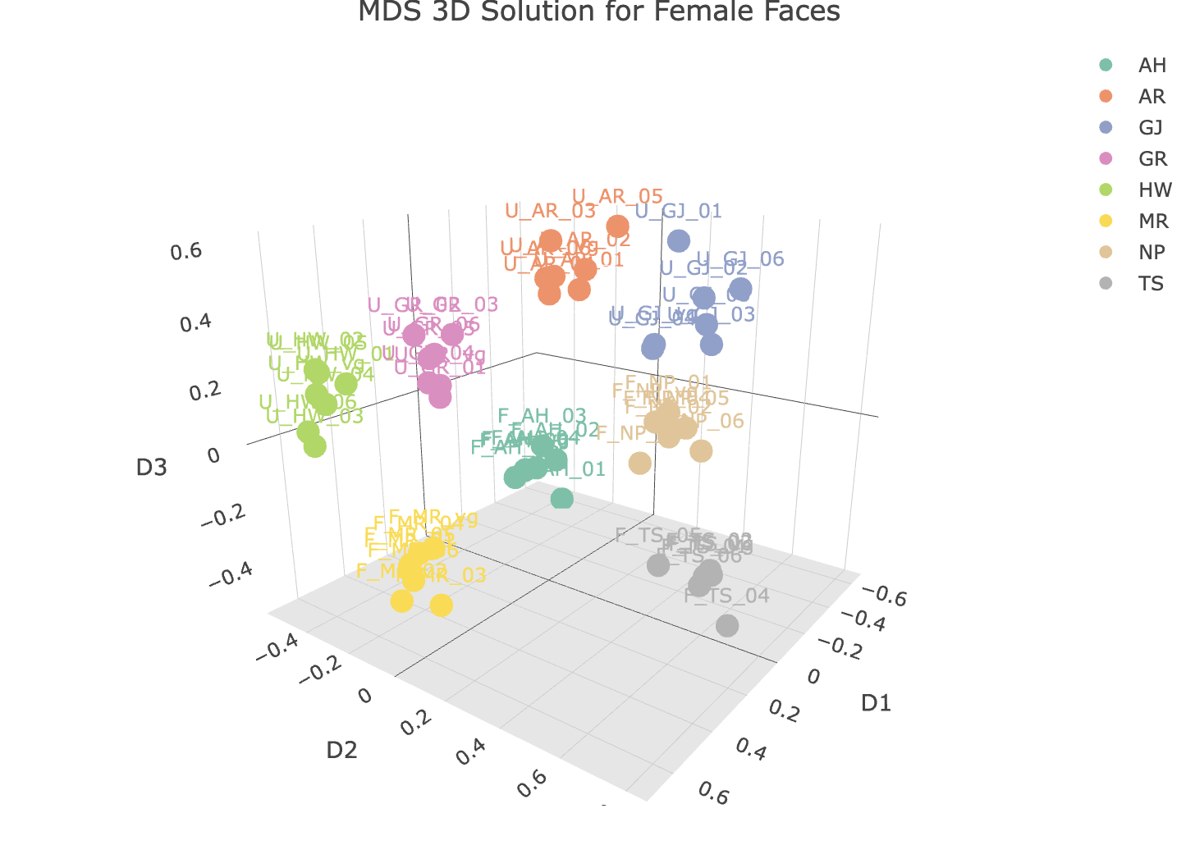
Multidimensional Scaling
Male Faces
Female Faces

Slide 13
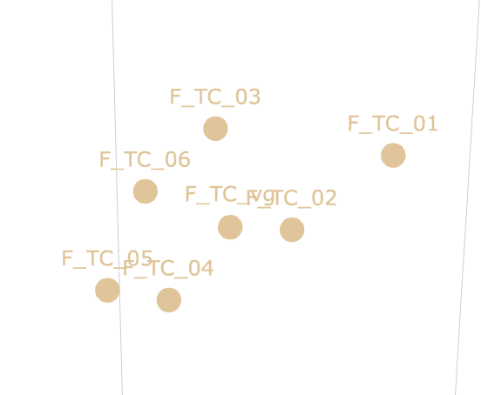
Within-person distances
Familiar
Unfamiliar
Dimension 2
Dimension 1

Slide 14
Are familiar faces more densely clustered? Yes!
Distance ~ Familiarity + (1 | Target Identity)
 | Male Faces | Female Faces
Familiarity | b = .07, p = .004, R² = 36% | b = .08, p = .03, R² = 31%
Target Identity | R² = 5% | R² = 25%

Slide 15
Are familiar faces more densely clustered? Yes!
Distance ~ Familiarity + (1 | Target Identity)
 | Male Faces | Female Faces
Familiarity | b = .07, p = .004, R² = 36% | b = .08, p = .03, R² = 31%
Target Identity | R² = 5% | R² = 25%

Slide 16
Between-people distances
Familiar
Dimension 2
Unfamiliar
Dimension 1

Slide 17
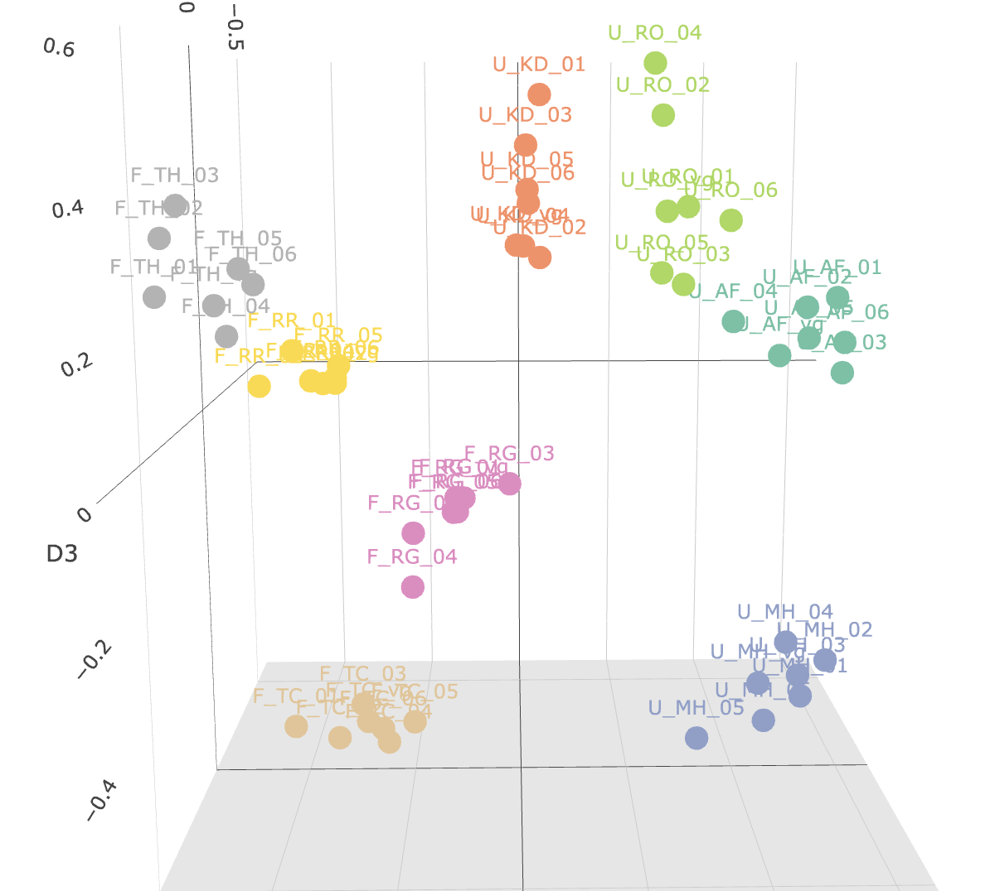
Global Expansion Model
Local Expansion Model

Slide 18
Are familiar faces further from others? Not really…
Distance ~ Familiarity + (1 | Target Identity)
Global Expansion | Male Faces | Female Faces
Familiarity | b = -.08, p > .05, R² = 26% | b = -.01, p > .05, R² = .3%
Target Identity | R² = 47% | R² = 55%
Local Expansion | Male Faces | Female Faces
Familiarity | b = .02, p > .05, R² = 4% | b = .03, p > .05, R² = .6%
Target Identity | R² = 62% | R² = 88%

Slide 19
Are familiar faces further from others? Not really…
Distance ~ Familiarity + (1 | Target Identity)
Global Expansion | Male Faces | Female Faces
Familiarity | b = -.08, p > .05, R² = 26% | b = -.01, p > .05, R² = .3%
Target Identity | R² = 47% | R² = 55%
Local Expansion | Male Faces | Female Faces
Familiarity | b = .02, p > .05, R² = 4% | b = .03, p > .05, R² = .6%
Target Identity | R² = 62% | R² = 88%

Slide 20
Summary
Familiarity organizes within-person variability by decreasing the distance between different images of the same person
Familiarity may not organize within-person variability by increasing the distance between identities
Target identity as a predictor of distinctiveness in the face space
Facial identity can be represented in a 3-dimensional face space

Slide 21
Limitations & future directions
Conceptual approach to familiarity
Binary
Lack of cross design
Familiarity by fame vs. personal familiarity
Stimulus set
Limited number of identities
Celebrities as stimuli
Distance calculations
Euclidean vs Riemannian manifolds
Burton, 2025; Natu & O’Toole, 2011 ; Townsend et al., 2024

Slide 22
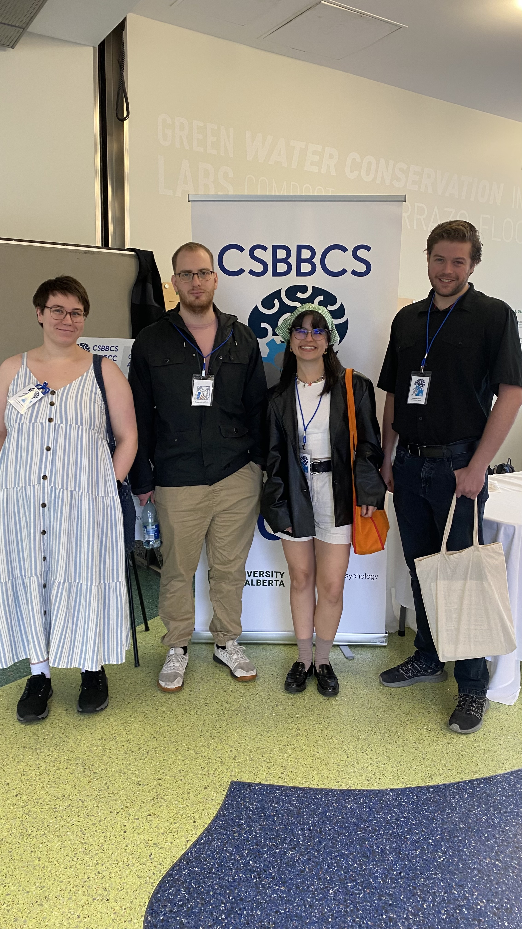
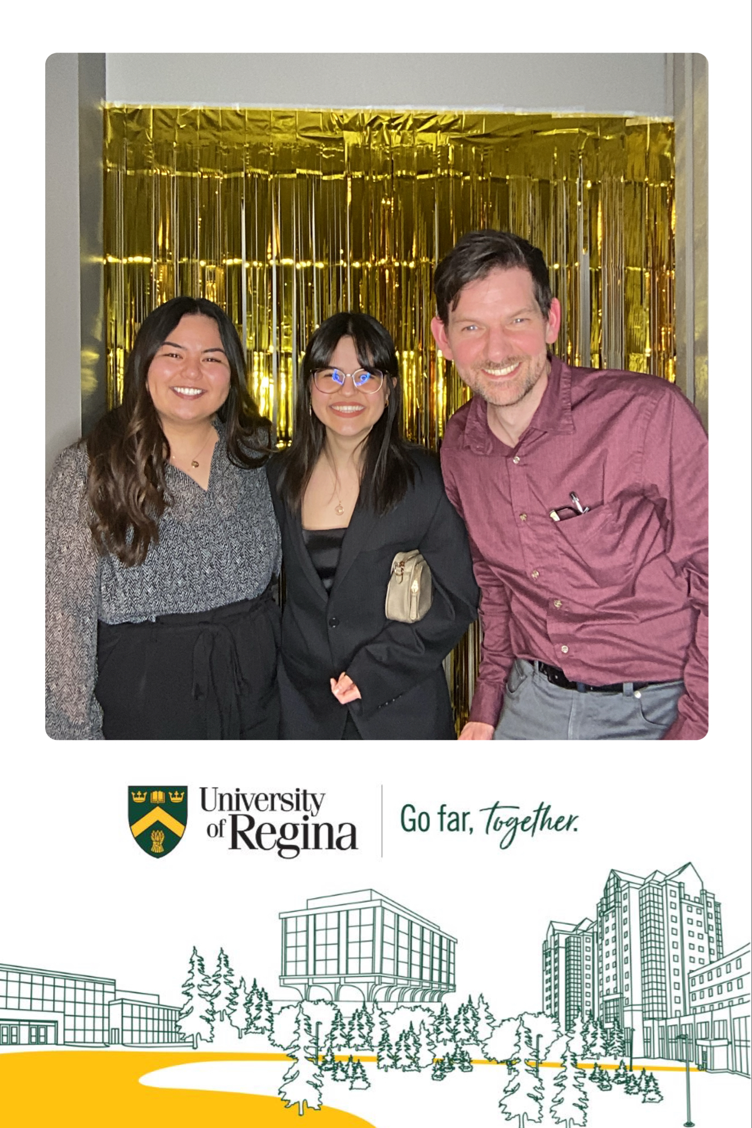


Thank you!

