Slide 1
How to make Tool

Slide 2


Slide 3
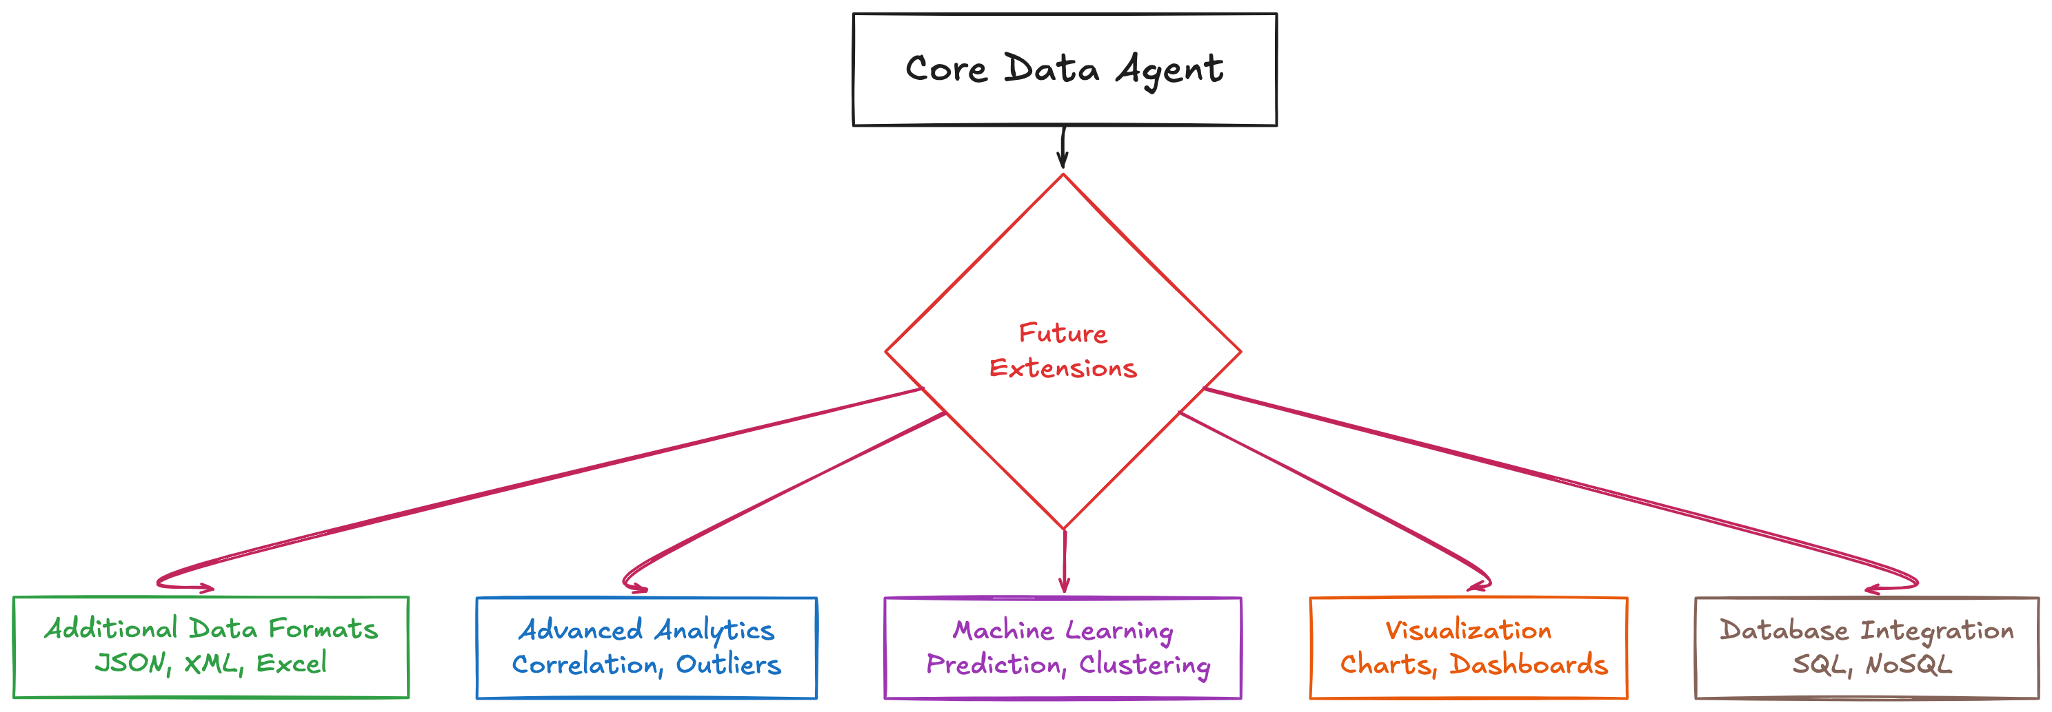

Slide 4
