Slide 1
RecQ1 NSC TSA Data 03/09/22 - Matthew Tippin

Slide 2
NCS Hits
Total +ve ΔTm Hits | 0.5°C(ΔTm) | 1°C(ΔTm) | 1.5°C(ΔTm)
5/40 | 3 | 2 | 0
12.5% | 7.5% | 5% | 0%

Slide 3
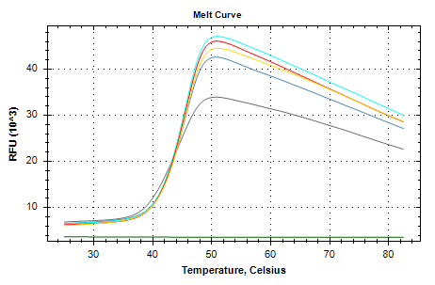
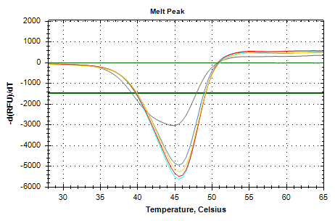
AMP Control (500uM Final)
Control Tm=45.0C
Tm°C | ΔTm°C
45.5 | 0.5
45.5 | 0.5
45.5 | 0.5
Grey Line: apo protein + DSMO control
Green Line: Dye + compound, no protein control
AMP
ΔTm=0.5C

Slide 4
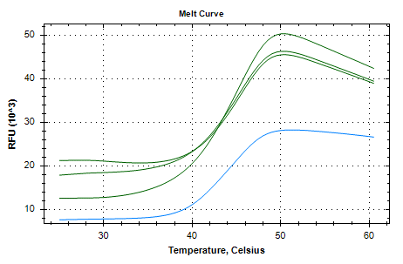
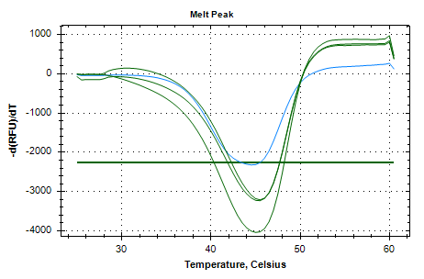
NSC 84100 (1mM Final)
Control Tm=44.5C
Tm°C | ΔTm°C
45 | 0.5
45.5 | 1
45.5 | 1
Blue Line: apo protein + DSMO control
NSC 84100 ΔTm=0.83C

Slide 5
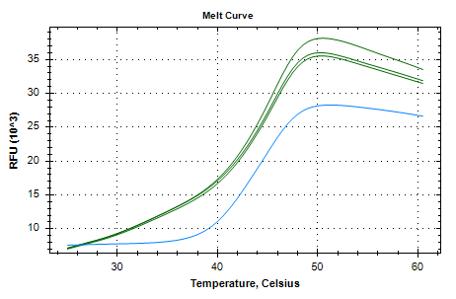
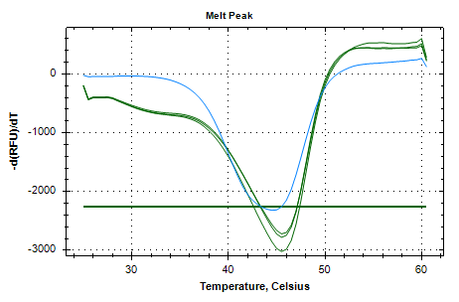
NCS 91529 (1mM Final)
Control Tm=44.5C
Tm°C | ΔTm°C
45.5 | 1
45.5 | 1
45.5 | 1
Blue Line: apo protein + DSMO control
NSC 91529 ΔTm=1C

Slide 6
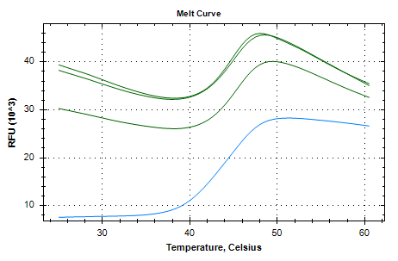
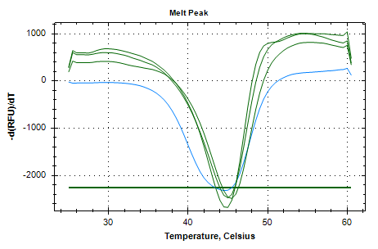
NSC 122819 (1mM Final)
Control Tm=44.5C
Tm°C | ΔTm°C
45 | 0.5
45 | 0.5
45.5 | 1
Blue Line: apo protein + DSMO control
NSC 122819
ΔTm=0.67C

Slide 7
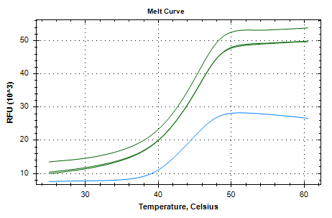
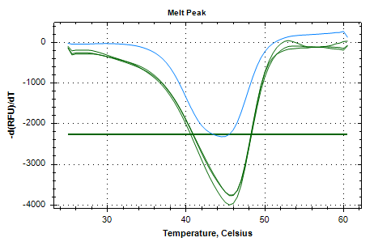
NSC 142335 (1mM Final)
Control Tm=44.5C
Tm°C | ΔTm°C
45.5 | 1
45.5 | 1
45.5 | 1
Blue Line: apo protein + DSMO control
NSC 142335
ΔTm=1C

Slide 8
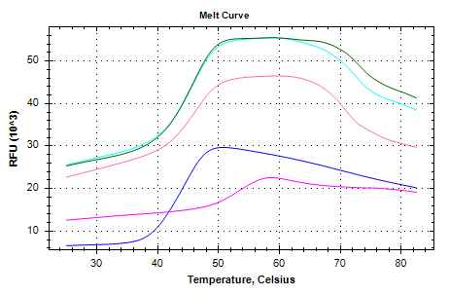
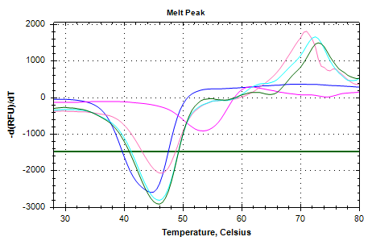
NSC 319990 (1mM Final)
Control Tm=45.0C
Tm°C | ΔTm°C
46.5 | 1.5
46.0 | 1.0
46.0 | 1.0
Blue Line: apo protein + DSMO control
Pink Line: Dye + compound, no protein control
NSC 319990 ΔTm=1.167C

Slide 9
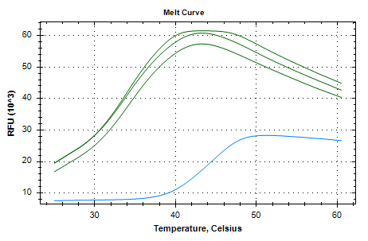
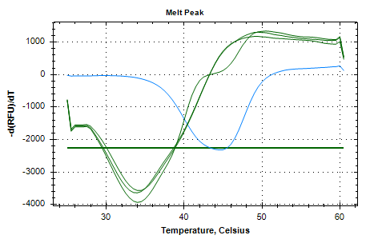
NSC 127133 (1mM Final)
Control Tm=44.5C
Tm°C | ΔTm°C
34 | -10.5
34 | -10.5
34 | -10.5
Blue Line: apo protein + DSMO control
NSC 127133
ΔTm=-10.5C

