Slide 1
Particle Filtering for Localization
Information Processing In Autonomous Systems
Yarin Hausler

Slide 2
Abstract
Particle filtering is a powerful probabilistic method for state estimation in dynamic systems. In this presentation, we investigate the application of particle filtering for localization of an agent in a beacon-based environment. We present a perception algorithm, specifically, an adaptive particle filter, that effectively estimates the agent's whereabouts in the field.

Slide 3
Introduction
The goal of this study is to design a perception algorithm that enables an agent to estimate its location in a field containing beacons with known coordinates. The agent's perception is limited to a proximity sensor and an odometer, and it lacks knowledge of its true location. We propose to implement a particle filtering algorithm to estimate the agent's state, known as adaptive particle filtering, which adjusts the number of particles based on the effective sample size. The effectiveness of the algorithm is assessed through simulation and analysis.

Slide 4
The Real World
The real world is a Euclidean plane within which the beacons are located. It is represented by the set of beacon locations together with the coordinates A and B, representing the terminal points of a trajectory to be followed by the agent. The shape of the path itself is not that important, and so are the locations of the terminal points, but it must pass nearby at least 50% of the beacons. The beacon coordinates, the real numbers, (Xi, Yi), i = 1,…,Nb, are independently drawn from a uniform density over a rectangular region with the corners (0, 0) and (EndX, EndY).

Slide 5
The World Perceived by the Agent
The agent state at time k, denoted z_k, is its instantaneous location in the real world, i.e., some point along the trajectory you have generated for it. The agent itself is unaware of its actual location and so it tries to estimate it using nearby beacon locations. The agent perceives the world only through its sensors, a very limited proximity sensor and an odometer. In addition, it is provided with the set of beacon locations (X_i, Y_i) and their identities. The proximity sensor is able to identify a beacon and measure its distance from the agent. Its reading is a set of beacon identifiers and their measured distances beacon_distance within a radius of 2 from the actual agent's location.

Slide 6
Perception (Information Fusion) Algorithm
The information fusion, or estimation, algorithm is a particle filter aimed at estimating the agent's state, z_k, based on the set of nearby beacons up to time k. To implement the particle filter, we first need to perform a several steps:
Prediction
Update
Likelihoods calculation
Resampling / ESS
Estimation

Slide 7
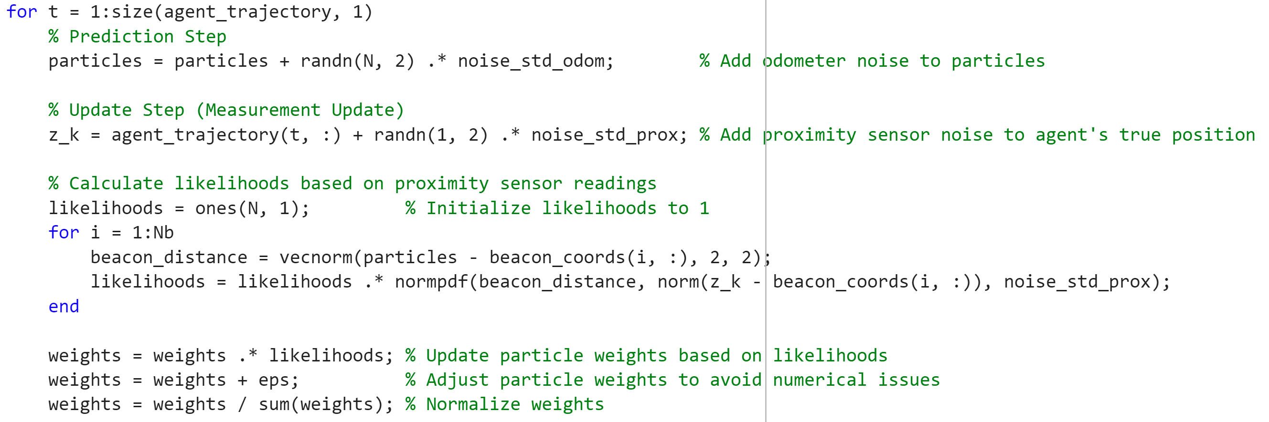
Pseudo-Code for Particle Filtering Algorithm

Slide 8
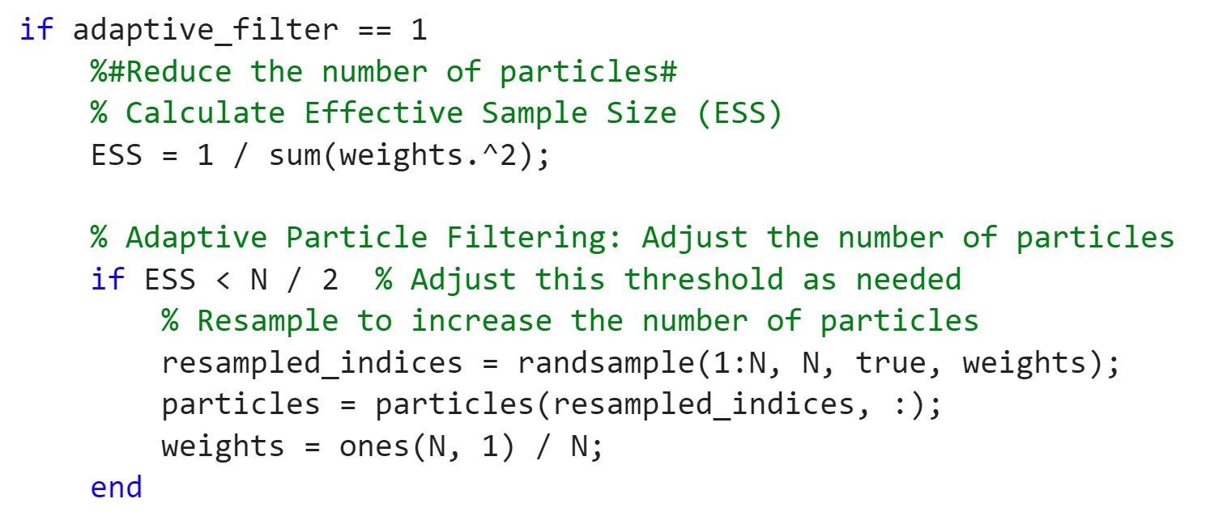
Pseudo-Code for Particle Filtering Algorithm

Slide 9
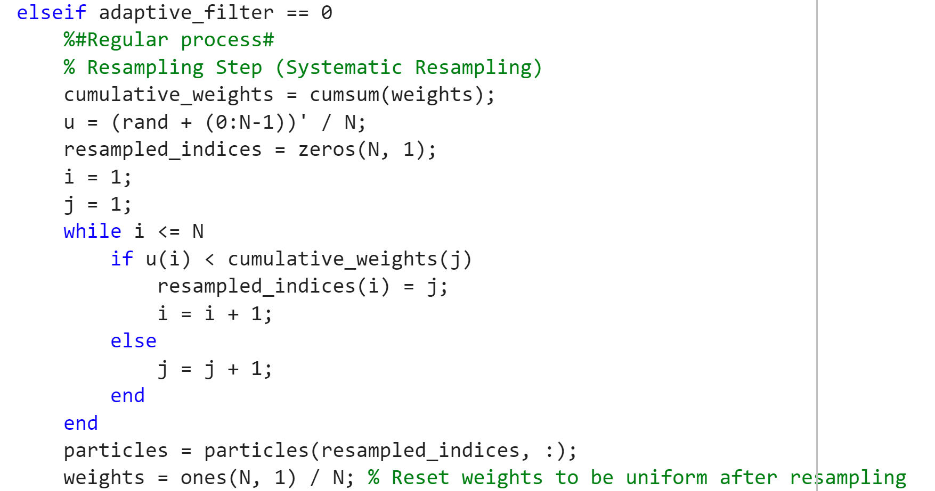
Pseudo-Code for Particle Filtering Algorithm

Slide 10
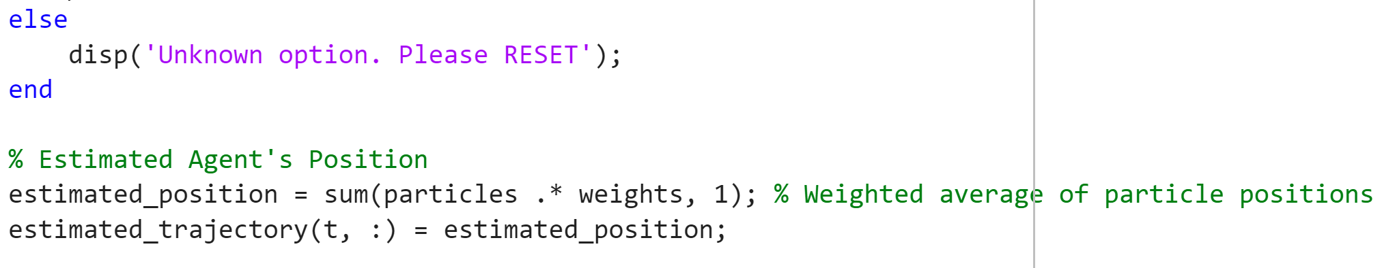
Pseudo-Code for Particle Filtering Algorithm

Slide 11
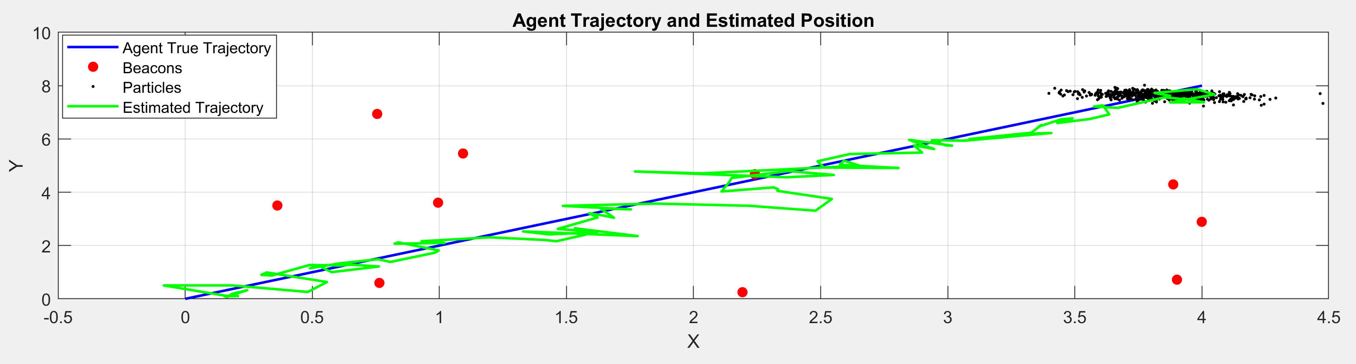
The Effect of the Number of Particles
Agent trajectory and Estimated position (1000 particles, 10 beacons, end at [4,8]):
Total MSE: 0.07

Slide 12
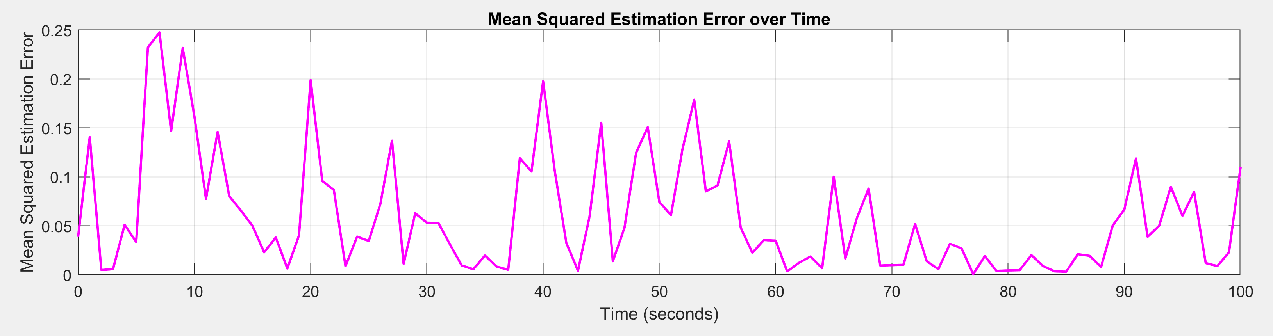
The Effect of the Number of Particles
Mean squared estimation error over time (1000 particles, 10 beacons, end at [4,8]):
Total MSE: 0.07

Slide 13
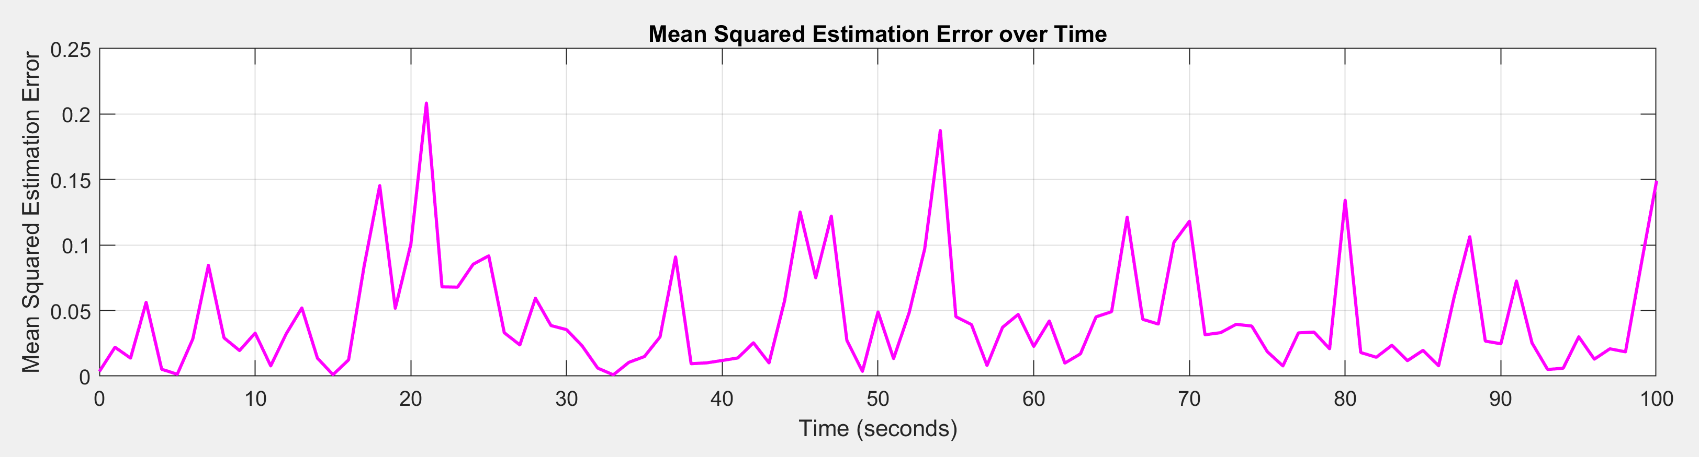
The Effect of the Number of Particles
Mean squared estimation error over time (2000 particles, 10 beacons, end at [4,8]):
Total MSE: 0.045

Slide 14
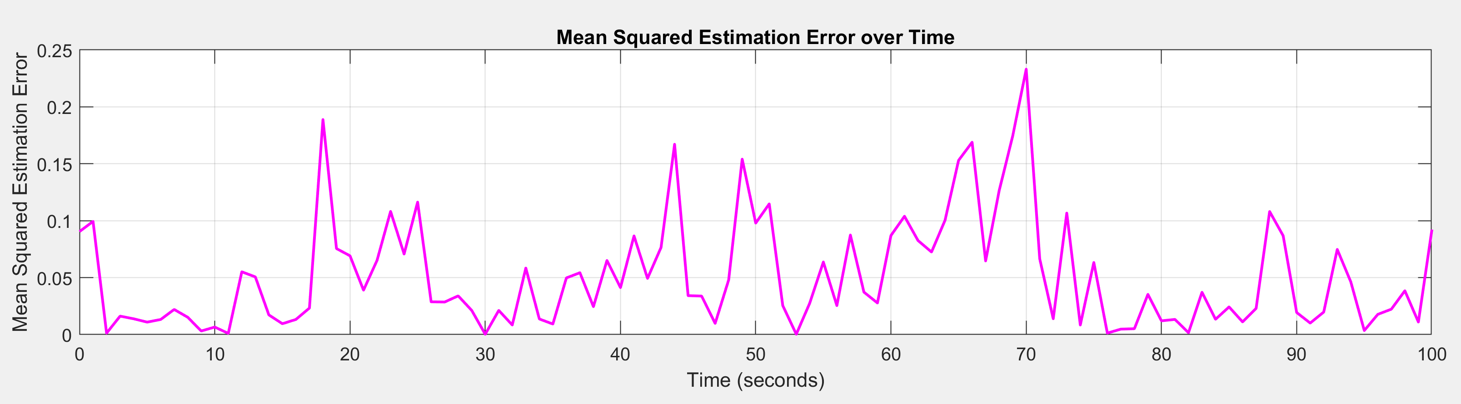
The Effect of the Number of Particles
Mean squared estimation error over time (4000 particles, 10 beacons, end at [4,8]):
Total MSE: 0.05

Slide 15
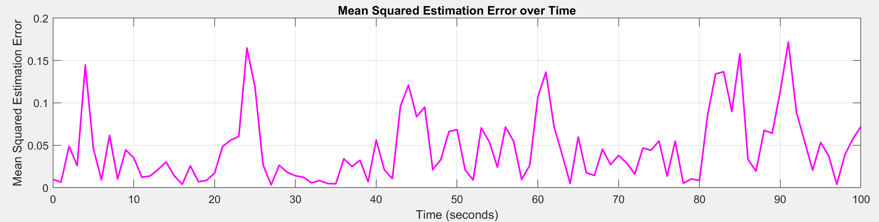
The Effect of the Number of Particles
Mean squared estimation error over time (8000 particles, 10 beacons, end at [4,8]):
Total MSE: 0.04

Slide 16
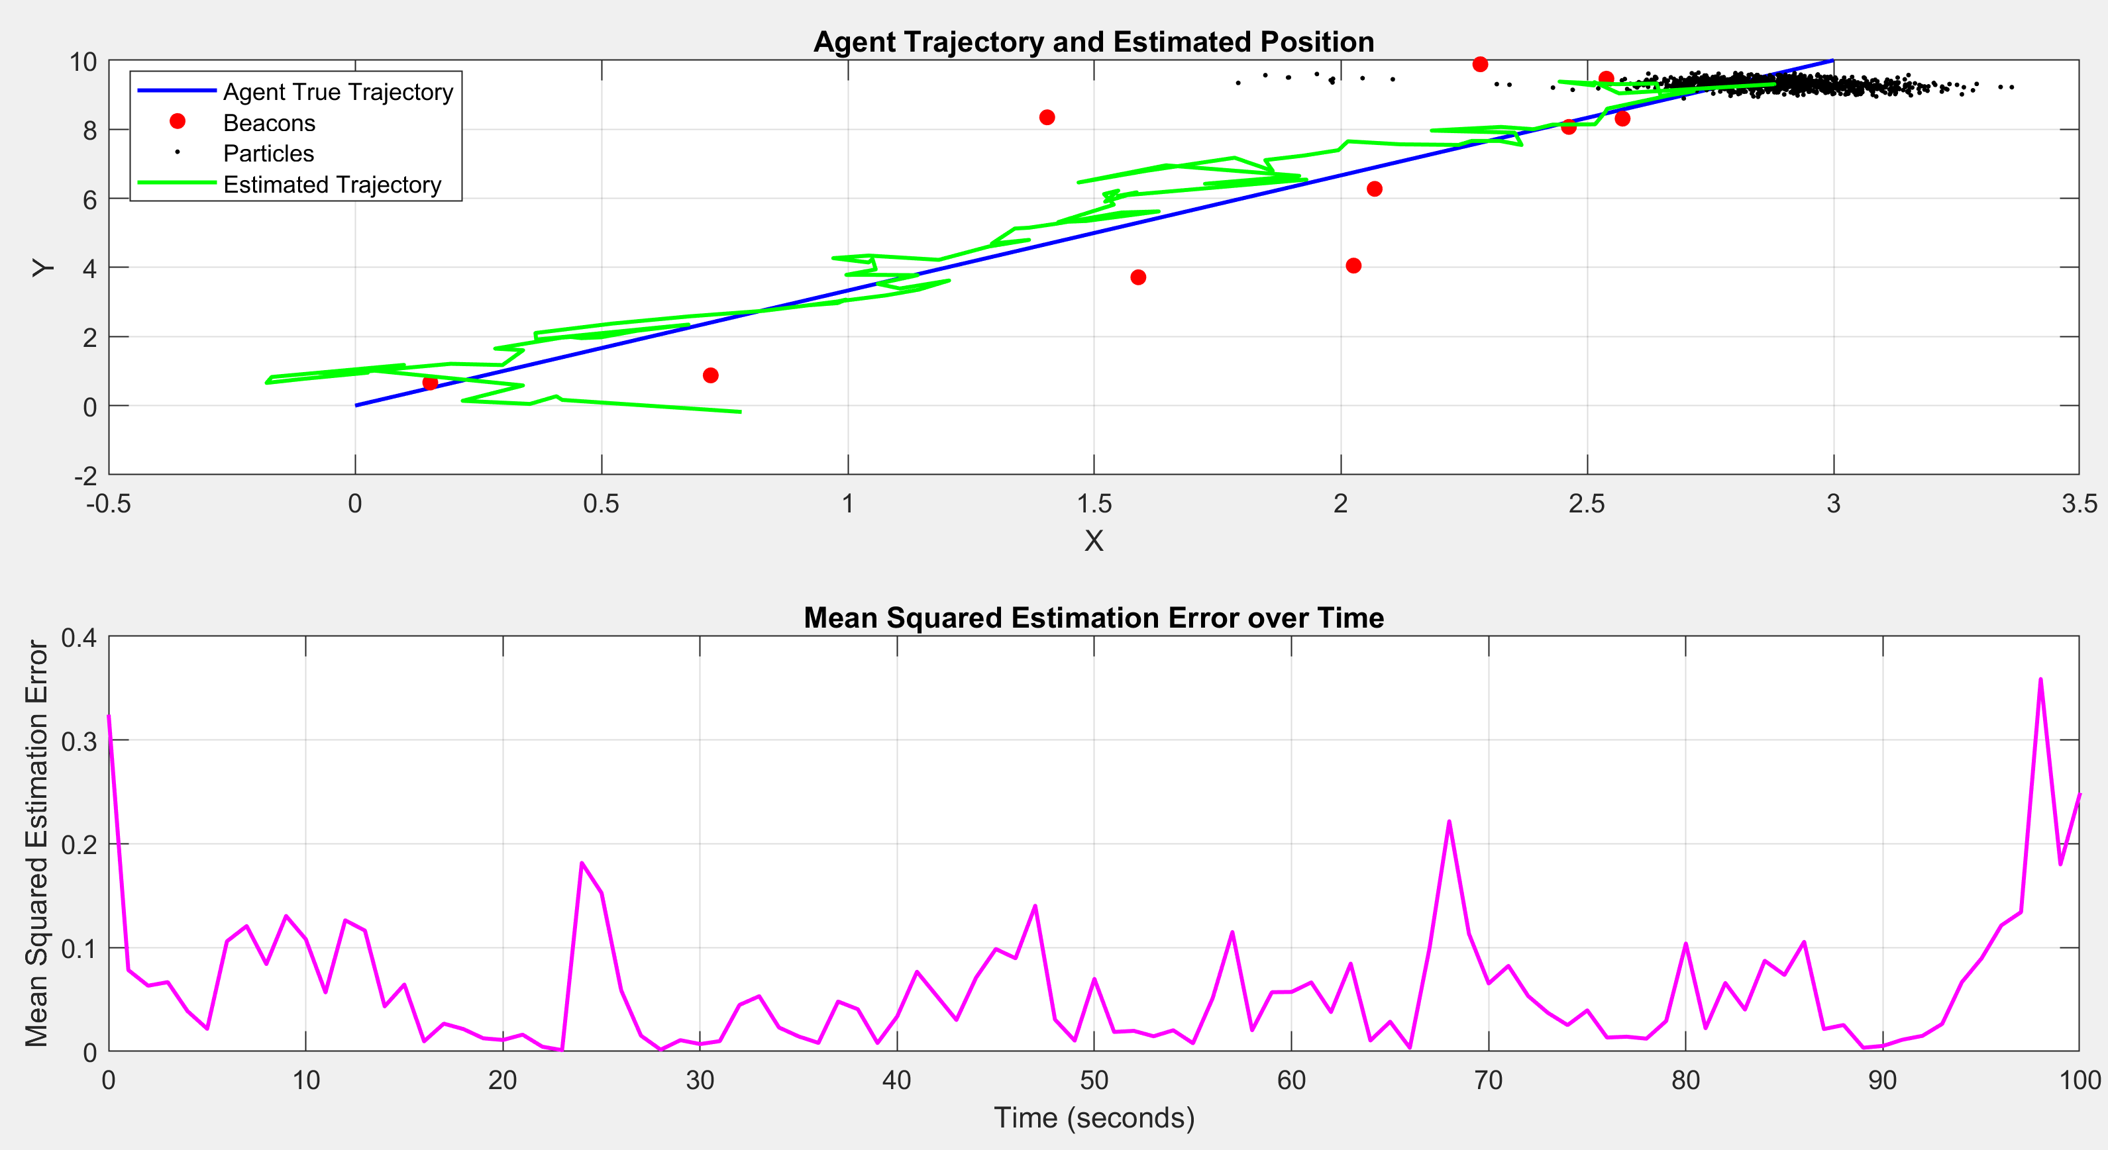
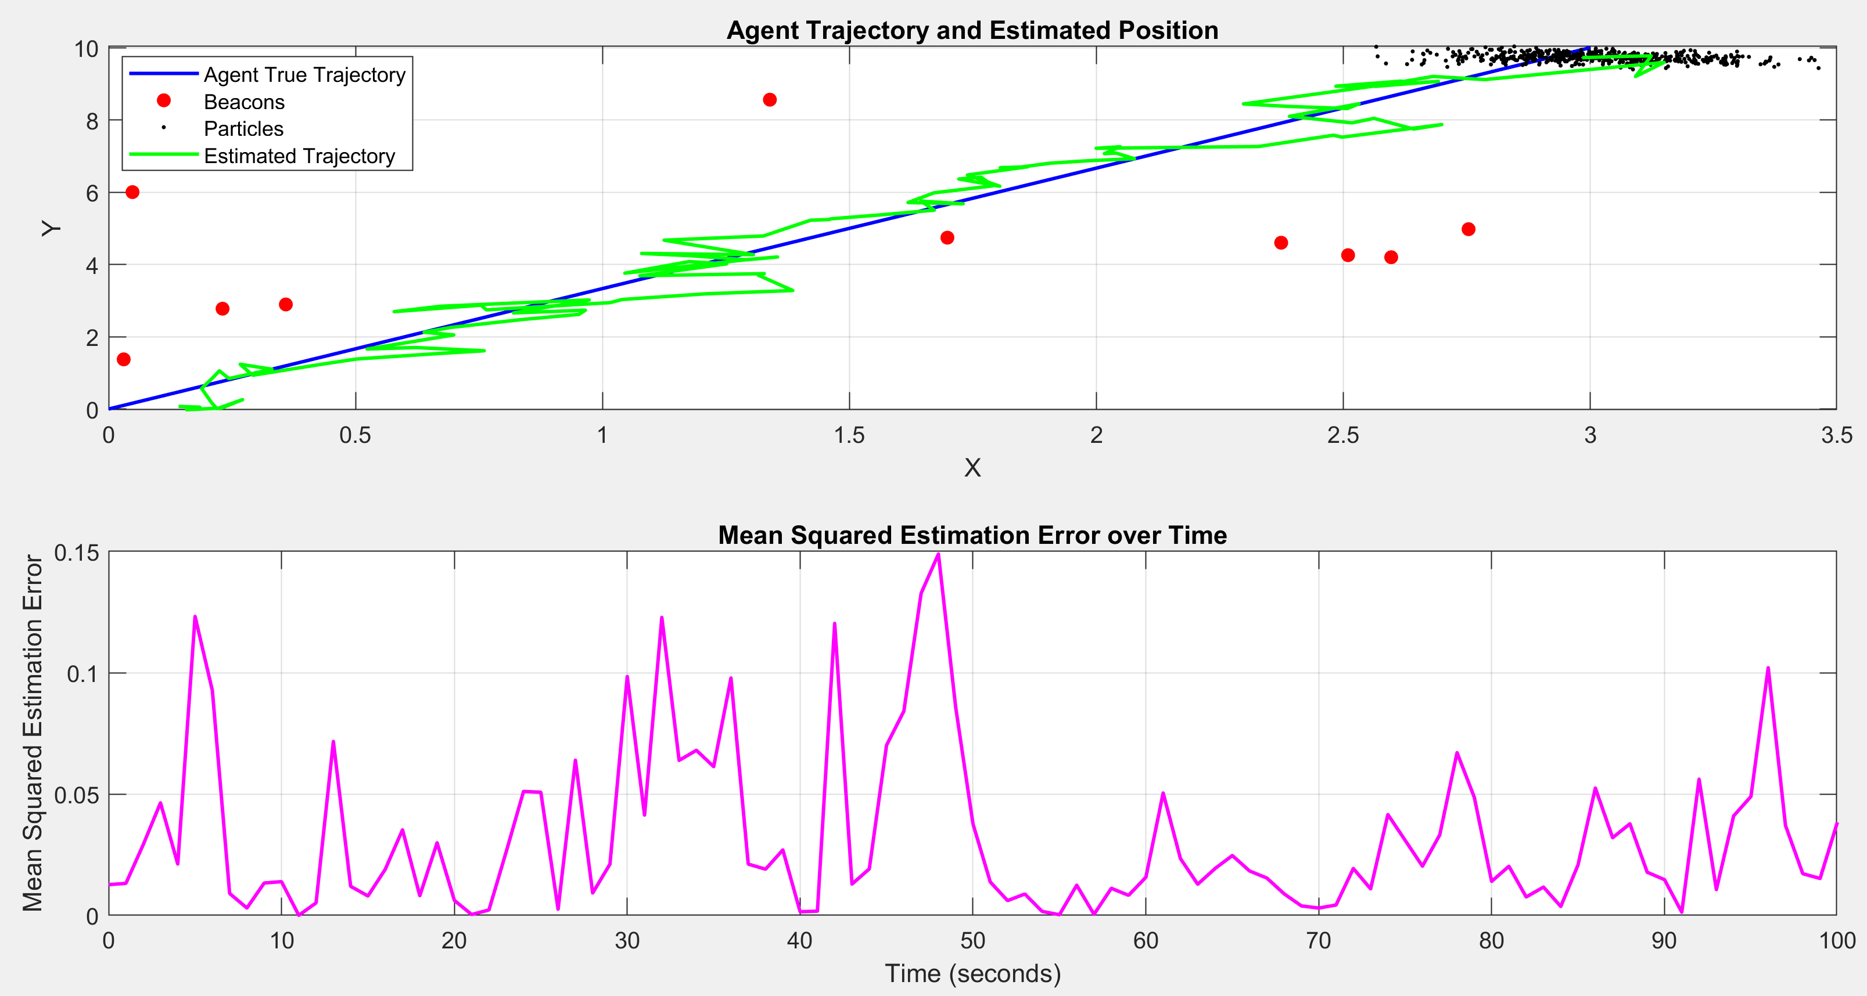
The Effect of the ESS
Agent trajectory and Estimated position (1000 particles, 10 beacons, end at [3,10]):
ESS ‘OFF’: Total MSE = 0.062 ESS ‘ON’: Total MSE = 0.0324

Slide 17
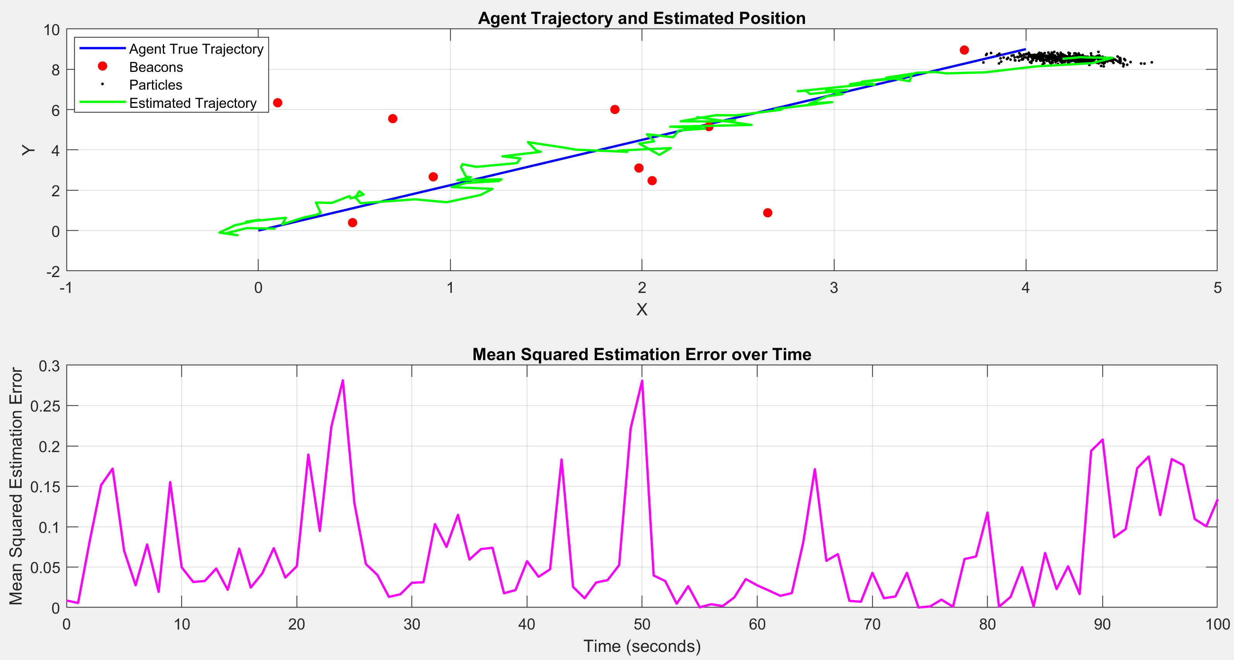
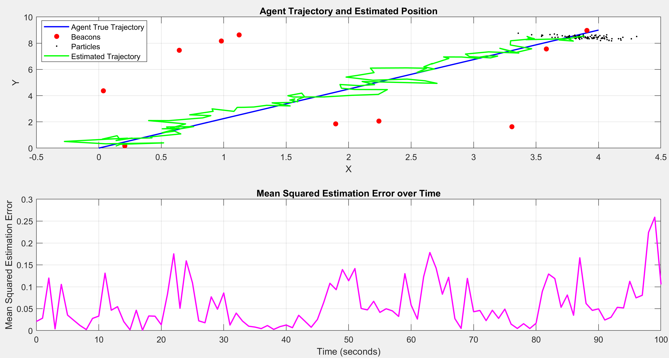
The Effect of the ESS
Agent trajectory and Estimated position (1000 particles, 10 beacons, end at [4,9]):
ESS ‘OFF’: Total MSE = 0.0679 ESS ‘ON’: Total MSE = 0.0594

Slide 18

Thank You!

