Slide 1
🎵
VibeMatch AI
A Music Recommendation System Powered by RAG + Claude
CodePath AI110 · Applied AI Systems Project
github.com/yarinacs/applied-ai-system-project

Slide 2
The Problem With Old-Style Recommenders
Old approach (Module 3)
VibeMatch AI
• Fill in a form: genre, mood, energy
• System matches on exact labels
• No understanding of what you mean
• Same inputs → same outputs, always
• Type: "chill for late-night studying"
• System understands the intent
• RAG retrieves semantically similar songs
• Claude explains why it picked that song
→

Slide 3
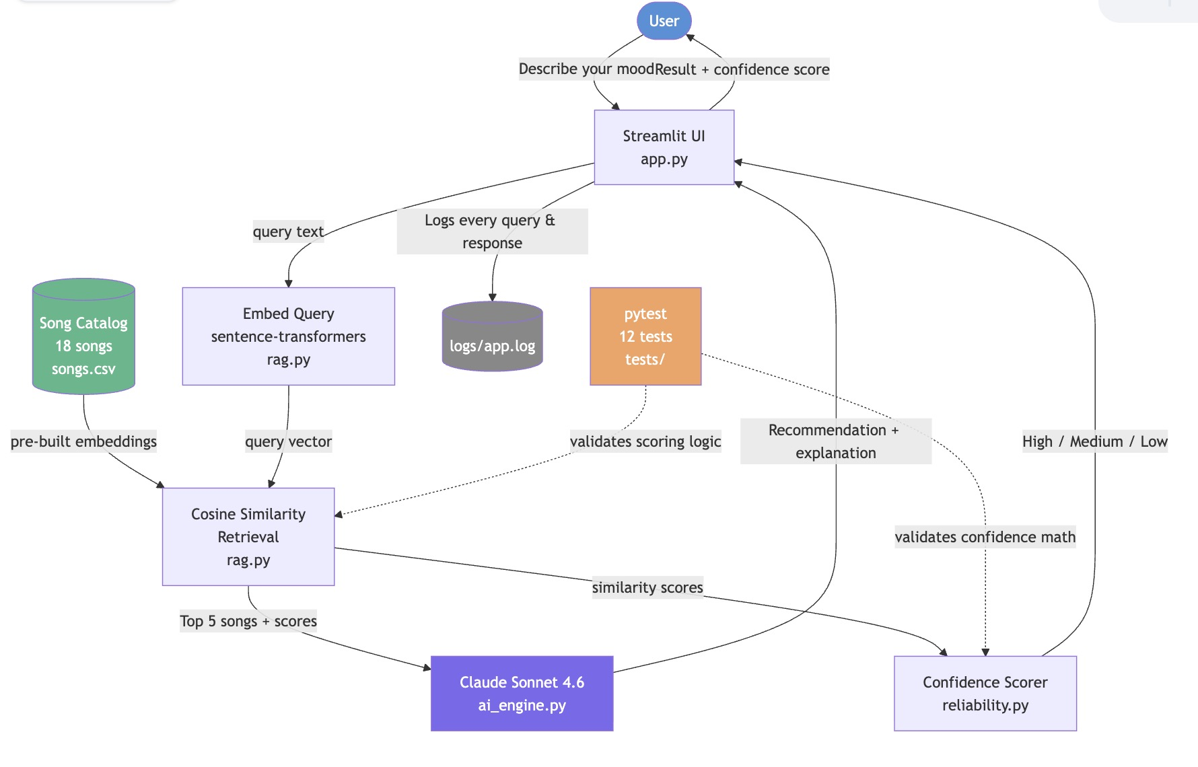
System Architecture
1
Query → vector embedding
2
RAG retrieves top 5 songs
3
Claude picks best match
4
Confidence score shown

Slide 4
Live Demo
3 queries — watch how behavior changes
Query 1
"something chill and focused for late night studying"
→ Focus Flow · High confidence · YouTube autoplays
Query 2
"high energy upbeat song for a morning run"
→ Pulse Horizon · High confidence · 0.95 energy, 140 BPM
Query 3
"music" (intentionally vague)
→ Low confidence · similarity scores all cluster together
Tip: open the RAG expander to see exactly what Claude was given

Slide 5
What I Learned
🔍
Generation is only as good as retrieval
When Claude got the right songs, answers were specific and accurate. Weak retrieval = weak recommendation — Claude was never the bottleneck.
📊
The confidence score was real signal, not decoration
Vague queries → clustered similarity scores → Low confidence. Specific queries → spread scores → High confidence. It actually worked.
⚡
AI systems need graceful degradation
Anthropic credits ran out mid-project. Built a Gemini 2.0 Flash fallback on the spot — app never went down.

Slide 6
Portfolio
github.com/yarinacs/applied-ai-system-project
"This project shows that I care about building AI systems that are honest about what they're doing. I didn't just connect a language model to an input box — I built a retrieval layer that grounds every recommendation in real data, added a confidence score that tells users when the system is uncertain, and made the intermediate steps visible so anyone can see what the AI was given before it answered. Throughout this project I was drawn to the questions around transparency and reliability — not just 'does the AI answer?' but 'does the user understand why, and can they trust it?' That instinct is what I want to bring to every AI system I build."
Thank you · Questions?

