Slide 1
TEACHING PSYCHOLOGY:
VIEWS FROM AROUND THE WORLD
Victor Karandashev,
Leningrad State University, Russia,
and Grand Valley State University, USA

Slide 2
Retrospective of International Endeavours in the Field of Teaching Psychology

Slide 3
Retrospective of International Endeavours in the Field of Teaching Psychology
1. Until 1990-s years of 20 century, little research has been devoted to examining the teaching of psychology from international perspective
2. 1990-1999 was a period when many publications began to shed light on the national practices in teaching and training in psychology
3. The edge of 20th Century and 21th Century have witnessed the more global and more purposeful coverage of the topic in publications and research projects

Slide 4
1990-1999: journals
was a period when many publications began to shed light on the national practices in teaching and training in psychology:
The Annual Review of Psychology
The American journal Teaching of Psychology
Psychology Teaching Review, a journal published by the British Psychological Society
In 1998, a special issue of the journal Psychology Teaching Review
News from EFPPA, the newsletter published by the European Federation of Professional Psychologists' Associations

Slide 5
1990-1999: edited books
More systematic attempts to provide international overviews of psychology appeared in edited books:
Gilgen and Gilgen (1987),
Sexton and Hogan (1992),
Schorr and Saari's (1995)
Stevens and Wedding (2004)

Slide 6
1990-1999: general reviews of teaching psychology
Lunt and Poortinga (1996),
Newstead and Makinen (1997)
provided general reviews of teaching psychology in European countries

Slide 7
The edge of 20th Century and 21th Century
The edge of 20th Century and 21th Century have witnessed the more global and more purposeful coverage of the topic in publications and research projects
Several international projects have been initiated to study more about teaching and training in psychology

Slide 8
Continental initiative projects
The European Federation of Professional Psychologists Associations (EFPPA):
Task Force and initiated the evaluation of the psychology curriculum (Stephen Newstead, UK, - convener)
European Framework for Psychologists’ Training (Ingrid Lunt, UK, - the project leader)

Slide 9
Continental initiative projects, cont’d
American Psychological Association: Psychology Partnerships Project (P3): Academic Partnerships to Meet the Teaching and Learning Needs of the 21st Century
One of the partnership programs was entitled Teaching a Global Psychology: International Faculty and Student Dialogue Project. Organizers/Leaders were Frank Hollingsworth, Sherri McCarthy, Samuel Cameron and Victor Karandashev

Slide 10
Global comparative projects and initiatives
At the beginning of the 21st century, not only continental but also global comparative projects and initiatives came to life.
They advanced both undergraduate and graduate psychology teaching.
Doctoral training attracted particular attention.

Slide 11
A survey of training programs in 16 countries/regions on six continents found significant variation in training, minimal qualifications, and roles of the professional psychologist (Burgess, et all, 2004).
The authors recommended that an international group of psychologists develop a regionally flexible but common training curriculum and qualification that would include a five- to six-year competency-based certification for psychologists.

Slide 12
A series of international conferences on psychology education and teaching of psychology started at the onset of 21th Century and have had success in the first two conferences
Two prominently noticeable publications have appeared as their productive results

Slide 13
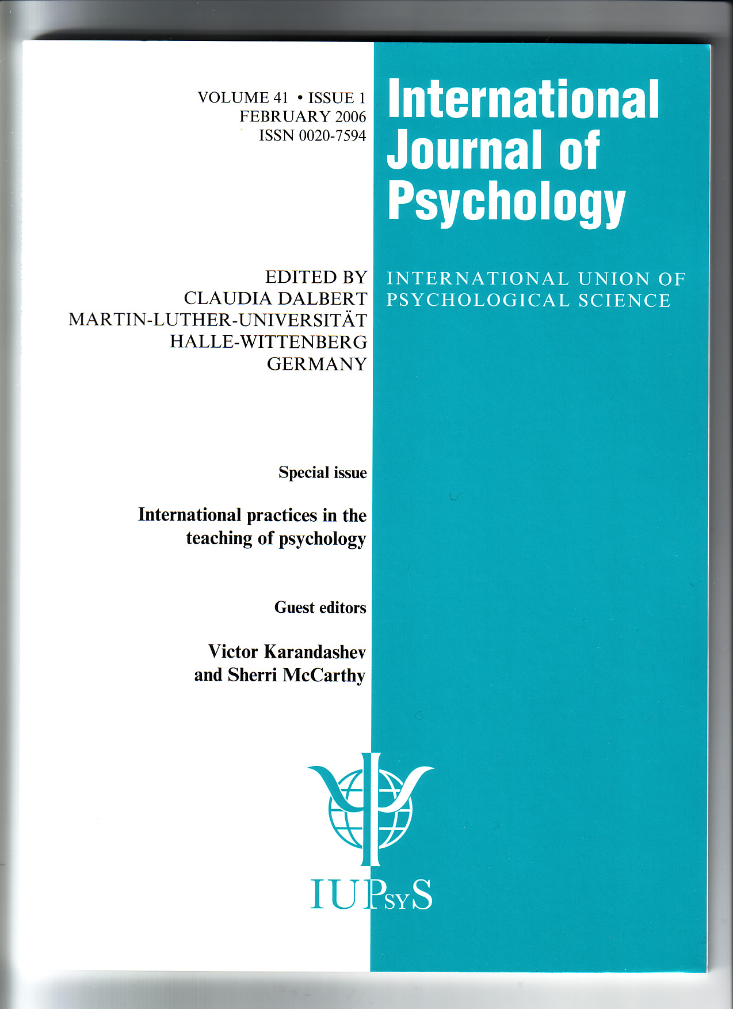
The International Journal of Psychology, flagship of IUPsyS, published a special issue International Practices in the Teaching of Psychology
Information from several countries, including China, Australia, Greece, Iran, the Philippines, Russia, the U.S., Brazil, Italy and Germany was presented (Karandashev & McCarthy, 2006).

Slide 14
In 2007 the book Teaching Psychology around the World edited by Sherri McCarthy, Stephen Newstead, Victor Karandashev, Carlo Prandini, Claudio Hutz, and William Gomes was published by Cambridge Scholars Publishing.
http://www.c-s-p.org/Flyers/Teaching-Psychology-around-the-World.htm

Slide 15
International Overview of Psychology Teaching

Slide 16
The goals, length, structure and content of higher education in different countries are quite dependent on:
(1) national systems of public education, which vary greatly from country to country;
(2) historical traditions;
(3) levels of development of higher education and number of universities;
(4) status of higher education;
(5) availability and quality of private universities;
(6) economic factors and
(7) sociopolitical factors

Slide 17
The two major aspects of psychology teaching are:
Curriculum: WHAT should we teach
Teaching methods: HOW should we teach
Curriculum tends
(a) to be more interesting to psychologists and
(b) to be more international (dependent on the nature of psychology as science and profession).
Teaching methods tend
(a) to be more interesting to educators and
(b) to be more national (dependent on national educational legislation)

Slide 18
What are the typical models of higher education in psychology internationally?

Slide 19
Structures of higher education may be continuous or discontinuous
A common model of higher education in many countries – Germany, Switzerland, France, Russia - has been, until now, a 5-year undergraduate degree program.
Universities organized along a discontinuous model — many in the UK, USA, Canada, Australia and Brazil — adhere to a two-level structure of separate undergraduate and graduate schools as opposed to a one-level, continuous organization.
Higher education and training in many countries outside the US and Europe resemble one of those two curricular plans, usually depending on historical ties in political-economic development.

Slide 20
discontinuous model
In discontinuous model, academic education is taken in undergraduate education and professional training in undergraduate education.
Undergraduate programs in universities and colleges are typically intended to give academic degree like a bachelor’s degree or other title for graduates.
Adjustment of higher education for further professional development of graduates usually takes place on the second level of higher education.
  Masters’ and doctorates’ programs are intended for this purpose.
  Training in different types of professional schools also pursues the same goal.

Slide 21
A further expansion of the discontinuous, multi-level model (bachelor’s, master’s and doctorate degrees earned separately) seems to be the current trend.
The Bologna Process implies a transition to the discontinuous model for the European Union by 2010, as well.

Slide 22
Goals of psychology learning
Psychology is applicable in many fields other than just professional practice as a psychologist.
So psychology courses taught by psychology professors become required in many study programs (like teacher education, medical school, business school, environmental science and industrial education)
On the other hand, the instructors of disciplines other than psychology incorporate psychology as a component in their own courses.

Slide 23
Students’ goals for learning psychology can be
  personal,
  educational,
  professional
Psychology appears at different levels of education, giving students flexible opportunities to study psychology depending on their personal, educational and professional goals.

Slide 24
Students may have the different degree of flexibility to construct their own psychology curriculum (depending in the goals of their education)
In some programs, there are compulsory courses. If a student is enrolled in the program, he or she must study all classes which this program requires. The program may be more or less flexible.
In other programs faculty members offer classes to students and they can elect those dependent on their educational and professional interests.

Slide 25
In Russia the compulsory factor is dominant.
In the USA, the elective possibilities are dominant.
In programs of academic education, students have more options to choose the courses which interest them.
In programs of professional training, the more mandatory components occur.

Slide 26
Curriculum development
(Topics of psychology teaching)
In general, topics of psychology courses can be classified into four groups:
  fundamental (basic or core) psychology,
  research methods and statistics,
  applied psychology
  internships, practice placement and service learning.
Students generally study fundamental aspects mostly during the first part of the program and applied topics mostly at the second part of program.

Slide 27
Typical fundamental courses studied in most countries in psychology are
general psychology,
biological psychology,
social psychology,
developmental psychology,
individual differences,
abnormal psychology,
theory and methodology of psychology,
and statistics

Slide 28
Typical applied disciplines studied in most countries in psychology are
clinical psychology,
work and organizational psychology,
educational and school psychology,
counseling psychology.

Slide 29
More and more diverse and specific topics in the field of psychology appear in curriculum, like gender studies, cultural psychology, environmental psychology, musical psychology, psychology of negotiation, eating, advertising, transport and space psychology.
It seems that more and more career areas incorporate a need for the teaching and learning of psychology, so it may be expected that psychology courses applied to various topics, businesses and careers will continue to expand.
The various areas of applied psychology have become very popular among students. Such diverse study within psychology seems very attractive and useful for students

Slide 30
The structure of undergraduate training has more fundamental academic courses and fewer applied courses within the discipline.
Graduate training, in turn, focused only on the discipline of psychology or, more precisely, one of many sub-disciplines within psychology such as counseling, clinical or school psychology.

Slide 31
A multi-level university structure generally focuses on fundamental courses and research methodology at the undergraduate level and applied psychology and internship placement at the graduate level.
In a one-level 5 year structure, introductory (undergraduate) and advanced (graduate) curriculum components are organized within one and the same school or college, usually with significant and flexible interplay between the two.

Slide 32
Regardless of the structure, many hours of applied practice under professional supervision and a thesis, dissertation or capstone project are generally compulsory parts of education required to become a professional psychologist in most of the world.

Slide 33
Scientist vs. Practitioner:
A Controversy in Training
By their tradition, universities strive for the highest scientific standards of training, requiring original, research-based dissertations at the doctoral level.
By the late 1960s in North America and about a decade later in Europe, this training strategy was more and more challenged by growing demands for psychological practitioners prepared to enter professional work in schools and clinics, in private practice and in industry.

Slide 34
Different universities and countries reacted differently to this challenge
Professional Schools of Psychology
  the science-practitioner of the APA, a professional doctorate like the doctor of psychology (Psy.D.)
Two stage model of training
  Such postgraduate programs combine advanced, specialized scientific and practical on-the-job training

Slide 35
Combined-Integrated (C-I) model
The C-I model exposes professional psychology trainees to two or more of the practice areas (i.e., clinical, counseling, school/educational).
The authors argue that the C-I approach is one that is well suited to the development of a global training curriculum due to its emphasis on broadly training psychologists as well as its respect for diversity and integration of various theoretical and professional orientations
  Burgess, G.H., Sternberger, L.G., Sanchez-Sosa, J.J., Lunt, I., Shealy, C.N., & Ritchie, P. (2004).

Slide 36
Conclusions
1. International endeavors continue in various areas of psychology. Interest for internationalization in academic psychology is a long-standing one, while psychology as a profession as well as the teaching of psychology tended to internationalize only in recent years.
  We can see the evidence of this trend in the number of publications on the topic, international comparative projects and conferences.
  As a result, much more information than ever before is available about teaching psychology around the globe.

Slide 37
Conclusions
2. It appears that, at present, teaching of psychology in various countries is mostly national in terms of structure and methods of teaching, but more international in terms of curriculum and content.

Slide 38
Conclusions
3. Multilevel teaching of psychology is becoming a more prevalent trend in many countries.

Slide 39
Conclusions
4. Diversity of psychology courses and popularity of applied psychology course are growing internationally

Slide 40
Conclusions
5. Psychology curriculum development internationally has a lot in common.
(a) fundamental (basic or core) psychology,
(b) research methods and statistics,
(c) applied psychology, and
(d) placement and service learning, constitute four basic components of psychology education.

Slide 41
Conclusions
6. Even though psychology education throughout the globe traditionally strives for the highest scientific standards of teaching in an academic sense, this training strategy has been challenged by growing demands for psychological practitioners prepared to enter professional work in schools and clinics, in private practice and in industry, so specialized science-practitioner curricula have also been set up at many universities all over the world.

Slide 42
In the final conclusion,
it is not easy to understand the ways in which psychology is taught in countries other than one’s own
Some features of other national educational system which originated historically may look strange and wrong
However it is an opportunity to take a different perspective.
At first glance, the system of teaching psychology in another country may seem a little bit strange simply because it is less familiar and not so habitual.
But in any case, I believe that new ideas in education are very often born out of the merging of paths and views across systems.
So these are the benefits and promises of continuing our international endeavours in the teaching of psychology and gathering views from around the world.

