Slide 1
Globalizing the Psychology Undergraduate Curriculum: The Role of the Institute for International and Cross-Cultural Psychology
Uwe P. Gielen
Institute for International and
Cross-Cultural Psychology
St. Francis College
New York City
Third International Conference on Teaching of Psychology, St. Petersburg, Russia, July 12-16, 2008

Slide 2
Contents
What is Global Psychology?
Definitions of Global Psychology, International Psychology, Cross-Cultural Psychology
St. Francis College
Institute for International and Cross-Cultural Psychology (IICCP)
Mission of IICCP
Characteristics of IICCP
Student Involvement
Psychology and Honors Courses
IICCP Events – Academic Year 2007-2008
Selected Research and Publication Projects
Characteristics of Projects
Conclusion

Slide 3
What is Global Psychology?
Global Psychology focuses on the worldwide enterprise of psychology in terms of communication and networking, scholarship, practice, and pedagogy. It seeks to broaden the scope of collaboration among psychologists and psychology students; advocate committed involvement in international psychology and policy-making organizations; support theorizing and research at the international level and across diverse countries and cultures; sensitize investigators to the hazards of implicit ethnocentric bias; promote responsible psychological practice conducive to human welfare; develop broadly acceptable ethical codes for professional conduct; and create psychology curricula that meet the needs of a culturally, economically, and politically diverse but rapidly shrinking world community.

Slide 4
Definitions
Global Psychology: Worldwide investigation of global issues from psychosocial and psychocultural points of view.
International Psychology: Investigates emergence and practice of psychology in different parts of the world.
Cross-Cultural Psychology: Comparative study of behavior and mental processes in different cultures.

Slide 5
St. Francis College
Located in Brooklyn Heights, New York City
Commuter college
Predominantly an undergraduate institution
2,300 students; 8%-9% of them psychology majors
Many students come from working class and immigrant families; moderate number of foreign students
“In the Catholic tradition” but not church-affiliated

Slide 6
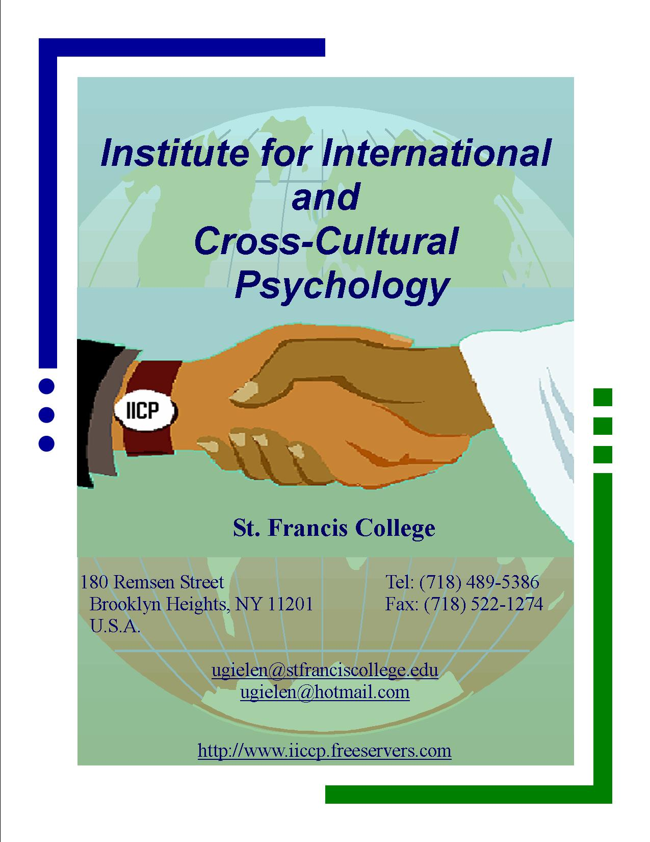

Slide 7
Mission of IICCP
IICCP was founded on March 6, 1998. Its core mission is to foster the globalization of the science of psychology. This translates into the following objectives at the international and local levels:
to promote cross-cultural awareness at St. Francis College by developing classes, workshops, symposia, and conferences;
to involve students in cross-cultural research;
to foster a sense of appreciation of the cultural richness in the St. Francis College community. Members of the institute are active locally, nationally, and internationally.
to sponsor research and publications in global, international, and cross-cultural psychology;
to create a network of ties with other interested psychological institutions in the US and abroad;

Slide 8
Characteristics of IICCP
Aims at college-wide impact
Interdisciplinary: Seeks to anchor psychology as a linkage discipline
Works together with several departments and programs (e.g., Sociology, International Cultural Studies, Fine Arts, Women’s Center, Honors Program)
Makes opportunistic use of resources; takes advantage of members’ relationships with colleagues at other departments and institutions; is pragmatically oriented toward what is possible at a small commuter college
Appeals to students’ desire for community across ethnic, national, and religious boundaries

Slide 9
Student Involvement
Students play an important role in the activities of the institute. Each semester, two student assistants help to keep the institute going by editing papers, proof-reading chapters and articles for professional journals, involvement in research activities, marketing events, helping to set up guest lectures and conferences, and advising students about psychology. Members of the Psi Chi Chapter and the Psychology Club also lend their support to the institute.

Slide 10
Psychology and Honors Courses
Emphasizing Cross-Cultural and Global Perspectives
PSY 3380 / ICS 3380 – Cross-Cultural Psychology and Communication
PSY 3370 / SOC 3370 – Gender Roles in Cross-Cultural Perspective
PSY 4003 – Seminar in International Psychology
PSY 4006 – Seminar: Multicultural Counseling and Healing
PSY 4470 – Seminar in Multicultural Psychology
PSY 4470 – Seminar: Culture, Therapy, Counseling, and Healing
PSY 4470 – Seminar: The Human Life Cycle in Cross-Cultural Perspective
PSY 3352, 3353 /REL 3352, 3353 – Images of Human Nature in Western, Non-Literate and Eastern Cultures: An Interdisciplinary Honors Seminar I, II
HON 5101 – Gender Roles: A Global Perspective (Freshmen Honors Seminar)

Slide 11
IICCP Events – Academic Year 2007-2008
October 1, 2007 - Frank Greene: Berlin: Its Architectural Heritage (cosponsored with Department of Fine Arts, Foreign Languages, and International Cultural Studies)
October 15, 2007 - Uwe P. Gielen: Travels in East Germany (cosponsored with Department of Fine Arts, Foreign Languages, and International Cultural Studies)
November 9-10, 2007 - Conference: Internationalizing the Psychology Curriculum (many presentations by APA Division 52 members)
November 19, 2007 - Brooklyn Baroque: Music at the Court of Frederic the Great, King of Prussia (introduction by Suzanne Forsberg; cosponsored with Department of Fine Arts, Foreign Languages, and International Cultural Studies)
January 3-February 2, 2008 - Photo Exhibition: Psychologists in Focus: Seeing Global Diversity, Photographs by Psychologists. Director: Joel Morgovsky (Brookdale Community College)
March 27, 2008 - Carol Bellamy (President and CEO, World Learning): Women and Children – Global Health’s Challenge (Cosponsored with SFC Women’s Center)

Slide 12
IICCP Events – Academic Year 2007-2008
March 28, 2008 - Tenth Anniversary of IICCP: Speakers: Carola Suárez-Orozco (New York University): Moving Stories: Immigrant Children Learning a New Land; Uwe P. Gielen (St. Francis College) and Ting Lei (CUNY): Growing into Adulthood in New York Chinatown; Reception and Dinner
April 7-11, 2008– Educational Faculty and Student Exchange Delegation, Sheffield Hallam University, UK (with Department of Sociology and Criminal Justice)
April 13, 2008 - Eleventh Annual Community Day, an international festival of prayer, music, dance, poetry, art, and cuisine
April 18, 2008 - Alan Astro (Trinity University, Texas): Yiddish Poetry of the Holocaust (Cosponsored with the Department of Sociology and Criminal Justice, the Eastern European Club, and College Relations)
May 2008– Visit of Professor Jasem Al-Khawajah (Kuwait University)

Slide 13
Selected Research and Publication Projects
Chinese-American Immigrant Adolescents and Emerging Adults in New York City
Principles of Multicultural Counseling and Therapy (Book Project)
Women around the World: Psychosocial Perspectives (Book Project)
Conversations with International Psychologists (Book Project)
International Psychology – What Students Need to Know (DVD Project)
The Development of Moral Reasoning in Cross-Cultural Perspective

Slide 14
Characteristics of Projects
Involve students if possible
Some students serve as paid assistants
Students learn by doing (in addition to classroom learning)
Cross-cultural perspectives integral to projects
Make use of New York’s multicultural heritage
Colleagues from other institutions and countries participate in the projects
Projects are frequently based on limited financial resources

Slide 15
Concluding Remarks
Globalization of psychology curricula, teaching, and extracurricular student life is possible with limited resources.
Globalization efforts need to be institutionally anchored and should involve several departments.
The establishment of IICCP has greatly facilitated efforts along these lines.
The Institute helps to keep the St. Francis College Psychology Department at the forefront of the internationalization process.
Additional ways to internationalize the teaching and learning process include offering internet based courses across national boundaries, international student and faculty exchange, student internships in multicultural settings, using multicultural visual materials, and many others.
Many points made above apply to undergraduate and graduate level education in psychology and the social sciences.

