Slide 1
Italian University Curricula in Psychology: An Appraisal of the EUROPSY Project
Remo Job - University of Trento, Italy
Claudio Tonzar - University of Urbino, Italy
Lorella Lotto - University of Padova, Italy
ICPT 2008, St. Petersburg

Slide 2
What is EUROPSY?
The EuroPsy is a European standard of education and training which enables individual psychologists to be recognised as having a European-level qualification in psychology.
It is based on a 6 year education and training in psychology which includes a year of supervised practice.
EuroPsy is based on EuroPsyT “A framework for education and training of psychologists in Europe” which was accepted by EFPA (the European Federation of Psychologists’ Associations) in 2001.
ICPT 2008, St. Petersburg

Slide 3
Why develop EUROPSY?
Protection of consumers and clients
Qualification and mobility of psychologists
Development of professional practice
Enhancement of university curricula
Promotion of adequate psychological services
ICPT 2008, St. Petersburg

Slide 4
What does EUROPSY offer?
  As clients and the public: protection through the existence of a register of qualified psychologists with an assured standard & quality.
  As a qualified psychologist: a ‘kitemark’ or standard of quality which will also help to move across Europe to practice.
  As an employer: a transparent means of understanding the competences of psychologists and of comparing qualifications in different countries.
  As a student: international recognition of qualification and a mechanism for moving across Europe when licensed.
It offers psychologist associations a benchmark of quality of professional qualifications.
ICPT 2008, St. Petersburg

Slide 5
Who developed EUROPSY?
EuroPsy was developed with the support of two project grants from the Leonardo da Vinci programme of the EU.
A team of 16 members from 12 countries has worked on the European Framework for Psychologists’ Education and subsequently on the European Diploma in Psychology.
The project team, headed by Ingrid Lunt, has had consultations with their national stakeholders: professional associations, universities, students and other bodies. The principles of EuroPsy have been accepted by EFPA (2005).
ICPT 2008, St. Petersburg

Slide 6
EuroPsy, the European Diploma in Psychology
A person in possession of EuroPsy will be referred to as a “Registered EuroPsy Psychologist”.
ICPT 2008, St. Petersburg

Slide 7
Individual psychologists are eligible to be listed in the Register of EuroPsy Psychologists if they:
    have completed an accredited academic curriculum in psychology of at least five years of full-time study (300 ECTS),
    show evidence of satisfactory supervised practice as a psychologist-practitioner in training for not less than one year of full-time work (60 ECTS),
    c) subscribe to the principles of professional conduct set out in the MetaCode of Professional Ethics of EFPA and in the code of ethics of the national association of psychology in the country of practice.
ICPT 2008, St. Petersburg

Slide 8
Individual psychologists are eligible to be listed in the Register of EuroPsy Psychologists if they:
    have completed an accredited academic curriculum in psychology of at least five years of full-time study (300 ECTS),
    show evidence of satisfactory supervised practice as a psychologist-practitioner in training for not less than one year of full-time work (60 ECTS),
    c) subscribe to the principles of professional conduct set out in the MetaCode of Professional Ethics of EFPA and in the code of ethics of the national association of psychology in the country of practice.
ICPT 2008, St. Petersburg

Slide 9
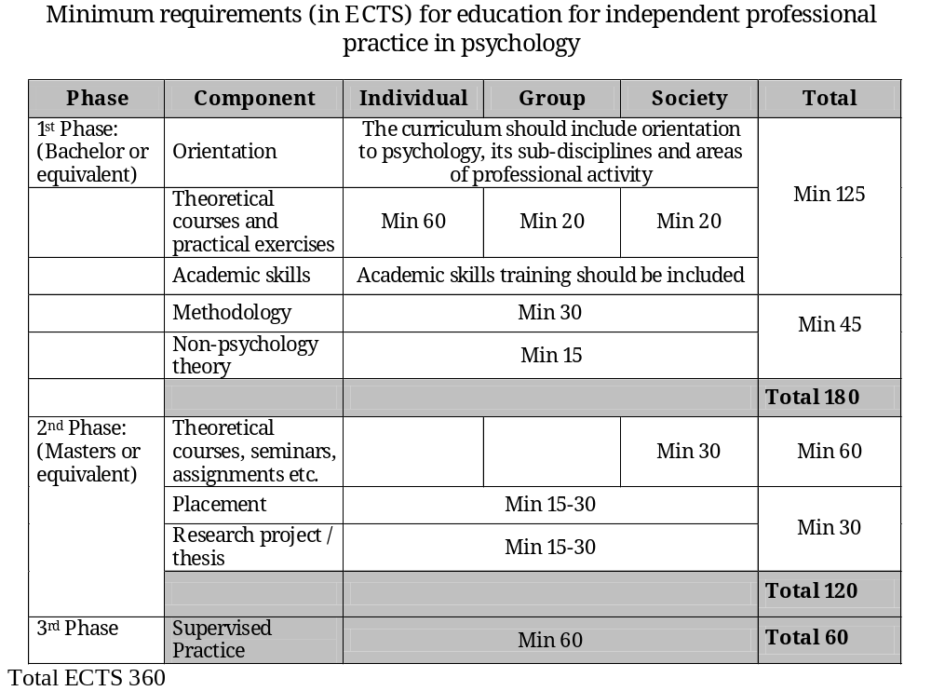
Academic curriculum in psychology
ICPT 2008, St. Petersburg

Slide 10
Individual psychologists are eligible to be listed in the Register of EuroPsy Psychologists if they:
    have completed an accredited academic curriculum in psychology of at least five years of full-time study (300 ECTS),
    show evidence of satisfactory supervised practice as a psychologist-practitioner in training for not less than one year of full-time work (60 ECTS),
    c) subscribe to the principles of professional conduct set out in the MetaCode of Professional Ethics of EFPA and in the code of ethics of the national association of psychology in the country of practice.
ICPT 2008, St. Petersburg

Slide 11
Supervised practice as a psychologist-practitioner in training
Psychologist Practitioners-in-Training will be working in real settings with real clients under the supervision of a qualified practitioner.
Practitioners-in-Training may either be completing their professional training within an integrated programme managed by a university department or be working under the supervision of licensed or registered psychologists in the work place.
In either case, it is necessary for a suitably qualified person to act as the Supervisor of the Practitioner-in-Training.
ICPT 2008, St. Petersburg

Slide 12
Supervised practice as a psychologist-practitioner in training
A Supervisor is a psychologist who, within the past three years, has had at least two years of full-time work as an independent practitioner within a professional context, and who is responsible for the acquisition and assessment of professional competence by a Practitioner-in-Training in that context.
The Supervisor will be responsible for assessing the competence of the Practitioner-in-Training on a day-to-day basis.
ICPT 2008, St. Petersburg

Slide 13
Individual psychologists are eligible to be listed in the Register of EuroPsy Psychologists if they:
    have completed an accredited academic curriculum in psychology of at least five years of full-time study (300 ECTS),
    show evidence of satisfactory supervised practice as a psychologist-practitioner in training for not less than one year of full-time work (60 ECTS),
    c) subscribe to the principles of professional conduct set out in the MetaCode of Professional Ethics of EFPA and in the code of ethics of the national association of psychology in the country of practice.
ICPT 2008, St. Petersburg

Slide 14
Individual psychologists are eligible to be listed in the Register of EuroPsy Psychologists if they:
    A pledge in writing to adhere to:
    the MetaCode of EFPA, which is organized around the following ethical principles:
    - respect for person’s rights and dignity;
    - competence;
    - responsibility;
    - integrity.
    the Italian psychologists’ code of ethics, which regulates professional practice in terms of:
    - general principles;
    - relationship with clients and organizations;
    - relationships with the colleagues;
    - relationship with society.
ICPT 2008, St. Petersburg

Slide 15
Contexts of practice
  Each holder of the EuroPsy will have a profile defining the context(s) within which they have demonstrated competence to practise from the time at which the Diploma is awarded.
A distinction is made between three broad professional contexts, designated as:
Clinical & Health
Education
Work & Organisations
(Other as a specific option)
ICPT 2008, St. Petersburg

Slide 16
Competences
The EuroPsy project has been based on criteria drawn from both “input” (curriculum) and “output” (competences):
The former provide standards for the education process, the latter for the professional training.
A future aim is to integrate the two approaches and to use
at best the work that has been done in the specification of
psychologists’ professional competences (e.g. Bartram & Roe, 2005)
ICPT 2008, St. Petersburg

Slide 17
Primary Competences
Before starting to work independently, a psychologist should acquire, and be able to demonstrate, two main sets of competences, implemented in specific ways in different professional contexts:
20 primary competences
Grouped into 6 categories
Goal specification e.g needs analysis
Assessment e.g. group assessment
Development e.g. service design
Intervention e.g. service implementation
Evaluation e.g. evaluation measurament
Communication e.g. giving feed-back
ICPT 2008, St. Petersburg

Slide 18
Enabling Competences
Professional strategy
Continuing professional development
Professional relations
Research & Development
Marketing & Sales
Account management
Practice management
Quality assurance
8 enabling competences
ICPT 2008, St. Petersburg

Slide 19
Becoming a Psychologist in Italy
Before the Bologna Agreement (BBA, until 1999)
5 years (Laurea)
1 year of supervised practice (6 month in a professional context and 6 month in a different professional context)
After the Bologna Agreement (ABA, since 2000)
3 years (Laurea)
2 years (Laurea Specialistica)
1 year of supervised practice (6 month in a professional context and 6 month in a different professional context)
After the After the Bologna Agreement (from 2008)…
ICPT 2008, St. Petersburg

Slide 20
Becoming a Psychologist in Italy
Italian Universities offering a Degree in Psychology:
1° cycle: Psychological Sciences and Techniques 32
2° cycle: Psychology 27
Ratio between Italian population and psychologists: 1/890
ICPT 2008, St. Petersburg

Slide 21
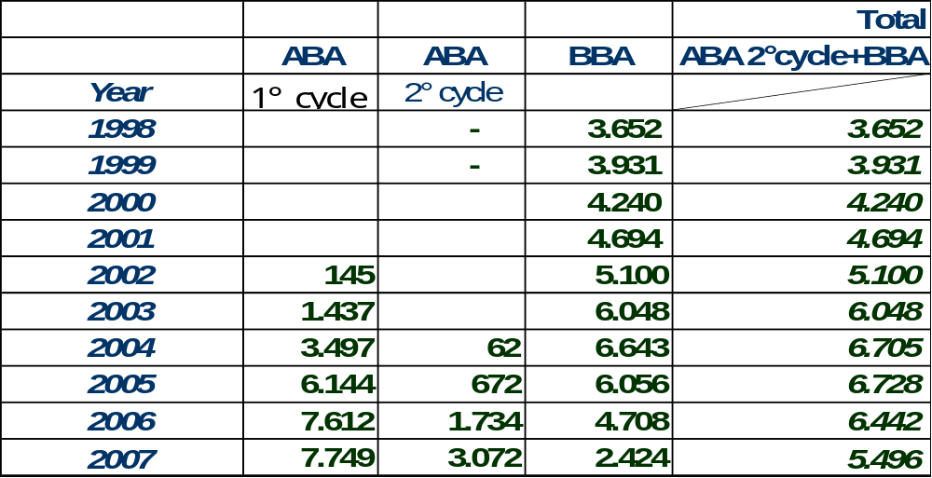
Becoming a Psychologist in Italy
Number of students graduating from the 1° cycle, the 2° cycle, and the BBA system.
ICPT 2008, St. Petersburg

Slide 22
Becoming a Psychologist in Italy: Curricula
After Bologna Agreement: Laurea 3-year level (180 ECTS)
Basic Courses: Foundations of Psychology (e.g. General Psychology …)
Min ECTS: 27 Interdisciplinary Education (e.g. Biology, Philosophy…)
Characterizing General (e.g. Perception, Neuropsychology)
Courses: Development & Education (e.g. Human development…)
Min ECTS: 43 Social and Work Psychology (e.g. Social cognition …)
Clinical (e.g. Testing, Clinical interview)
“Integrating” Courses: Non-psychological disciplines (e.g. Economics)
Min ECTS: 18
Other Activities: Academic skills (e.g. English, Informatics, Stage…)
Min ECTS: 30
ICPT 2008, St. Petersburg

Slide 23
Becoming a Psychologist in Italy:
Curricula
After Bologna Agreement: Laurea Specialistica 2-year level (120 ECTS)
Basic Courses: Psychology (e.g. Psychometrics …)
Min ECTS: 8 Interdisciplinary Education (e.g. Philosophy of Science…)
Characterizing Courses for a “General” MA or a
Courses: “Specialized” MA (e.g. Work Psychology)
Min ECTS: 32
“Integrating” Courses: Non-psychological disciplines (e.g. Technology…)
Min ECTS: 12
Other Activities: Academic skills (e.g. English, Thesis …)
Min ECTS: 28
ICPT 2008, St. Petersburg

Slide 24
Becoming a Psychologist in Italy
To become a licensed psychologist, after the degree and after having completed one year of supervised practice, an individual must pass a state examination.
Licensed psychologists can join the Ordine degli Psicologi, the Italian Board of Psychologists.
ICPT 2008, St. Petersburg

Slide 25
Experimentation of EuroPsy in Italy
The National Awarding Committee for Italy, CNAE, has been appointed by INPA (Italian Network of Professional Psychologists), the national association of Italy in EFPA (European Federation of Psychologists Associations), on Ottobre 2005. Members are:
  Remo Job, Chairperson (AIP)
  Adalgisa Battistelli (FISSP)
  Claudio Tonzar (CNOP)
  Vito Tummino (AUPI)
  Bruna Zani (CPFP)
ICPT 2008, St. Petersburg

Slide 26
Experimentation of EuroPsy in Italy
  Following article 17 of the EuroPsy document, CNAE has:
  (a) translated the EuroPsy document into Italian;
  (b) set up a web page: http://www.inpa-europsy.it;
  (c) sent a letter to all the Deans of Psychology Faculties asking for information about the university curricula in psychology in order (i) to advise institutions of higher learning of conditions for approval and (ii) to prepare and publish a list of currently approved curricula for academic education in psychology;
  (d) started an experimentation as part of the Six Country Garden Project (Finland, Germany, Hungary, Italy, Spain, UK) as decided by the Leonardo Group.
ICPT 2008, St. Petersburg

Slide 27
    1^ Stage of Experimentation
    (October 2006- December 2007)
Two groups:
  for the “standard” procedure, psychologists registered with the National
  Board were asked to indicate a person they recently supervised.
  for the “grandparenting” procedure, psychologists registered with
  the National Board either in or before 2001 were identified.
  Each person was sent the relevant information about EuroPsy, and the application form, specifying a deadline for application
  Applications received by CNAE within the deadline: 50
  Applications approved by CNAE: 44/50 (88%)
  Applications for which further information was required: 3/50 (6%).
  Application rejected by CNAE: 3/50 (6%). In all cases, applicants failed to show evidence of professional work as a psychologist for at least 400 hours per year over a period of 5 years over the period of the last 10 years
ICPT 2008, St. Petersburg

Slide 28
2^ Stage of Experimentation (from Spring 2008)
The second stage aims at simulating the “real” situation in which EuroPsy should be awarded. It requires:
changes in the application and evaluation forms as motivated by the 1st stage of experimentation,
a decision about the administrative fee,
a general call for application addressed directly to potential candidates, also using the press and other media,
ICPT 2008, St. Petersburg

Slide 29
Concluding Remarks
The preliminary results of the experimentation show a satisfactory degree of congruency between the EuroPsy requirements and the actual Italian university curricula in psychology. However, some changes may be required.
The tri-partition “individual-group-society” advocated by EuroPsy is present in the Italian curricula. However, it is not easily coded in terms of ECTS because in Italian curricula group and society are grouped together under the heading “Social psychology and group relations”. Furthermore, the names of the courses are often quite generic, and inspection of the course content would be time-consuming and, sometimes, impossible since the information may not be available.
ICPT 2008, St. Petersburg

Slide 30
Concluding Remarks
The allocation of ECTS to the “Methodology” category is sometimes difficult because Universities have been asked to teach methodology as part of the disciplines rather than just by itself. So, there may not be a course on “Testing” but intelligence tests are presented in the course “Intelligence” and projective tests in the course “Clinical Psychology”.
Ethics is scarcely developed and students have not sufficient knowledge and awareness of ethical issues.
ICPT 2008, St. Petersburg

Slide 31
Concluding Remarks
As for the supervised practice, the Italian law prescribes that a psychologist practitioner-in-training spends six month of his/her training in a professional context and six month in a different professional context. The supervisor may be the same or may be different.
In this latter case, awarding EuroPsy should require the evaluation of the supervised practice by both supervisors, but this may be quite time-consuming and costly.
On the other hand, a change in the Italian law is not foreseen, and this will require adapting the EuroPsy procedure to the Italian context.
ICPT 2008, St. Petersburg

Slide 32
Concluding Remarks
A further issue about the supervised practice concerns the evaluation of the practitioner-in-training.
At present, there is not such procedure in Italy, but the Garden Experiment has shown that supervisors asked to fill in the supervised practice evaluation form judge positively such procedure.
Also, since the supervision form has been cast in terms of competences, the procedure plays an important role in allowing psychologists to focus on competences in a structured way, thus raising their awareness on the issue and providing them with a tool both in setting up the professional context they offer to the psychologist practitioner-in-training and in assessing his/her competences.
ICPT 2008, St. Petersburg

Slide 33
Concluding Remarks
At a “political” level, EuroPsy has been instrumental in setting some standard in the reform of the curricula now in progress in Italy by providing the Conference of the Deans of Psychology Faculties with a frame of reference during their work on the new 3+2 schema.
For psychology, the curricula developed by the Italian Universities offering a program in psychology are now much more homogeneous than before, and in general quite compatible with EuroPsy.
Last but not least, the experimentation has allowed a fruitful cooperation among the various Agencies involved by CNAE, especially the Italian Board of Psychologists, the Conference of the Deans of Psychology Faculties, and the Italian Psychological Associations.
ICPT 2008, St. Petersburg

Slide 34
Concluding Remarks
http://www.efpa.eu
http://www.inpa-europscy.it
Thank you
ICPT 2008, St. Petersburg

