Slide 1
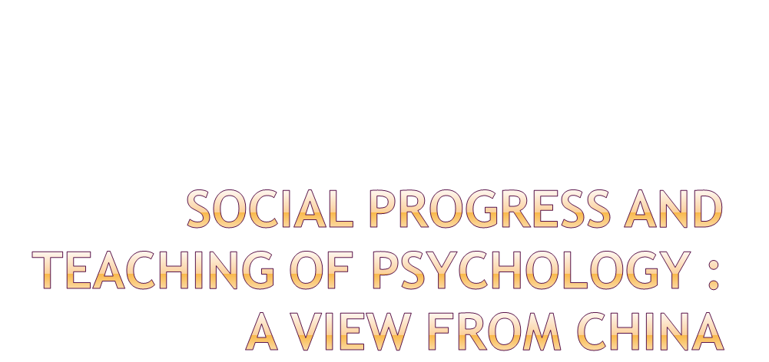

Houcan Zhang
Beijing Normal University
China

Slide 2

A Historical Overview of Teaching of Psychology
Contemporary Teaching of Psychology

Slide 3

The beginning of Chinese Psychology
  first introduced into China in early 20 century
1920’s -1930’s
  the first generation of Chinese psychologists
  establishment of psychology departments
  smoothly developed until the war in 1937
  the first prosperous period of Chinese psychology

Slide 4
After the founding of New China
  Dialectical materialism as the foundation of science
  No more independent department of psychology
  courses for students majored in Education
    some courses on psychology remained
    mainly theoretical explanations with some demonstrations

Slide 5
a special program of psychology in early 1960’s
  first established in Beijing Normal University
  some new courses added
the disastrous period during Cultural Revolution
  severely criticized and abandoned
rehabilitated as a scientific discipline
  the first stage with five psychology departments
  instruction were different depends on professors

Slide 6

Recent development of psychology since 1980
Main characters of contemporary teaching
The courses for students at present time
Conclusion

Slide 7

Stress on the scientific nature of Psychology is the main purpose at the first few years
Along with the transition of economic system, the significance of applied psychology displayed
More departments of psychology came out and new courses developed

Slide 8

1. scientific foundation for learning psychology are emphasized
  Besides general psychology, English, advanced mathematics, human physiology, physics and computer technology for first two years
  Experimental psychology, statistics and psychometrics are also stressed from the methodological point of view
  Different branches of psychology are taught in the last two years, both requisite and optional

Slide 9

2. the direction of application are enhanced for higher classes
  psychological counseling, and industrial and organizational psychology, especially human resources are the main fields of psychological application in China
  Courses of testing, social investigation, mental health, counseling and abnormal psychology etc are offered in recent years

Slide 10
3. practice of some applied courses are also highlighted
  4-6 weeks practice in school or in enterprises
  observation in the mental hospital
  seminar discussions in most class teaching, interaction are stressed

Slide 11

1. The Basic Courses
  Computer Science, Physical Education
  2 of Political Science, 2 of English Language
  Advanced Mathematics, Computer Programming, Physiology and Education
  4-6 weeks of practice: school teaching / societal survey

Slide 12
2. Core courses (7+1 model of MOE)
  Seven courses are requisite
General Psychology Physiological Psychology
History of Psychology Developmental Psychology
Experimental Psychology Psychological Statistics
Psychological Measurement
  the other One: different direction of department
  Educational Psychology — teacher training universities
  Industrial psychology — Zhejiang University
  General and physiological psychology — Peking University

Slide 13
3. Other courses:
  requisite
    Cognitive Psychology Personality Psycholog
    Abnormal Psychology Psychological Counseling
    Social Psychology Management Psychology
  optional depends on the university
  Health Psychology Behavior Modification
  Environmental Psychology Advertisement Psychology
  Career Design and Guidance Clinical Psychology
  Methods of Social Investigation Research Methodology
  Psychology of Learning

Slide 14

along with the rapid economic growth, psychology developed rapidly.
new department of psychology established and new courses offered.
teaching technology changed, practice increased.
most psychology graduates have a strong basis for further study or job finding.

Slide 15
From the developmental course of teaching of Psychology in China, we may conclude:
social progress requires psychology
and
psychology promotes social progress.

Slide 16

Thank You !

