Slide 1
The changing nature of psychology education in the UK
Annie Trapp,
Director, Higher Education Academy Psychology Network www.psychology.heacademy.ac.uk a.trapp@psych.york.ac.uk

Slide 2
UK psychology education
Psychology widely taught at school level
Level Zero – Foundation/Access courses
3or4 year undergraduate Bachelors degree (First cycle)
Masters level courses (one year) (Second cycle)
PhD,DPhil (Third cycle)
Robust quality assurance mechanisms across Universities
National subject benchmarks (agreed learning outcomes)
BPS accredited but also non-accredited courses
Around 12,000 graduates (Bachelors) each year
<15% move to professional psychology training

Slide 3
Professional psychology routes
Clinical psychologists
Counselling psychologists
Educational psychologists
Forensic psychologists
Health psychologists
Neuropsychologists
Occupational psychologists
Sport and exercise psychologists
Teachers and researchers in psychology
Other types of psychologist

Slide 4
Changing landscapes
Government policy around Higher Education
Government policy relevant to psychology
Impact on universities
Impact on students
How psychology education is responding
Employability of psychology graduates

Slide 5
Government policy
Economic prosperity
Development of workforce
Selling UK education
Legislation
50% of 18-30 year olds participating in higher education by 2010
Population changes - older and overseas students
more important to the economy

Slide 6
Examples of government policy relevant to psychology
Statutory regulation
  Psychologists (Counsellors, psychotherapists)
Layard Report:
  Getting people back into work (evidence-based interventions, cognitive behavioural therapy, IAPT)
New Ways of Working
  Breaking down professional barriers
Every Child Matters –
  Inter-professional education, early years, childhood studies
  Vocational training & skills training in childcare, communication skills, interviewing skills

Slide 7
Universities
Funding linked to government priorities
  Eg. Widening participation
Introduction of tuition fees
Research funding more competitive & focused
Accountability & management
Alignment of structures with Europe (Bologna)
Professional standards framework for teaching

Slide 8
Quality assurance and enhancement
University departmental review
Quality Assurance Agency academic review
National Student Survey
Quality Enhancement Themes (Scotland)
Higher Education Academy
PGCHE

Slide 9
Students
A strong case for individuals investing in their education has also been promoted, demonstrating the additional earnings, health and wellbeing that graduates enjoy compared to those who do not go on to higher education.
Good retention rate
Increasingly diverse population
Student voice: National Student Survey
Tuition fees

Slide 10

National Student Survey

Slide 11


Slide 12
Employers
  Government pressure to co-fund courses
  Sector skills agency
  Critical of graduate skillset
  ? relevance of 3rd cycle (research PhD, DPhil) to labour market

Slide 13
Government
Employers
Students
Subject disciplines
PSYCHOLOGY
Universities
Professional
bodies
Neuroscience
Research

Slide 14
Changes in psychology education
Under more pressure from universities strategies
  Modularisation (to fit in with ECTS and Bologna)
  More psychology courses (joint, foundation, extended degrees)
  Respond to NSS and student voice
  Larger classes, more international students
  Development of short courses
Increase in non-accredited degrees
Increase in Masters level courses
Introduction of professional doctorates
More interest in employability

Slide 15
Changes to the way we teach
Exemplar photos removed

Slide 16



Changes to the way we teach
Responding to students’ needs

Slide 17

Changes to the way we teach
Breaking the boundaries

Slide 18
Examples of change in UK departments
More training: eg. Postgraduates who teach network
Greater focus on employability
Active learning (even in large classes)
Greater range of assessment methods
First year experience
Vertical teaching model, peer-mentoring (Southampton, Westminster)
User-involvement (Surrey)
First online Bachelors accredited psychology degree (Derby)
Enquiry-based learning (Sheffield)
E-innovation, podcasts, clickers, vle (Aston, Bangor)

Slide 19
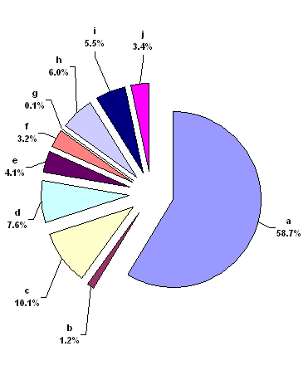

What do psychology graduates do after their three or four year training?
Six months after graduation
58.7% In UK employment
7.6% Studying for a higher degree
4.1% Studying for a teaching qualification
3.3% Undertaking further study

Slide 20
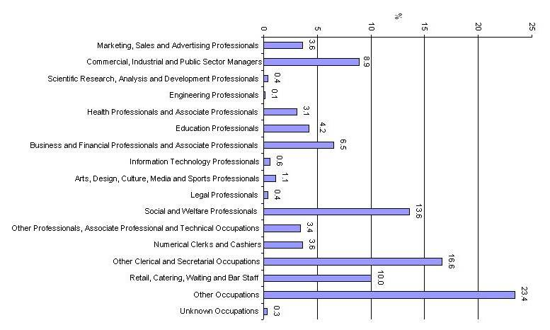
58.7% in UK employment…

Slide 21


Employability
Preparing students
  to enter the workplace with the knowledge, skills and capabilities to operate in international and multicultural workplaces
Information society
  – to challenge and evaluate claims
Notes:
UK vs overseas students
Diversity in the curriculum

Slide 22
Employability
How are departments responding
  Greater focus on employability
  Departmental and institutional initiatives, eg. PDP
  Employability guide
    http://www.psychology.heacademy.ac.uk/html/reports.asp
  More work placement modules/years
Notes:
Discussion of ways in which students and lecturers can enhance students’ employability
Identifies various skills based on subject benchmarks and maps these skills against input from CIHE employer membership regarding skills, competencies and attributes valued by employers.
“slapped in face with wet fish”

