Slide 1
Developing Critical Thinking in Research Methods
Barney Beins
Ithaca College
Ithaca, New York USA
beins@ithaca.edu
Third International Conference on the Teaching of Psychology
St. Petersburg, Russia
13 July 2008

Slide 2
A Matter of Health
How healthful is your lifestyle?
  1 = Very Poor
  7 = Very Good

Slide 3
A Matter of Health
How healthful is your lifestyle?
  1 = Very Poor
  7 = Very Good
  What is a Body Mass Index?
  What is Your Body Mass Index?

Slide 4
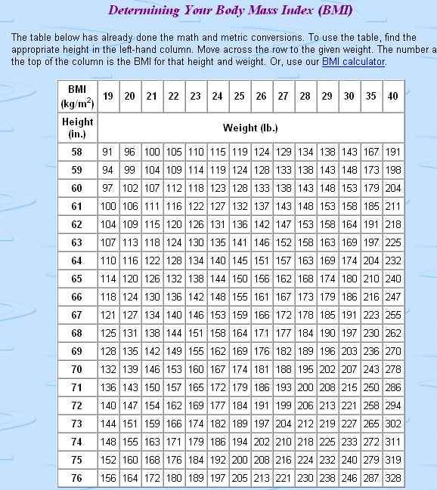

Slide 5
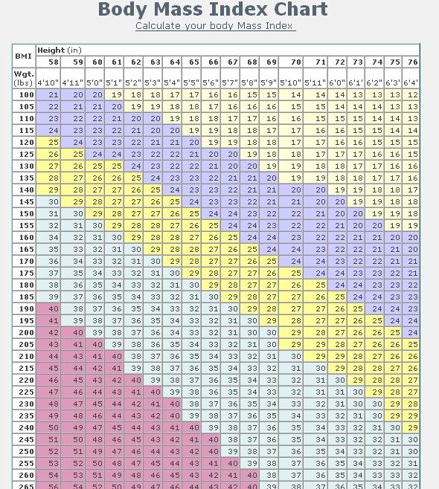
Notes:
Magenta—Seriously overweight
Baby Blue—somewhat overweight
Yellow—slightly overweight
Lavender—Ideal
Pale yellow--underweight

Slide 6
Is there a correlation between BMI and self rating of healthfulness of lifestyle?

Slide 7
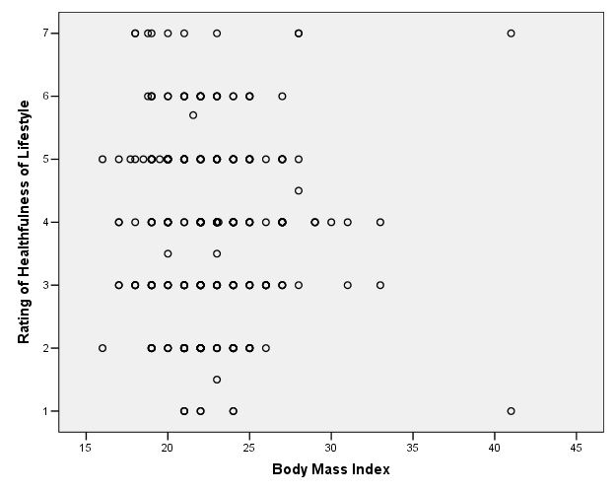
r(283) = -.034, p = .567

Slide 8
Here is where it gets interesting
Why is there no relation between BMI and self rating? There should be!
The methodology here is poor. Why?
What could you do to improve it?

Slide 10
How Fidgety are Students?
How complex are each of the following concepts? (1 = Not very complex; 7 = Very complex)
Anxiety
Depression
Happiness
Empathy
Fidgeting

Slide 11
How Fidgety are Students?
 | Minute 1 | Minute 2 | Minute 3 | Total
Observer 1
Observer 2

Slide 12
If it is this hard to count fidgets, how hard is it to measure a psychologically complex construct?
There is another message here. This would be a poor study methodologically. Why?

Slide 13
Any Questions So Far?

Slide 14
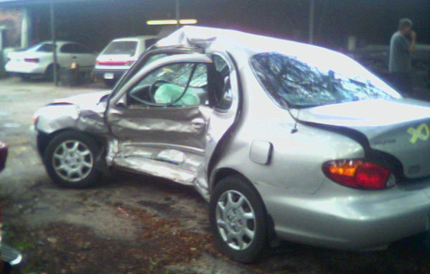
A mother was killed by a cell phone user

Slide 15
External Validity
Strayer, Drews, and Johnston (2003) studied why cell-phone conversations distract people more than other activities. The researchers studied undergraduates in a driving simulator. The testing situation includes screens that show a realistic driving environment.
There were different conditions:
  Some subjects conversed on a cell phone
  Some subjects conversed with a person sitting next to them.

Slide 16
The researchers found that drivers are
  More accident-prone and
  Slower to react
They cannot process visual information as well when using a cell phone as when they are merely talking to somebody. The researchers call this deficit to "inattention blindness".
QUESTION: Are these results likely to be similar if applied to drivers other than college students? What variables might be important in generalizing from this sample?

Slide 17
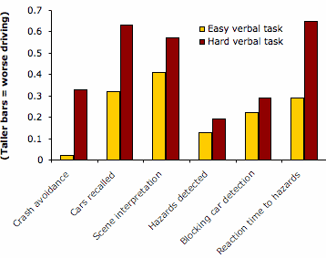

Slide 18
Cell Phones and Driving
Researchers investigated cell phones and auto accidents on the road.
They studied cell phone records of 699 drivers who were involved accidents resulting in substantial property damage but no personal injury.
Notes:
They approached 5,890 drivers, of whom 1064 acknowledged having a cellular phone; 742 consented to participate. The researchers obtained billing records with exact numbers and times of calls for 699 people.

Slide 19
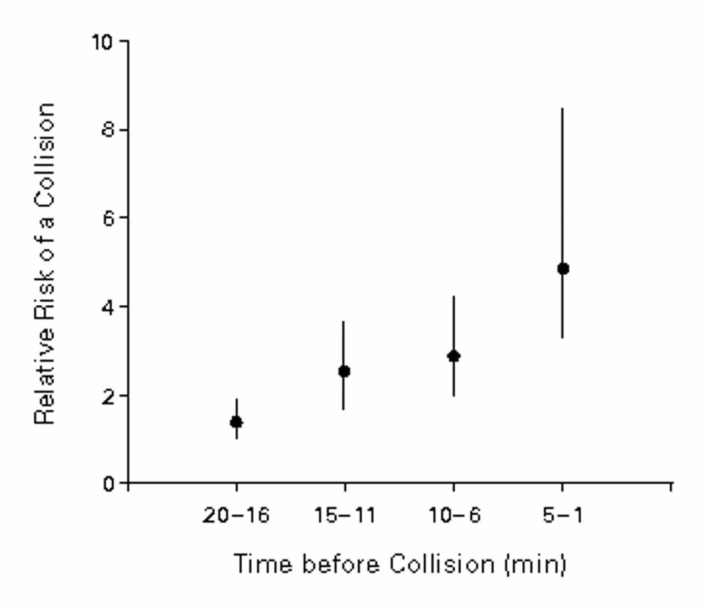

Time of Cellular-Telephone Call in Relation to the Relative Risk of a Collision
Redelmeier D and Tibshirani R. N Engl J Med 1997;336:453-458

Slide 20
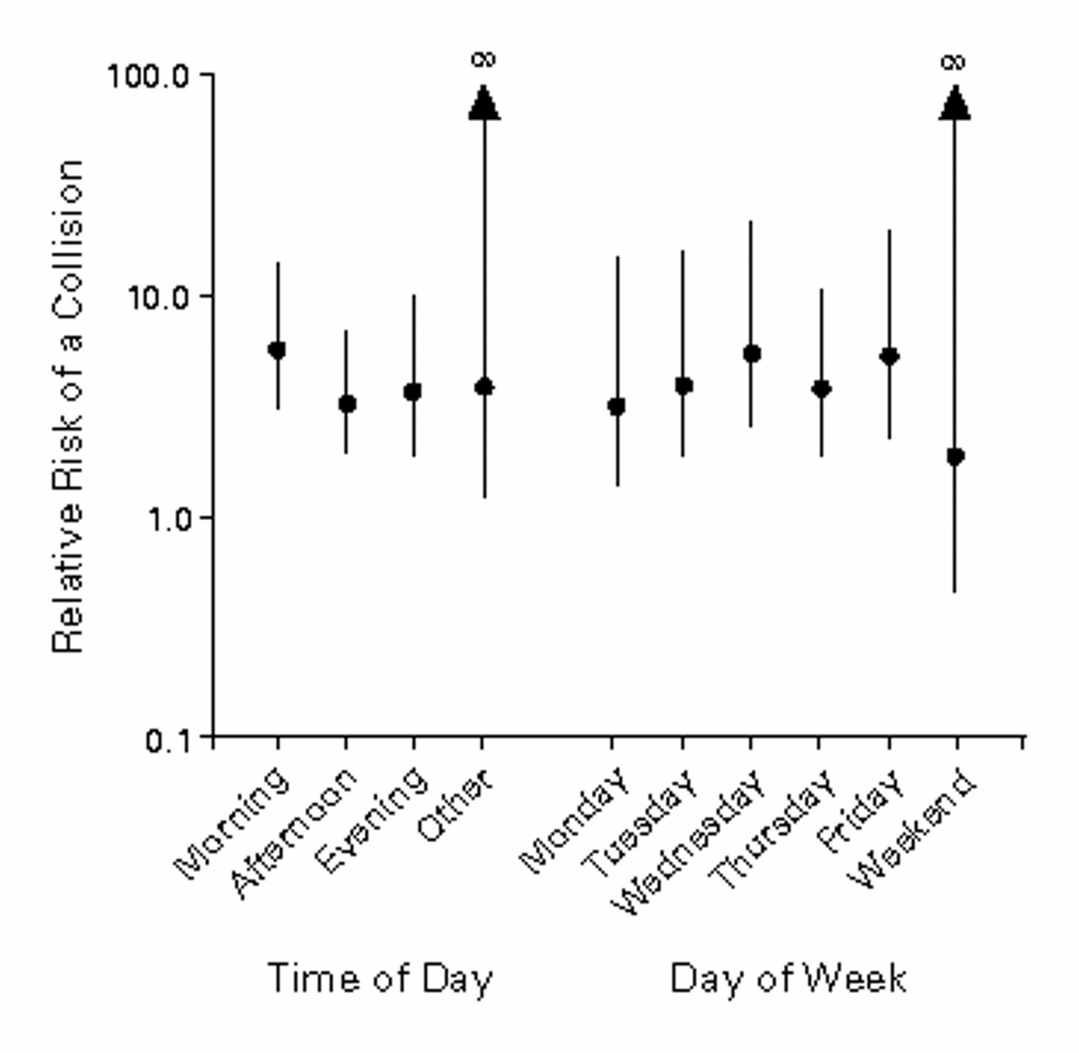
Consistency of Relative Risks Obtained from Different Collision Times
Redelmeier D and Tibshirani R. N Engl J Med 1997;336:453-458
Notes:
When the entire confidence interval is greater than one, the effect is statistically significant.

Slide 21
Overall, 170 people (24 percent) had used a cell phone in the 10-min. period prior to the accident.
Based on the number of accidents, the researchers reported a risk factor of 4.3, indicating over a fourfold increase in accidents associated with cell phone use. This is about the same value as for drunken driving.
Are there limitations to this study?

Slide 22
Converging Evidence
Each cell phone study has its own limitations
Using two different methodologies that have different limitations can lead to confidence in your conclusions.
Do these research results really tell us about driving behavior?

Slide 23
What do you think?
Would you vote for a woman for president if she were qualified?
Is America ready for a woman president?
Notes:
Respond “Yes” or “No” to the first question.—HANDS IN THE AIR?
Respond to the second question—HANDS IN THE AIR

Slide 24
What do you think?
If you had to assign a grade to the public schools in this country as a whole, what grade would you assign: A, B, C, D, or F?
If you had to assign a grade to the public schools that your children attend(ed) or in your neighborhood, what grade would you assign: A, B, C, D, or F?

Slide 25
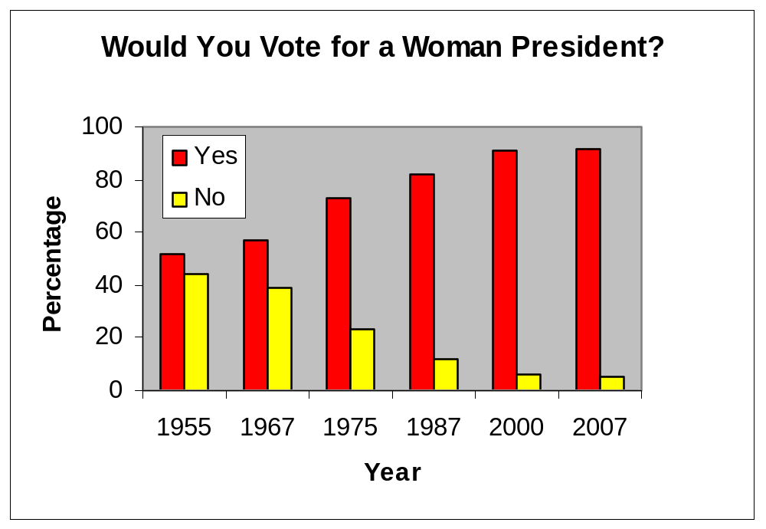

Slide 26
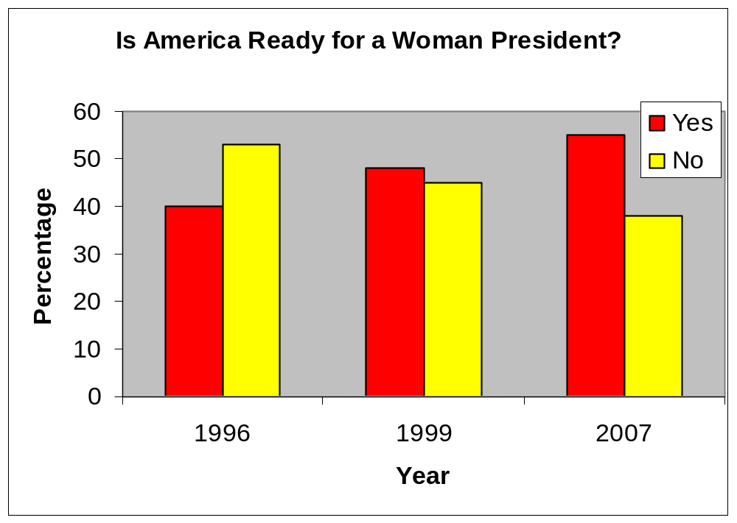
Notes:
Why the difference in the results?
Are people not in touch with what others believe?
Are we that different from all those others?
Is this another instance of the Lake Woebegone effect?
What does this say about the chances of a female president? It turns out that there is a cohort effect such that older people are less likely to think that the country is ready for a female president. Fewer than half of those 65 and older said “yes.” And they vote in inordinate numbers.

Slide 27
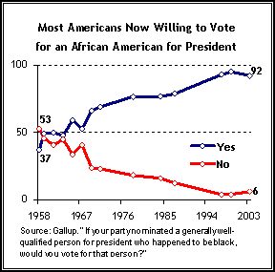
Notes:
Can You Trust What Polls Say about Obama's Electoral Prospects?
Two Important Trends Suggest Americans May Now Be Ready to Elect an African American President
by Scott Keeter and Nilanthi Samaranayake
February 7, 2007

Slide 28
What do you think?
Is there something special about the idea of women in politics?
Or is this a more general pattern regarding how people respond to survey questions?

Slide 29
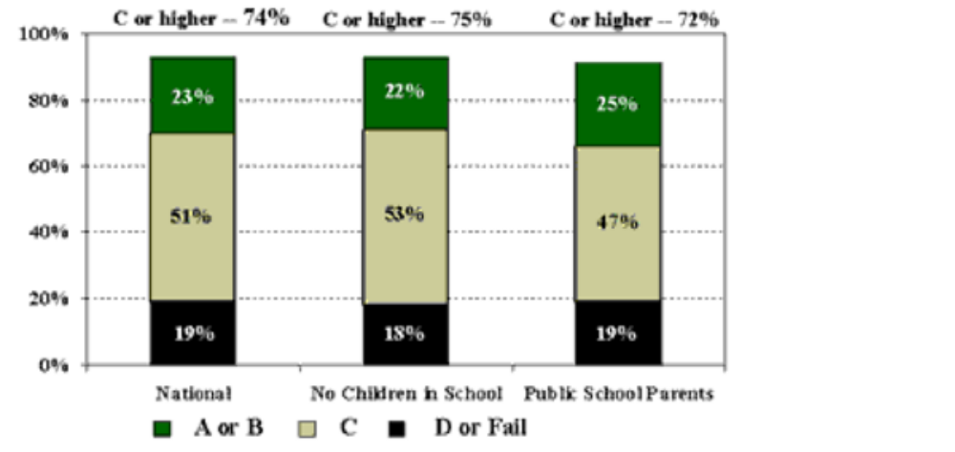
Grade for Schools Nationwide
2001
Notes:
When people are asked to grade schools nationwide, what do they say?

Slide 30
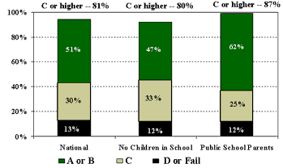
Grade for Local Schools
2001

Slide 31
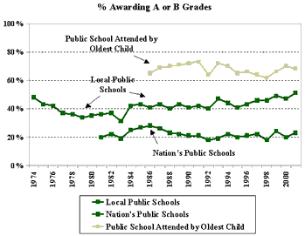
Trends Since 1974
Notes:
Now let’s take a look at how people have graded schools since 1974.
What do you think would happen if you asked people in New York City about their schools?

Slide 32
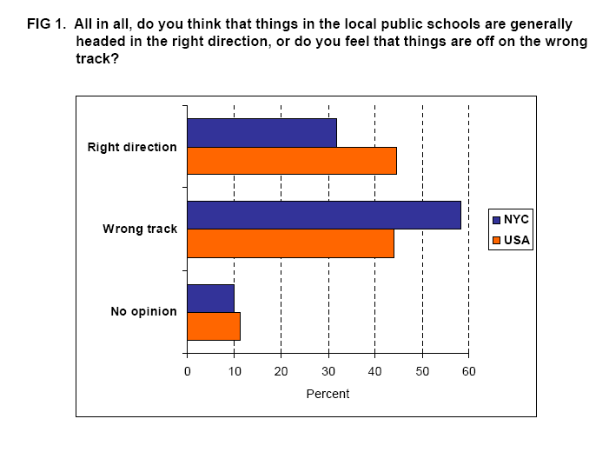

Slide 33
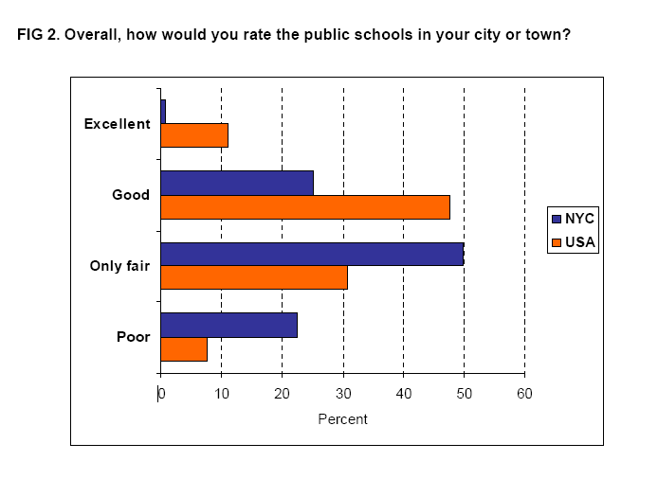

Slide 34
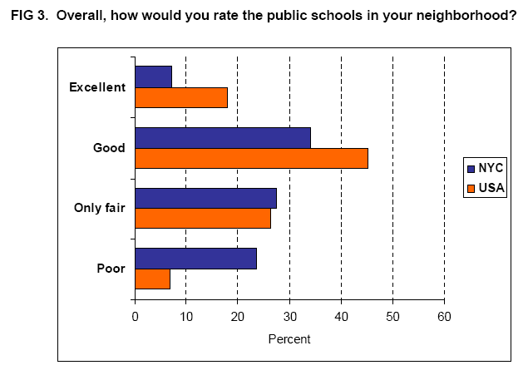
Notes:
When people are asked to grade their local schools, what do they say?
If we asked people from New York City how the schools in Georgia were doing, what do you think they would say?
Is this a good way to find out if schools are doing a good job?
Let’s look at test scores.
When was the last Golden Age for education?

Slide 35
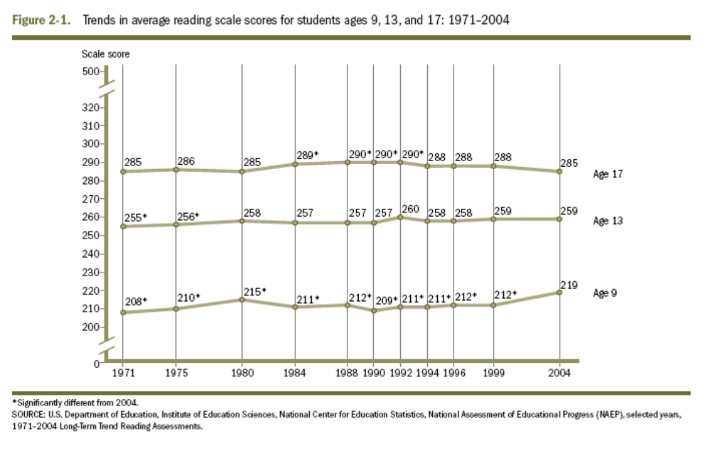
Scores on the National Assessment of Educational Progress:
Reading

Slide 36
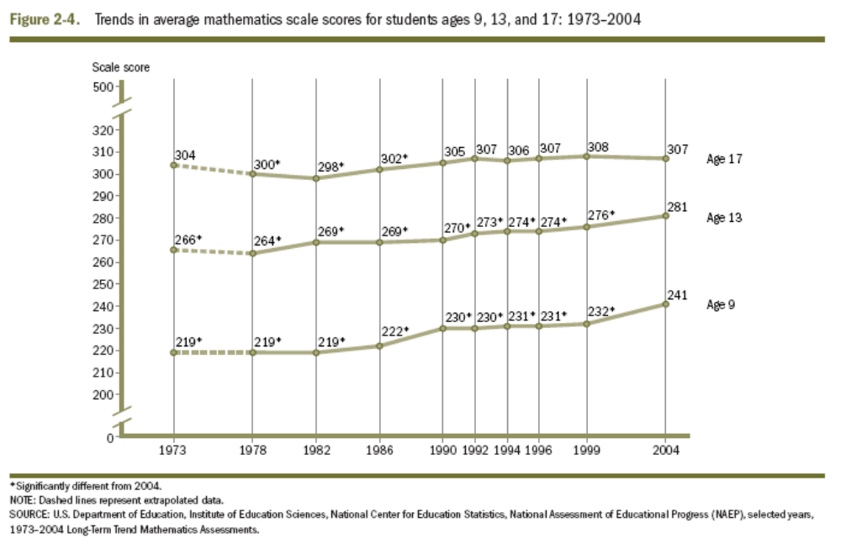
Scores on the National Assessment of Educational Progress:
Mathematics

Slide 37
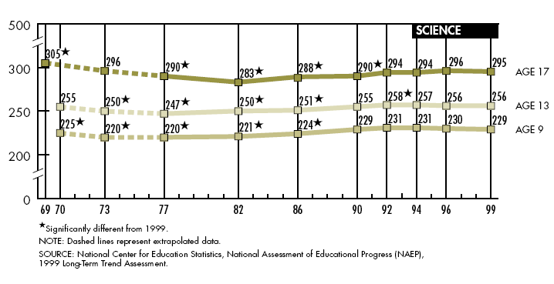
Scores on the National Assessment of Educational Progress
(1999)
Notes:
Do men like romantic films?
If you asked a man who watched a romantic film with a girlfriend which scene would he like to act out from the film, would he choose the sex scene or the romance scene? Women used stereotypes to estimate whether the man would prefer sex to romance, underestimating how many men would prefer the romance.

Slide 38
Important Elements
Asking the Right Questions
Difference Between Surveying Knowledge and Surveying Attitude

Slide 39
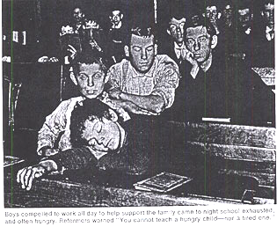

Slide 40
Thanks

