Slide 1
Things That Go Bump in Their Heads: Reducing Students’ Beliefs in the Paranormal by
Richard L. Miller
ICTP-St. Petersburg, 2008

Slide 2
Extent of Paranormal Belief from Gallup Poll

Slide 3
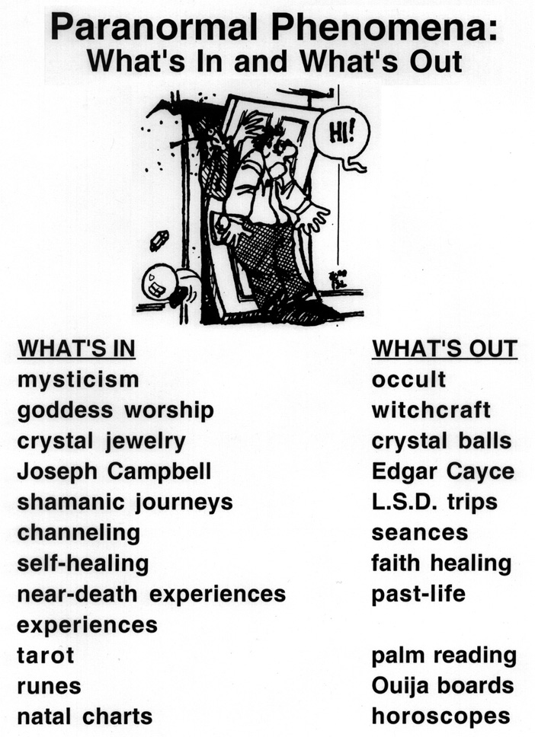

Slide 4
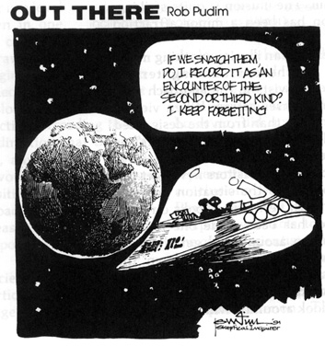
Alien Abduction

Slide 5
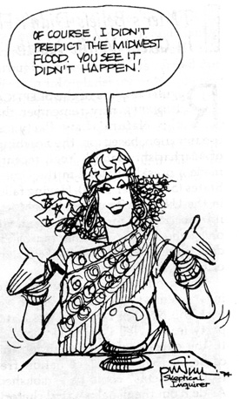
Astrology, Crystal Balls & Tarot

Slide 6
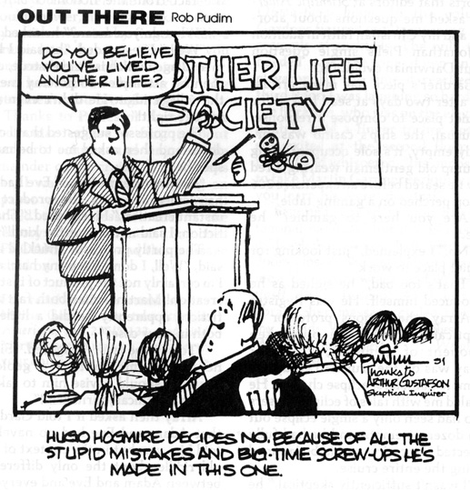
Reincarnation

Slide 7
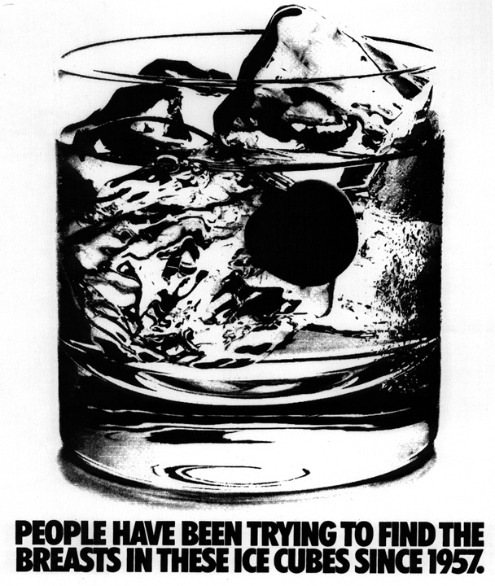
Subliminal Perception

Slide 8
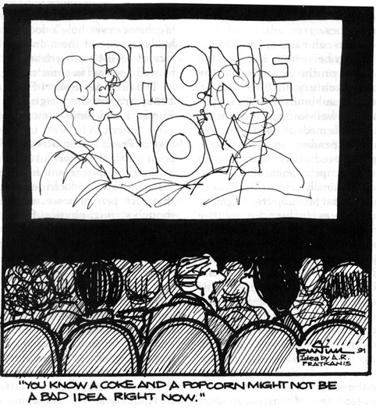
Subliminal Persuasion

Slide 9
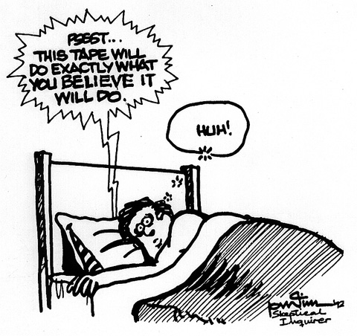
Subliminal Persuasion

Slide 10
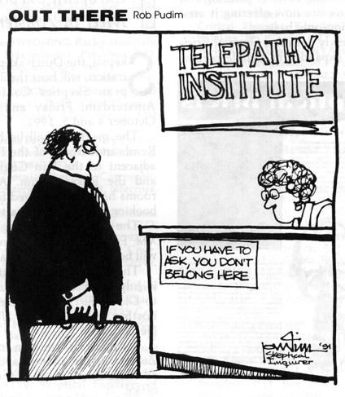
Why we believe: Reducing Uncertainty

Slide 11
Why We Believe: Reducing Uncertainty - Terror Management
Belief Systems:
  Biblical Literalists
  Modernists
  Post-modernists
  New Agers
Changes in Traditional & Paranormal Beliefs as a function of Death Anxiety

Slide 12
Effects of Mortality Salience on Religious Beliefs

Slide 13
Effects of Mortality Salience on Paranormal Beliefs

Slide 14
Techniques to Reduce Students’ Paranormal Beliefs
Courses that emphasize critical thinking and research methodology
Educational interventions based on Cognitive Dissonance Theory
  Counterattitudinal Advocacy
  Belief Perseverance
  Hypocrisy Induction

Slide 15
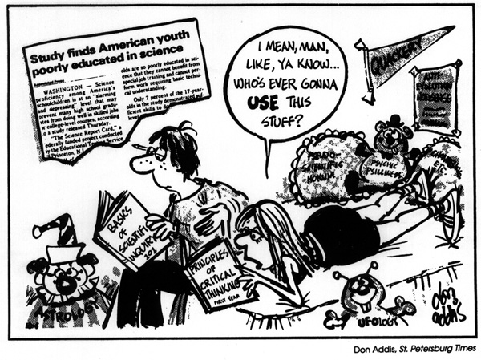
Traditional Educational Approaches

Slide 16
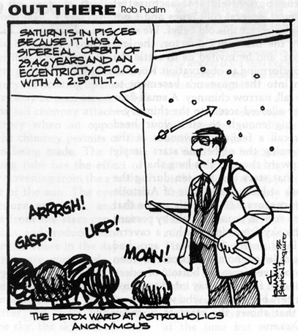
Flooding applied to the Classroom

Slide 17
Research Methods Class:
Palm Reading
Double-blind Technique
Preparation of Stimulus Materials
Descriptions Provided by the Reader
Finding Yourself

Slide 18
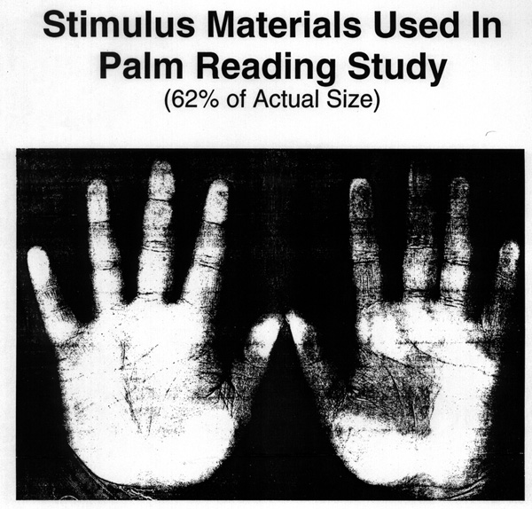

Slide 19
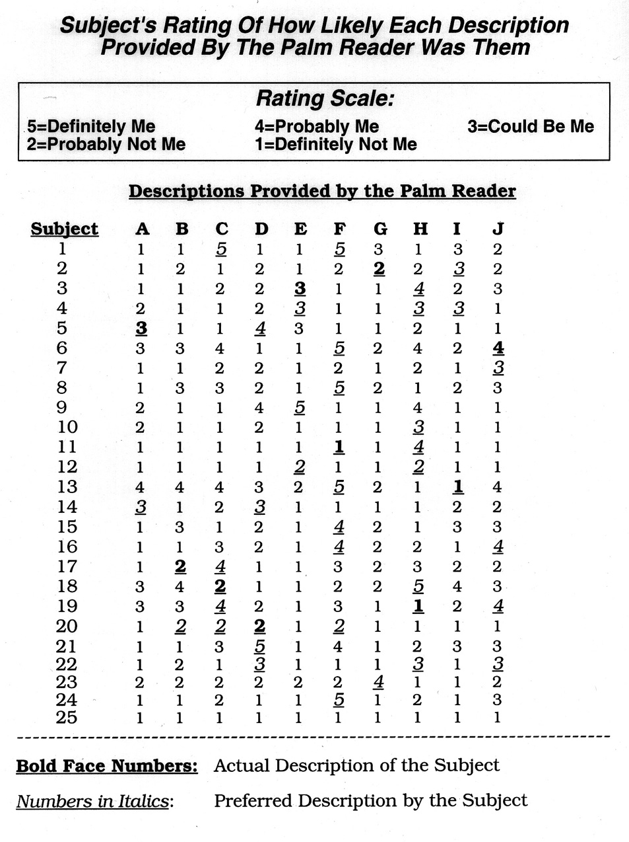

Slide 20
Counterattitudinal Advocacy I
Stimulus Materials
Reading, Writing and Control
Before and After
Miller, et al. Teaching of Psyhology, 1998

Slide 21
Figure 1. Agreement with Scientific Position

Slide 22
Figure 2.. Agreement with Scientific Position

Slide 23
Counterattitudinal Advocacy II
Effort vs. Self-generation of Arguments
Attitudes and Behavioral Intentions
Miller & Wozniak, Current Research in Social Psychology, 2001

Slide 24
Figure 1. Belief in Subliminal Perception

Slide 25
Table 1. Behavioral Intentions

Slide 26
Other Approaches to
Overcoming Paranormal Beliefs
Belief Perseverance
Hypocrisy Induction
  Water Conservation
  Condom Use
  Prejudice
Limitations
  Self-affirmation
  Descriptive Norms
  Psychological Reactance

Slide 27
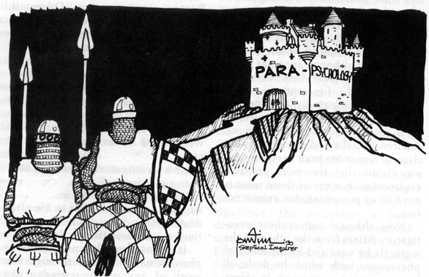
The Challenge to us All as Teachers

