Slide 1

Using Multimedia Instructional Materials: Best Practices for the Teaching of Psychology
Thomas E. Ludwig
Hope College
Holland, Michigan U.S.A

Slide 2
Roadmap
A little history -- Technology Trends
Some lessons learned
A few demonstrations
Some examples of the changes

Slide 3
Roadmap
A little history -- Technology Trends
  Trends in Classroom Technology

Slide 4
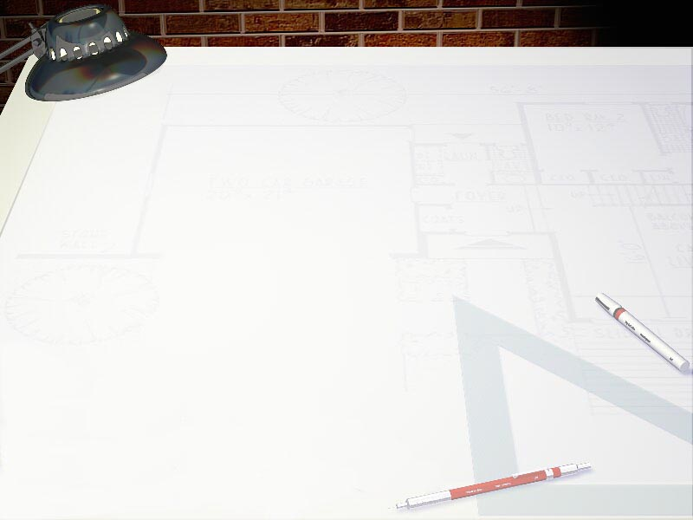
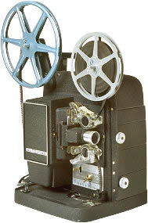
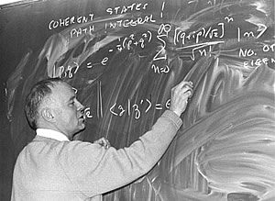
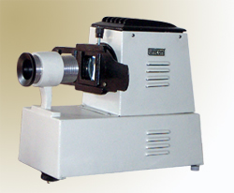
Instructional Tech Timeline
Some historical perspective for those new to the field ☺
1970s -- chalkboard + filmstrips + 16 mm movies

Slide 5
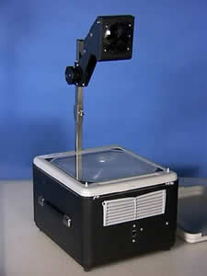
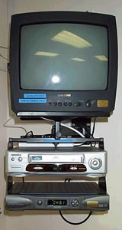
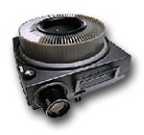
Instructional Tech Timeline
1970s -- chalkboard + filmstrips + 16 mm movies
1980s -- slides + overhead transparencies + videotapes

Slide 6
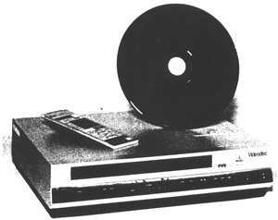
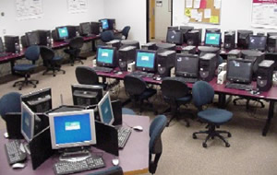
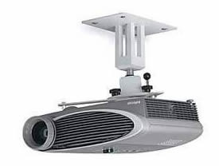
Instructional Tech Timeline
1970s -- chalkboard + filmstrips + 16 mm movies
1980s -- slides + overhead transparencies + videotapes
1990s -- videodiscs + computer labs + digital projectors + CD-ROMs + PowerPoint

Slide 7
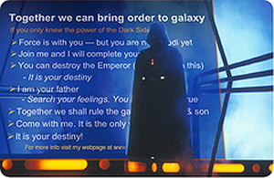
Evils of PowerPoint
Edward Tufte’s critique of the cognitive style induced by PowerPoint
  uncritical acceptance of info from authority figure
  complex principles can be boiled down to bullet points
  lockstep linear progression of ideas
What if Darth Vader used PowerPoint?

Slide 8
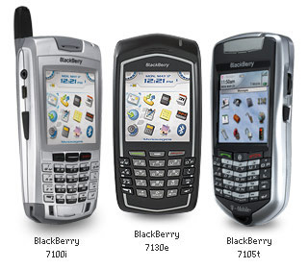
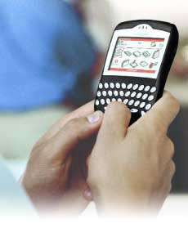
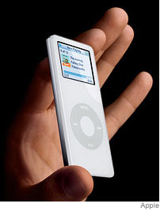
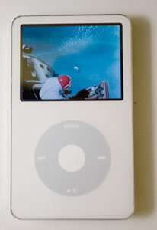
Instructional Tech Timeline
1970s -- chalkboard + filmstrips + 16 mm movies
1980s -- slides + overhead transparencies + videotapes
1990s -- videodiscs + computer labs + digital projectors + CD-ROMs + PowerPoint
2000s -- DVDs, streaming network video, ubiquitous projectors + cell phones + Blackberries + iPods

Slide 9
Roadmap
A little history -- Technology Trends
  Trends in Classroom Technology
  Trends in Computer-Assisted Learning

Slide 10
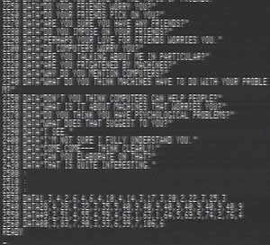
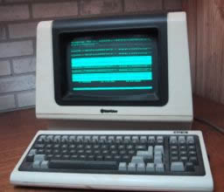
Computer-Assisted Learning
1960s-70s -- text-based activities (in FORTRAN) on mainframe time-share terminals

Slide 11
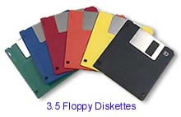
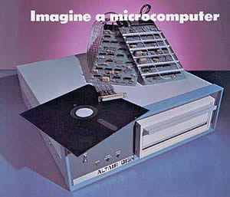
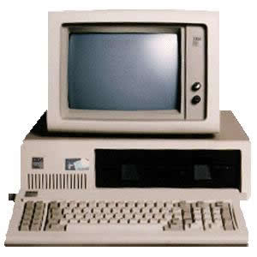
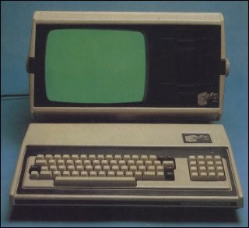
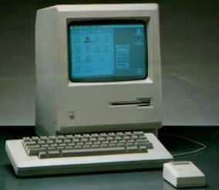
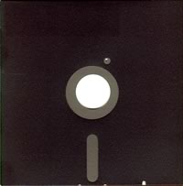
Computer-Assisted Learning
1960s-70s -- text-based activities (in FORTRAN) on mainframe time-share terminals
1980s -- real-time activities (in BASIC) with text and crude graphics on microcomputers

Slide 12
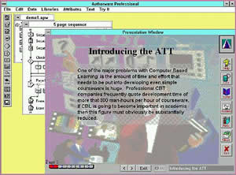
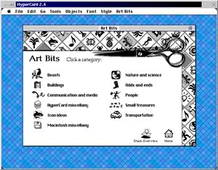
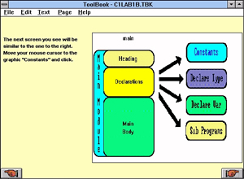
Computer-Assisted Learning
1960s-70s -- text-based activities (in FORTRAN) on mainframe time-share terminals
1980s -- real-time activities (in BASIC) with text and crude graphics on microcomputers
1990s -- more sophisticated activities with bit-mapped graphics, audio clips, and simple animations, produced in HyperCard, ToolBook, Authorware, Director for delivery via floppy disks or CD-ROM

Slide 13

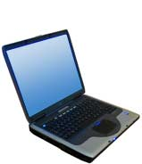
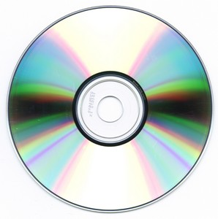
Computer-Assisted Learning
1960s-70s -- text-based activities (in FORTRAN) on mainframe time-share terminals
1980s -- real-time activities (in BASIC) with text and crude graphics on microcomputers
1990s -- more sophisticated activities with bit-mapped graphics, audio clips, and simple animations, produced in HyperCard, ToolBook, Authorware, Director for delivery via floppy disks or CD-ROM
2000s -- highly complex activities with hi-res photos, detailed animations, and video clips, produced in Flash or HTML/Javascript for delivery through a web browser

Slide 14
Roadmap
A little history -- Technology Trends
  Trends in Classroom Technology
  Trends in Computer-Assisted Learning
  My personal history with C.A.L.

Slide 15
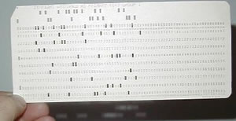
My History with C.A.L.
1970 -- wrote my first program (in FORTRAN) on IBM 360 mainframe with punch cards
1974-76 -- wrote programs in BASIC and assembly language on DEC mini-computers

Slide 16
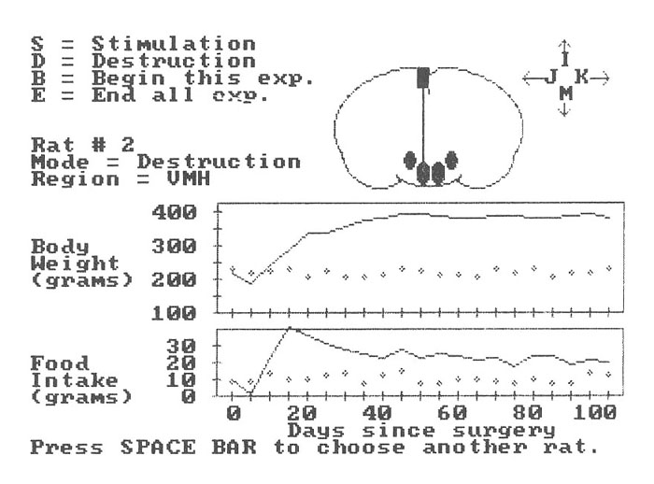
My History with C.A.L.
1978 -- with help from a grant from NIMH, began programming microcomputers for research
1980 -- wrote my first activity for use by students
1980 -- wrote a complete statistical analysis package

Slide 17
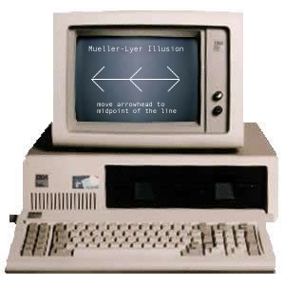
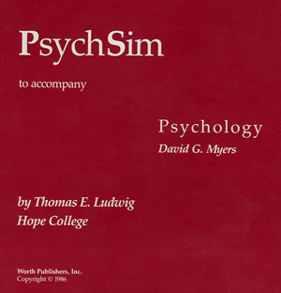
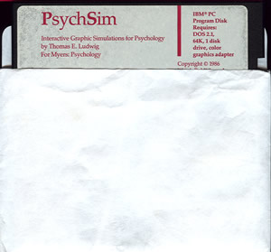
My History with C.A.L.
1984 -- signed a contract with Worth Publishers to produce Psychology Simulations (shortened to PsychSim)
1986 -- PsychSim was published with 12 activities (one 360K floppy disk!), written in BASIC for IBM-PC

Slide 18
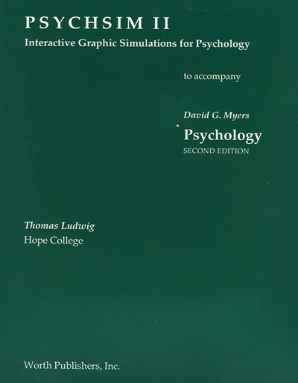
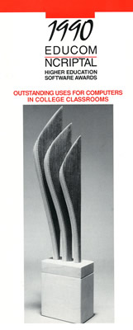
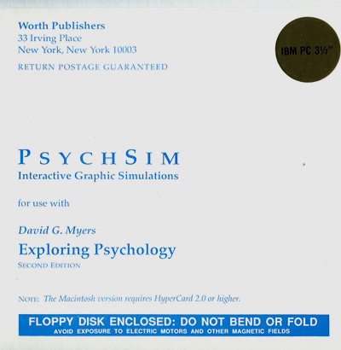
My History with C.A.L.
1989 -- PsychSim II published with 15 activities, in three versions (MS-DOS, Apple II, Macintosh)
1990 -- PsychSim II wins EDUCOM Higher Education Software Award for “Best Psychology Software”
1992 -- PsychSim 3 published with 19 activities, in three versions (MS-DOS, Windows, Macintosh), adding bit-mapped graphics

Slide 19
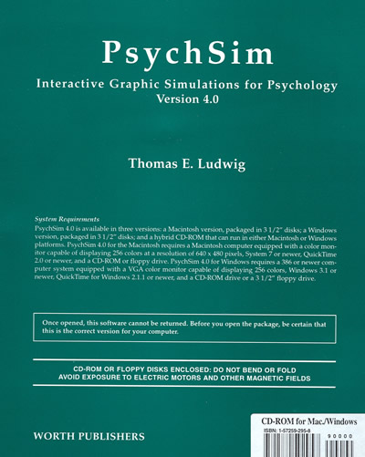
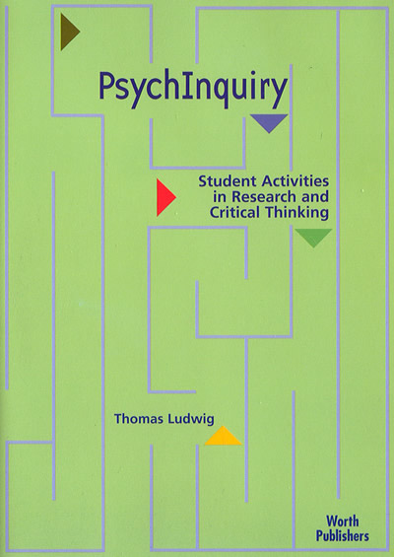

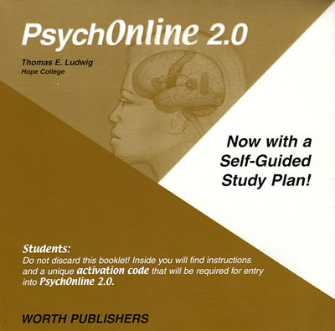
My History with C.A.L.
1996 -- PsychSim 4 published with 19 activities (Windows and Macintosh) adding hi-res graphics
1997 -- PsychQuest (8 longer activities)
2000 -- PsychOnline (complete online course)
2001 -- PsychInquiry (20 research-based activities)

Slide 20
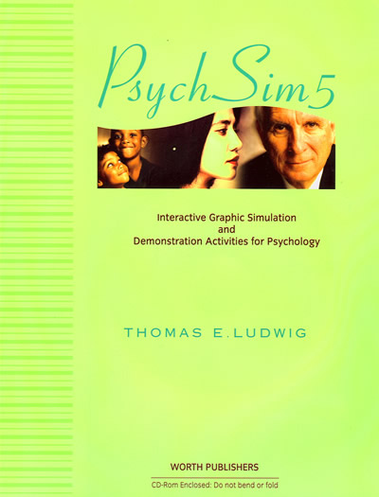
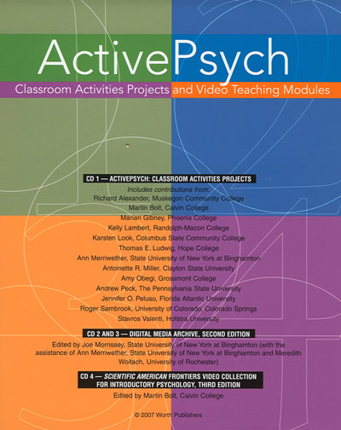
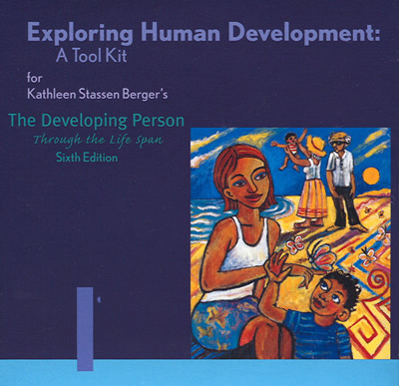
My History with C.A.L.
2003 -- Exploring Human Development (co-authored)
2004 -- PsychSim 5 (42 activities)
2006 -- ActivePsych (co-authored)
2008 -- PsychPortal (“Concepts in Action” 109 activities)

Slide 21

Roadmap
A little history -- Technology Trends
Some lessons learned
A few demonstrations
Some examples of
the changes

Slide 22
Lesson 1: Multimedia materials can enhance learning
Early studies (before 1995) showed little improvement
Recent studies (using higher-quality media) show
  enhanced understanding – better comprehension of key principles, measured immediately after the multimedia event
  increased memorability – better retrieval of both the general principles and specific details, measured hours or days later
But why? And how?

Slide 23
Lesson 1: Multimedia materials can enhance learning
Research suggests two explanations for the improvement:
A multimedia effect based on dual coding of the information
  Two or more modalities (visual + auditory, text + images)
  Better initial encoding or registration in memory, leading to better retention over time
A motivational effect based on increased student interest in the topic (especially with animations or video clips)

Slide 24
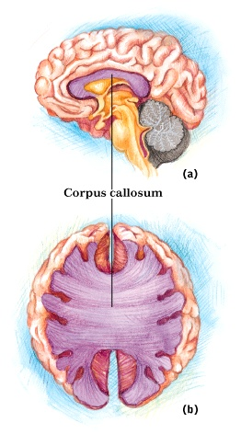
Lesson 1: Multimedia materials can enhance learning
EXAMPLE: dual coding of the information in two or more modalities (visual + auditory, text + images)
Adding the illustration helps students understand the
verbal description.
The corpus callosum is a band of neural fibers connecting the two hemispheres

Slide 25
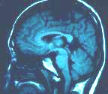
Lesson 2: Careful design of multimedia materials is important
Different media must support each other
  Synchronized timing is important
  Same terminology used in all media
The brainstem controls vital functions such as heart rate and breathing.
pons
The term “brainstem” in the
verbal description doesn’t appear as a label on the illustration, nor are the terms “pons” and “medulla” mentioned in the verbal description.
medulla

Slide 26
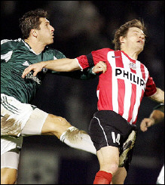
Lesson 2: Careful design of multimedia materials is important
Eliminate unnecessary media elements
  Flashing lights, unusual sounds, graphic photos might distract.
  Don’t include elements just for entertainment.
The intensity of pain perception depends in part on the number of nerve fibers in that particular region of the body.
The vivid image may capture the viewers’ attention, making it difficult for them to comprehend and remember the point about pain intensity explained in the verbal description.

Slide 27
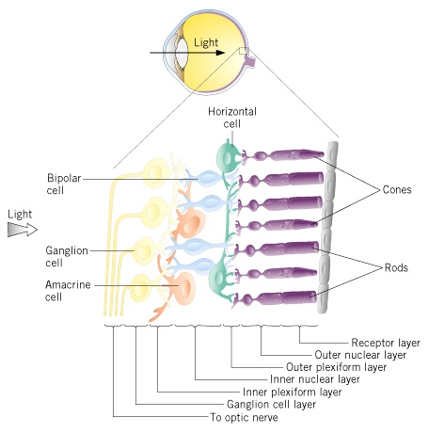
Lesson 2: Careful design of multimedia materials is important
Avoid cognitive overload
This is a good illustration of the retinal layers, but it simply contains too much information. This illustration should be broken into segments that are presented sequentially.

Slide 28
Lesson 3: Video is not always the best instructional solution
Video clips do have the greatest impact on student interest
    Video is the most popular type of media with students
    Video leads to the biggest increase in focused attention
But video clips don’t always produce the best comprehension of the key principles
    Students engage the video experience, but lose objectivity
    Students often fail to see the connections between events in the video and psychological principles

Slide 29
Lesson 4: Interactive animations are (can be) the most effective media
Can simulate events that can’t be shown in other media formats
  More “value added” than other types of media
Can show dynamic processes over time
  Slower or faster than “real-time”
Best when self-paced and paired with narration
  Explanatory text is helpful
  Audio narration is better

Slide 30
Summary of Lessons Learned
To raise interest level -- Students appreciate a variety of media, especially paired with "hands-on" learning activities.
To enhance understanding -- Multimedia materials paired with self-paced, repeatable instructional guidance can increase student comprehension of complex topics.
To increase memorability -- Use of multimedia leads to better encoding at multiple levels and easier, more complete retrieval of the information.
To expand instruction -- Computer-based homework activities can provide in-depth coverage of topics not covered in class.

Slide 31
Roadmap
A little history -- Technology Trends
Some lessons learned
A few demonstrations
Some examples of the changes

Slide 32
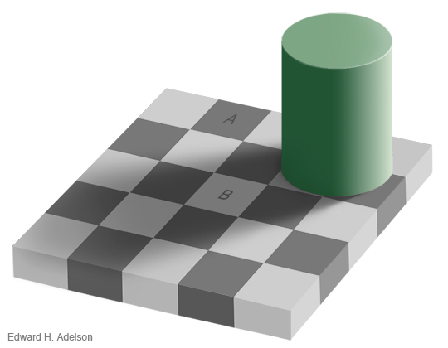
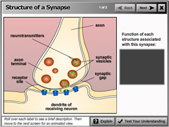
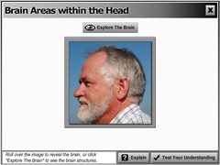
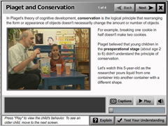


Activity Demonstrations

Slide 33




Activity Demonstrations

Slide 34





Activity Demonstrations

Slide 35
Using Multimedia Instructional Materials: Best Practices for the Teaching of Psychology
Thomas E. Ludwig
Hope College
Holland, Michigan U.S.A

