Slide 1
Image and Identity in Online Discussions:
Using pseudonymity in social psychology teaching
Andrea Chester¹ & Agi O’Hara²
¹ RMIT University, Australia
² University of Sydney, Australia

Slide 2
Research Aims
How and why do students choose to represent themselves in asynchronous online discussions?
  Name – real or pseudonym
  Image – real or constructed
What implications do these self-presentational choices have for learning and teaching?

Slide 3
Method: Participants
Students enrolled in undergraduate Social Psychology courses at two Australian universities
140 students (113 female, 27 male)

Slide 4
Method: Measures
Pre-test
  Demographics
  Self-presentation choice
  Group choice

Slide 5
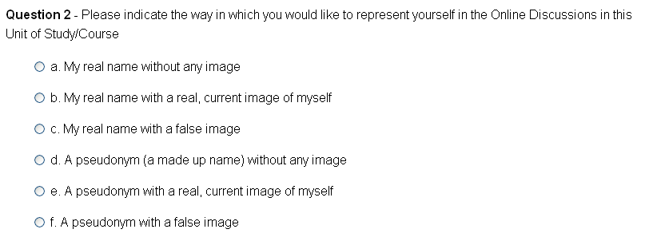
Method: Measures
Pre-test
  Demographics
  Self-presentation choice
  Group choice

Slide 6
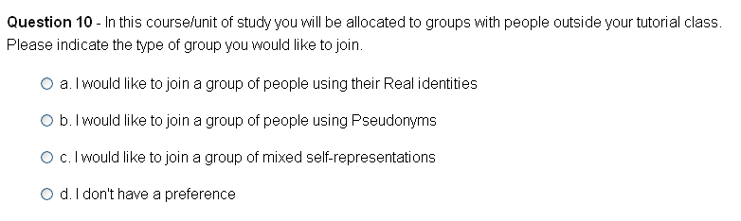
Method: Measures
Pre-test
  Demographics
  Self-presentation choice
  Group choice

Slide 7
Method: Measures
Post-test
  Self-presentation satisfaction
  Self-presentation choice for next time
  Educational value of learning task
  Impression of group – Impression Development Measure (Walther,1993)

Slide 8
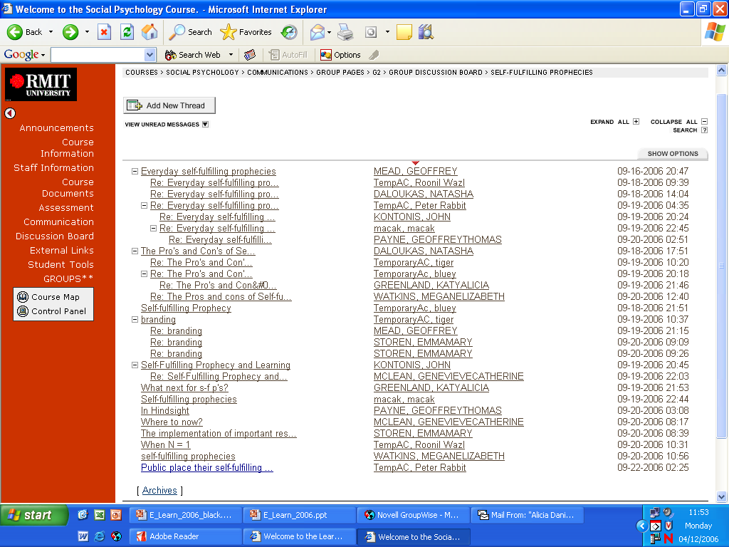
Method: Measures

Slide 9
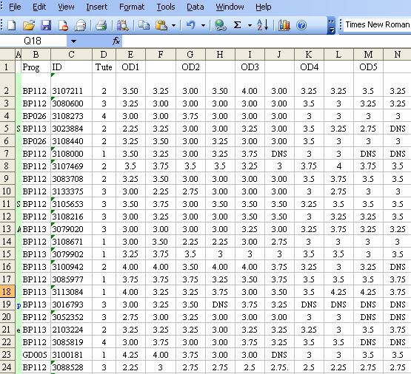
Method: Measures

Slide 10
Method: Procedure
Students allocated to Online Discussion Groups within courses (n = 20).
Asynchronous online discussions conducted for 9 weeks, requiring contributions to at least 5 topics.
Online discussions conducted on WebCT and Blackboard.

Slide 11
Results
Response rate
  Pre-test - N = 140
  Post-test - N = 96
  Characteristics of responders

Slide 12

Results: Self-presentation

Slide 13
Results: Self-presentation
Examples of pseudonyms
  Celebrities and well-known characters
  Madonna, Bob Marley, Veruca Salt, peter rabbit
  Generic fantasy
  Mermaid_4, angel01, Pirate
  Inanimate objects
  kiwifruit, rice cracker, feathers
  Names and nicknames
  fat_nat, chang, billie
Notes:
These categories are consistent with previous research on alias choice in social contexts online (e.g., Bechar-Israeli, 1996; Chester, 2004)

Slide 14
Results: Self-presentation
Reasons for choosing a pseudonym
Freedom to express opinions without being judged or stereotyped
This is a chance for me to express myself freely without having to worry about people's perception of me.
It will be easier to express what I truly believe, as I will not worry that people will judge me.
Encourage honesty
I would feel more comfortable expressing my personal opinions and disagreeing with what is being said if people didn't know who the comment was coming from.
I expect it will promote more honest and lively discussion this way.
Experimentation, curiosity and fun
i would like to see what response i will receive without people knowing who i am.
Because anonymity is fun!

Slide 15
Results: Self-presentation
Reasons for choosing to use one’s real name
Importance of owning one’s opinions
I feel that when offering an opinion you should be willing to have that opinion associated with your real name. If you don’t, then you probably shouldn’t be offering it.
There is no shame in having your own opinions. If you believe in something enough to voice it, you should be willing to put your name to your argument.
Context makes it simpler for others
It is easier for people who know me to understand where I am coming from if they know who is speaking. It is just easier to make sense of.
Easier option
I can't be bothered making up a name…

Slide 16

Results: Self-presentation

Slide 17
Results: Self-presentation
Reasons for using an image
Communication of complexity, ambiguity, and context
because a picture of something else can often say more about you than a photo. It represents more than physical appearance. It can represent emotions, attitudes and ideas. (constructed image)
A picture provides extra information (which therefore avoids the difficult task of describing oneself) and helps the reader create a voice for the words they are reading. Additionally, people usually want to know what a person looks like when they are talking to them. (real, current image)

Slide 18

Results: Self-presentation
Notes:
Either:
Genuinely satisfied with their self-presentation – chose what worked well for them.
Cognitive dissonance reduction.

Slide 19

Results: Self-presentation
Notes:
t

Slide 20
Results: Self-presentation
Student perception of disadvantage associated with use of real name.
I would in hindsight have used an alias because I feel the tutors for this subject mark well people they like. I feel most students have been pigeon holed into categories, i.e. smart, etc.
Someone else had commented that they would have chosen a pseudonynm if they had known about the marking and everything. I felt that maybe having chosen to present ourselves with our real names could have possibly resulted in bias when our tutors marked our weekly contributions.

Slide 21
Results: Self-presentation
Did self-presentation make a difference to grades?
Students who used their real name got higher average marks for their online contributions than those who used a pseudonym, t (63) = 2.27, p = .026, d =.56.
Notes:
Three reasons:
Better students chose to use their real name.
Real name leads to increased conscientiousness.
Tutors use the real name context to the students’ advantage.

Slide 22
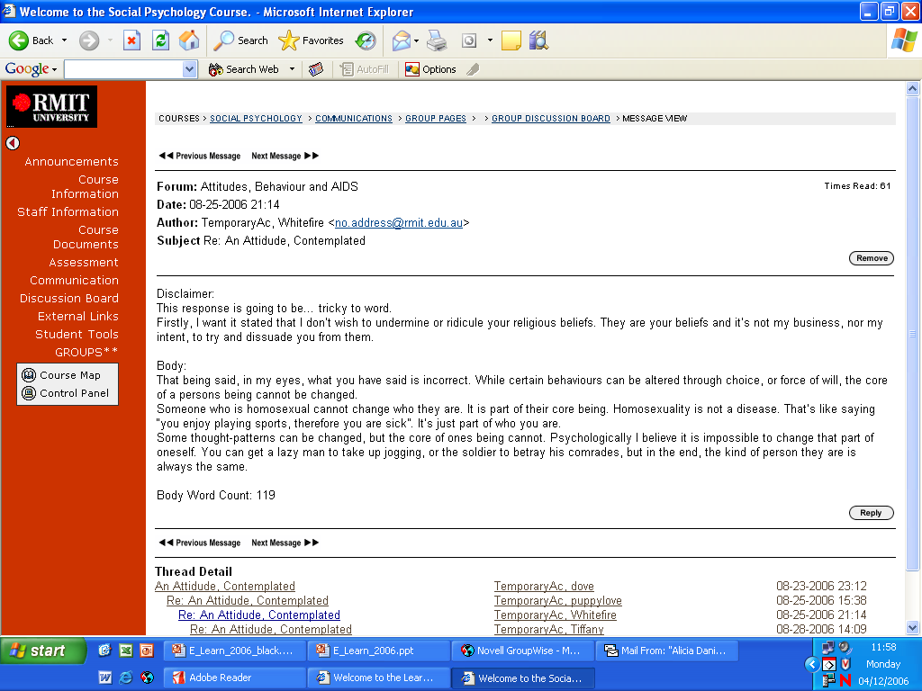
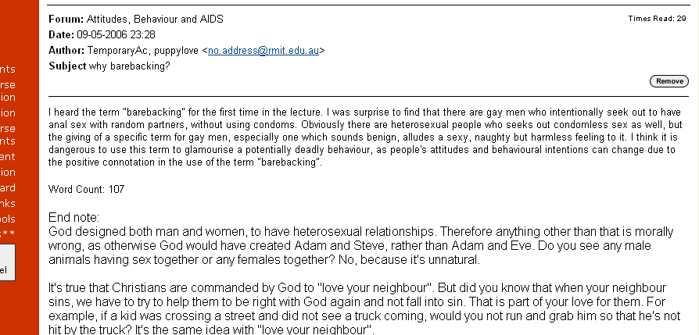
Notes:
Protocol – I made a comment to the group about freedom of speech, respect for difference and this started a thread reflecting on the nature of the group and the interactions as a result of psedonymity. Invited mid-semester feedback from all students.

Slide 23
Results: Self-presentation
Mid-semester feedback
Is there anything you would like to see changed? If so, how might it best be changed?
  Discussion board comments: some comments are all opinion and very discriminating – I am offended by some posts. It should be a place of learning and helping/solving social problems, not an open slather on minority groups (see Group 3 esp. Attribution and AIDS) Needs to be explained to some people more clearly.
  Discussion boards – some people are taking it a bit out hand and posting discriminatory content in group (3).
  Online discussions are intimidating. Groups 3 has had comments posted which are highly offensive and upsetting. It has potential to be all those things a good tute can be, that is, open, reflective, safe and helpful. I would appreciate boundaries and control in order to make these safe places for all students, no sounding boards or platforms for soap boxes to be lectured from. I have discussed this with other students who also feel intimidated and offended.

Slide 24

Results: Educational value

Slide 25
Results: Educational value
Did self-presentation make a difference?
Satisfaction with learning task was not dependent on self-presentation choice
Satisfaction with learning task was not correlated with satisfaction with self-presentation

Slide 26
Implications and conclusions
There is variation in the ways students choose to present themselves in the online discussions.
Generally students are satisfied with these choices and their learning in the task.
Some students who use a real name are interested in experimenting with a pseudonym next time, however…
Using one’s real name can be an advantage.

Slide 27
Implications and conclusions
Cautions:
Ethical issues
How well can we generalise from these social psychology courses to other courses?

Slide 28
Implications and conclusions
Offer students (and staff) self-presentation choices
Encourage reflective self-presentation
Make choices easy for students
Be prepared to manage disinhibition

