Slide 1
TRANSNATIONAL STUDENT ONLINE COLLABORATION: DOES IT REDUCE ETHNOCENTRISM?
Hermann Kurthen
Grand Valley State University, Michigan, USA
kurthenh@gvsu.edu
Acknowledgements:
The author wishes to thank Diane Boehm (Saginaw Valley State University, MI, USA) and
Lilianna Aniola-Jedrzejek (Poznan University of Technology, Poznan, Poland) for their help in data collection
Please do not cite or distribute this content without author permission

Slide 2
Research Purpose & Instruments
The purpose of this presentation is to investigate the measurable effect of transnational online student collaboration on ethnocentrist attitudes (mediated by demographics such as age, gender, residence, religiosity, political attitudes, etc.) and the role of cultural factors, such as a person's degree of collectivism/individualism.
My research employs two well-known instruments:
  Neuliep's/McCroskey's (1997) GENE ethnocentrism scale and the
  Individualism/Collectivism scale developed by Triandis (1995) and derived from earlier attempts by Adorno et al. (1950)

Slide 3
Research Question
Two concepts of cultural psychology, ‘ethnocentrism’ (Neuliep) and ‘collectivism/individualism’ (Triandis) have frequently been applied to the study of intercultural communication.
Ethnocentrism and collectivism/individualism are considered barriers to effective and competent intercultural communication.
With the global revolution in E-learning in recent years the question has been raised whether transnational student online collaboration results in an increase of intercultural awareness and a reduction of ethnocentric and collectivist attitudes (Brislin 1993).

Slide 4
Literature Review
Previous studies have examined the impact of intercultural online student exchanges, primarily in language learning confirming “the value of network-based interactions for the development of intercultural learning” (O’Dowd, 2003, p. 137). They found that
  Language learning in online interaction can be hampered by ethnocentric stereotypes (O’Dowd 2003)
  Culture acts a a filter in intercultural exchanges (Neuliep 2002)
  Intercultural learning can also be influenced by collectivist/individualist environment (Triandis 1995)
O’Dowd warns against the assumption that contact between cultures, including virtual intercultural contact, “automatically leads to intercultural learning and to the development of positive attitudes toward the target culture” (O’Dowd, 2003, p. 118)
  O’Dowd cautions that “intercultural exchanges which fail to function properly can lead to a reinforcement of stereotypes and a confirmation of negative attitudes” (O’Dowd, 2003, p. 138).
However, previous studies have been limited, in that they
  did not require students to complete a collaborative project (Belz, 2002),
  or used email as the primary or only interaction tool (O’Dowd, 2003),
  or had a different focus, such as ‘cultural literacy’ (Furstenberg, Levet, English, & Maillet, 2001)

Slide 5
What is Ethnocentrism?
In 1906, Sumner defined ethnocentrism as “the technical name for this view of things in which one’s own group is the center of everything, and all others are scaled and rated with reference to it” (p. 13).
The concept of ethnocentrism has evolved since its introduction. In 1950, Levinson stated that ethnocentrism is “based on a pervasive and rigid ingroup-outgroup distinction; it involves stereotyped, negative imagery and hostile attitudes regarding outgroups, stereotyped positive imagery and submissive attitudes regarding ingroups, and a hierarchical, authoritarian view of group interaction in which ingroups are rightly dominant, outgroups subordinate" (p. 150).

Slide 6
Understanding Ethnocentrism
Ethnocentrism is the tendency to use one’s own culture as the standard for judging and evaluating the values, attitudes and behaviors of another culture
Ethnocentrism is universal (Neuliep, 2002)
Ethnocentrism creates barriers to effective and competent intercultural communication (Neuliep and McCroskey, 1997)
Ethnocentrism remains invisible until or unless some experience activates it
(Crampton & Hinds, 2005)

Slide 7
The generalized Ethnocentrism Scale (GENE) by Neuliep
Measures individual differences in ethnocentrism
Developed in 1997; widely used
15 of 22 items on a Likert scale are used to calculate ethnocentrism with a score range between 27 (=lowest) and 63 (= highest)

Slide 8
Generalized Generalized EthnocentrismScale (GENE)
Neuliep (2002)
1. Most other cultures are backward compared to my culture.
2. My culture should be the role model for other cultures.
3. People from other cultures act strange when they come into my culture. f
4. Lifestyles in other cultures are just as valid as those in my culture.*
5. Other cultures should try to be more like my culture.
6. I am not interested in the values and customs of other cultures. f
7. People in my culture could learn a lot from people in other cultures.*
8. Most people from other cultures just don’t know what is good for them.
9. I respect the values and customs of other cultures.*
10. Other cultures are smart to look up to our culture.
11. Most people would be happier if hey lived like people in my culture.
12. I have many friends from different cultures. f
13. People in my culture have just about the best lifestyles of anywhere.
14. Lifestyles in other cultures are not as valid as those in my culture.
15. I am very interested in the values and customs of other cultures. f
16. I apply my values with judging people who are different. f
17. I see people who are similar to me as virtuous. f
18. I do not cooperate with people who are different.
19. Most people in my culture just don’t know what is good for them. f
20. I do not trust people who are different.
21. I dislike interacting with people from different cultures.
22. I have little respect for the values and customs of other cultures.
*=reverse scored, f=filler

Slide 9
The concept of Individualism – Collectivism (I/C)
Since the 1960s when Hofstede first measured individualism and collectivism across cultures, the original two-dimensional conceptualization has been a successful predictor of behavioral patterns (Triandis and Gelfand, 1998; Wheeler et al., 1989) and is now considered fundamental to the understanding of cultural values (Triandis, 2004; Triandis et al., 1988).

Slide 10
Four types of Individualism-Collectivism
(Triandis, 2001; Triandis & Suh, 2002)
From Triandis' conceptualization, four types of cultures can be identified:
(1) Horizontal Individualism (HI-uniqueness) where people strive to be unique and do their own thing;
(2) Vertical Individualism (VI-achievement oriented) where people want to do their own thing and strive to be the best;
(3) Horizontal Collectivism (HC-cooperativeness) where people merge themselves with their in-groups;
(4) Vertical Collectivism (VC-dutifulness) where people submit to the authorities of the in-group and are willing to sacrifice themselves for their in-group

Slide 11
Individualism-Collectivism Scale
Using a 32-item, ten-point, Likert-type scale ranging from 1=Strongly Disagree, 5= Undecided, and 10=Strongly Agree, each of the four dimensions was measured:
  (1) horizontal individualism (HI)
  (2) vertical individualism (VI)
  (3) horizontal collectivism (HC)
  (4) vertical collectivism (VC)
Based on extensive testing, Sivadas et al (2008) recommended for cross-national research the use of only 14-items out of the original 32 items of the SELF scale. In this research, I followed Sivadas and in my final data analysis used his revised scale representing 3 HI, 3 VI, 4 HC, and 4 VC items only
Measures representing the above mentioned four cultural orientations included statements such as
  "I often do ‘my own thing’ "(HI item)
  “Competition is the law of nature" (VI item)
  "If a coworker gets a prize, I would feel proud" (HC item)
  “I usually sacrifice my self-interest for the benefits of my group" (VC item)
For the purpose of this research only standardized horizontal individualism and vertical collectivism attitude scales were used because they reflect two opposite sides of a continuum of attitudes

Slide 12
Research Design & Samples
Non-random quasi experimental control group pretest-posttest design
Samples were taken from 328 undergraduate students at Saginaw Valley State University/Michigan U.S.A and 118 undergraduate students at Poznan Technical University/Poland
Time periods: Fall 2006, Spring 2007, Fall 2007, Spring 2008 Types of students: Undergraduates
Demographic characteristics: Mean Age: 20/21, 2 years in College, 78% female in Michigan, 36% in Poland
Experimental groups were involved in six week transnational online collaboration using a Sakai course management system to carry out asynchronous and synchronous virtual tasks via Discussion board, Email, Wiki, Virtual chat & Skype
Online collaboration tasks: Completion of a joint project and presentation. Projects ranged from analyses of cultural contrasts in politics, energy, the job market (SVSU freshmen students) to the development of case studies on complex cultural issues such as immigration/emigration, workplace ethics, and systems of education (SVSU upperclass students, see Boehm and Aniola-Jedrzejek, 2006).

Slide 13
Instruments
1. The study was carried out voluntarily & confidential. Questionnaires were administered in the classroom
2. After a brief explanation by instructors, students in the experimental and control groups were asked to fill out questionnaires during the first week of the online collaboration
3. On the sixth week of the online collaboration the identical questionnaire was administered again to the same experimental and control groups
4. The questionnaire consisted of
  an identifier to match respondents pre and post questionnaires
  the GENE ethnocentrism scale with 22 questions
  the individualism/collectivism scale with 32 questions
  eleven demographic questions about respondent’s Sex, Age, Year in college, Ethno-national background, Residential background, News sources use, Political leaning, Religious affiliation, Attendance of religious services, Family size, Study major

Slide 14
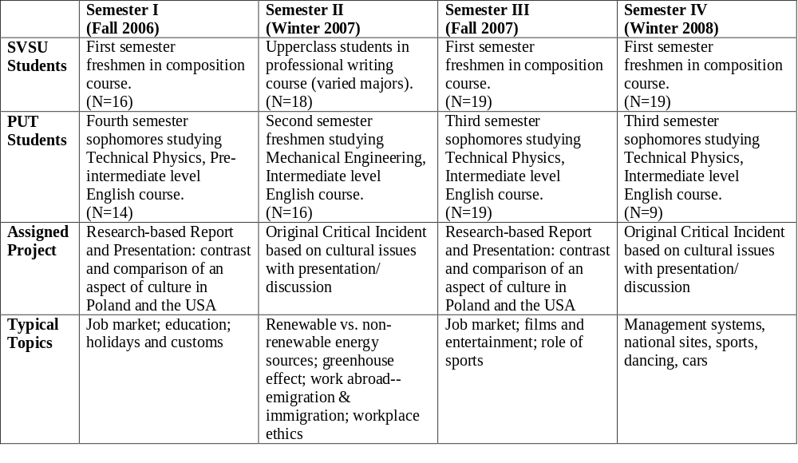

Slide 15
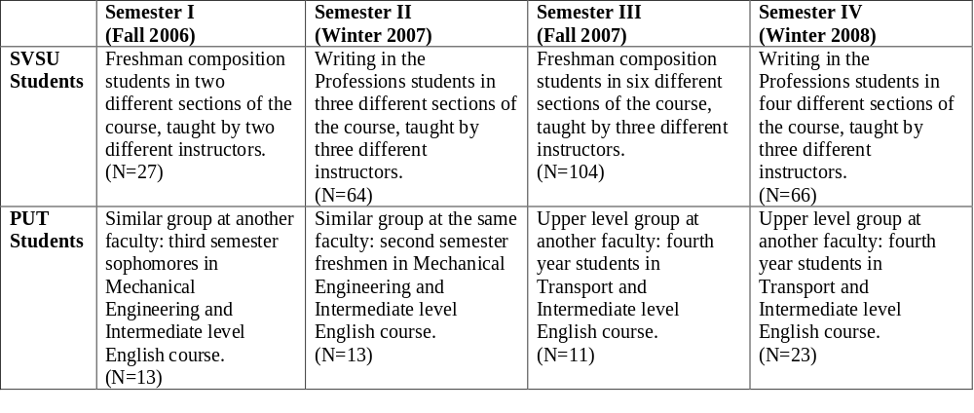

Slide 16
Study Hypotheses I
1. Participation in online collaboration
  reduces ethnocentric attitudes in college students, and
  reduces vertical collectivist attitudes, and
  increases horizontal individualist attitudes
2. Ethnocentrism is
  negatively correlated with horizontal individualist attitudes, and
  positively correlated with vertical collectivist attitudes

Slide 17
Study Hypotheses II
3. More secular and urban students are in general
  less ethnocentric, and have
  higher scores on horizontal individualistic attitudes, and
  lower scores on vertical collectivistic attitudes
4. Because the Polish culture is less diverse and has a more ‘collectivist’ history and culture
  ethnocentrism scores of Polish students are on average higher compared to those of U.S. students, and
  horizontal collectivist scores of Polish students are on average higher compared to those of U.S. students, and
  Vertical individualist scores of Polish students are on average lower compared to those of U.S. students

Slide 18
Study Hypotheses III
5. On average we can observe among secular and urban students the greatest ethnocentric attitude reduction as a result of online participation
6. As a result of online collaboration the average ethnocentrism scores decreased relatively stronger among U.S. students because of their comparatively stronger individualist culture compared to Polish students
7. The translation of the questionnaire into Polish language after the third semester in Spring 2008 significantly increased the understanding of the survey questions among Polish control group respondents who were not as much fluent in English compared to the experimental Polish student sample who interacted with U.S. students as part of their online collaboration

Slide 19
Samples and Scales
Sample Testing
  Are experimental and control samples from the same population for each semester and each college?
  Nonparametric Mann-Whitney Independent Samples Tests confirmed this assumption for GENE, Horizontal Individualism, and Vertical Collectivism scales with the exception of
    Horizontal Individualism Scale: Polish sample of Fall 2006 pre Experimental-pre Control groups (p. = .048, Mann-Whitney test)
    Vertical Collectivism Scale: U.S. sample of Spring 2008 pre Experimental-pre Control groups (p. = .018, Mann-Whitney test)
Scale Testing
  Is the reliability of the GENE and HI/VC scales sufficient, i.e. > 0.5?
  Alpha Reliability test confirmed this assumption with the exception of
    GENE Scale for the Polish sample of Spring 2007 (Alpha = .464)
    Vertical Collectivism Scale for Poland Fall 2006 (Alpha = .072)
    Vertical Collectivism Scale for Poland Spring 2007 (Alpha = .300)

Slide 20
Finding Hypothesis 1.1
1.1 Participation in online collaboration reduces ethnocentric attitudes in college students
This hypothesis is not confirmed
  There is no statistical significant effect observed using several tests like Nonparametric Independent Variable test and Parametric Independent Samples t-test on pre-post Gain variables, ANCOVA & ANOVA tests on pre-post pair variables

Slide 21
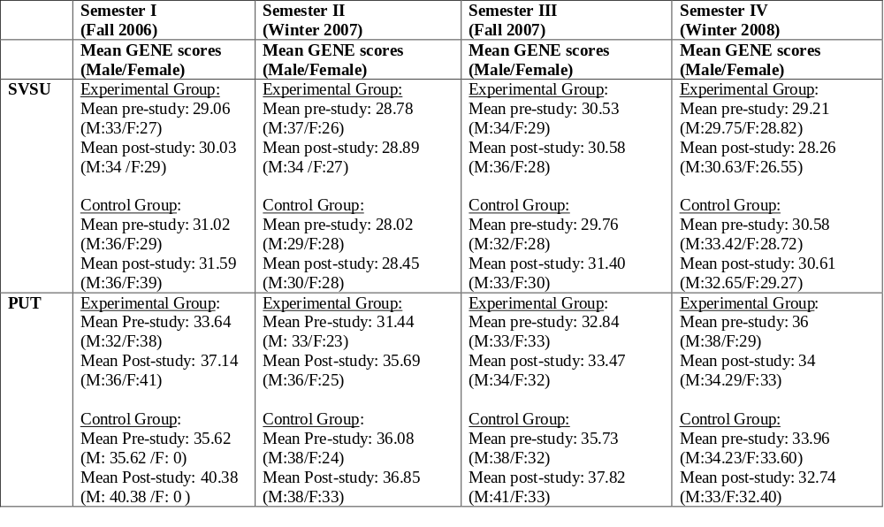

Slide 22
Finding Hypothesis 1.2
1.2 Participation in online collaboration reduces vertical collectivist attitudes in college students
For most samples this hypothesis was not confirmed with the exception of
  A Nonparametric Independent Sample Mann-Whitney test found a statistical significant difference on pre-post gain scores comparing experimental and control groups only for the
    U.S. sample for Fall 2006 (p. = .021) with an experimental group Mean difference of 27.75 versus a control group Mean rank difference of 18.59
  An Independent Samples t-test found a statistical significant difference on pre-post gain scores comparing experimental and control groups only for the
    U.S. sample for Fall 2006 (p. = .011 equal variance not assumed respectively p.= .016 equal variance assumed) with experimental group Mean scores of .6280 and control group scores of -.5025
  An Independent Samples t-test found a statistical significant difference on pre-post gain scores comparing experimental and control groups only for the
    U.S. sample for Spring 2008 (p.= .025 equal variance not assumed respectively p.= 015 equal variance assumed) with experimental group post scores of -1.3570 compared to control group post scores of -.0216
  A Matched Pairs t-test found statistically significant differences between pre-post scores for the
    U.S. sample of Fall 2006 pre-post experimental groups (p.= 053) and the
    U.S. sample of Spring 2008 pre-post control groups (p.= .013)
  A General Linear Model ANCOVA on pre-post pairs found statistically significant differences between control and experimental groups only for the
    U.S. sample Fall 2006 (p.= 025)
  ANOVA to test the effect of online participation on pre-post gain scores found that there was a statistically significant difference only for the
    U.S. sample of Fall 2006 (p.= .016, and with p. =.011 for the Equality of Means test ( p.= .011)

Slide 23
Finding Hypothesis 1.3
1.3 Participation in online collaboration increases horizontal individualist attitudes in college students
For most samples this hypothesis was not confirmed with the exception of
  A Parametric Independent Samples T-test found a statistical significant difference on experimental versus control group scores only for the
    Polish sample for Fall 2006 (p.= .021) with experimental group post Mean scores of 1.1742 versus control group post scores of -1.0038
  An Independent Samples t-test found a statistical significant difference on pre-post gain scores comparing experimental and control groups only for the
    Polish sample for Fall 2007 (p.= .050 equal variance not assumed respectively p. = .034 equal variance assumed) with experimental group post scores of 1.1354 compared to control group post scores of -1.295
  Matched Pairs t-test found statistically significant differences between Control and Experimental group only for the
    U.S. sample of Spring 2008 pre-Post Control groups (p.= .059)
  A General Linear Model ANCOVA on pre-post pairs found statistically significant differences between control and experimental groups only for the
    Polish sample of Fall 2006 (p.= 037).

Slide 24
Finding Hypothesis 2
2.1 Ethnocentrism is negatively correlated with horizontal individualist attitudes
This hypothesis is confirmed:
  U.S. sample: Chi Square p. = .003 and Kendall’s tau b, p. =.009
  Polish sample: Chi Square p. = .860 and Kendalls’ tau b, p. = .744
2.2 Ethnocentrism is positively correlated with vertical collectivist attitudes
This hypothesis is supported for the Polish sample – though not with statistical significance (Chi Square p. = .408, Kendalls’ tau b, p. = .699)
This hypothesis is not confirmed for the U.S. sample because the relationship was negative and statistically significant (Chi Square p. = .014, Kendall’s tau b, p. =.008)
  Test: Crosstabulation with ordinal measures

Slide 25
Finding Hypothesis 3.1
3.1 More secular and urban students are in general less ethnocentric
This hypothesis is partially confirmed for U.S. (N=656 pre & post) but has to be rejected for the Polish sample (N=236 pre & post) using Multiple Linear Regression
  U.S. Sample: Adj R square =.141 with GENE as dependent variable
  Ethnocentrism was statistically significant correlated with low Horizontal Individualism scores (p.=.000), low Vertical Collectivism scores (p.= 000), male sex (p.= 000), younger age (p.= 000), being politically not Left or Liberal (p .000), and not majoring in Business or Social Sciences (p.= 032)
  Polish Sample: Adj R square =. 70 with GENE as dependent variable
  Ethnocentrism was statistically significant positively correlated with male sex (p .001) and large family size (p.= 033). [The Polish regression excluded ethnicity and study major]
NOTE: Previous studies have found statistically significant GENE scale gender differences (e.g., Goldstein & Kim, 2006, found men’s mean of 35.5 compared to women’s mean of 30.6)

Slide 26
Finding Hypothesis 3.2
3.2 More secular and urban students have in general higher scores on horizontal individualistic attitudes
This hypothesis is neither confirmed for the U.S. (N=656 pre & post) nor for the Polish sample (N=236 pre & post) using Multiple Linear Regression
  U.S. Sample: Adj R square =.071 with Horizontal Individualism as dependent variable
  Horizontal Individualism was statistically significant negatively correlated with Ethnocentrism (p.= 000) and Vertical Collectivism (p .000) but positively with non-Caucasian respondents (p.= .018) and not majoring in Business or Social Sciences (p.= 049)
  Polish Sample: AdjR square =.083 with Horizontal Individualism as dependent variable.
  Horizontal Individualism was statistically significant negatively correlated with Vertical Individualism (p.= 000) and positively with large family size (p.= 002)
3.3 More secular and urban students have in general lower scores on vertical collectivistic attitudes
This hypothesis is partially confirmed for the U.S. and for the Polish sample using Multiple Linear Regression
  U.S. Sample: Adj R square =.088 with Vertical Collectivism as dependent variable
  Vertical Collectivism was statistically significant negatively correlated with ethnocentrism (p.= 002) and Horizontal Individualism (p.= 000) but positively with regular church attendance (p .029)
  Polish Sample: Adj R square = .120 with Vertical Collectivism as dependent variable
  Vertical Collectivism was statistically significant negatively correlated with Horizontal Individualism (p.= 000) but positively correlated with online collaboration (p.= 014), older age (p.= 007), residing in urban cities larger than 50,000 population (p.= 003), and large family size (p.= 021).

Slide 27
Finding Hypothesis 4
Because the Polish culture is less diverse and has a more ‘collectivist’ history and culture
4.1 ethnocentrism scores of Polish students are on average higher compared to those of U.S. students, and
This hypothesis is confirmed.
  Ethnocentrism levels in Poland (Mean 34.82, S.D. = 6.67) are statistically significant (p. =.000) higher in Poland compared to U.S. ethnocentrism (29.93, S.D.= 7.00) levels
4.2 horizontal collectivist scores of Polish students are on average higher compared to those of U.S. students, and
This hypothesis is confirmed.
  Horizontal Individualism levels in Poland (Mean .5267, S.D. =1.91) are statistically significant (p. =.000) lower in Poland compared to U.S. sample (1.3866, S.D. =1.59)
4.3 Vertical individualist scores of Polish students are on average lower compared to those of U.S. students
This hypothesis is rejected.
  In Poland Vertical Collectivism scores (Mean =-.7108, S.D. =1.92) are lower (though NOT statistically significant according to T-Test with p. =. 683 and NPAR Mann-Whitney test p. =.887) compared to the U.S. sample (Mean =-.7748, S.D. =2.12)
Tests: Independent Samples T-Test for MEAN & Nonparametric t-Test for MEANS

Slide 28
Finding Hypothesis 5
5. On average we can observe among secular and urban students the greatest ethnocentric attitude reduction as a result of online participation
This hypothesis is not confirmed for both the U.S. (N=656) and the Polish samples (N=236) using Multiple Linear Regression
  U.S. Sample: Adj R square =.000 with GENE Gain Pre-Post score difference as dependent variable
  The variance of the dependent variable was not statistically significant correlated with any of the independent variables
  Polish Sample: AdjR square =-.004 with GENE Gain Pre-Post score difference as dependent variable
  The variance of the dependent variable was statistically significantly correlated only with younger age of respondents (p.=.029)

Slide 29
Finding Hypothesis 6
6. As a result of online collaboration the average ethnocentrism scores decreased relatively stronger among U.S. students because of their comparatively stronger individualist culture compared to Polish students
This hypothesis is rejected both for the U.S. and Polish sample
  Independent Samples T-Test pre-post ethnocentrism differences were not statistically significant with p. = .071 (equal variances assumed). The Nonparametric t-Test pre-post ethnocentrism difference was p. = .077 (Mann-Whitney test).
  The Polish Mean of Gain scores was -1.64 (S.D.: 5.78)
  The U.S. Mean of Gain scores was .00 (S.D.: 4.45)

Slide 30
Finding Hypothesis 7
7. The translation of the questionnaire into Polish language after the third semester in Spring 2008 significantly increased the understanding of the survey questions among Polish control group respondents who were not as much fluent in English compared to the experimental Polish student sample who interacted with U.S. students as part of their online collaboration
This hypothesis is statistically significant confirmed comparing the Polish control sample scores before and after the introduction of the questionnaire translation
  Gene scale Mean before translation 37.04 (S.D.= 7.00) and Mean after translation 33.35 (S.D.=5.41) with Indep. Samples T-Test p.=.002 (equal variance assumed) and NPAR t-test p. =.002 (Mann-Whitney)
  Horizontal Individualism Mean before translation -.0339 (S.D.= 1.86) and Mean after translation .8251 (S.D.=2.26) with Indep. Samples T-Test t-Test p.=.025 (equal variance assumed) and NPAR t-test p. =.019 (Mann-Whitney)
  Vertical Collectivism Mean before translation -.4817 (S.D.= 1.66) and Mean after translation 1.4138 (S.D.=2.16) with Indep. Samples T-Test t-Test p.=.009 (equal variance assumed) and NPAR t-test p. =.030 (Mann-Whitney).
The equivalent comparison of Polish experimental sample scores before and after the introduction of the questionnaire translation found no statistically significant differences between the samples

Slide 31
Short Summary of Findings
Hypotheses about a statistically significant impact of a six week Polish-American student online collaboration on ethnocentrism respectively collectivist/individualist attitudes were not supported by our four semester empirical investigation
The relationship between ethnocentrism and individualist/collectivism is also not as clear-cut as assumed. However, there seems to be a positive relationships between ethnocentrism and vertical collectivism as well as a negative one between ethnocentrism and horizontal individualism
Ethnocentrism and collectivism scores were on average lower for American students as expected. But this fact had no impact on the degree of attitude change as a result of participation in transnational student online collaboration
With the exception of gender (with males in Poland and the U.S. having on average statistically significant higher ethnocentrism scores regardless of online participation) we did not find clear cut effects of other demographic characteristic of students on ethnocentrism or individualist/collectivist attitudes

Slide 32
Possible Explanation of Findings
The measurement instruments used in this study (GENE, Individualism/Collectivism scales) could be insufficient to measure the impact of online teaching on intercultural learning and ethnocentrism
Short-time transnational online collaboration projects do not effectively change student attitudes – they may even have a counterproductive effect under certain circumstances and promote ethnocentrism, stereotyping and prejudice
Intercultural learning depends on a number of respondent characteristics and environmental factors that were not measured in this study
Intercultural learning takes time to ‘sink in.’ Therefore it is recommended to repeat measurements at later time intervals (3, 6, 12 or more months…)
Intercultural learning requires further stimuli and follow-up activities to have a lasting effect, such as travel/study abroad experiences, development of personal relationships or contacts across boundaries, intercultural awareness training, additional courses, etc

Slide 33
Suggestions
Undertake more research to better understand the factors contributing to ethnocentrism and its reduction as a result of transnational student online collaboration
Offer more opportunities for various types of and tools for transnational online collaboration, intercultural learning, course syllabi, cultural awareness courses as a feasible mass-alternative to study abroad programs
Educators should keep in mind that the primary reasons for the expansion of transnational student online collaboration are demands for training to better cope with economic and technological demands of globalization. Intercultural learning is in itself in most cases only considered a benign side effect. The question for interested educators is to match and promote intercultural awareness AND global training most effectively and develop ‘best practices’ of online teaching & collaboration to promote this new tool or global interaction and learning (Kurthen 2008)

