Slide 1

Collaborative Group Podcasts in Psychology:
Reflections and Reactions from Students
Hannah Barton, Christine Horn, Philip Penny and Mark Riordan
IADT, School of Creative Technologies

Slide 2
Students as Architects of Podcasts Does it work?- Background
B. Science in Psychology applied to IT now Applied Psychology
50% course Psychology and 50% Technology.
Students in year 3 group IT project.
Psychological Society of Ireland Accreditation.
Msc. in Applied Cyberpsychology
Social Psychology Module-
40% “ enforced Altruism” project
10% Group Podcast project

Slide 3
Students as Architects of Podcasts
Background - History
Previous studies:
  Pilot study looking at using iPods as assistive technology (2006). Multi - sensory, manageable chunks of information.
  Applied action research using a second year course and providing podcast summaries.
  Both were part of an EU funded study on mobile learning with Ericssons as the lead partner.
Current Study:
  Using podcasts to fully engage students in active learning and to encourage group and peer learning.

Slide 4
Students as Architects of Podcasts Theoretical Background
Duke University – issued over 1600 iPods to students in 2004 to record lectures. (Belanger 2005).
IMPALA project – cross institutional study of impact of podcasting on distance & campus based learning (Edirisingha and Salmon 2007).
Most common use of podcasting: lecturers making podcast recordings of lectures for students to use as revision tools.
argued that this is “simply an extension of common practice of giving out electronic versions of lecture slides.” (Copley 2007).

Slide 5
Students as Architects of Podcasts Theoretical Background (2)
Prensky (2001) “ digital natives” in terms of their familiarity with technology.
Observation that most of the students are able to quickly master and use new technology. YouTube, Flicker, BeBo, Second Life.
Digital native defined as any tech-user under age of 30 who was born into the digital world.
Digital immigrants – over 30 and print world.

Slide 6
Students as Architects of Podcasts
Project - Learning Objectives
Podcasts were to be personalised group learning packages - to be created in terms of content and process by the students themselves. (Constructivism)
Improve team working skills
  Shared responsibility between all in order to reduce social loafing. (Collaboration)
Allow students control about learning
  High degree of autonomy - control over the content of the learning packages. ( Group Management)
  Enhance technical skills.

Slide 7
Students as Architects of Podcasts
Project - Methodology
5 groups with seven 3rd year students
Task for each group:
  Study 5 topics of Social Psychology, read at least 5 selected journal articles (Blackboard).
  Produce a 5-10 minute Podcast summary for each of the 5 topics - summaries were produced as a text file and converted to MP3 format using synthetic voice over (MAC, Leopard OS).
  Time allocated in class
  Students had 12 weeks for this project
  (4 students dropped out of the project).

Slide 8

Students as Architects of Podcasts
Project - Sample Podcasts
Sample Podcasts:
Compliance
Group Dynamics
Persuasion Summary
Social Cognition
Altruism

Slide 9
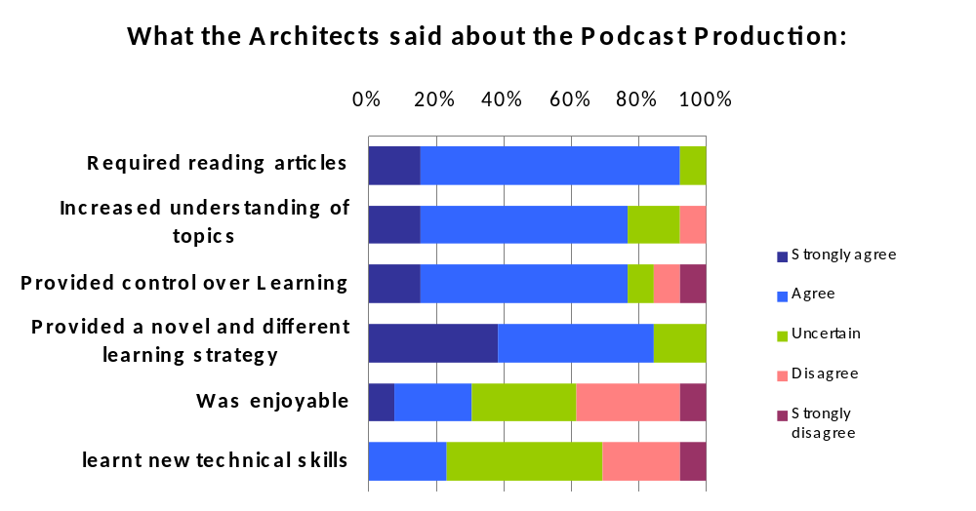
Students as Architects of Podcasts Does it work? - Results (1)

Slide 10
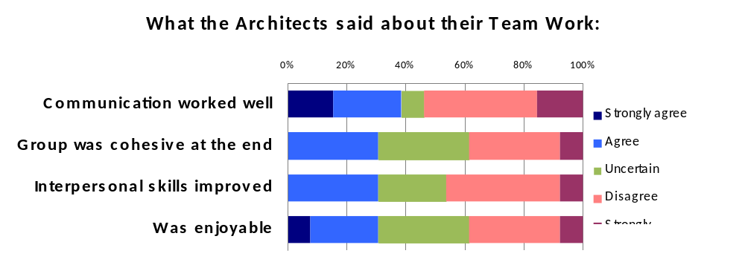
Students as Architects of Podcasts Does it work? – Results (Final)
Main Problems reported: “getting the group to meet ” (9x); communication problems (8x); workload (2x); Content related problems (2x)

Slide 11
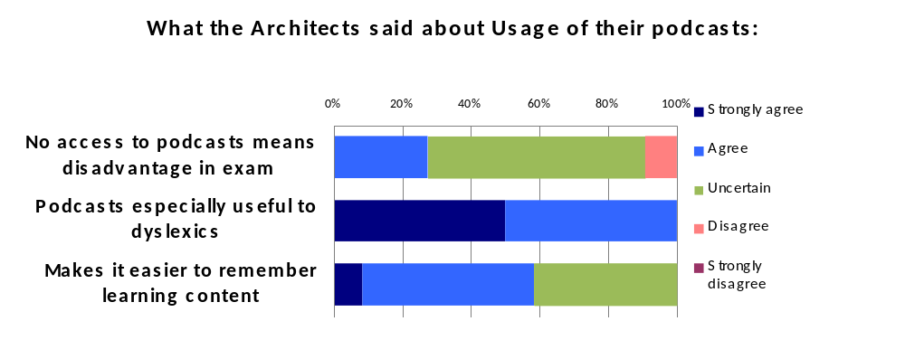
Students as Architects of Podcasts Does it work? - Results (3)
Main Benefits reported: increased understanding and useful for revision (3x), ease of learning, researching material….passive learning

Slide 12
Students as Architects of Podcasts
Does it work? - Discussion (1)
Learning Outcomes mostly achieved change in focus of study.
End of year affected sample size of post production and usage evaluation.
Importance of Transferable skills to be explicitly taught in curriculum.
Team size and interpersonal skills is important – students felt overwhelmed by big team.
Podcast production brought up time management and communication issues in all groups especially at the end of the project.
Technical aspects were not an issue and content related matters were minor.

Slide 13
Students as Architects of Podcasts
Does it work? - Discussion (2)
Students are very positive about podcasts; 80-90% own an MP3 player.
Students took control – more than anticipated. Instead of anticipated horizontal sharing (different persons for different topics) they shared workload vertically (researchers, writers and producers).
Role of lecturer – guide/ facilitator

Slide 14
Students as Architects of Podcasts
Does it work? - Lessons learnt
Group size matters- initial experiences positive in terms of cohesion (social loafing) and communication.
(Honeymoon Analysis) but then problems emerged.
Students are digital natives - support students in their collaborative work rather than on technical issues.
Start earlier in the year – Current study focussed so far on “Architects” – Podcast Production

Slide 15
Students as Architects of Podcasts Where do we go?
Mandatory workshops for first/ second year students in groups skills and group management, conflict resolution, mind mapping, critical thinking.
Re-survey 2008 podcast architects and users of these podcasts – extended focus on usage for exam preparation.
Did the podcasts have an effect on exam performance compared to other modules in year?
“Is this also valid for students in Business/Art?
Can students create “own mini animations “ ?
On-line element to aid in communication?
Exit interviews with dropout students.

Slide 16
Students as Architects of Podcasts
References (1)
Ashcraft, D., Treadwell, T. & Kumar, V. K. ( 2008). Collaborative Online Learning: A Constructivist Example. Merlot Journal of Online Learning and Teaching, Vol.4,(1)109-117.
Belanger, Y. (2005). Duke University iPod first year experience final evaluation report. Available online at http://cit.duke.edu/pdf/ipod_initiative_04_05.pdf (accessed 5th May 2008).
Boud, D.J. & Prosser, M.T. (1980). Sharing responsibility : staff- student cooperating in learning. British Journal of Education Technology, 11, 24-35.

Slide 17
Students as Architects of Podcasts References (2)
Copley, J. ( 2007). Audio and video podcasts of lectures for campus based students: production and evaluation of student use. Innovations in Education and Teaching International,Vol.44,(4) 387-399.
Edirisingha, P. & Salmon, G. (2007). Pedagogical models for podcasts in higher education. Draft report available online at http://www2.le.ac.uk/projects/impala/
Jacques, D. (2000). Learning in Groups. ( 3rd ed.). London: RoutledgeFalmer
Prensky, M. (2001). Digital Natives, Digital Immigrants. Retrieved May 2nd 2007. from http://www.Marcprensky.com/writing

Slide 18
Thank you for your attention!
Contact Details:
Hannah.Barton@iadt.ie
Christine.Horn@iadt.ie
Philip.Penny@iadt.ie
Mark.Riordan@iadt.ie

