Slide 1
Individual differences in statistics anxiety
Donncha Hanna
School of Psychology
QUB

Slide 2
Aims
Introduce statistical anxiety & relevance
Outline the potential antecedents of SA
Describe the on-line study & measures
Present the main findings

Slide 3
Statistics anxiety
Originally related to Maths Anxiety
The feelings of anxiety students experience when they encounter statistics
Experienced by 80%of students
    (Onwuegbuzie & Wilson, 2003)

Slide 4
Statistics anxiety & Psychology
Its important because:
It is detrimental to performance
    (Reviews: Baloglu & Zelhart, 2003;
    Onwuegbuzie & Wilson, 2000)
Psychology students must complete statistics component for accreditation

Slide 5
Antecedents of statistics anxiety
Gender (Onwuegbuzie, 1995; Baloglu, 2003)
Age (Onwuegbuzie, 1998; Benson, 1989)
Previous mathematical/statistical experience (Baloglu, 2003;Birenbaum & Eylath, 1994)
Awareness (Tremblay et al., 2000)

Slide 6
Research aims
To investigate individual differences (gender, age, previous mathematical experience, awareness) on UK psychology students’ statistics anxiety levels.
To assess the perceived difficulty and satisfaction of the statistics compenent

Slide 7
Method
Participants
650 UK psychology UGs
  82% female (consistent with population)
  Age range 18-56 with a mean of 21.98 (5.44)
  Represented 31 different universities

Slide 8
Method
Materials
Statistics Anxiety Rating Scale or STARS
Demographic questions

Slide 9
The STARS
51 items answered on a 5 point likert scale
Measures six factors:
  Worth of Statistics
  Interpretation Anxiety
  Test & Class Anxiety
  Computational Self-Concept
  Fear of Asking for Help
  Fear of Statistics Teachers

Slide 10
The STARS
The construct validity of the STARS has been recently demonstrated with UK psychology students (Hanna, Shevlin & Dempster, 2008)
It does appear to measure six separate aspects of statistical attitudes & anxiety

Slide 11
No Anxiety increasing Strong anxiety Anxiety
2. Interpreting the meaning of a table in a journal article
1 2 3 4 5
Strongly Strongly
Agree Disagree
39. I could enjoy statistics if it weren't so mathematical.
1 2 3 4 5

Slide 12
Method
Materials
The Statistics Anxiety Rating Scale
Demographic questions
Age
Gender
GCSE grade
Awareness
Rate difficulty
Rate enjoyment

Slide 13
Method
Procedure
The questionnaire was made available on-line during May 2007.
50 universities across the UK were asked to inform their students about the study.
Participants had to be provide a university e-mail address & state their course in order to participate.

Slide 14
Results
First we will look at the enjoyment and difficulty ratings
Then we look at the effects of:
Age (≤21 v ≥22 or older)
Gender (male v female)
Previous mathematical experience (GCSE grade)
Awareness (Yes or No)

Slide 15
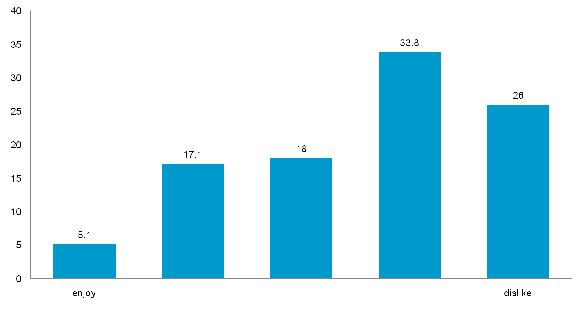
Enjoyment rating

Slide 16
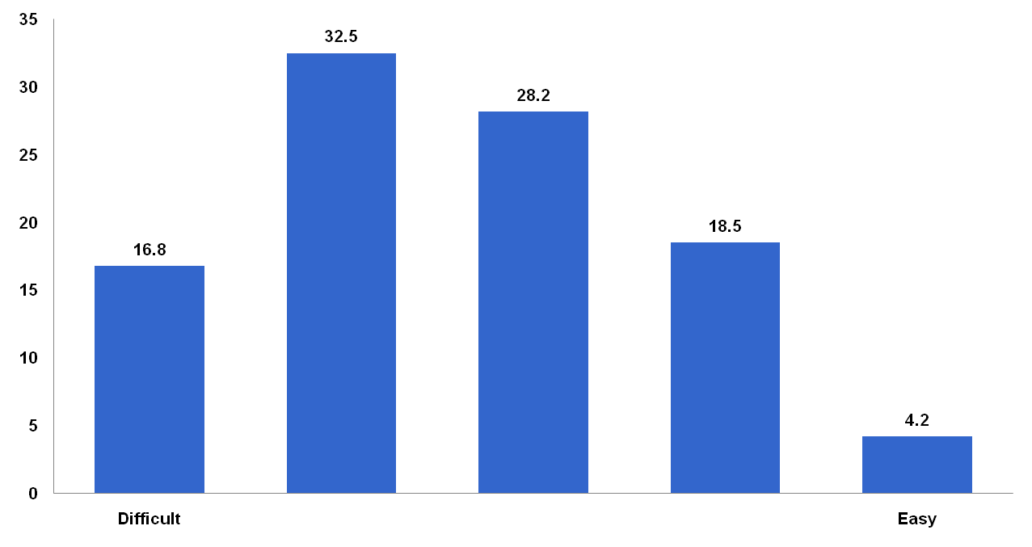
Difficulty rating

Slide 17
Results
MANOVA was conducted on the six subscales
Significant main effect for:
  Age (F(6, 578) = 2.272; p=.035)
  Gender (F(6, 578) = 2.757; p=.012)
  Awareness (F(6, 578) = 4.944; p<.001)
  No significant main effect for GCSE grade

Slide 18
Results
Age
Main effect on the ‘worth of statistics’ subscale (F (1,583) = 6.479; p=.011)
Therefore older students valued and recognized the usefulness of statistics

Slide 19
Results
Gender
There was a significant main effect of gender on the subscales of ‘interpretation anxiety’ (F (1,22) = 9.409; p=.002) and ‘test and class anxiety’ (F (1,583) = 8.268, p=.004).
Females reported higher anxiety levels.

Slide 20
Results
Awareness
Prior knowledge of the statistics and methods component of their course had a significant main effect on each of the six subscales (less anxiety and positive attitudes).

Slide 21
Results
Awareness
Furthermore, those students that reported prior knowledge demonstrated lower perceived difficulty (χ² = 36.41; df=4; p<0.001) and increased enjoyment (χ² = 42.50; df=4; p<0.001) compared to colleagues.

Slide 22
Conclusions
Older students do not demonstrate more anxiety but may have more positive attitudes
Females experience more anxiety
50% of students are unaware of the statistical component of the degree; this is related to higher anxieties & negative attitudes

