Slide 1
SERVICE LEARNING IN
HONORS INTRODUCTORY
PSYCHOLOGY
Teresa K. King, Ph.D.
Bridgewater State College
Bridgewater, MA USA
ICTP July 2008
Notes:
This presentation will describe the development and evaluation of a service learning component in Honors Introductory Psychology.
Service learning was a required component of one of two sections of the course. The service learning consisted of students (N=14) providing social support one hour a week for 10 weeks to residents at a local nursing home. Students had weekly writing assignments to reflect on their experiences at the nursing home and to relate these experiences to specific learning objectives in the course. They also had a final project requiring them to reflect on the service learning experience as a whole. One other section of the same course served as the comparison (nonservice learning). The nonservice learning section (N=15) completed alternative assignments (four papers) to equate the writing requirement. Exams for both sections were identical as were all other course components, including the instructor. At the end of the semester, students in both sections of the course completed the institution’s course evaluation forms. These evaluation forms were developed by the Educational Testing Service (ETS) and are known as Student Instructional Reports II (SIR II). The SIR II summative report contains seven subscales: Course Planning and Organization, Communication, Faculty-Student Interaction, Grading, Learning Outcomes, Student Effort, and Overall Evaluation. In addition to the SIR II, students in the service learning section anonymously answered six questions concerning the service learning experience. Although both sections rated the course positively, results suggest that students in the service learning section were more satisfied with the course. According to the SIR II summative report, the service learning section’s means for Course Organization and Planning, Communication, and Overall Evaluation were significantly above the comparative means provided by ETS. The largest difference in ratings between the two sections was for Learning Outcomes. A pooled t test on the final exam scores for the two sections was not significant. The specific evaluation of the service learning component indicated that 100% of the students would recommend the service learning experience to other students. Frequently reported benefits of participating in the service learning experience included developing critical thinking skills through applying course material to a real-life situation, changing attitudes regarding the elderly, and the social interaction. These results suggest that service learning can heighten students’ perceptions of learning by connecting learning objectives to a
real-world situation, even if the experience does not influence exam scores.

Slide 2
Developing the service learning component.
Connecting the service learning component to learning objectives.
Students’ perceptions.
Impact on exam scores and course evaluations.
Notes:
The presentation will describe the steps involved in developing the service learning component, the assignments used to connect the service learning component to learning objectives, students’ perceptions of the service learning experience, and research evaluating the impact of service learning on exam scores and course evaluations.

Slide 3
Development of a Service Learning Course
Why SL?
Education (mine)
Identification of an appropriate course
Identification of a community partner
Mandatory versus voluntary?
Establishing relationships
Field agreement
Ongoing monitoring
Notes:
Provost
New administrative position
In the opening session of this conference Michael Stevens brought up how psychologists in the US are reluctant to jump in and actually get involved in helping the community. SL is a great way to improve the every day lives of people.
Curriculum guidelines for psychology emphasize the coverage of diversity and ethics. SL can provide unique and practical opportunities to cover these topics.
Teaching two sections of Honors intro psych in the fall, seemed like a good place to start to evaluate SL as a pedagogical tool.
’s (proximity to campus/relation to discipline/need)

Slide 4
Notes:
In year 2 I decided to implement a behavioral contract.

Slide 5
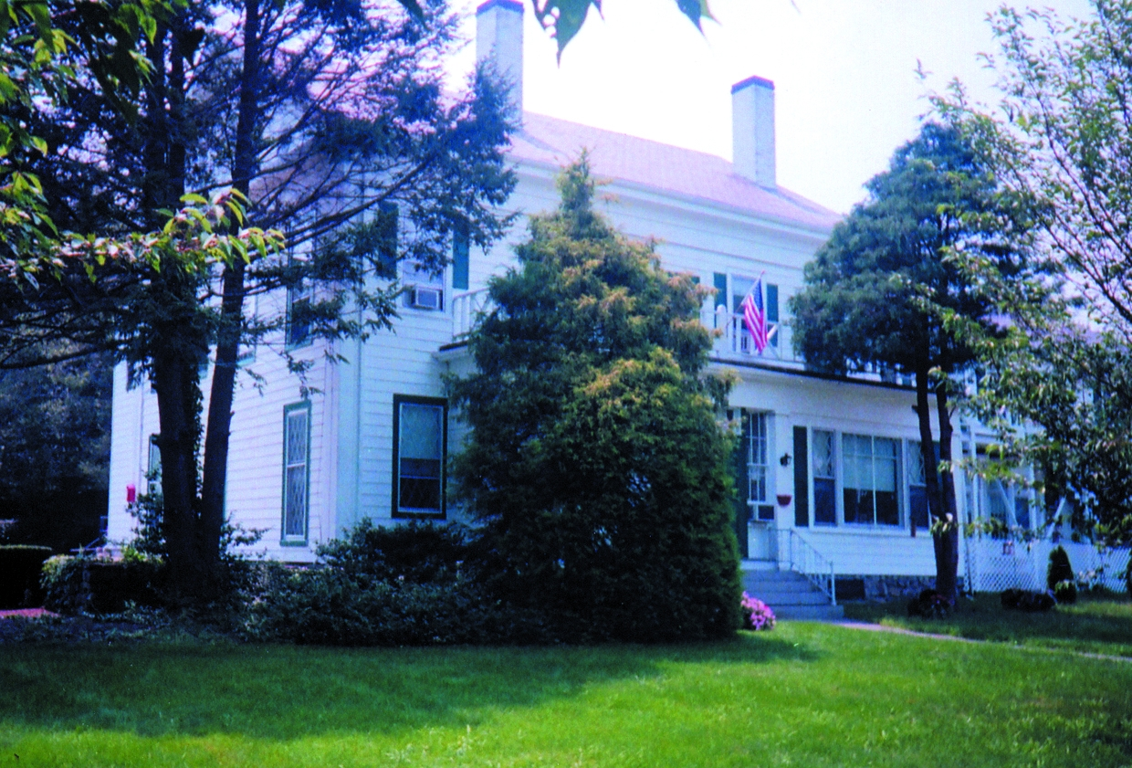
Development of a Service Learning Course: Service
Students (N=27) provided social support one hour a week for 10 weeks to residents at a local nursing home.
Notes:
The service learning consisted of students (N=14-yr 1; N=13 yr2) providing social support one hour a week for 10 weeks to residents at a local nursing home.
N=14 in year 1; N =13 in year 2

Slide 6
Development of a Service Learning Course: Learning
Weekly writing assignments to reflect on their experiences at the nursing home and to relate these experiences to specific learning objectives.
Final project requiring them to reflect on the service learning experience as a whole.

Slide 7
Service Learning Course:
Weekly Writing Assignments
Reflection Exercise #1
Write a journal entry describing your first experience at the Bridgewater Nursing Home. Next, based on your observations and interactions with the residents develop a research study designed to answer some question you have after your first visit. Be sure to state what the question is and how you would go about answering the question. Describe the research methodology you would use. Aim to apply at least 3 concepts (terms) from chapter one of the Myers' text. This assignment should be no longer than 2 pages and is due in class next Thursday September 21.
Please remember not to use resident’s names in written reports. In addition, please do not discuss residents outside of the class as this would violate their right of confidentiality. Let me know if you have any questions.

Slide 8
Service Learning Course: Weekly Writing Assignments
Reflection Exercise #2
Write a journal entry describing your second experience at the Bridgewater Nursing Home. Based on your observations and interactions with the resident develop a case study in neuroanatomy like the ones we completed in class. Describe the scenario in a few sentences and then describe the brain structures used in the scenario. Be sure to give a rationale as to the role of each brain structure. Aim to apply at least 10 brain structures from chapter 2 of the Myers' text.

Slide 9
Service Learning Course:
Weekly Writing Assignments
Reflection Exercise #10
Write a journal entry describing your final experience at the Bridgewater Nursing Home. Let me know how you said goodbye to the residents. How was the news you were leaving received? Walk me through the final hour--what was said, what was done, how it was for you, how it was for the residents.
For your final reflection exercise I would like you to read all of your other journal entries. Summarize how your experiences at the nursing home evolved over time. Did any of your beliefs about the elderly change? How did the course content impact your understanding of the residents and their current situation? What questions are you left with? Specifically, how could psychology be used to improve the lives of these elderly individuals?

Slide 10
Comparison Sections
The nonservice learning sections (N=28) completed alternative assignments (four papers) to equate the writing requirement. Exams for all sections were identical as were all other course components, including the instructor.
Notes:
The nonservice learning section (N=28) completed alternative assignments (four papers) to equate the writing requirement. Exams for both sections were identical as were all other course components, including the instructor.

Slide 11
Comparison Sections: Assignments
Paper #3 - In The Company Of Men
Click on the link above to watch the film on your computer. After viewing the film answer the following questions.
1. According to your text, behavior is considered pathological when it is deviant, distressful, and dysfunctional. Evaluate Chad’s behavior using these three criteria. Does his behavior meet each criteria? Be sure to provide examples from the film. (20 points)
2. Which psychological disorder from chapter 16 do you think Chad has? Document each symptom you observe and provide examples for the symptom/behavior from the film. (20 points)
3. Which approach from chapter 17 of your text would you use to treat Chad? Be sure to provide a rationale for your answer. (10 points)
Notes:
The nonservice learning section (N=15) completed alternative assignments (four papers) to equate the writing requirement. Exams for both sections were identical as were all other course components, including the instructor.

Slide 12
Development of a Service Learning Course: Outcomes Year 1
*
*
*
Notes:
At the end of the semester, students in both sections of the course completed the institution’s course evaluation forms. These evaluation forms were developed by the Educational Testing Service (ETS) and are known as Student Instructional Reports II (SIR II). The SIR II summative report contains seven subscales: Course Planning and Organization, Communication, Faculty-Student Interaction, Grading, Learning Outcomes, Student Effort, and Overall Evaluation. Although both sections rated the course positively, results suggest that students in the service learning section were more satisfied with the course. According to the SIR II summative report, the service learning section’s means for Course Organization and Planning, Communication, and Overall Evaluation were significantly above the comparative means provided by ETS. The largest difference in ratings between the two sections was for Learning Outcomes.

Slide 13
Development of a Service Learning Course: Outcomes Year 2
*
Notes:
Year 2 the classes are more similar but you can see that SL section continues to rate learning outcomes and effort higher than the nonservice learning section.

Slide 14
Development of a Service Learning Course: Outcomes
T-tests on final exam scores comparing service learning sections with nonservice learning sections by year and combined were all nonsignificant.
      M
SL 78.31
NSL 78.21
Notes:
A pooled t test on the final exam scores for the two sections was not significant.

Slide 15
Development of a Service Learning Course: Outcomes
1. What was the most beneficial aspect of the service-learning component of this class?
2. Can you identify any important areas the instructor failed to cover that would have strengthened the connection between community service and classroom learning?
3. What two or more things would you do differently in the reflection component of the course?
4. Is there anything you would change regarding the group presentation component of this experience? Why or why not?
5. What useful skills or experiences did you acquire that will complement your academic studies or enhance your career prospects?
6. Would you recommend this experience to other students? Why or why not?
Notes:
In addition to the SIR II, students in the service learning section anonymously answered six questions concerning the service learning experience.

Slide 16
Service Learning Course: Student Evaluation
96% of the students would recommend the service learning experience to other students.
Benefits: developing critical thinking skills through applying course material to a real-life situation, changing attitudes regarding the elderly, and the social interaction.
Notes:
The specific evaluation of the service learning component indicated that 100% of the students would recommend the service learning experience to other students. Frequently reported benefits of participating in the service learning experience included developing critical thinking skills through applying course material to a real-life situation, changing attitudes regarding the elderly, and the social interaction.

Slide 17
5 Conclusions/Additional Thoughts
SL can heighten students’ perceptions of learning.
May increase satisfaction with the course.
Importance of connecting learning objectives to a real-world situation.
Effect on retention?
Academic rigor is not compromised.
Notes:
Neil Lutsky
These results suggest that service learning can heighten students’ perceptions of learning by connecting learning objectives to a real-world situation, even if the experience does not influence exam scores.
Retention?
Does not impact academic rigor.
Increases satisfaction with the course.
Provides some real world skills like communicating with others, time management, etc.

