Slide 1


Professional Coach Training
Evaluation Research
Beyond Participants’ Self-Reports
Arthur Drexler University of Innsbruck Department of Communication in the Professional Field and Psychotherapy Schöpfstrasse 3 A-6020 Innsbruck | Heidi Möller University of Kassel Department 04 Arnold-Bode-Straße 10 D-34109 Kassel
Notes:
Welcome to my presentation.
I am…, about myself
from the…
where I…
Today I will be presenting the results from our evaluation research. We conducted this research…

Slide 2

Overview
„How can hard facts for soft skills be collected?“
Background
The Research Focus
Characteristics of a Coach
Evaluation Design and Instruments
Results
Outlook
ICTP/ St. Petersburg 2008
Notes:
I’d like to give you a quick overview of what I’ll be presenting. Our basic question was, “How can hard facts…?”
I’ll be giving you background, then information about the research focus. Because we studied a coaching training programme, I will also take a brief look at the characteristics of a coach.
Then I will give you more details about our evaluation design and we’ll take a look at the instruments we used before going on to the results. I’ll conclude with an outlook into future applications and further study.
So let’s get started with the background, so you have an idea of why we began this research. I’ll begin by telling you about the coach training programme…

Slide 3

Background: Lack of Evaluation Tools
No tradition of evaluating coach trainings
No valid and practicable specific tools for evaluation and quality assurance
No benchmarks available
ICTP/ St. Petersburg 2008
Notes:
Our department offered a professional training programme for qualifications in coaching. We were confronted with a common problem in continuing education and training: there is no tradition of…
As a result, there are no valid and…
And of course that means there are no benchmarks available for quality development.
In light of this situation, we decided to launch a research project focused on the evaluation of the training results. We formulated three research questions…

Slide 4
Background: The Coach Programme
9 weekend seminars (=190 training units)
Duration of 16 months
Each seminar focused on specific topic
  conflicts
  communication skills
  group dynamics
  etc.
ICTP/ St. Petersburg 2008
Notes:
Regarding the background…..

Slide 5
The Research Focus
The research addresses three main questions:
What theoretical knowledge, skills and personality traits does a coach need to successfully meet the clients’ needs?
Do the participants have the knowledge and skills at their disposal after coach training?
What instruments can make these factors visible?
ICTP/ St. Petersburg 2008
Notes:
Our research addresses three main questions…
Now let’s take a look at the first question, which we needed to address. What are the knowledge, skills and personality traits needed by coaches and therefore should be the result of a coach training?

Slide 6


Characteristics of a Coach
Motivation
Personality factors
Concept competence
Key qualifications
ICTP/ St. Petersburg 2008
Notes:
We identified the following four points for the purposes of our study…
Motivation includes…
Personality factors, such as…
Thirdly, we looked at what we call “concept competence”. It includes…
Finally, there are key qualifications that every coach needs, including…
Once we had established the characteristics of a coach which should be fostered by the training programme, we were able to design the study and select evaluation instruments which I’d like to tell you about in more detail now…

Slide 7
Sample Description
Sample size: 17
Gender: 6 men, 11 women
Mean age: 44 years (s = 6.6)
Profession: 23.5% work in a social profession, 76.5% in other professions (e.g. business consulting, HR, medicine)
ICTP/ St. Petersburg 2008
Notes:
6 of whom were men….
The rest of the group were …

Slide 8
Evaluation Design and Instruments
Pre-measurement at the beginning of the training
Continuous measurements
after each seminar
Post-measurement
Questionnaires
Case Study
Affect Recognition Tests
Business Knowledge Test
Sculpting
Self and trainers’ assessments of
learning progress through questionnaires
Questionnaires
Case Study
Affect Recognition Tests
Business Knowledge Test
ICTP/ St. Petersburg 2008
Notes:
We opted for a classic pre- and post-measurement design, and included continuous measurements after each seminar in the coaching programme.
Pre-measurement was done with…FPI in the german speaking world
The core was the case study for
Business knowledge: not a main goal
Continuous or On-going measurement was done after each seminar through…Not any useful informations
Our post measurement reflects the pre-measurement. We again used…

Slide 9
Initial Motivation Results
Goal of their own personal development through coach training
Desire for a change to improve their professional lives – not necessarily as coaches
Motivation to help clients (and themselves) reach professional goals
ICTP/ St. Petersburg 2008
Notes:
The participants’ initial motivation was not necessarily to become professional coaches. Many of them chose the programme for their own personal development or personal benefit. Another motivation was the desire for change in their professional lives, they wanted to improve their work but not necessarily…
Some also chose the programme because they wanted to help their clients….
Overall you can see that the motivation was not necessarily professional qualification in coaching per se. Now let’s go on to the results of the personality test…

Slide 10
Results Personality
FPI-Scales |  | T | df | Sig.
 | Satisfaction/Contentedness | ,891 | 13 | ,389
 | Social Orientation | -6,204 | 13 | ,000*
 | Performance Orientation | -5,264 | 13 | ,000*
 | Inhibition | 2,104 | 13 | ,055
 | Excitability | -,900 | 13 | ,385
 | Aggression | -,306 | 13 | ,765
 | Pressure | 1,236 | 13 | ,238
 | Physical Complaints | 10,262 | 13 | ,000*
 | Concerns about Health | -1,000 | 13 | ,336
 | Openness | -2,918 | 13 | ,012*
 | Extraversion | -4,954 | 13 | ,000*
 | Emotionality | 1,127 | 13 | ,280
ICTP/ St. Petersburg 2008
Notes:
We used the FPI test, as mentioned earlier. The test analyses… The most significant traits are the ones highlighted in blue. As you can see the relationship factors increased – relevant for the profile of a coach
Physical complaints: one or another person was ill at the beginning…
Another pre-measurement tool was the Facial Affect measurement, which we chose because…

Slide 11
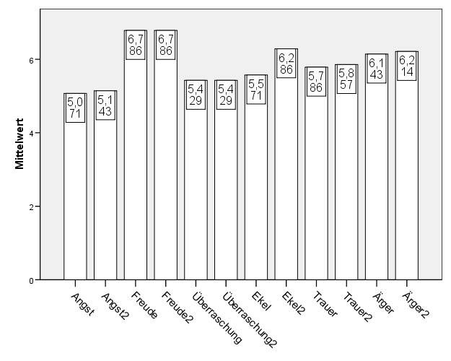
Results Affect Recognition
No significant changes for anxiety, joy, surprise, loathing, mourning and anger
ICTP/ St. Petersburg 2008
Notes:
The results here show the pre- and post-results. As you can see there is some improvement in all of the factors…
We also wanted to assess the impact of the training programme on their business knowledge, for which we designed a…

Slide 12
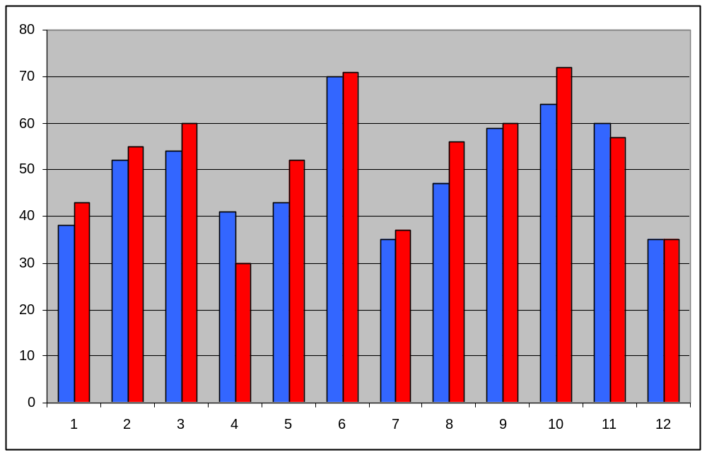
Business Knowledge
Individual changes (blue bars: pre / red bars: post-measurement)
Overall-changes are not significant (p = 0.119)
ICTP/ St. Petersburg 2008
Notes:
This graph shows the individual changes – red indicates the post-test results. As you can see, most of the participants….
As business knowledge was not the main focus of the programme, we also wanted to analyse concept competence, which is particularly challenging to quantify. For this are, we chose case study analysis to assess the development of the participants’ concept competence….

Slide 13
Results Case Studies
Case analyses improved
  Considered different levels (relationship, competence, emotional)
  Considered psychodynamics
  Considered group dynamics in the organisation
Hypotheses improved
  More hypotheses
  More complex hypotheses
Problem-solving skills improved
  Beyond mere description
  Concrete interventions
ICTP/ St. Petersburg 2008
Notes:
The post-measurement case study showed improvement in three areas: their analysis, their hypothesising and their problem-solving skills.
As I mentioned earlier, we also did continuous measurement using self-assessments and trainer assessments…

Slide 14
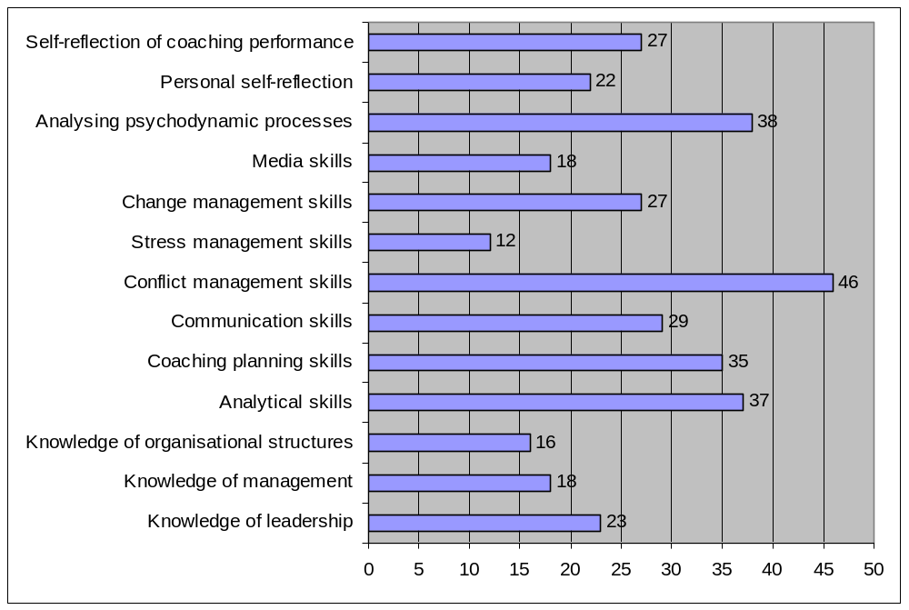
Self-Assessments
Self-assessments of improvement, after the conflict management seminar
ICTP/ St. Petersburg 2008
Notes:
I’d like to show you two examples, the summary of self-assessments after a single seminar in the programme and the final overall self-assessment.
Here you can see the bar graph how much the participants felt they had improved in specific skills areas after the conflict seminar…This is to be expected, because it was the conflict seminar – but for educational controlling it is very useful.

Slide 15
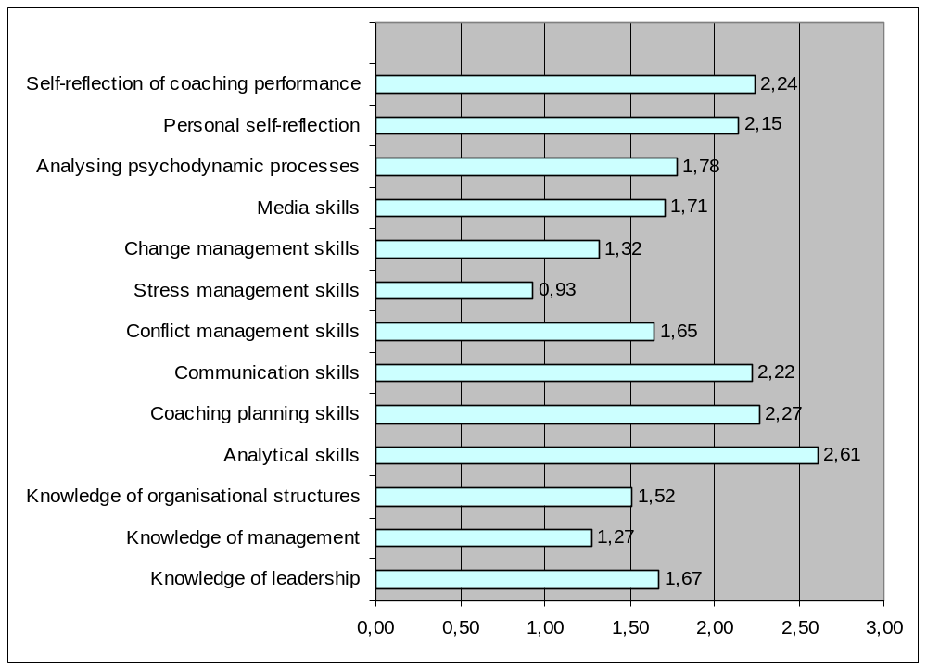
Self-Assessments
Self-assessments of improvement after completion of the programme
ICTP/ St. Petersburg 2008
Notes:
Here you can see the self-assessment results at the end of the programme. The overall subjective impression shows main improvements at specific coaching skills as ….and personal development and ..soft skills.

Slide 16
Summary
Motivation to attend dominated by expectations of personal and professional development
Social orientation, performance orientation, extraversion and openness increase
Tendencies of improvement in recognising emotions
Tendencies of improved business knowledge
Better development of hypotheses based on interpretive frameworks and improved problem-solving skills
Seminar-related improvements correlate mostly with the seminar topic
Strong improvements of analytical skills and self-reflection
ICTP/ St. Petersburg 2008
Notes:
To summarize what we have seen, let’s have a look at the main points…
When we wrap up the results…

Slide 17
Summary
Motivation
More Social Orientation
Personal and professional development
More Performance Orientation
+
Coaching skills
Extraversion
Openness
ICTP/ St. Petersburg 2008
Notes:
This is a graphic representation summarising what we gained in terms of the evaluation information for the coach programme....
I‘d like to conclude with a brief look at the future and what our results could mean for continuing research...

Slide 18

Outlook
The multi-methodological approach to evaluate coach training can be prototypic for adult education and training evaluation in general.
Results allow the comparison of the development of competencies in different education and training contexts.
Participants and course designers can benefit from the feedback provided by the evaluation process.
“Hard facts” can be collected for quality assurance and quality development in training.
ICTP/ St. Petersburg 2008
Notes:
….
Thank you for your attention. I would be happy to answer any of your questions.

