Slide 1
“Uluäkea - Hawai’i Place-Based Educational Teaching of Sport Psychology“
Harald Barkhoff & Taupouri Tangaro
Mähele Olakino/ Ho'oikaika Kino
Kalai Pilikanaka
Kulanui o Hawai'i ma Hilo
harald@hawaii.edu
Oral Presentation at
at the Third International Conference on the Teaching of Psychology
St. Petersburg, Russia - 7/15/08

Slide 2
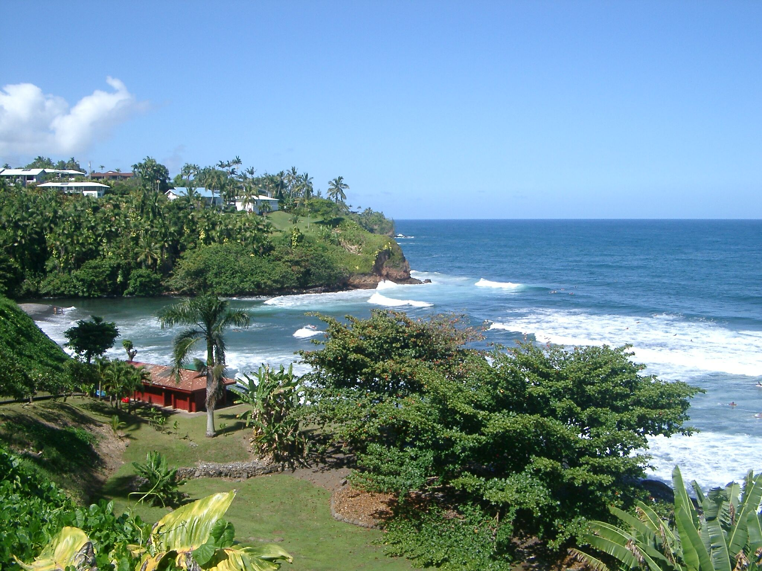
“Uluäkea - Hawai’i Place-Based Educational Teaching of Sport Psychology“
Presentation Outline
Chant
Ki‘i
Imagery
Application
Results
Implications & Discussion
honolii

Slide 3
Chant - KE HA`A LA PUNA I KA MAKANI
Chant
Literal Translation
Hermeneutic Interpretation
Ke ha’a la Puna i ka makani
Puna dances in the wind
Through the nodes the spirits dance
Ha’a ka ulu hala o Kea’au
The pandanus groves of Kea’au are bent low
Enchantment has spread, a weaning from the breast
Ha’a Hä’ena me Höpoe
Hä’ena and Höpoe are bent-knee in dance
The enchantment marks a portal toward maturation
The principal female, Pele, falls under the spell
Ha’a ka wahine
The woman dances
‘Ami i kai o Nanahuki ë
Revolving at the sea of Nanahuki
Hinging toward the sea provoking serenity

Slide 4
“Hawaiian Ki’i Concept“
Ki’i is an image (natural or fabricated) used in ritual to fetch
Ki’i/Imagery – vision (because of our visual dominance)
– plus all other sensory systems
Ki’i/Imagery – mundane level (to entertain)
– spiritual level (engender high level of interaction with environments, including audience)
Ki’i/Imagery – used to peak performances under any conditions (including mental obstacles/barriers)

Slide 5
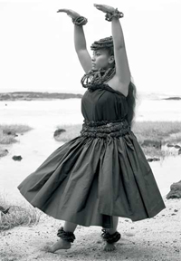
“Hawaiian Ki’i Concept“ cond.
Ki’i is used in hula
Hula = general term used to define Hawai’i’s traditional dance
2 terms define the function of the dance:
Hula & Ha’a
Hula only requires the hula practitioner & an audience
Ha’a requires
1 the environment in which the hula is executed
2 the hula practitioner (inclusive of teachers, musicians and dancers)
3 an audience (human or otherwise).

Slide 6
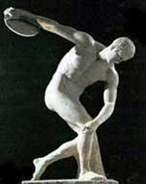
“Imagery of Elite Athletes in Modern Sport Psychology“
  Genesis of Sports – Olympics – Spirituality/Religion/Rituals
Recreating experiences.
Imagining and picturing events that have yet to occur.
Recalling memory information and shaping those memories into meaningful images.

Slide 7
Imagery Perspective
Internal
  First person view
  You see only what you would see if you actually did the skill.
  Emphasizes the kinesthetic or feel of the movement.
External
  Third person view
  As if you are watching yourself on video.
  Little emphasis on kinesthetics.

Slide 8
Uses of Imagery
Improve Concentration
Build confidence
Control emotional responses
Acquire and practice sport skills
Acquire and practice strategy
Cope with pain and injury
Solve problems
It can enhance a variety of skills to improve performance and can facilitate the learning of new techniques and strateg

Slide 9
Results
Ki’i
Motivated by national individual, family, social pressure
Physical
Mental
Spiritual
Goal: peak performance
Recreating spiritual connection
Imagery
Motivated by social support
Physical
Mental
…
Goal: peak performance
Outcome & performance goals

Slide 10
Results
Implications:
“Reclaim” Spirituality in Imagery in Sport Psychology
“Rebuild” Identity by Applying appropriate Cultural Concepts which might foster Effectiveness of Imagery for Peak Performance

