Slide 1
Creating an Undergraduate Social Psychology
Degree Program
Andrew Johnson, Kevin J. Payne, & Brian J. Cowley
Park University
Third International Conference on the Teaching of Psychology,
St. Petersburg, Russia, July, 2008
Contact Information: ajohnson@park.edu

Slide 2
Introduction & Context
Park College (University) was founded in 1875 along the banks of the Missouri river in Parkville, Missouri (Kansas City) by Col. George S. Park and Dr. John A. McAfee.
Its mission was to provide college education for financially underprivileged individuals through an active work study program grounded in religious tradition (Fides et Labor).

Slide 3
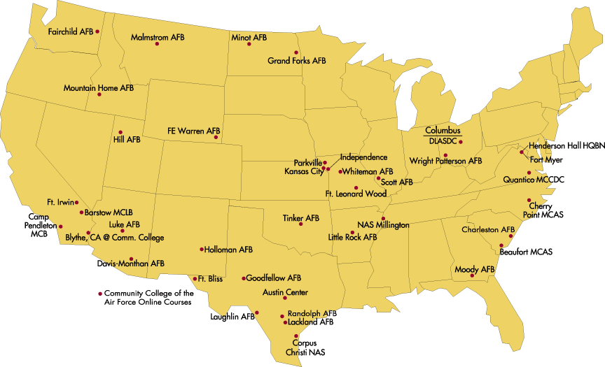
Park University: 43 Campus Centers in
21 states and online

Slide 4
Student Numbers: 26,000 students, 3,285 BS Social Psych Majors (215 online exclusively)

Slide 5
History of Social-Psych Program
In 1972 Park College organized an agreement with the United States military to offer educational degree programs off of the main campus (Parkville, MO).
The BS in Social Psychology was created as a byproduct of this agreement for an accelerated course schedule (eight-week terms – five sessions per year) for military students.
In its original structure it consisted of psychology, sociology, and business courses

Slide 6
History of Social-Psych Program cont.
In 2006 we extensively redesigned the Social-Psychology curriculum to not only modernize it, but also to have it more closely resemble a social psychology curriculum.
Our current Social Psychology curriculum consists of 51 hours (a balanced contribution from psychology and sociology).
  39 hours are for core classes
  12 hours are for elective courses or concentrations.

Slide 7
Social Psychology Philosophy
Social Psychology blends the strengths of psychology and sociology. It studies the “person in the situation,” and integrates knowledge about individual, group, and organizational processes.
Our program equips students with a set of tools useful for a wide range of careers in business and industry, government, applied social research, data analysis and interpretation, policy and program implementation, the helping and service professions, or continued graduate study in psychology or sociology.

Slide 8
Social Psychology
Program Competencies
Differentiate the major theoretical approaches, conceptual bases, and trends in psychology
Create a research design with: data analysis, statistical interpretation, and application of findings
Apply ethical standards of psychology to personal, social, and organizational issues
Effectively utilize information technology to gather, assess, and communicate about psychological issues and research

Slide 9
Social Psychology
Program Competencies
Use skeptical inquiry, critical thinking, and scientific approaches to understand behavior
Show an appreciation of cultural diversity and individual differences
Communicate professionally
Show increased self-awareness and interpersonal skills

Slide 10
Social Psychology
Program Competencies
Differentiate the various psychological roles, professional settings, and career opportunities related to psychology
Describe the structure and function of counseling, psychology, and human activity within the context of the point of view of the individual disciplines

Slide 11
Social Psych Core Curriculum
Psychology Core (9 cr.)
PS 101 Introduction to Psychology . . . . . . . . . . . .3 cr.
PS 121 Human Growth and Development . . . . . . 3 cr.
PS 315 Theories of Personality . . . . . . . . . . . . . . 3 cr.
Sociology Core (9 cr.)
SO 141 Introduction to Sociology . . . . . . . . . . . . . 3 cr.
SO 208 Social Inequality . . . . . . . . . . . . . . . . . . . . 3 cr.
SO 210 Social Institutions . . . . . . . . . . . . . . . . . . . 3 cr.
Integration (6 cr.)
PS 301 Social Psychology . . . . . . . . . . . . . . . . . . . 3 cr.
SO 304 Social Problems. . . . . . . . . . . . . . . . . . . . . 3 cr.

Slide 12
Social Psych Core Curriculum
Technical Skills (12 cr.)
SO 220 Ethical Issues in Social Science . . . . . . . . .3 cr.
SO 306 Writing for Social Sciences . . . . . . . . . . . . .3 cr.
SO 307 Statistics for Social Sciences . . . . . . . . . . . 3 cr.
SO 308 Principles of Social Research . . . . . . . . . . .3 cr.
Professional Development (3 cr.)
PS 398 Junior Seminar in Psychology . . . . . . . . . . .1 cr.
PS 498 Senior Capstone in Psychology . . . . . . . . . 2 cr.

Slide 13
Concentrations in the Curriculum
Theories and Methodologies
Human Developmental
Clinical and Abnormal
Cultural, Organizational, and Institutional
Note: within each of these concentrations there are both psychology and sociology offerings.

Slide 14
In Summary
Our BS in Social Psychology blends the best of both psychology and sociology to give the graduate an impressive set of flexible skills to study the
“person in the situation”.

Slide 15
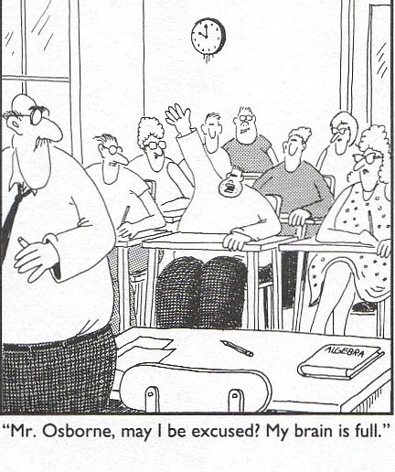
The End
Professors,

