Slide 1
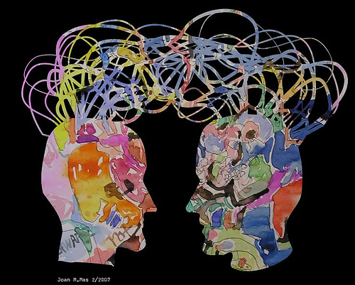

Curious Minds :
Considering Motivation and Collaboration in Abnormal Psychology Design
Norma Wolford, M.S. - Madonna University
Notes:
Good afternoon, I am so pleased to be here in St. Petersburg at this wonderful gathering of educators. In this part of our symposium, I will report on my experiences teaching Abnormal Psychology at Madonna University, a private college in Michigan, utilizing a course design that links course material with areas of student of interest and appeal, such as the arts, popular culture, and current events. Together we will examine strategies that encourage the natural curiosity of students in order to establish a collaborative learning environment that promotes student success.

Slide 2
Abstract
In this presentation I will examine strategies that encourage the natural curiosity of students in order to establish a collaborative learning environment that promotes student success in an abnormal psychology course. I will discuss my experiences teaching abnormal psychology in a private university setting and present ideas for course design that build on areas of student interest and appeal in order to promote successful learning. The design paradigm will be influenced by environmental factors, culture, technology, instructional practices, and learning styles. Specific techniques will be shared that focus on motivating students by utilizing content highly interesting to them; content areas such as classic and contemporary art, film, and music. Practical implementation of course activities will be demonstrated as the presenter engages the audience in the learning process. Positive student response to these techniques, as well as the benefits and challenges associated with their use will be discussed.
Notes:
To begin with, I must give credit to our panel moderator, Dr. Jim Hansell, as it is his book, Abnormal Psychology, co-authored with Lisa Damour, and the book’s design that have shaped my ideas.
For each topic presented throughout the semester in lecture and readings, the scientific literature is presented in the context of political, sociological, and artistic issues or examples of the relevant mental disorders, their causes, and treatments. Students report that this course design increases the relevance of their Abnormal Psychology course, provides useful connections to other courses in their curriculum, and increases their interest in the field of psychology. Now let’s look at some of the ideas behind this approach, as well as some practical applications.

Slide 3
Thoughts on Curiosity…and Education
Curiosity is one of the permanent and certain characteristics of a vigorous intellect. (Samuel Johnson)
Curiosity has its own reason for existing. One cannot help but be in awe when he contemplates the mysteries of eternity, of life, of the marvelous structure of reality…..
It is a miracle that curiosity survives formal education. (Albert Einstein)
Curiosity is the wick in the candle of learning. (William Arthur Ward)
Notes:
In his book, Curious Minds, John Brockman collected 27 essays from some of the world’s foremost scientists. He spoke with varied scientists, like David Buss from the field evolutionary psychology, Robert Sapolsky a professor of biological and neurological sciences, Mary Catherine Bateson the daughter of Gregory Bateson and Margaret Mead, herself an esteemed anthropologist and educator, research psychologist Howard Gardner, and neuroscientist, Joseph LeDoux among others. As a starting point for the essays , he asked the contributors what happened to them when they were younger that led them to pursue a life in their area of science. What he published is a fascinating book on the many, varied paths to their individual achievements, but a common thread in their stories is the curiosity about their subject that was stoked by something more than what they learned in books. They report an intense curiosity often arising out of unique educational experiences.
(CLICK) Let’s think for a minute about the nature of curiosity……….
The English writer, Samuel Johnson, described curiosity as “one of the permanent and certain characteristics of a vigorous intellect.”
American physicist, Albert Einstien, said that “curiosity has its own reason for existing. One cannot help but be in awe when he contemplates the mysteries of life, of the marvelous structure of reality…”
However, he also commented that “it is a miracle that curiosity survives formal education!” Oh my, I believe I know some students, very intelligent and curious students who may feel the same way. We have the opportunity to build on student curiosity as they enter our classrooms and lecture halls and it is a privilege to do so.
As American author, Willam Arthur Ward reminds us, “curiosity is the wick in the candle of learning.” We, as educators can help to keep the candle burning brightly.
How do we do that effectively? We will hear many ideas on the subject at this conference. Our panel here has shared valuable insights to get us started.

Slide 4
Topic Suggestions:
Encouraging curiosity, adding relevance
Song of the Week – thinking about familiar songs in a new way
Weekly Art-ifact – exploring the art and science of psychology
Literary Gems – pondering the relationship between temperament and creativity through literature
Psychology in Film – reviewing film from a psychological perspective
In the News – bringing the latest front page news into the classroom
Hot Topics – discussing/debating current controversies in the field of psychology
Notes:
Some of the most practical methods I have found to be effective in working with students is to meet them where they live. Abnormal psychology, by its very nature, is an intriguing subject to students. In any given class, you will find students who are required to take the course for their major area of study, and you will also find students who have taken the course as an elective because it just sounds interesting.
That is to say students come to class CURIOUS!
And it seems that students are motivated by this curiosity when they find ways that the subject has relevance to them.
Some topics and techniques that can be used to motivate students are shown here.
Let’s talk about them a bit and then look at some examples.

Slide 5

Song of the Week
http://youtube.com/watch?v=bd2B6SjMh_w
I remember when, I remember, I remember when I lost my mind
There was something so pleasant about that place.
Even your emotions had an echo
In so much space
And when you're out there
Without care,
Yeah, I was out of touch
But it wasn't because I didn't know enough
I just knew too much
Does that make me crazy
Does that make me crazy
Does that make me crazy
Possibly [video version]
And I hope that you are having the time of your life
But think twice, that's my only advice
Come on now, who do you, who do you, who do you,
who do you think you are,
Ha ha ha bless your soul
You really think you're in control
Well, I think you're crazy
I think you're crazy
I think you're crazy
Just like me
My heroes had the heart to Lose their lives out on a limb
And all I remember is thinking, I want to be like them
Ever since I was little, ever since I was little it looked like fun
And it's no coincidence I've come
And I can die when I'm done
Maybe I'm crazy
Maybe you're crazy
Maybe we're crazy
Possibly
Crazy –
Gnarls Barkley
Notes:
Music is one example of popular cultural medium with classroom advantages. It has a theoretical basis in some of the educational literature aimed at enhancing student motivation and personal involvement in the learning process. Songs, as well as videos, and their lyrics may be used to highlight the importance of a concept, provide a concrete illustration of the concept, demonstrate the relevance of an idea in a contemporary context, increase general awareness of psychological aspects of everyday media, stimulate classroom discussion, encourage personal involvement by students, who may also bring in songs of their own, lastly offer a novel, entertaining stimulus with which to break up monotony of lengthy class sessions. My own class, for example is offered as a weekly 3 hours + class.
I will often introduce the day’s topic with a song or video and accompanying lyrics. Then students are asked to identify ways in which the lyrics illustrate lecture or textbook ideas.
Students ratings collected by a university-wide student opinionnaire consistently provide feedback that confirms “using music aided my understanding or learning” and sometimes simply “made the class more fun.”
As I am always looking for ways to make our coursework a collaborative venture, I will look for ask for volunteers to provide the music for a particular week’s lesson. They are required to provide lyrics for the music and run their ideas by me.

Slide 6
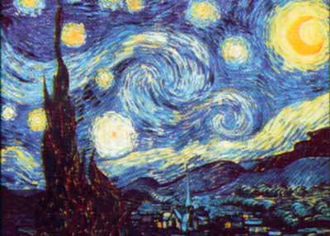
Weekly Art-ifact
'Vincent' (Starry Starry Night) Montage/Music
http://youtube.com/watch?v=HFxhI_NgNBU
Notes:
The masterworks of artists, as well as the life histories of the artists themselves, can provide stimulus for discussion on a wide range of topics in Abnormal Psychology. Munch, Magritte, Picasso, and so many others help students to think deeply about how psychological suffering can co-exist with enormous talent and creativity. For example, the emotional expression seen in the works of Vincent Van Gogh, coupled with the history of his struggles with mood disorder are often a highlight of the semester. We begin by thinking of what Van Gogh might have been trying to express through the flurry of paintings in his _________-year career.
(Youtube)
As we watched the montage, did you get a feel for what kind of discussions a student might offer? Often we speak of the depth of emotions that Van Gogh’s paintings depict. Students speak of the difficulties a person might have containing all those feelings. Students also talk about the nature of mania and point to the large number of works that Van Gogh painted in a short period of time.

Slide 7
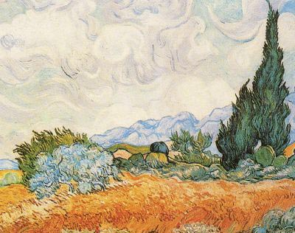
The Context and Colors…
Starry, starry night.
Paint your palette blue and grey,
Look out on a summer's day,
With eyes that know the darkness in my soul.
Shadows on the hills,
Sketch the trees and the daffodils,
Catch the breeze and the winter chills,
In colors on the snowy linen land.
Notes:
I have invited an art teacher to my class to share class time in order to facilitate discussion from both the artistic and psychological perspective. Some of the things that came up were…

Slide 8
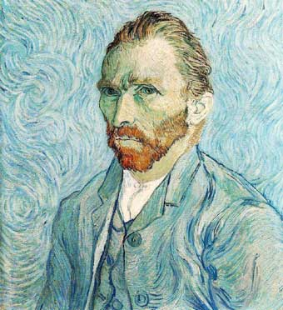

The Expression…
Starry, starry night.
Flaming flowers that brightly blaze, Swirling clouds in violet haze,
Reflect in Vincent's eyes of china blue.
Colors changing hue, morning field of amber grain,
Weathered faces lined in pain,
Are soothed beneath the artist's loving hand.
Notes:
Students

Slide 9
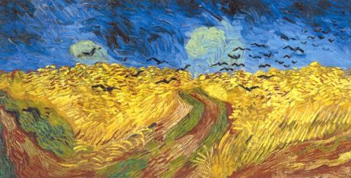
The Emotions…
For they could not love you,
But still your love was true.
And when no hope was left in sight
On that starry, starry night,
You took your life, as lovers often do.
But I could have told you, Vincent,
This world was never meant for one
As beautiful as you.

Slide 10
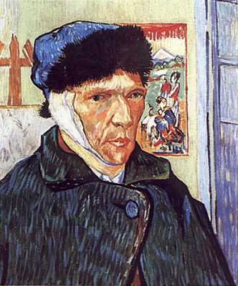
The Legacy…
Now I think I know what you tried to say to me,
How you suffered for your sanity,
How you tried to set them free.
They would not listen, they're not listening still.
Perhaps they never will...
Notes:
The legacy of a particular artist, as well as the stigma each may have endured.

Slide 11
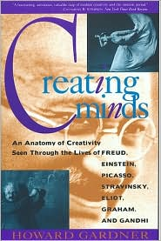
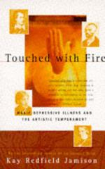
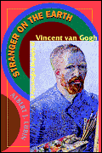
Literary Gems
Notes:
The relationship between creativity and psychological functioning is always fascinating to students. At the beginning of each semester we start a list of “Literary Gems” that come up during the course on the intersection of creativity and psychological functions, as well as any others that come up throughout the course of the semester. I post books that I think will be interesting to students; however, this is mainly an area of collaboration between the students themselves. It is posted as a thread in the “discussion” section of our online Blackboard. It always amazes me how many students report reading the books and bring the content into our discussions.

Slide 12
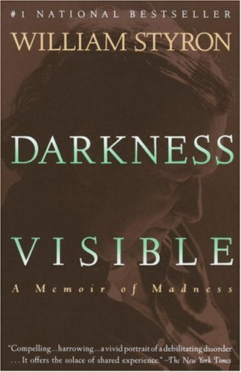
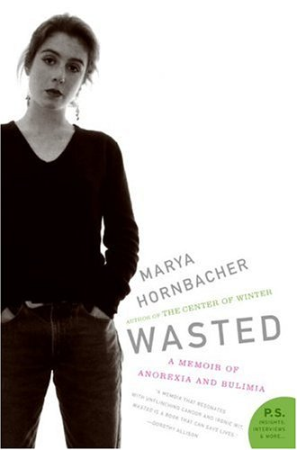
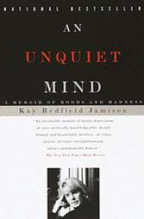
The Professor’s Book Club
Notes:
A student favorite among course activities comes in the form of the Professor’s Book Club. Early in the semester, students are required to choose one of three books to read and write about in a final paper.
Students are required to address questions like:
What symptoms do you notice that indicate the presence of a disorder or distress?
In what way does the writer’s personality influence his or her disorder or treatment?
What factors inside the person make it difficult for him/her to recognize that they have a problem?
How is the writer’s life affected by his/her condition even after treatment is underway?
On the day the paper is due, students meet in groups according to the book they have chosen, and share their questions, insights, and reflections. It is enjoyable to watch them put the semester’s learning into application.

Slide 13
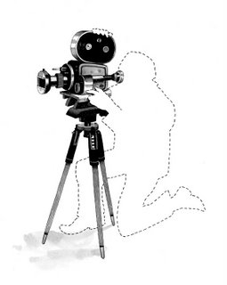
Psychology in Film
Notes:
Both movies and psychology focus on human thought, emotions, behavior, and motivation. This makes film a particularly suitable medium for exploration in an Abnormal Psychology course. Just as the students compile a list of books they find interesting throughout the semester, so do we keep a list of films that students have seen or would like to see which depict a topic or disorder covered in class. One class period is set aside for movie day as well, when a relevant film is chosen and viewed, and followed by discussion.

Slide 14

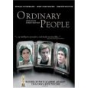
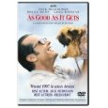



Psychology in Film
Notes:
Just think of the film depictions of psychopathology….

Slide 15

Psychology in the News

Slide 16
In the News
Experts Shy From Instant Diagnoses of Gunman’s Mental Illness, but Hints Abound By JOHN SCHWARTZ and BENEDICT CAREY The New York Times April 20, 2007
The video testament that Cho Seung-Hui mailed to NBC during the intermission in his killing spree offers a compelling peek into the troubles that shaped a gunman, experts in forensic psychology say….
Dr. Michael Stone, an expert on personality disorders and killers, said in an interview that he saw in the videos “a paranoid person with sadistic traits, possibly psychotic.” These are people, he said, who might see conspiracies all around, and who have so little empathy that they “can do the most heinous things almost as if they were whittling wood….”
Mr. Cho’s taped rants, and his peers’ descriptions of him as a classmate, suggest a blend of severe and specific personality problems, said Dr. Theodore Millon, dean and scientific director of the Institute for Advanced Studies in Personology and Psychopathology in Coral Gables, Fla., who has designed testing questionnaires used in many colleges….
People with so-called avoidant personality disorder shun social situations because of a paralyzing dread of disapproval or criticism. Those with paranoid personality disorder nourish a deep distrust of others and see insults and malicious meanings in almost every interaction. Both are stubborn patterns of behavior that can begin in adolescence or earlier….”

Slide 17
Hot Topics: Opinion-Editorials
Op-Ed Columnist The Morality Line
By DAVID BROOKS (Published: New York Times April 19, 2007)
Over the next few days, we’ll ponder the sources of Cho Seung-Hui’s rage. There’ll be no shortage of
analysts picking apart his hatreds, his feelings of oppression and his dark war against the rich,
Christianity and the world at large.
Some will point to the pruning of the brain synapses that may be related to adolescent schizophrenia.
Others may point to the possibility that an inability to process serotonin could have led to depression
and hyperaggression. Or we could learn that he had been born with a brain injury that made him
psychopathic. Or perhaps he was suffering from the ravages of isolation.
It could be, for example, that he grew up with some form of behavioral illness that would have made it
hard for him to interact with and respond appropriately to other people. This would have caused others
to withdraw from him, leading to a spiral of loneliness that detached him from the world and then
caused him to loathe it.
Over the next weeks, we could learn these or other things about Cho Seung-Hui. And as we learn the
facts of his life, we’ll be able to fit them into ever more sophisticated models of human behavior. For
over the past few decades, neuroscientists, evolutionary psychologists and social scientists have made
huge strides in understanding why people — even murderers — do the things they do……
In short, the killings at Virginia Tech happen at a moment when we are renegotiating what you might
call the Morality Line, the spot where background forces stop and individual choice — and individual
responsibility — begins.

Slide 18
Concluding thoughts
Student Response
Challenges and Solutions
Questions
Thank you!
Contact information:
nwolford@madonna.edu
734-432-5766

Slide 19
References
Bain, K. (2004). What the best college teachers do. Cambridge, MA: Harvard University Press.
Brockman, J. (Ed.). (2004). Curious minds: How a child becomes a scientist. New York, NY: Pantheon Books.
Gabbard, G.O. & Gabbard, K. (1994). Psychiatry and the Cinema. Washington DC: American Psychiatric Press, Inc.
Gardner, H. (1993). Creating minds. New York, NY: Basic Books.
Hansell, J., & Damour, L. (2008). Abnormal psychology. Hoboken, NJ: John Wiley & Sons.
Potkay, C.R., (1992). Teaching abnormal psychology concepts using popular song lyrics. Teaching of Psychology 9(4), 233-234.
Roman, B., & Kay, J. (2007). Fostering curiosity: Using the educator-learner relationship to promote a facilitative learning environment. Psychiatry, 70(3), 205-208 .

