Slide 1
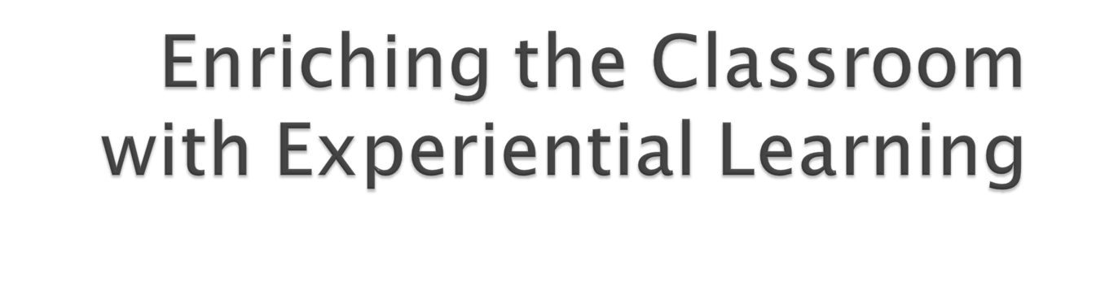

Mominka Fileva, Ph.D.
Davenport University
Mominka.Fileva@davenport.edu
ICTP 08, St. Petersburg, Russia

Slide 2
Enriching the Classroom with Experiential Learning
Preview
Experiential learning
  Definition, types, significance, challenges
PERC – assignment design and assessment template
Examples
Conclusion

Slide 3
Experiential Learning - Definition
Learning outside the classroom, in which the experience of the learner occupies central place, the learner analyzes his/her experience by reflecting, evaluating and reconstructing it in order to draw meaning from it, and to apply the knowledge to other settings and situations.

Slide 4

Semester/Year Long
  Internship/Clinical
  Study abroad
  Service learning
Classroom/session activities
  Field trips
  Job shadowing
  Service learning projects
  Experiential papers/cases (based on past/current experiences)

Slide 5
Experiential Learning - WHY
Educational Perks
Learning process is most successful when students have first-hand knowledge or experience the phenomenon being studied
Abstract thinking and experiential learning have a reciprocal relationship
  Reinforce one another
  Accelerate skill development
  Facilitate higher-order understanding

Slide 6
Experiential Learning - WHY
Educational Perks
Improvement in
  Understanding and memory
  Higher-order thinking skills
Increase in
  Perception of real-world value
  Motivation, engagement, and attendance

Slide 7
Experiential Learning - Challenges
Academic rigor
  Danger of undermining it
    Not all students value experiential learning
    Class Control
    Preparation and classroom time
    Faculty preparedness

Slide 8
Experiential Learning - Challenges
Assessment - experiential learning relies on anecdotal evidence, not precise assessment measures
  Need for formal evaluation
  Accuracy and validity of the assessment in the context of an academic discipline

Slide 9

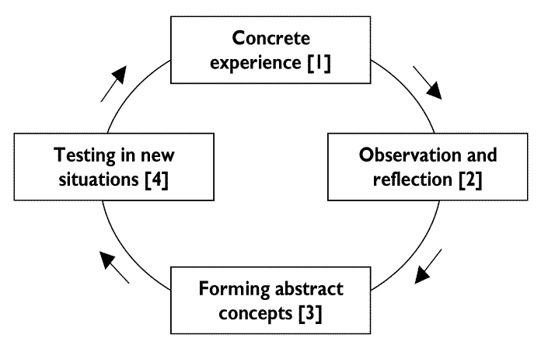
Learning cycle can begin at any one of the four points
Learning should really be approached as a continuous spiral
Generalization implies the ability to see a connection between the actions and effects over a range of circumstances

Slide 10


Three Stages of Effective Experiential Learning Based on Kolb’s Model
PERC
Prepare
  Research relevant concepts, principles, and circumstances
Experience
  Keep a learning journal
Rationalize/Create
  Reflect upon one’s experience
  Evaluate/compare experience with research
  Form new insights and construct new meanings
  Transfer/test knowledge in new encounters

Slide 11


Testing in New Situations
Formation of new knowledge/practices
Evaluation/Comparison of preliminary information/research with experience
Rationalize/Create
Concrete Experience Journal
Experience
Preliminary Information: Relevant Concepts, Principles, Circumstances
Prepare

Slide 12

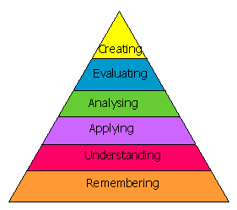

Slide 13

Transferability of knowledge
Reflection
Concrete Experience
Relevant Preliminary Information

Slide 14

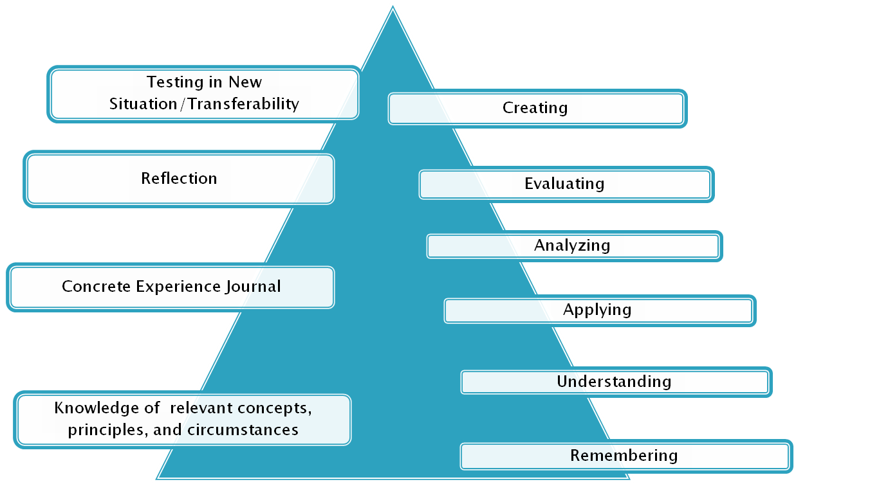
PERC
III. Rationalize/Create
II. Experience
I. Prepare

Slide 15

Information reviewed is reliable and relevant to the theme of the experience
  Lists/describes all concepts relevant to the theme of the experience
  Explains issues/topics clearly
  Reviews sufficient number of reliable literature sources

Slide 16
Prior knowledge of background and steps/stages of the experience is evident
  Identifies relevant circumstances/settings
  States clearly expectations for the effects/outcomes of the experience, and/or anticipated learning
  Recognizes potential challenges or dilemmas that might be encountered
  Discusses knowledge/skills the student will bring to the activity, and ways to address challenges.

Slide 17

Accurately describes all events/places/issues/people with supporting details and examples
Demonstrates which student’s expectations were met
Describes any unexpected learning opportunities

Slide 18
Interprets personal experience in the context of relevant theoretical knowledge
  Matches the concepts with the experience/events/issues
  Illustrates what went well
  Identifies the weaknesses/issues
Demonstrates ability and knowledge to effectively solve unexpected or anticipated issues
Sketches personal reactions, perceptions, physical sensations, thoughts, and feelings generated by the experience

Slide 19

Compares prior research findings and experiential observations
  Appraises similarities
  Examines differences and possible reasons for the differences
Critiques issues/problems that occurred during the experience in relation to theoretical principles/concepts
  Evaluates what needed to be done differently

Slide 20
Clearly formulates personal position on the topics/issues in discussion
Thoughtfully defends his/her position.
Generates alternative principles/concepts and/or explanations of phenomena/events
Designs strategies for applying the knowledge gained to other settings/new encounters
  Examines recurrent issues/problems under similar/different circumstances
  Evaluates what should and can be done differently in the future

Slide 21
Conclusion
If the
Goal = providing educational perks through experiential learning,
then the effective
Tool = PERC assignment design/assessment generic template

Slide 22

Andresen, L. D. Boud & R. Cohen (2000), Experience-Based Learning: Contemporary Issues, in Understanding Adult Education and Training. 2nd ed. Sydney: Allen & Unwin.
Cantor, J. (2003). Experiential learning in Higher Education: Linking Classroom and Community, retrieved from http://www.ntlf.com/html/lib/bib/95-7dig.htm.
DeCourcy, Alan (1998). From Clinic to Classroom: Power of Experiential Learning,
College Teaching, 46.4 140-3.
Fileva, M. & P. Phillips (2006). Cost-Benefit Evaluation Instrument for Choosing Effective Learning Activities, ISETL, 2006.
Fileva, M. & P. Phillips (2007). Experiential Exercises and Projects Elevate Active Learning in the Classroom from Good to Great, ISETL, 2007.
Forrest, Krista D. (2005). Experiential learning in the introductory class: the role of minor league hockey in teaching social psychology. College Student Journal 39.4 794(4).
Hubbs, D. L. & C. Brand (2005). The Paper Mirror: Understanding Reflective Journaling. The Journal of Experiential Education, 28(1), 60-71. Retrieved from Education Module database. (Document ID: 915159721).
Ian J Grand (2005). The Practice of Embodied Emergence: Integral Education in a Counseling Psychology Program. ReVision, 28(2), 35-42. Retrieved from Humanities Module database. (Document ID: 935163601).
O'Sullivan, M. (1993). Teaching Undergraduate Community Psychology: Integrating the Classroom and the Surrounding Community, Teaching of Psychology, Vol. 20, retrieved from http://www.questia.com/googleScholar.qst?docId=76995206

