Slide 1
“Culture” in Introductory Psychology Texts:
A 20-Year Follow-Up
Presenters:
Walter J. Lonner
Western Washington University, USA
Elke Murdock, Luxembourg
“Cultural” Content in Introductory Psychology Texts: A 1988 –2008 Contrast
Pradeep Chakkarath
Ruhr University, Bochum, Germany
“Culture” in Introductory Psychology Texts: The German Example
John Adamopoulos
Christine M. Smith,
Grand Valley State University, USA
The Treatment of Culture in American Social Psychology Textbooks
Discussant: Ype Poortinga. Tilburg University, Netherlands.

Slide 2
KEY BACKGROUND REFERENCES
“A SYSTEMATIC ANALYSIS OF THE CULTURAL CONTENT OF
INTRODUCTORY PSYCHOLOGY TEXTBOOKS”. ELKE (RUMPEL) MURDOCK. (UNPUBLISHED MASTER’S THESIS, WESTERN WASHINGTON UNIVERSITY, AUGUST, 1988).
“THE INTRODUCTORY PSYCHOLOGY TEXT AND CROSS-CULTURAL PSYCHOLOGY: BEYOND EKMAN, WHORF, AND BIASED I.Q TESTS.” W. J. LONNER IN D. M. KEATS, D. MUNRO & L. MANN, HETEREOGENEITY IN CROSS-CULTURAL PSYCHOLOGY: SELECTED PAPERS FROM THE NINTH INTERNATIONAL CONFERENCE OF THE INTERNATIONAL ASSOCIATION FOR CROSS-CULTURAL PSYCHOLOGY NEWCASTLE, AUSTRALIA, JULY, 1988. (PRESIDENTIAL ADDRESS)‏
THE INTRODUCTORY PSYCHOLOGY TEXT AND CROSS-CULTURAL PSYCHOLOGY: A SURVEY OF CROSS-CULTURAL PSYCHOLOGISTS. W. J. LONNER, OCTOBER, 1988.

Slide 3
SOME IMPORTANT CONSIDERATIONS FOR THE
1988 STUDY AND OTHER REPORTS
THE GROWTH OF CROSS-CULTURAL PSYCHOLOGY BECAME ACCELERATED IN THE LATE 1960s AND EARLY 1970s.
BY THE LATE 1970s AND EARLY 1980s, THIS GROWTH SHOULD HAVE BEEN “PICKED UP” AND BRIEFLY INCORPORATED IN INTRODUCTORY PSYCHOLOGY TEXTS, GIVEN THE 3 TO 5 YEARS THAT IT TAKES TO WRITE AND PUBLISH AN INTRODUCTORY PSYCHOLOGY TEXT, OR TO REVISE IT.
BECAUSE THE GROWTH OF CROSS-CULTURAL PSYCHOLOGY COULD BE VIEWED AS A “REFORM”, IT SHOULD BE POSSIBLE TO QUANTIFY THIS REFORM IN SOME WAY. THIS THINKING WAS INFLUENCED BY D. T. CAMPBELL’S 1969 AMERICAN PSYCHOLOGIST ARTICLE ,“REFORMS AS EXPERIMENTS,” IN WHICH HE STATED “. . . SPECIFIC REFORMS ARE ADVOCATED AS THOUGH THEY WERE CERTAIN TO BE SUCCESSFUL.”
WHILE CROSS-CULTURAL PSYCHOLOGY IS NOT A MASSIVE REFORM SUCH AS UNESCO, GERMAN REUNIFICATION, OR CIVIL RIGHTS LEGISLATION IN THE U.S., IT IS LIKEA REAL REFORM BECAUSE SO MANY HAVE EMBRACED THE IDEA. THEREFORE, ONE COULD ASK TO WHAT EXTENT IT HAS BEEN A “SUCCESS” AS WELL AS HOW “SUCCESS” CAN BE MEASURED.

Slide 4
THE NATURE OF THE CURRENT AND ONGOING STUDY
IT IS A QUASI-REPLICATION OF THE STUDIES OF THE MID- TO LATE- 1980s
20 YEARS HAVE PASSED SINCE THE ORIGINAL STUDIES, WHICH MEANS 20 MORE YEARS OF POSSIBLE INFUSION OF CULTURALLY-ORIENTED MATERIAL INTO INTRODUCTORY AND OTHER TEXTS.
A 1993 SYMPOSIUM/WORKSHOP AT WESTERN WASHINGTON UNIVERSITY MAY HAVE HAD SOME (BUT UNMEASURABLE) INFLUENCE. IT INVOLVED:
-- 10 NOTABLES IN CROSS-CULTURAL PSYCHOLOGY (E.G. TRIANDIS, BERRY, BRISLIN, KITAYAMA, GREENFIELD, OTHERS)‏
-- 10 PSYCHOLOGY EDITORS FROM MAJOR PUBLISHING COMPANIES

Slide 5
THE NATURE OF THE 40 TEXTS IN THE STUDY: PART 1
The 40 texts represent an estimated half of the currently available introductory texts designed for use by undergraduates in the U.S. and Canada. Many of these texts are “best sellers”.
Together, however, they are used by a large majority of the approximately two million students in the U.S. who take the introductory course each year. They are also used extensively in many other countries. Worldwide the 40 texts may be reaching about three million students per year.
The authors of the texts are invariably products of U.S. culture. With very few exceptions the authors are not involved with culturally-oriented research (which is not the same as saying they have no interest in it).

Slide 6
THE NATURE OF THE 40 TEXTS IN THE STUDY: PART 2
The range of year of copyright: 2003 (N=2), 2004 (2), 2005 (7), 2006 (8), 2007 (11), and 2008 (N=10), with a median and mode 2007.
The texts are generally very good to excellent overviews of psychology. They represent much work, art, photos, and creative ways to present material. They generally have high visual appeal enhanced by advances in textbook publishing that is noticeably better than in the mid-1980s.
Twenty-six of the texts were published after the initial study. 14 of them are revisions of the 35 texts in the original study, almost always with new, additional or re-arranged co-authors. Many of the texts in the original study are out of print and never revised.
They almost always contain between 16 and 22 chapters, all designed to encompass fairly discreet psychological domains (e.g., learning and motivation, biological bases of behavior, human development, personality, social, etc.) so as to introduce students to the entire breadth of the discipline. A few texts have an appendix featuring basic statistics. We did not assess the content of those chapters.

Slide 7
SEARCHING THE TEXTS FOR CULTURAL CONTENT AND DEVELOPING ANALYSES
GUIDED BY EACH TEXT’S TABLE OF CONTENTS, PREFATORY COMMENTS, AND ESPECIALLY THE SUBJECT AND AUTHOR INDEXES. ELKE AND I BOTH HAVE COPIES OF EACH OF THE 40 TEXTS
A “TOPIC TEMPLATE” WAS DEVELOPED. IT CONTAINED 22 GENERIC CHAPTER TITLES. RELEVANT CULTURAL CONTENT WAS READ AND “GRADED” FOR THE DEPTH OF EACH TOPIC COVERED. THE “GRADING SCALE” USED WAS AS FOLLOWS (POINTS IN PARENTHESES:
A – 3 OR MORE PAGES ON THE TOPIC, WITH PROMINENT HEADING OR SUBHEADING (5)‏
B – 1-2 PAGES, PROBABLY WITH HEADING OR SUBHEADING (4)‏
C – 2-5 PARAGRAPHS (OR BETTER PART OF A PAGE), POSSIBLY WITH HEADING OR SUBHEADING (3)‏
D – MODERATE LENGTH OF 6-15 LINES OF TEXT, EITHER AS A SHORT PARAGRSPH OR PART OF A PARAGRAPH (2)‏
E -- BRIEF MENTION OF FIVE LINES OR LESS, USUALLY AS PART OF A PARAGRAPH (1)‏
THE GRADING SCALE WAS USED IN LIEU OF A MUCH MORE TIME-CONSUMING WORD COUNT

Slide 8
Perfunctory and Highly Similar “Copy-Cat” Coverage of Culture-Related Topics in the Initial Study (Rumpel/Murdock)
THREE TOPICS THAT WERE COVERED WITH NEARLY TOTAL
PREDICTABILITY IN THE 1988 STUDY:
EKMAN (the universality of facial expressions of emotion)
WHORF/WHORF-SAPIR/WHORFIAN HYPOTHESIS (linguistic relativity, linguistic determinism)‏
BIASED I.Q. TESTS (the basic issue of “culture-fair/free testing”).
It is noteworthy that these three areas are still abundantly discussed (especially Ekman and colleagues) and referenced in the current texts.

Slide 9
SOME IMPORTANT CONSIDERATIONS: PART 1
IACCP WAS FOUNDED IN 1972 AS A DIRECT CONSEQUENCE OF VARIOUS INTERELATED ACTIVITIES (E.G. SMALLER CONFERENCES IN THE LATE 1960s, DIRECTORIES, THE INAUGURATION OF JCCP IN 1970),
PERHAPS THE MAJOR GOAL OF IACCP HAS BEEN TO STIMULATE THE KIND OF CULTURE-ORIENTED RESEARCH THAT SHOULD HELP TO CREATE A MORE INCLUSIVE DISCIPLINE.
AN OVERARCHING QUESTION FOLLOWS: HOW SUCCESSFUL HAVE IACCP AND CULTURE-ORIENTED ORGANIZATIONS AND PSYCHOLOGISTS BEEN IN MAKING STUDENTS AWARE OF THE IMPORTANCE OF CULTURE IN THEOUGHT, THEORY, AND BEHAVIOR?

Slide 10
SOME IMPORTANT CONSIDERATIONS: PART 2
BRIEF AND SHALLOW PENETRATION OF CULTURE INTO THE UNDERGRADUATE PSYCHOLOGY CURRICULUM MAY BE MUTED BY THE FOLLOWING:
NAÏVE ETHNOCENTRISM: A BELIEF THAT ALL PSYCHOLGICAL THEORIES, PRINCIPLES, AND “LAWS” ARE UNIVERSALLY VALID.
ADDING THE “CULTURAL VARIABLE” IN AN ATTEMPT TO MEET THE CHALLENGING TASK OF EXPLAINING WESTERN CULTURE TO BEGINNING STUDENTS MAY BE TOO MUCH AT THAT LEVEL.
IS THERE ENOUGH ROOM IN INTRODUCTORY TEXTS FOR ANYTHING BUT THE BASICS IN ALL PSYCHOLOGICAL DOMAINS? THUS EVERYTHING MAY HAVE TO BE “WATERED DOWN.”
TEXT AUTHORS MAY BE RELUCTANT TO DEAL WITH ANYTHING THEY KNOW LITTLE ABOUT. THEY MAY HAVE SUCH LIMITED FAMILIARITY WITH THE BREADTH AND SCOPE OF CROSS-CULTURAL PSYCHOLOGY THAT THEY TEND TO OVERSIMPLIFY AND TRY TO EXPLAIN TOO MUCH WITH JUST A FEW CONCEPTS, SUCH AS INDIVIDUALISM-COLLECTIVISM.

Slide 11
SOME IMPORTANT CONSIDERATIONS: PART 3
THERE MAY BE SOME PERCEPTION THAT BEGINNING STUDENTS ARE EXPERIENTIALLY INCAPABLE OF UNDERSTANDING AND ASSIMILATING CULTURAL MATERIAL. THUS AUTHORS MAY “DUMB DOWN” SUCH COMPLEXITIES. SOME INSTRUCTORS MAY AVOID CULTURE COMPLETELY, JUST AS A FEW TEXTS HAVE DONE.
THERE MAY BE A WIDESPREAD ASSUMPTION THAT COMPLEX CONCEPTS SUCH AS CULTURE AND ITS MANY INTERACTIONS WITH THE ENTIRE SCOPE OF PSYCHOLOGY ARE BEST LEFT IN THE HANDS OF INSTRUCTORS WHO TEQCH MORE RELEVANT COURSES IN PSYCHOLOGY, SUCH AS SOCIAL, PERSONALITY, DEVELOPMENTAL, AND ESPECIALLY CULTURAL/CROSS-CULTURAL PSYCHOLOGY, OR COURSES IN OTHER DISCIPLINES SUCH AS ANTHROPOLOGY.

Slide 12
Overview: Key Findings
Replication Study 1988 - 2008
1. Overall Increase in Quantity
Indicators:
1.1. Citation of Key Terms in Indices
1.2. Frequency of Mentions of Culture-related Topics.
2. Overall Increase in Quality (Breadth and Depth of Coverage)‏
Indicators:
2.1. Breadth of Coverage of Topical Categories
2.2. Depth of Coverage (Space and Author Citations)‏
3. Similarities and Differences in Terms of Coverage
4. Other Observations

Slide 13
Topical Categories
1. Abnormal behavior (psychopathology)‏
2. Biological factors (brain and nervous system, genetics...)‏
3. Cognition and thought (information processing, problem solving...)‏
4. Commentary on Cultural influences
5. Developmental (infancy, childhood, adulthood)‏
6. Developmental (adulthood, aging, death)‏
7. Emotion and its communication
8. Environmental (personal space)‏
9. Evolution (Darwinism, human nature)‏
10. Industrial/ Organizational (work, leadership)‏
11. Intelligence (including. IQ testing)‏
(Continued)‏

Slide 14
Topical Categories (continued)
12. Language and language development
13. Learning (classical, instrumental, social learning)‏
14. Memory and forgetting
15. Motivation (hunger, thirst, achievement, sex, intrinsic)‏
16. Personality (theory, personality measurement)‏
17. Psychotherapy and healing (counseling, folk healing)‏
18. Sensation and perception (vision, hearing, other senses)‏
19. Sexuality (gender roles)‏
20. Social psychology (conformity, stereotypes, prejudice, attitudes)‏
21. States of consciousness (dreams, drugs, hypnosis)‏
22. Stress, adaptation, coping.
NOTE: Classification according to CONTEXT

Slide 15
THE 1988 AND 2007/2008 SURVEY OF EXPERTS
As part of both the 1988 and 2007/08 examination of introductory psychology texts, samples of recognized experts in cross-cultural psychology were invited to participate in a brief exercise. The exercise asked them to suggest up to 10 items, topics, frameworks, or body of research that they think should be prime candidates for inclusion in introductory psychology texts. A cover letter said that they could list their recommendations from any combination of three domains: ORGANIZATIONAL, METHODOLOGICAL, or CONCEPTUAL.
The experts were, in both surveys, highly visible scholars in cross-cultural psychology. They were not required to rank them, but just to list them.
The results are briefly presented in the following slides.

Slide 16
SURVEY EXPERTS IN 1988
Thirty-two of the thirty-four invitees responded (94.1%) and nearly all
listed 10 items (Mean=9.3). The 297 responses were categorized by
judges. The topical categories and the N of responses in each:
1. Methodological/Research Issues and Problems (40)
2. Social Psychological Variables. Included here was IndCol (37)‏
3. The General Rationale and Value of Cross-Cultural Research (32)‏
4. Child Development, such as the Whitings’ Framework (26)‏
5. Perception, Culture, and Ecology (N=18)‏
6. Cognition (15)‏
7. Abnormality and Mental Health (13)‏
8. Organizational/Structural, such as Journals and Associations (13)‏
9. Cognitive Style (mainly Witkin) (12)‏
10. Intercultural Interaction and Training (12)‏
Continued Next Slide --

Slide 17
Survey of Experts in 1988 (Continued)‏
11. Cognitive Development (11)‏
12. Intelligence and Intelligence Testing (10)
13. Language and Linguistics (10)‏
14. Problems Associated with Ethics and Ethnocentrism (8)‏
15. Acculturation and Social Change (7)‏
16. Paralinguistics (5)‏
17. Culture and Self (4)‏
18. Studying Indigenous Psychologies (4)‏
19. Sex Differences and Culture (3)‏
20. The Study of Ethnic Minorities (3)‏
21. Responses Difficult to Classify (14)

Slide 18
2007/8 SURVEY
APPROXIMATELY 20 EXPERT INVITEES SUBMITTED THEIR LISTS.
COMPARED WITH THE 1988 RESPONSES, THEY SHOWED CONSIDERABLE GROWTH AND SOPHISTICATION IN METHODOLOGY, CONCEPTUALIZATIONS, AND APPLICATIONS. EXAMPLES OF SUGGESTIONS:
1. EXPLAIN DIFFERENCES/SIMILARITIES IN APPROACHES TAKEN BY CULTURAL PSYCHOLOGISTS, CROSS-CULTURAL PSYCHOLOGISTS, INDIGENOUS PSYCHOLOGISTS, AND PSYCHOLOGICAL ANTHROPOLOGISTS.
2. EXPLAIN KEY METHODOLOGICAL ISSUES AND PROBLEMS SUCH AS VARIOUS TYPES OF EQUIVALENCE
3. DEBUNK MYTHS THAT ALL CULTURES ARE ALIKE OR THAT ALL ARE DIFFERENT, AND THAT UNIVERSALITY-RELATIVISM ARE BOTH IMPORTANT
4. BRING TOGETHER EVOLUTIONARY-CULTURAL APPROACHES AND EXPLAIN THEIR OVERLAP
5. EXPLAIN THE NATURE AND SCOPE OF PATTERNS AND DIMENSIONS OF CULTURE IN PERSONALITY, COGNITION, VALUES, ETC.
(CONTINUED)‏

Slide 19
2007/ 2008 SURVEY (CONTINUED)‏
6. EXPLAIN THE “LEVELS OF ANALYSIS” PROBLEM: DIFFERENCES, SIMILARITIES, PATTERNS AT THE CULTURAL LEVEL CANNOT AUTOMATICALLY BE TRANSFERRED TO THE INDIVIDUAL LEVEL. A GOOD EXAMPLE IS THE WIDELY USED CONCEPT OF INDIVIDUALISM-COLLECTIVISM.
7. PRESENT AND EXPLAIN VARIOUS MODELS AND PERSPECTIVES THAT HAVE BEEN INFLUENTIAL OVER THE YEARS. INCLUDING BERRY'S ACCULTURATION STRATEGIES, KAGITCIBACI'S FAMILY CHANGE MODEL, SUPER & HARKNESS'S “DEVELOPMENTAL NICHE”, AND OTHER WIDELY USED PERSPECTIVES.
8. IN ALMOST ALL PSYCHOLOGICAL TOPICS AND DISCUSSION, REPLACE MISUSED CONCEPT OF RACE WITH MORE JUSTIFIABLE CONCEPT OF CULTURE.
FURTHER DETAILS ARE FORTHCOMING
WITH VERY FEW EXCEPTIONS IN 1988 AND THE CURRENT SURVEY, THE EXPERTS STRONGLY RECOMMENDED THAT “CULTURAL” MATERIAL SCHOULD BE INTEGRATED THROUGHOUT INTRODUCTORY TEXTS RATHER THAN HAVING A SEPARATE CHAPTER FOCUSING ON THESE MATTERS. ALL 40 TEXTS IN THIS STUDY TOOK THIS APPROACH. HOWEVER, IT IS DEBATABLE WHETHER THIS APPROACH IS BETTER THAN THE MAIN ALTERNATIVE OPTION OF INCLUDING A CHAPTER FOCUSING ONLY ON CULTURE AND THE VARIOUS STRATEGIES AND FINDINGS THAT ARE RELEVANT. AN APPROACH THAT MIXES BOTH PERSPECTIVES MAY BE ATTRACTIVE.

Slide 20
1.Increase in Quantity:
1.1.Mentions of Key terms in Indices
Culture mentioned in 11 Texts in 1988 and 36 in 2008.
Cross-cultural mentioned in 8 Texts in 1988 and 19 in 2008.
Culture-related terms: 98 in 1998, on average 27 per text (!) in 2008 or 1061 in total.

Slide 21
Reserve: Citations of Key Terms in Indices (2008)‏
Culture mentioned in 90% of the texts
“Diversity” did not feature in 1988
Use of Terms:

Slide 22
Increase in Quantity:
Total Mentions of Culture-related Topics
A total of 490 entries were counted in 1988.
A total of 393 entries were already counted after the analysis of 12 texts.
For several categories, 2008 has already 'overtaken' 1988 in terms of frequency of mentions.

Slide 23
Quality: Breadth of Coverage
- Much wider coverage of topical areas by
- much broader range of texts.

Slide 24
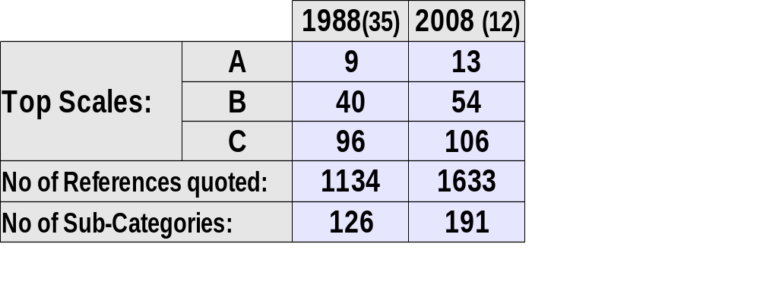
Quality: Increase in Depth of Coverage:
Several Indicators highlight the increase in depth of coverage:
- Increase in Frequency of Top Scales
- Increase in No of References quoted
- Increase in No of Sub-Categories

Slide 25
Quality of Coverage:
Depth of Coverage (expressed as average value) has increased:

Slide 26
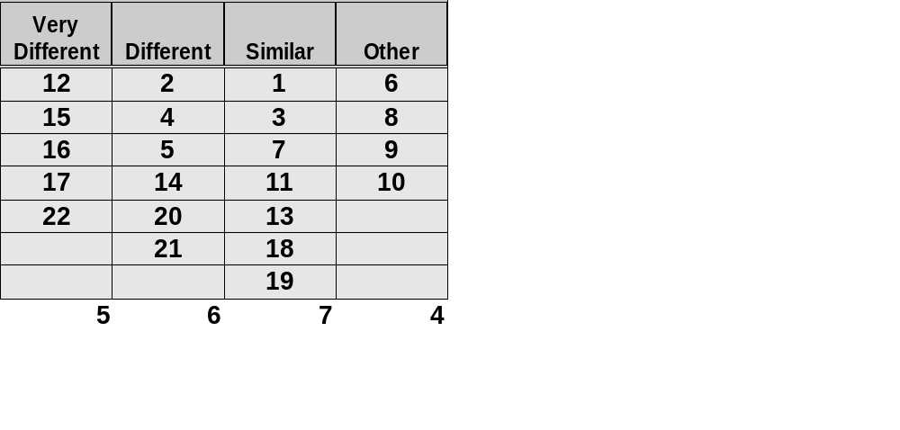
Differences and Similarities – 1988 - 2008:
Coverage of the Topical Categories:
Note: Very different – Quantity and Content of Coverage
Different – Change mainly in the Quantity of Coverage

Slide 27
Breakdown: Very Different Coverage
Cat. 12 (Language)‏
=> Much more prominent in 1988 (Whorf-Sapir Hypothesis)‏
=> Nature of sub-topics very different in 2008 (bi-lingualism etc.)‏
Cat. 15 (Motivation)‏
=> Eating Habits/ Disorders feature prominently in 2008. Eating & Culture had received only 2 mentions in 1988.
Cat. 16 (Personality)‏
=> FFM and INDCOL feature strongly in 2008.
=> Top Mention in 1988: Universality and Oedipus Complex.
Cat. 17 (Psychotherapy and Healing)‏
=> Influence of Culture on Therapist-Client Relationship widely discussed in 2008. Dramatic increase in volume of mentions.
Cat. 22 (Stress, Adaptation, Coping)‏
=> Wide variety of topics included in 2008 (Acculturative stress, culture and happiness/ coping etc. ). In 1988 a total of 4 mentions.

Slide 28
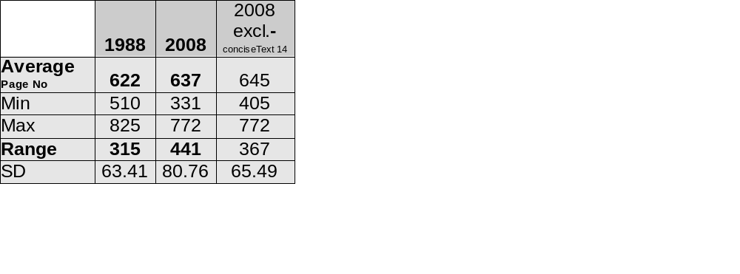

Increase in Coverage, Increase in Page numbers
Modest increase in page numbers – 2.3% or 3.6% (Excluding Text 14).
Mentions of “Culture” in Title/ Subtitles:

Slide 29
Approaches: Inclusion of Cultural Material
Dimensions:
Depth vs. Breadth
Integration vs. Dedicated Features
Text 8: Depth and Breath
Text 10: Depth (Spotlights)‏
Text 7: Breadth
Text 12: Explicit Integrationist

Slide 30
Citations of Relevant Journals and Associations
(based on the Analysis of 12 texts in 2008)‏

Slide 31
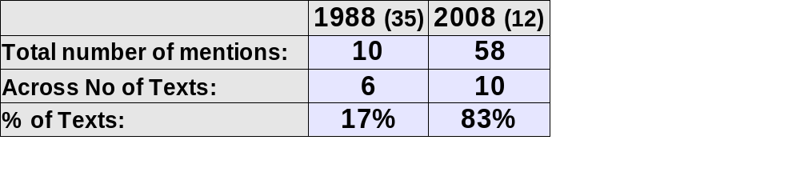
Citations of Journals and Associations in 2008:

Slide 32
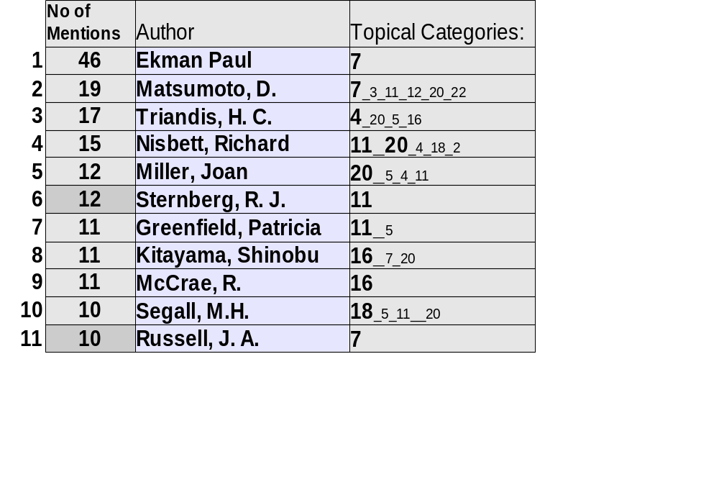
Preliminary result:
Authors most frequently mentioned (2008, 12 Texts)‏

Slide 33
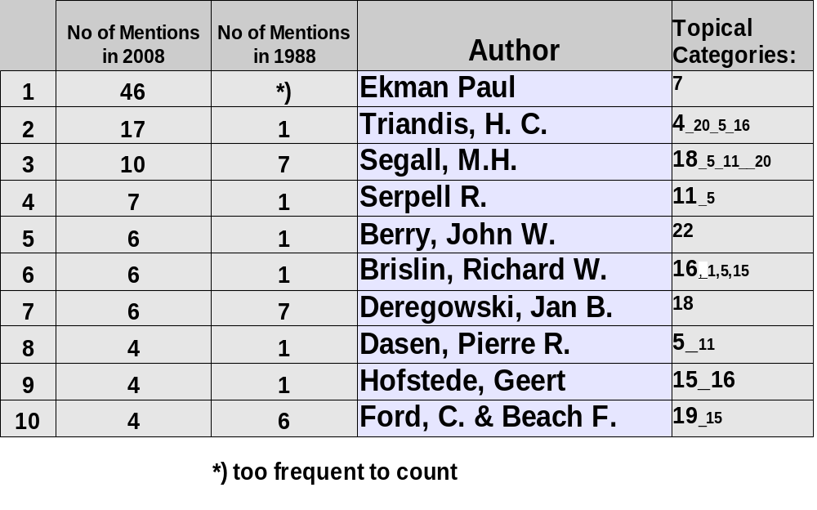
Authors mentioned in both1988 and 2008:

Slide 34
Issues and Questions of Interest to ICTP
What are the implications of the quasi-replication study to ICTP?
Are certain core elements in psychology so important that they must be included in any psychology curriculum, regardless of where it is taught and who teaches it?
Does the globalization of psychology suggest that a uniform “code” of coverage or syllabus should be developed?
Consistent with the age-old argument of “universalism vs. relativism”, to what extent should psychology be reviewed as a discipline that must be tailored to meet each country's or culture's needs as opposed to arguing for uniformity of coverage?

Slide 35
Some Tentative Conclusions and Observations
With only a few exceptions, we are impressed with how the 40 texts have introduced and handled “cultural” material. Contemporary coverage is impressively more detailed and informative than texts analyzed in 1988.
2. We acknowledge that authors of introductory texts would have a difficult time dealing in a sophisticated manner with almost any topical area. Space constraints are too imposing to involve much depth.
3. Why and how the current texts became more “inclusive” of culture since the initial study is a topic worth exploring. Perhaps this can be explained by the confluence of mandates imposed by psychological associations (e.g. IUPsyS, APA, IACCP) and by demands of publishing companies in the competitive market place..

