Slide 1
The Treatment of Culture in American Social Psychology Textbooks
John Adamopoulos & Christine M. Smith
Grand Valley State University
USA

Slide 2
“Culture” in Psychology
10-15 years ago, when I was the editor of the Cross-Cultural Psychology Bulletin, there was an intense if brief discussion in the cross-cultural psychology community, reflected to some extent in Bulletin letters and editorials, about whether or not the emerging interest in “culture” among psychologists was here to stay or purely ephemeral
Today, the optimists among us may want to celebrate about the continuation of this interest. It is beginning to appear that “culture” is here to stay
Of course, the question is “how” will it stay? What is its impact?

Slide 3
A good measure of that is how culture is treated in college textbooks, since it takes a number of years before instances become trends
The overall theme of this presentation, then, is the treatment of culture in social psychology textbooks
It is limited to social texts since general psychology texts are covered by the other symposium participants and because the emphasis in our teaching is in social and cultural psychology
It is also restricted to American psychology texts because that is the practical limit of our experience to date

Slide 4
The main questions we addressed concerned (1) the specific content of cultural coverage (i.e., topics covered)
(2) the sensitivity of the texts to culture and to the relevant literature
(3) the extent to which culture was used to issue a call for the modification or revision of mainstream psychological theories
(4) the broader theoretical context in which culture was understood

Slide 5
Method
SOURCES
We coded information from the following 10 North American social psychology textbooks:
Baumeister, R. F., & Bushman, B. J. (2008). Social psychology and human nature. Belmont, CA: Wadsworth/Thomson (brief version)
Moghaddam, F. M. (1998). Social psychology: Exploring universals across cultures. New York, NY: W. H. Freeman
Worchel, S., Cooper, J., Goethals, G. R., & Olson, J. M. (2000). Social psychology. Belmont, CA: Wadsworth/Thomson

Slide 6
4. Feldman, R. S. (1998). Social psychology (2nd ed.). Upper Saddle River, NJ: Prentice Hall
5. Aronson, E., Wilson, T. D., & Akert, R. M. (2007). Social psychology (6th ed.). Upper Saddle River, NJ: Pearson Prentice Hall
6. Baron, R. A., Branscombe, N. R., & Byrne, D. (2008). Social psychology (12th ed.). Boston: Pearson Allyn & Bacon
7. Gilovitch, T., Keltner, D., & Nisbett, R. E. (2006). Social psychology. New York, NY: W. W. Norton
8. Kassin, S., Fein, S., & Markus, H. R. (2008). Social psychology (7th ed.). Boston: Houghton Mifflin
9. Franzoi, S. L. (2006). Social psychology (6th ed.). Boston, MA: McGraw Hill.
10. Myers, D. G. (2008). Social psychology (9th ed.). Boston, MA: McGraw Hill.

Slide 7
Codes
We started with a rather ambitious set of questions, including information on:
The first page “culture” was mentioned
What about culture beyond Individualism/Collectivism was mentioned
What cultures were mentioned in the definition or first occasion in which culture was discussed
What topics were covered
Which cultures were compared
What theoretical explanations were offered for cultural differences
Whether structure (e.g., dimensions) vs. process (e.g., causal mechanisms) were emphasized
Whether there was a call to revise mainstream theory

Slide 8
Codes (cont’d)
However, some of these simply did not work out, so we focused on a few main themes, including when and how culture was mentioned, what topics were covered, and calls for the possible revision of mainstream theory

Slide 9
Coding Procedure
Complete coverage of full text in each case was not feasible
Instead we focused on a procedure which, if not exhaustive, offered the possibility of gaining insight into the extent to which culture was a main or organizing theme in the text
Specifically:

Slide 10
We examined those index entries that mentioned explicitly the word “culture and its derivatives (e.g., “cultural”).
We felt that this would get at the idea that the material regarding a psychological issue was arranged and explained primarily through a cultural viewpoint.
In other words, we did not concern ourselves with whether or not a particular topic (e.g., the self) was covered in a text, but with whether it was covered primarily in the context of cultural differences, processes or dimensions

Slide 11
Coding Procedures (cont’d)
Finally, we compared the “cultural” coverage of these texts to the coverage of social psychological topics offered in two well received texts in the area of psychology and culture:
From the “cross-cultural” tradition: Matsumoto, D., & Juang, L. (2008). Culture and psychology (4th ed.). Berlmont, CA: Wadsworth/Thomson.
From the “cultural” tradition:
Heine, S. J. (2008). Cultural psychology. New York, NY: W. W. Norton.

Slide 12
Coding Procedure-Cont’d
It turned out that
the coverage in these two texts is not all that different from each other and
The majority of the social topics covered in these two comparison texts were covered—even if briefly—in many of the social psychology texts
So much for the cross-cultural vs. cultural psychology distinction 15 years later…

Slide 13
Coding Procedure-Cont’d
Finally, we counted the # of references in the ten texts that came from one of the known “cultural” journals (e.g., JCCP, Cross-Cultural Research, Culture & Psychology), as an index—albeit imperfect—of the impact of such journals on the field
We also counted the % of photographs in each of the ten texts that depicted a non-Caucasian individual in its coverage of two widely discussed topics: the self and obedience
We considered this a measure of a text’s “cultural sensitivity”

Slide 14
Results and Discussion
Question 1: Topical coverage
We classified topics covered from a cultural viewpoint in the following 20 categories:

Slide 15
Self
Attribution Theory
Cognitive Processes/Judgment/Reasoning
Norms
Morality/Moral Judgment
Emotions
Attitudes
Stereotypes
Attraction/Sexuality/Love/Relationships
Attractiveness
Gender Differences
Aggression
Happiness
Helping/Altruism
Conformity
Social Loafing
Cooperation/Competition
Negotiation/Conflict/
Group Performance/Groupthink/Leadership
Crowding/Interpersonal Distance/Nonverbal Communication

Slide 16

Five Topics Covered Most Frequently from Cultural Viewpoint in the Textbooks

Slide 17

Five Topics Covered Least Frequently from Cultural Viewpoint in the Textbooks

Slide 18
Question 2(a): Cultural sensitivity of texts to cross-cultural research published in journals with a clear cross-cultural/cultural emphasis (e.g., JCCP, Cross-Cultural Research)

Slide 19
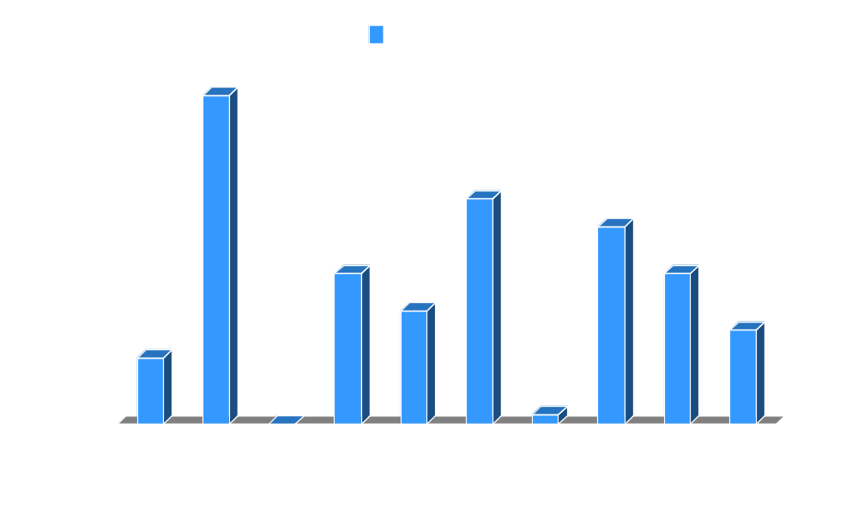
Number of References to “Cultural” Journals in the Textbooks

Slide 20
Question 2(b): Sensitivity of texts in the inclusion of photographs of non-Caucasian individuals to cover two topics—Self and Obedience

Slide 21
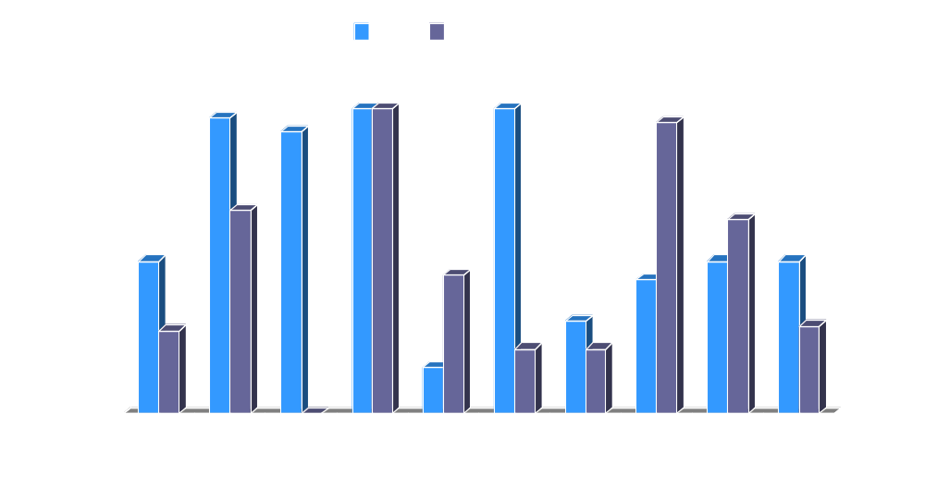
Percent Photographs with non-Caucasians in Coverage of Two Topics in the Texts

Slide 22
Question 3: Were the results of cultural/cross-cultural research used to issue a call for the modification of “mainstream” theory?

Slide 23
Answer to question 3:
A resounding NO!
There were suggestions in 2 texts that the fundamental attribution error may not in fact be fundamental
and
In one text a challenge to Fiedler’s model of leadership

Slide 24
Question 4: What was the broader theoretical context in which culture was discussed or understood?
There are a number of components to this question, and we will address them in separate parts

Slide 25
1. Definition and Discussion of “Culture”
a. 90% of texts provide a general statement regarding the importance of cross-cultural research
b. 100% of the text mention the word “culture” or its derivatives within the first 50 pages (which may not be all that significant considering the subject matter)
c. Only 20% of the texts provide a definition of “culture”

Slide 26
2. How are cultural differences explained?
All 10 texts use Individualism/Collectivism as a way of discussing cultural differences
All 10 texts use the emerging East-West distinction as well (which may simply indicate the interests of American social psychologists at this time)
Other theoretical frameworks (e.g., Hofstede, Schwartz) are covered only by one or two texts, respectively

Slide 27
3. Culture and Evolution
a. 20% of the texts discuss cross-cultural similarities as pointing to evolutionary mechanisms
b. Only one text mentions culture as a challenge to evolutionary explanations
c. 20% of the texts formulate the argument that humans evolved to “do” culture and that social psychology should pay more attention to it

Slide 28
Culture and Evolution—Final Impression
Strong impression that evolutionary arguments for causes of social behavior were more clearly articulated, which implies a general lack of understanding of cultural transmission mechanisms on the part of the authors of these texts
Things are not as good for cultural/cross-cultural research as they might seem

Slide 29
Thank You!

