Slide 1
USING THE NATIONAL SURVEY OF STUDENT ENGAGEMENT TO ASSESS EDUCATIONAL EFFECTIVENESS
Jeanne Butler, Director
Office of Assessment
University of Nebraska Kearney

Slide 2
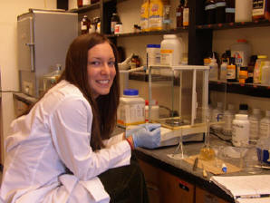
What Really Matters in College?
“Because individual effort and involvement are the critical determinants of impact, institutions should focus on the ways they can shape their academic, interpersonal, and extracurricular offerings to encourage student engagement.”
Pascarella & Terenzini, How College Affects Students, 2005, p. 602

Slide 3
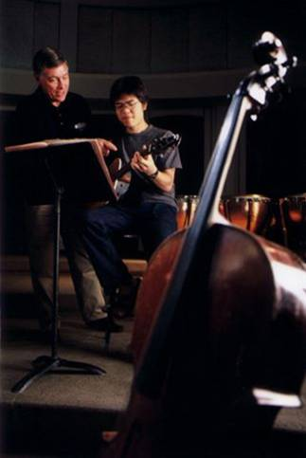
Research on Student Engagement
Time on task (Tyler, 1930’s)
Quality of effort (Pace, 1960-70)
Student involvement (Astin, 1984)
Social, academic integration (Tinto, 1987, 1993)
Best Practices in undergraduate education (Chickering & Gamson, 1987
Student engagement (Kuh, 1991, 2005)

Slide 4

Research Findings
Thousands of studies have been done to determine causes of attrition of college students. A common finding is that:
The degree of student engagement with faculty and other students and stage at which the engagement begins is positively correlated with retention.
Student engagement is positively correlated with the academic success (GPA) and persistence of students to graduation.

Slide 5
Student Engagement Trinity
What institutions DO – using effective educational practices to induce students to do the right things
What faculty DO – channel student energy toward activities that matter
What students DO - time and energy devoted to educationally purposeful activities

Slide 6
What is NSSE?
The National Survey of Student Engagement (NSSE) is a college student survey that assesses the extent to which students engage in educational practices associated with high levels of learning and development.
http://nsse.iub.edu/index.cfm

Slide 7
Who Uses NSSE?
1,000,000 + students from 1,200 different institutions of higher education in the US
80% of 4-year US undergraduate FTE
50 states, Puerto Rico, Canada
70+ consortia

Slide 8
NSSE Virtues
Research based
Focus on educationally purposeful activities
Results point to areas where improvement is needed
Compelling face validity
Established psychometrics
Transparent operations
Third party administration
Random sampling
Targeted sampling
Flexibility
Contributes to value-added estimates when linked to BCSSE, CLA, and other measures
Benchmarks for peer, national and other comparisons

Slide 9
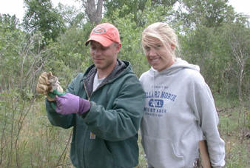
Measures Effective Educational Practices
Level of Academic Challenge
Student Faculty Interaction
Active and Collaborative Learning
Supportive Campus Environment
Enriching Educational Experiences

Slide 10

Good Practices in Undergraduate Education
Student-faculty contact
Active learning
Prompt feedback
Time on task
High expectations
Experiences with diversity
Cooperation among students

Slide 11
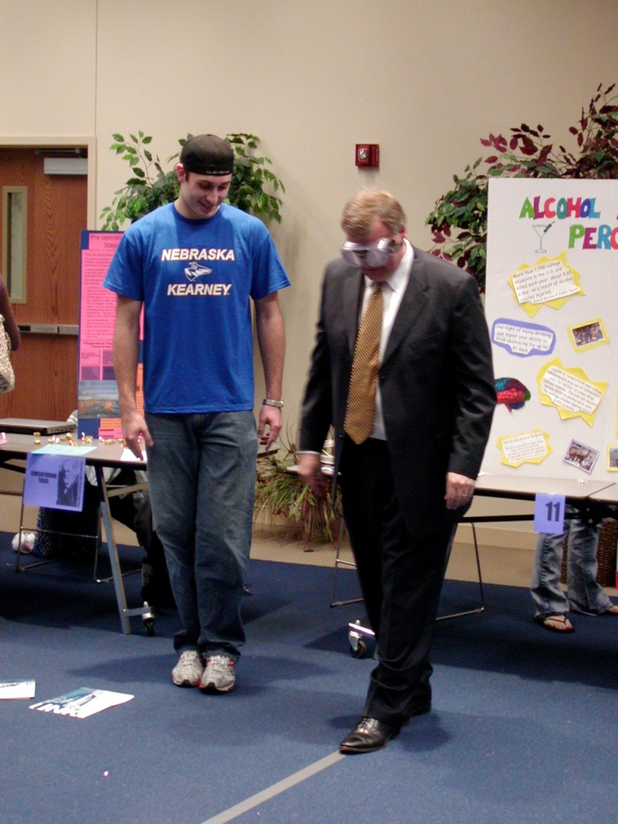
Focus on the Real Problems
Engaging students
First year experience
Academic challenge
Connections to real world
Capstone experiences

Slide 12

Engaging Students
Class discussions
Required class participation
Group or team projects
Student presentations
Student research
Real world assignments
Other:

Slide 13


First Year Experience
Freshman orientation
Student mentors
Faculty advising
Connection to department
Research experience
Formal 1st year course
Other:

Slide 14

Academic Challenge
High standards
Meaningful learning experiences
Recognition/rewards
Student feedback
Other:

Slide 15
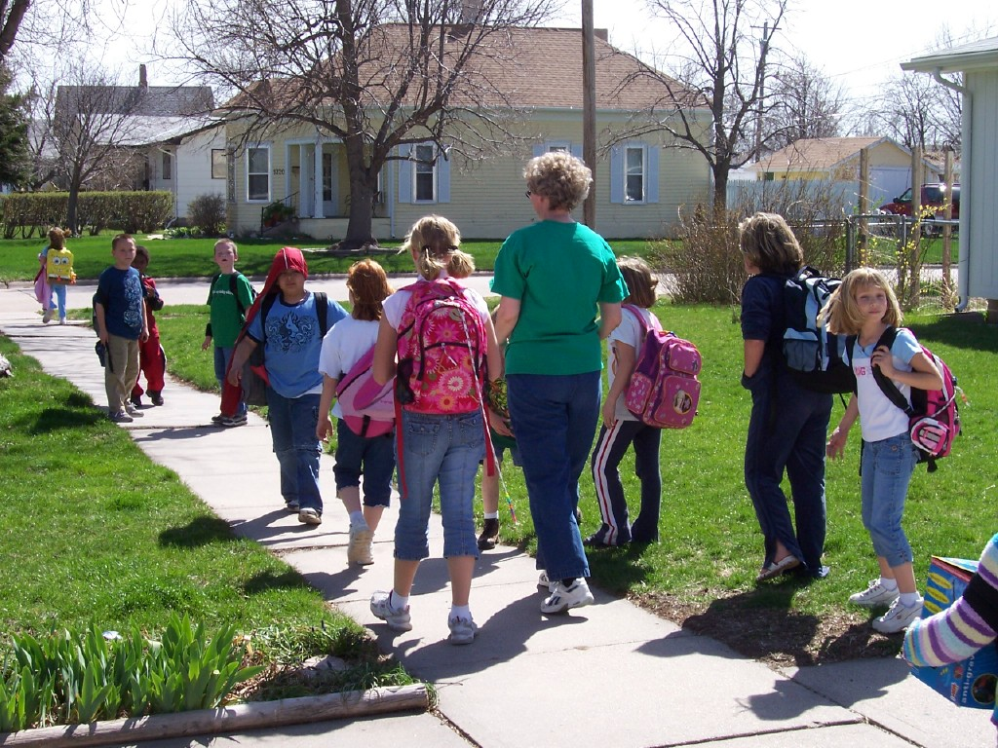
Real World Connections
Service learning projects
Internship/work placement
Work study
Research assistant
Teaching assistant
Other:

Slide 16
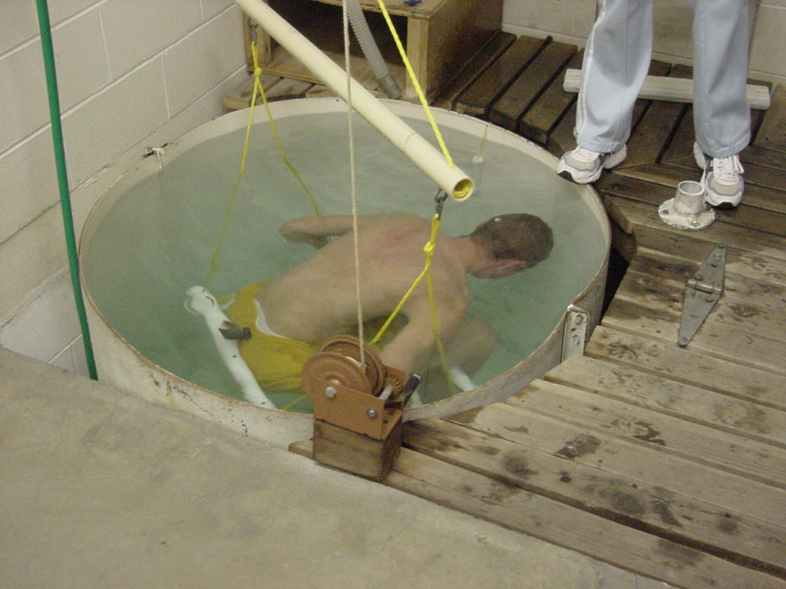
Capstone Experience
Independent Research
Lab Course
Senior Seminar
Practicum
Other:

Slide 17
Faculty Buy-In
Make sure faculty understand the concept of student engagement
Confirm/corroborate results
Drive data down to department level
Gain consensus on student engagement priorities

Slide 18
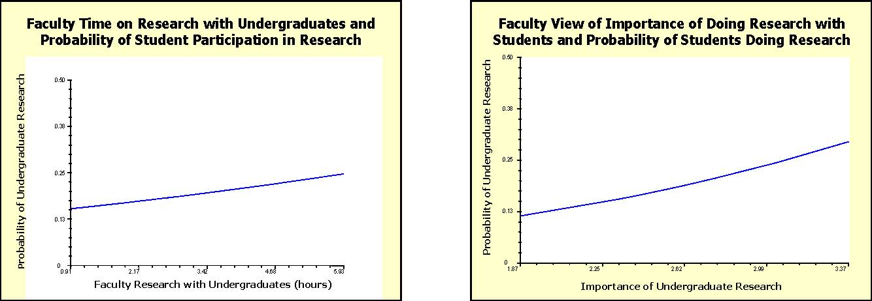
Impact of Faculty Buy-In

Slide 19
What to Make of This
When faculty members value and emphasize certain educational practices, students engage in them to a greater extent than their peers elsewhere.

Slide 20
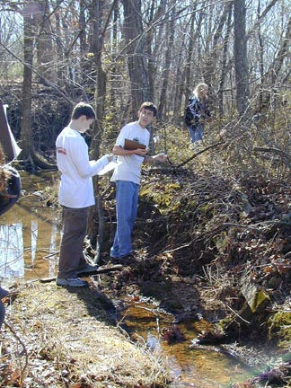
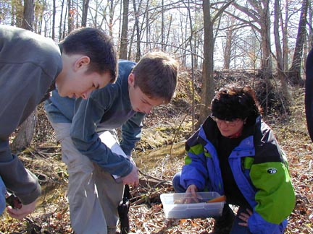
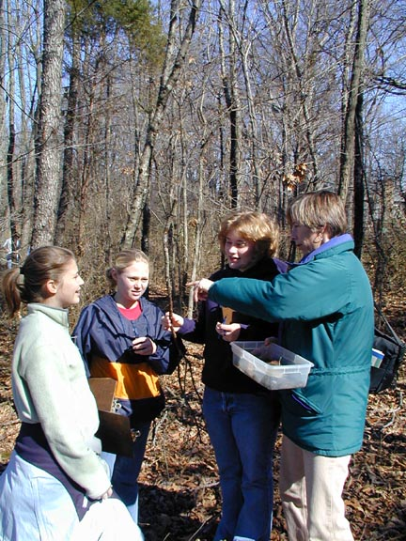
Engaging Students
Active Learning
Fungi, Slime Molds, Lichens, and Mosses
Passive Learning

