Slide 1
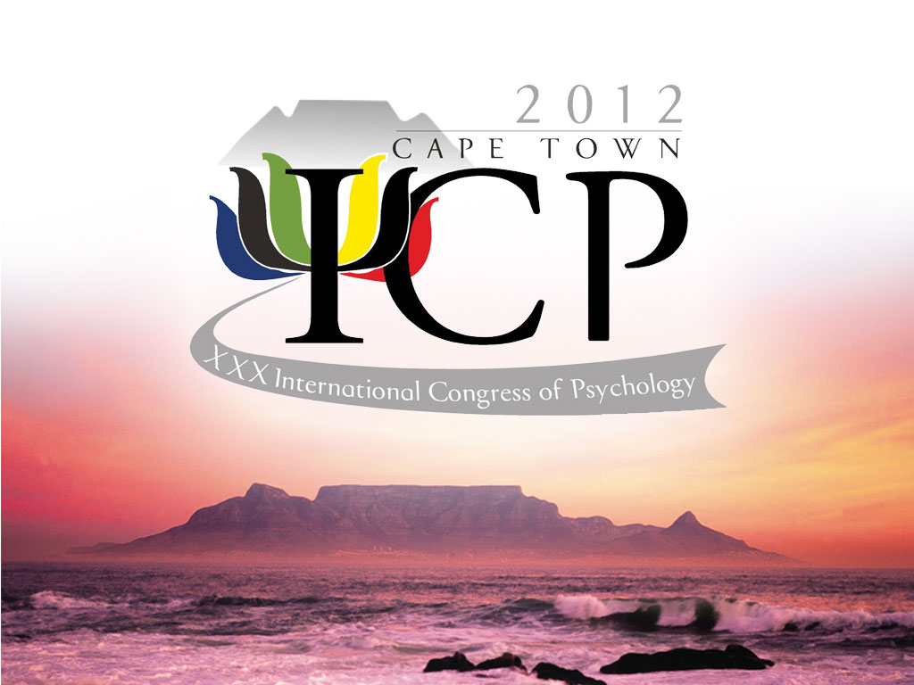

Slide 2
Teaching Psychology in South Africa
ICTP-2008, St Petersburg

Slide 3
An Overview of Psychology in South Africa
        Saths Cooper
        President: 30th International Congress of Psychology
        Vice President: International Union of Psychological Science
        Past President: Psychological Society of South Africa

Slide 4
An Overview of
Psychology in South Africa
Organized psychology’s historical role & evolution has often mimicked & mirrored socio-historical developments within the South African social formation at different historical junctures, acting as a microcosm of South African society at different times
(Suffla et al, 2001)

Slide 5
An Overview of Psychology in South Africa
1928 Carnegie Commission: ‘poor white’ problem
- laid ideological trajectory by privileging white concerns over black
- many recommendations became cornerstones of apartheid law (Nicholas et al, 1990 Duncan et al, 2004)
1946 National Institute of Personnel Research
- ‘Scientific’ basis for inferiorization of blacks

Slide 6
An Overview of Psychology in South Africa
1948 National (Apartheid) Party assumes power
1948 South African Psychological Society formed
Contested resolution to include blacks fearing jeopardizing IUPsyS membership
1962 Whites-only Psychological Institute of the Republic of South Africa (PIRSA) founded

Slide 7
An Overview of
Psychology in South Africa
1977 Professional Board for Psychology
1983 SAPA & PIRSA merge to form PASA
Legacy of racist knowledge production: South African Psychologist, PIRSA Monograph, Psygram; racially separate universities
1994 PsySSA formed January, 1st National Democratic Election 27 April

Slide 8
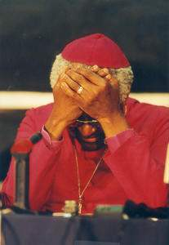
Truth & Reconciliation
Commission
Robbertse, other psychologists defend perpetrators of gross human rights violations
No psychologist appears for victims of Apartheid excesses
No Ethical Code until 1999
Employment Equity Bill prohibits testing

Slide 9
An Overview of
Psychology in South Africa
Statutory Profession 1977
Post-Masters Licensing: Clinical, Counseling, Educational, Industrial, Research
Specialization: Neuro, Forensic
Accredited Training: 14 of 23 Universities
National Ethical Code: Accepted into Law 2004
Compulsory CPD

Slide 10
An Overview of
Psychology in South Africa
One National Psychology Org: PsySSA
Baccalaureate Entry for service provision
5000 practicing psychologists - 48m population
Scarce & Priority Resource
Community Service
Societal affirmation

