Slide 1

Attendance in South African psychology lectures: why do students skip lectures?
Andrew Thatcher, Gillian Mooney, Nicky Israel - School of Human & Community Development
Notes:
Acknowledge larger project of 5 staff, 2 RA’s, and students

Slide 2


The context: Psychology at the University of the Witwatersrand, Johannesburg
University primarily non-residential (78% non-residence students), urban, located in downtown Johannesburg, approximately 25 000 students
Approximately 65% students from previously disadvantaged backgrounds
Psychology primarily ‘housed’ in Humanities Faculty, but students taught from all five Faculties
Lectures in Psychology are primarily face-to-face in large classes (150-550 students/class) with some small group tutorials (20-50 students/tutorial)
Degree is 3-year bachelor’s degree
Lecture attendance is non-compulsory
Notes:
Students in this study were primarily Humanities students, followed by Science students, and then Commerce/Law students
Students in these classes are predominantly female; First year students may only be taking psychology as “filler” credits

Slide 3
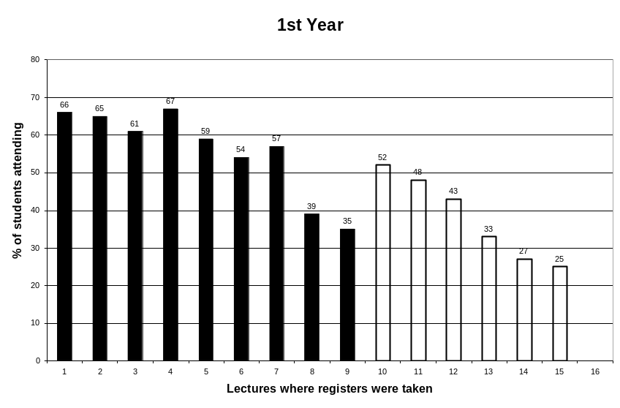
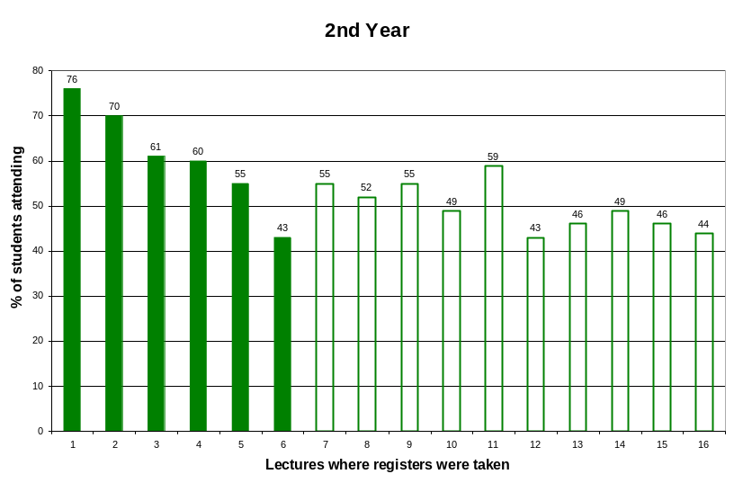
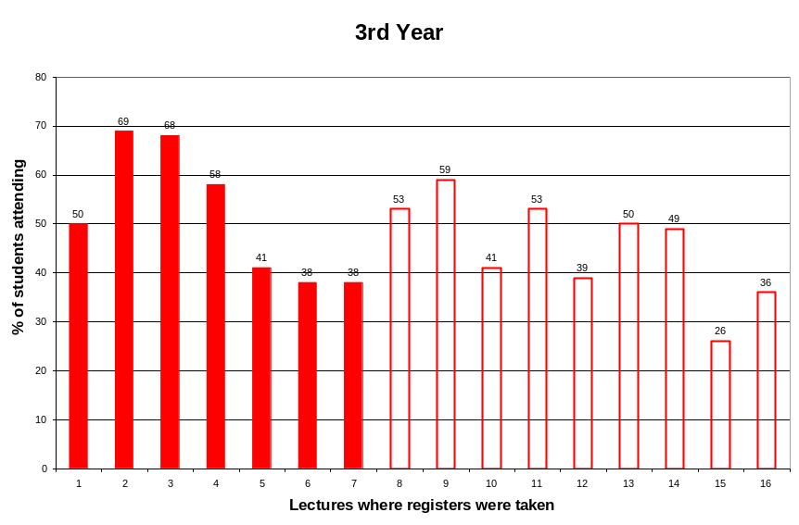
Attendance usually lower than 60%
Trends from early in the teaching block to late in the teaching block
Trends at 2nd and 3rd year around assignment dates
Notes:
Data collected across a Term; 1st year shows strong trend from start of each ‘block’ (two blocks per term) to end of a ‘block’; attendance doesn’t fully recover at start of a new ‘block’; attendance at 2nd and 3rd year strongly associated with when assignments are due (especially in ‘block’ 2 leading up to exams)

Slide 4
Attendance and academic performance
First Year
Test1: 0.11 Essay1: -0.001
Test2: 0.007 Essay2: 0.08
Exam: 0.04
Second Year
Test1: 0.29* Essay1: 0.12
Test2: 0.29* Essay2: 0.20*
Exam: 0.26*
Third Year
Test1: 0.26* Essay1: -0.02
Test2: 0.26* Essay2: 0.27*
Exam1: 0.20* Exam2: 0.02
Relationships between attendance and performance at 2nd and 3rd year levels, but not 1st year
Stronger for Year mark assessments such as tests
Notes:
May be issue of socialisation/adjustment into 1st year (i.e. performance more related to socialisation/preparedness into tertiary education); 1st year assessments are also largely based on a textbook (especially the exam); these classes are also the largest classes and lack of attendance is easiest to ‘hide’

Slide 5
Why do students miss lectures?
From previous studies:
  Galichon & Friedman (1985): high socialisation, drinking, boring lectures, don’t like lecturer
  Van Blerkom’s (1992) 6 most common reasons: competing assessments, boring lectures, major illness, minor illness, high socialisation, overslept (no proportions given)
  Fleming (1992): competing assessments (24%), poor lecturing (23%), lecture timing (16%), poor content/structure (9%)
  Hunter & Tetley (1999): competing assessments (43%), apathy (35%), get material in other ways (26%), lecture not worth it (25%), lecture timing (20%), illness (14%), transport/parking (7%), p/t work (4%), family problems (4%)
Students mostly from previously disadvantaged backgrounds, therefore:
  expected more transport problems, financial problems, P/T work, competing assessments
  Students more likely to note these problems compared with high socialisation, lecture characteristics, availability of online notes, substance abuse problems
Notes:
Paucity of studies reporting reasons for missing lectures; only van Blerkom’s study reports data from psychology classes
SA study may have unique characteristics due to relatively more students from disadvantaged backgrounds and also a largely non-residential university

Slide 6
Method and Data
Pilot questionnaire
Questionnaire developed, pilot-tested on 2nd year class in 2006, closed-ended and open ended sections
88 completed questionnaires
Study questionnaires (distributed in class)
377 completed questionnaires, open ended questions at start of term
192 1st Year, 112 2nd Year, 73 3rd Year
168 completed questionnaires, closed-ended questions at end of term
Telephonic structured interviews (specifically students who didn’t attend classes)
75 telephonic interviews, 25 from each year of study
Additional data: attendance registers, academic performance, 3 focus groups, interview with each lecturer (6 in total), and academic motivation questionnaire
Notes:
4 sets of data: a pilot study conducted in 2006; 377 questionnaires gathered in first week of term; 168 questionnaires gathered in last week of term; 75 telephonic interviews; different times and different types of data may have an impact on data results; also part of a much larger research project

Slide 7
Pilot questionnaire (closed-ended questions)
Reasons for missing
Assignment due 50%
Studying for test 47%
Ill/sick 30%
Lecture too early 27%
Lecture too late 22%
Personal/family crisis 16%
Poor transport 8%
Part-time work 7%
Never missed 7%
Went out night before 3%
Boring lecture 2%
Catching up on lectures
Notes from friends 80%
Read textbook 44%
Look on website/WebCT 13%
Read other sources 9%
Don’t catch up 7%
Ask lecturer 3%
Notes:
Pilot questionnaire data collected to set up coding categories and to rationalise the larger study;
Emphasise that 7% of students claimed they never missed class yet only 5% of students attended all classes according to attendance registers (either attendance registers are wrong or students forget that they missed lectures; an astounding 7% of students openly admitted to not trying to catch up on lectures missed

Slide 8
Pilot questionnaire (open-ended questions)
Inhibiting factors (self)
Essays/assignments due 19%
Lecturer incompetent 16%
Lecturer boring 15%
Poor lecture structure 13%
Good textbook 11%
Lecture too early 10%
Inhibiting factors (others)
Learn from textbook 33%
Lazy/apathy 24%
Essays/assignments due 20%
Use friends’ notes 15%
Lectures not important 16%
Lack of interest 14%
Closely mirror closed-ended responses
Interesting external locus of control in self reasons (i.e. lecturer issues and multiple assignments due)
Interesting external locus of control in others’ reasons (i.e. lazy, uninterested, apathetic, skewed priorities, etc.)
Notes:
Open-ended pilot questions used to generate categories for larger study (although results very closely match the larger study); hence asking the question about why do they think other people miss classes – e.g. because they are lazy; because they think lectures aren’t important (closely matches telephonic data)

Slide 9
1st Year: open-ended questions
Lecture/Lecturer-based factors
Boring lecture/lecturer 28%
Poor lecturing style 20%
Poor lecture structure 13%
Textbook better 13%
Lecture venue issues 5%
Student-based factors
Sick/illness 10%
Lecture too early 7%
Transport/traffic problems 7%
Personal/family crisis 7%
No friends in class 4%
Lecture too late 4%
Other assignments 4%
“Dull lecturers with monotone voices who just cover work from the textbook”
“Bad lecturer and incoherentness [sic]”
“If my friends are not around [in class]”
“When I’m sick and when I have financial problems”
Notes:
1st years have some socialisation issues (i.e. they like to know their friends are in class), but mostly they find lectures dull and uninteresting; some of these students will have come from “small” lecture classes in other subjects and others will have come from “small” school classrooms; some students only doing psychology for extra credit

Slide 10
2nd Year: open-ended questions
Lecture/Lecturer-based factors
Boring lecture/lecturer 29%
Poor lecture structure 19%
Poor lecturing style 17%
Lecture venue issues 6%
Textbook better 3%
Student-based factors
Transport/traffic problems 8%
Other assignments 6%
Personal/family crisis 5%
Sick/illness 5%
Too tired in morning 5%
No friends in class 3%
P/T work 1%
“The lecturer can be a huge bore sometimes”
“The lecturer can’t speak properly and has a boring way of speaking”
“Unprepared lecturer, dictatorship, someone who is not passionate about their subject”
“I have to wait in a queue for a taxi from Soweto to Johannesburg”
Notes:
Dominance of lecturer/lecture characteristics as reasons for attending again; first two years of psychology classes are largely theoretically based with very little application (this starts in second part of second year); P/T work issues and transport issues emerge;

Slide 11
3rd Year: open-ended questions
Lecture/Lecturer-based factors
Boring lecture/lecturer 27%
Poor lecture structure 21%
Poor lecturing style 8%
Textbook better 8%
Student-based factors
Other assignments 8%
Sick/illness 7%
Personal/family crisis 5%
Transport/traffic problems 5%
Too tired in morning 4%
If it is too cold/hot/raining 4%
P/T work 1%
“Parking is a terrible issue on campus”
“If it is raining and I am swamped with other work”
“If the lecturer is lazy, reads directly off the transparencies all the time”
“If there are not enough notes or examples given in class”
Notes:
Boring lecture/lecturer characteristics persist into 3rd year despite the introduction of an ‘application’ focus; competing assignments/tests now the dominant student-related factor;
Remember – the last 3 slides are data based on students who have actually been coming to class; difficult to ascertain what they mean by ‘boring’?

Slide 12
Study questionnaire (closed-ended questions)
Reasons for missing
Assignment due 61%
Studying for test 54%
Ill/sick 34%
Personal/family crisis 20%
Lecturer boring 18%
Lecture not important 13%
Poor transport 12%
Part-time work 8%
Couldn’t afford 2%
Catching up on lectures
Notes from friends 72%
Read textbook 65%
Read other sources 15%
Ask lecturer 10%
Look on website/WebCT 6% *
* Only one first year component had a website
Notes:
While percentages are slightly different, ordinal results are very close to those from the pilot study

Slide 13
Telephonic interviews
Lecture/Lecturer-based factors
Textbook better 11%
Poor lecturing style 9%
Conflicting lectures 4%
Have the notes already 1%
Student-based factors
Apathy/don’t care 19%
Transport/traffic problems 12%
Poor time management 11%
P/T work 9%
Sick/illness 9%
Rather stay home to study 9%
Other assignments 9%
Personal/family crisis 3%
Results almost opposite from questionnaires:
- Biased towards student-based factors
- Student apathy the largest contributor
- Far fewer lecturer-based characteristics
Notes:
Telephonic interviews were focused on the ‘low attendees’, although also included some students who were frequent attendees; factors for non-attendance were most frequently student-related such as apathy, time mismanagement, part-time work; wondering whether lack of attendance skills have been built up over the previous two years?

Slide 14
Conclusions
Open-ended questions:
  Primary reasons across all years were lecture/lecturer characteristics
  Missing lectures to complete assignments/study for tests were less frequent
  Transport/parking problems and illness were frequent student-based reasons
  Competing P/T work commitments only emerged in later years of study
Closed-ended questions:
  Other assignments due and studying for test (matches attendance patterns at 2nd + 3rd year)
  Lecture notes obtained from friends or the textbook
  Enormous opportunity to make notes available electronically (but threat that this may reduce attendance further)
Notes:
Quite a bit of similarity between the different years of study especially when it comes to reasons for non-attendance; difference between closed-ended and open-ended questions not difficult to reconcile (open-ended were at the start of the term and were largely historical or hypothetical – i.e. ‘I did last year …” or “I might if …”

Slide 15
Conclusions
Telephonic interviews:
  Apathy, transport issues, time management, and P/T work more frequent reasons
  Lecturer/lecture-based reasons less frequent.
Transport-related issues arose frequently, P/T work issues infrequently, and direct financial-related issues rarely emerged.
P/T work issues probably did not arise due to high national unemployment rates, P/T job opportunities taken by graduates and semi-skilled (depending on job)
Almost no high socialisation reasons (infrequent late night partying; no students mentioned substance abuse – hardly surprising given questionnaire format)
Very few psychology courses have online support; maybe useful, especially near term-end
Competing assessments/studying commitments may be a result of under-preparedness for tertiary education
Notes:
Quite a few of the dominant reasons overlap with previous studies although it is important to notice the differences wrt high socialisation (e.g. heavy partying and substance abuse); students do not have as many P/T job opportunities (e.g. waitering, causual labour, etc.); socialisation into 1st year may be a problem wrt studying techniques and note-taking

Slide 16

Project team:
Prof. Andrew Thatcher
Prof. Kate Cockcroft
Dr Gillian Mooney
Ms Nicky Israel
Ms Moira de Groot
Mr David Rosenstein (RA)
Ms Kieke Grootenhuis (RA)
We would like to express our thanks to the Claude Leon Foundation for the funds that sponsored this research project and the University of the Witwatersrand, Johannesburg who has provided additional research funds for a regional workshop

