Slide 1
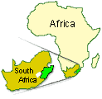

THE ROLE OF TELEHEALTH IN EDUCATION
ICTP-2008, St Petersburg, Russia
Basil J Pillay
Department of Behavioural Medicine
Nelson R Mandela School of Medicine
Durban, KwaZulu-Natal
South Africa

Slide 2
South Africa faces many burdens…
Psychosocial: poverty, housing, education issues, crime, abuse, post traumatic stress, …
Burden of disease: HIV/ AIDS, Tuberculosis, Depression, etc.
… places heavy demand on health resources.

Slide 3
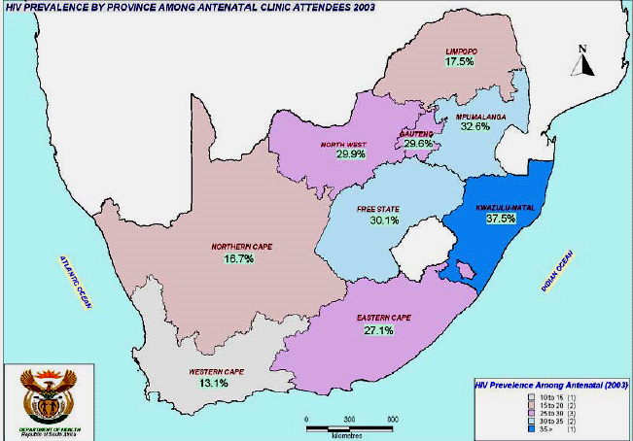
2005

Slide 4
Estimated number of people living with HIV
in sub-Saharan Africa, 1985–2005
30
Million
25
20
Number
of people
living
with HIV
15
10
5
0
1985
1990
1995
2000
2005
Year

Slide 5
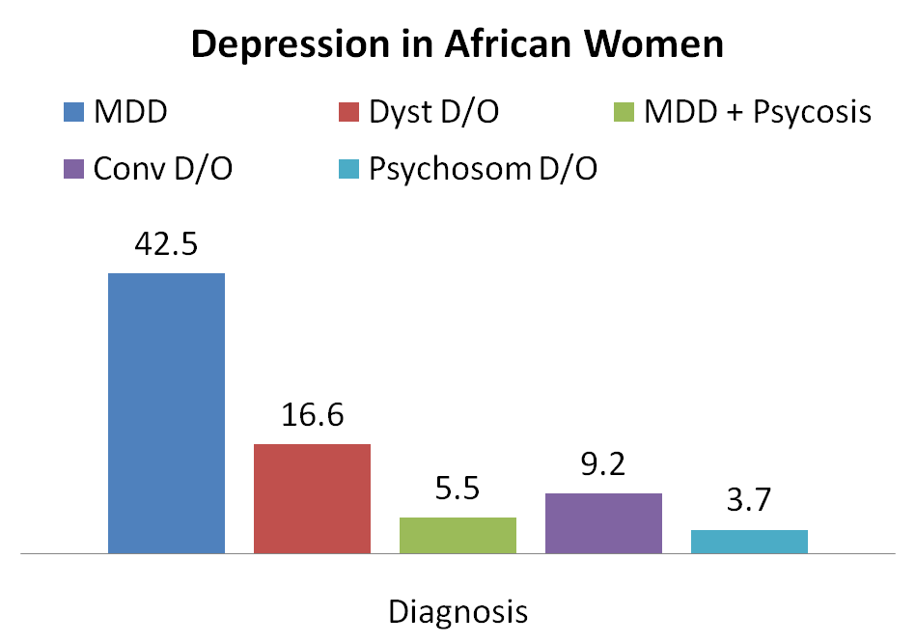
Female (75.90%)
Ngcobo, M & Pillay, BJ (2008)

Slide 6
Historic imbalance in the training of health care professionals from the Apartheid era
  Still persisting fourteen years after the advent of democracy,
The ubiquitous shortage of health care professionals in South Africa poses many challenges to the already burdened health and education sectors.
  society of some 48 million people there are less than 6000 psychologists

Slide 7
Adding to this need is the high turnover and loss of health professionals due to:
  poor working conditions,
  inadequate salaries,
  security concerns and
  the attractions offered by developed countries.

Slide 8
New ways and novel approaches are required to rapidly train and produce much needed health care professionals

Slide 9
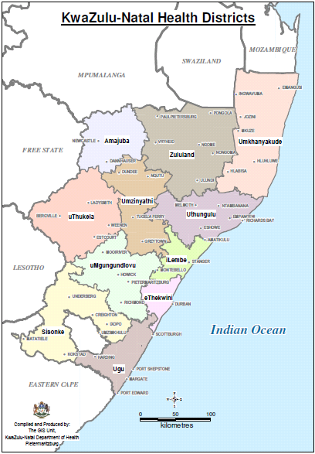
Health Statistics Available for KwaZulu-Natal
Health personnel per 100 000 population, KZN 2005
Category | Number per 100 000
Dental practitioner | 0.71
Dental specialist | 0.03
Dental therapist | 0.33
Enrolled nurses | 92.7
Medical practitioners | 24.2
Medical specialists | 6.2
Nursing assistants | 67.0
OT’s | 1.1
Pharmacists | 4.2
Physiotherapist | 2.18
Professional nurses | 108.8
Psychologists | 0.77
Radiographers | 4.5
Student nurses | 23.4
Reference: South African Health Review 2005.

Slide 10
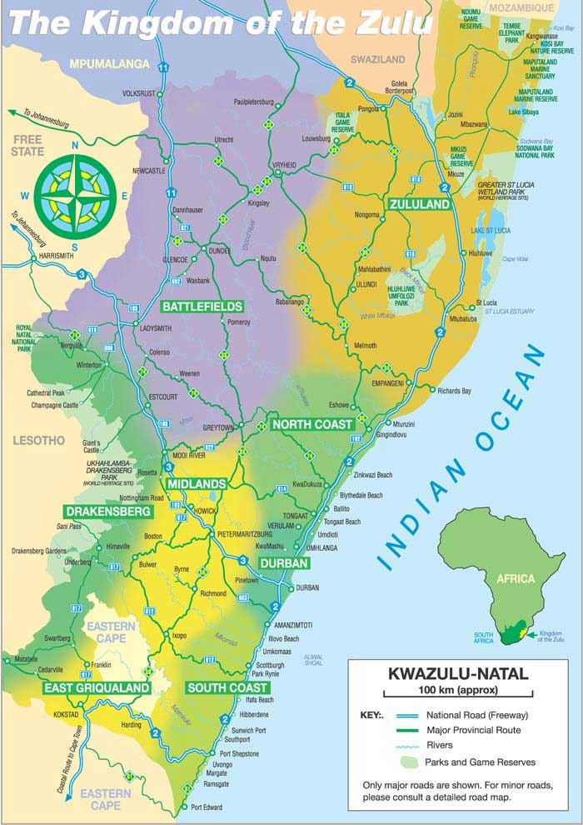
KwaZulu-Natal (98 000 Km²)
population of 9.7 million
54% rural
Health (mental health) transformation
  ↑ access
  Urban > rural

Slide 11
Travel to the University for their academic requirement of teaching and training.
Disruption of clinical service
  Shortage of skilled clinicians, high service
Hospitals are 85km, 120km, 200 km and 280 km from the medical school.
Teach MED Psychiatry via videoconferencing

Slide 12
Telehealth System
1999 The SA National Dept of health launched a National Telemedicine Pilot project
In KZN tele-opthalmology and tele-ultrasound were trailed installing Polycom 128, point to point videoconferencing at 11 units in hospitals.
The pilot project was unsuccessful.
KZN Dept of Health decided to use infrastructure for medical education
Video conference units were moved to relevant node hospitals , equipment upgraded and band width increased to 384kb, Fixed phone lines ISDN (IP can be used … no band width)

Slide 13
Telehealth System… cont
In 2007 broadcasted for 885 hrs
  2½ hrs a day, 7 days a week
26 programs involved (including clinical – Dermatology & Psychiatry)
3 sites at the medical school
Linked to 37 sites altogether
  65 Hospitals (every second one)
Recent HPCSA accreditation unique in SA

Slide 14
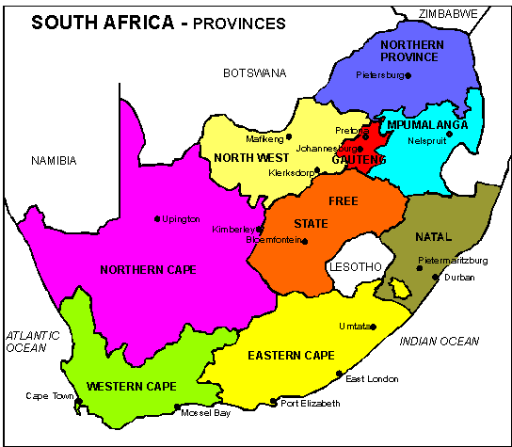
Telehealth System… cont
Link outside KZN
Universities in
  Umtata
  Limpopo
Egypt, Morocco, Senegal, Sudan, Ruwanda)
Link also

Slide 15
Medical School 2 technicians - at sites no format site coordinators (identify super-users)
Videoconferencing venues can accommodate 20 to 75 students

Slide 16
Videoconference is projected on screen via a data projector
PowerPoint presentations incorporated using scan converter in a computer interface to the videoconference unit or an SVGA feed
Only one video-camera is used at each site - no special lighting
The sessions are recorded to a VHS videocassette or DVD
Sound amplification used with wireless microphones to facilitate questions and interaction

Slide 17
Programme
40 lectures p.a.
Two hours weekly
14 lecturers
Were possible material prepared in advanced and emailed/ or provided online for download
PowerPoint slides
Pdf files

Slide 18
M Med Part 1 - Course Overview
Clinical Health Psychology/Behavioural Medicine
Basic Skills
  Clinical Interviewing Skills
  Problem Solving & Crisis Intervention
  Basic Principles of Psychotherapy/ Micro techniques of Psychotherapy
  Indications and Contra-indications for psychotherapy.
  Resistance, transference & counter-transference,
  Planning & monitoring psychotherapy according to patient dynamics
Human Development
  Fundamental Theories of Development:
  Learning: A Basis to Human Development
  Psychological Development
Psychological Assessment (adult and child assessment)
Research methodology
  An introduction to Research Methodology
  The use of quantitative statistics in research
  An introduction to qualitative research
Theories of Personality and Psychotherapeutic Method and Application
  Behavioural Conceptions of Personality & Psychotherapeutic Applications
  Cognitive Theory and Approach to Psychotherapy
  Cognitive Behavioural Techniques
  Family Therapy – Theory and Psychotherapeutic Method
  Psychoanalytic and Psychodynamic Theory and Approaches to Psychotherapy
  Short Term Psychodynamic Approaches to Psychotherapy
  Jung's Theory of Personality and Approach to psychotherapy
  Existential Conceptions of Personality and Psychotherapeutic Applications
  Humanistic Conceptions of Personality and Psychotherapeutic Applications
  Group Therapy - Theory and Psychotherapeutic Approach

Slide 19
MMed Part 2
YEAR ONE
YEAR TWO
Session One: Basic therapeutic
6-month :
One lecture/ Role playing of concepts/ Transcripts of interaction/ Video recoding and observations /Self/ peer/ supervisor rating on standardised therapeutic skill schedules
Session Two: Cognitive-Behavioural Therapy
3-month
One lecture/ workshop/ Video and observations/ Supervision
Session Three: Psychodynamic therapy
3-month
One lecture/ workshop/ Video and observations/ Supervision
Session Four: Systemic Therapy/ Family Therapy
3-month
One lecture/ workshop/ Video and observations/ Supervision
Session Five: Supportive Therapy
3-month
One lecture/ workshop/ video and observations/ Supervision
Session Six: Group Therapy
3-month course
One lecture/ workshop/ video and observations/ Supervision

Slide 20
Evaluation?

Slide 21
Infrastructure
Existing resources were used
The sound and image quality did not appear to be a problem but limited interactivity.
Organising and coordination is extremely important
Often font and background colours had to be changed for more effective transmission and clarity.
Technical problems: Load shedding / power cuts
Venues not well designed (noise, lighting, adaptability)

Slide 22
Lecturers
Most presenters were able to continued teaching without additional preparation.
Psychological material (clinical) can be easily taught
  Psychological concepts difficult for medical students
  African students (cultural, language, etc.)
Difficulty experienced in teaching some concepts without a whiteboard.
Participation lower … more so at sites
Less contact with lecturers
Results similar to previous years

Slide 23
Student
Students generally felt that videoconferencing was a good and an effective alternative to face to face seminars.
Clinical services were not disrupted.
Session could be reviewed
Appreciated not travelling to the medical school and reduced costs
Participation was lower… particularly at the sites
  social and affective advantages of the small groups
  more perceptive, sensitive and tolerant to the needs of others.

Slide 24
Student … cont.
Some students preferred to have all the material and work individually.
  Learning in a group time consuming, frustrating and stressful.
  Cultural forces that foster competition and compliance in previous school environments.
  Pay attention to the changing and developing needs of students so that an appropriate balance of individual and collective needs can be achieved

Slide 25
Future
Need to move away from ISDN line based connectivity to IP based conferencing
Training of academic staff
  Videoconferencing session management
  Videoconferencing etiquette
  Slide production (regularise fonts, font usage, text per slide, animation and effects)
  Material preparation
Consider ways to improve interaction

Slide 26
Greater collaboration will optimise use of scarce human resources
Requests from Namibia, Botswana, Zambia, Rwanda and Kenya
Can effectively be utilised in contexts outside South Africa where there are both abundance and scarcity of resources.

