Slide 1
INTRODUCTION
1. Internationalization in psychology
2. Networking and information provision in the teaching of psychology
3. Internationalization in the teaching of psychology

Slide 2
Internationalization in psychology
Networking and information provision in the teaching of psychology
Internationalization
in the teaching of psychology

Slide 3
1. Internationalization in psychology
International conferences, congresses and workshops, cross-national research teams, and academic training curricula have come to play an integral role in the professional life of psychologists in many countries and regions of the world
Currently more information than ever before is available about psychology from different countries.
International associations, journals and conferences supply this information for psychology researchers and practitioners,
  much less for psychology teachers

Slide 4
Regionalization
Although American psychology continues to occupy a dominant position in most of the world… (with some exceptions like German, French, Russian psychologies etc.),
in many countries there is an increasing awareness of the need to develop psychology as a science and profession for meeting local needs and for coping with local contexts

Slide 5
Internationalization
Psychology has become more global and pays increasing attention to international developments:
  the development of the European Diploma of Psychology (Lunt, 2002, Ed.)
  global training curriculum and qualification serve the integration and internationalization of professional psychology (Burgess, et all, 2004).

Slide 6
Regionalization + Internationalization
The development of a regionally flexible training curriculum and qualification common to many countries that would provide quality of the profession in the formulation of professional standards is recommended by Poortinga (2005)

Slide 7
2. Networking and information provision in the teaching of psychology
During the last two decades, the interest to study the teaching of psychology has been growing rapidly in many countries, on different continents

Slide 8
Societies and divisions specifically dedicated to the field of teaching and learning psychology
Society for the Teaching Psychology, APA Div. 2, in the USA;
Special Interest Group for Teaching Psychology of the British Psychological Society (later transformed in Division for Teachers and Researchers) in the UK;
Section of Psychology Education of BDP in Germany;
Association of University Professors in Psychology in France;
Section of Psychology Education of RPS in Russia;
Association for the Teaching of Psychology in the UK;
Teachers of Psychology in Secondary Schools of the APA in the USA;
Union of Psychology Teachers in Germany

Slide 9
Institutions supporting psychology teaching
Education Directorate of APA;
Learning and Teaching Support Network for Psychology (recently transformed into the Higher Education Academy Psychology Network) in the UK;
Association of Psychology Education in Russia.

Slide 10
Special journals devoted to the teaching and learning of psychology
Teaching of Psychology in the US
Psychology Teaching Review in the UK
Psychology Learning and Teaching in the UK

Slide 11
Special national conferences and meetings devoted to the field of teaching psychology
annual meetings of Society for the Teaching of Psychology during APA conventions;
occasional topical conferences of Russian Psychological Society;
biannual Psychology Learning and Teaching conferences in the UK
annual conferences of Association for Teaching Psychology in the UK
annual conferences of Teachers of Psychology in Secondary Schools of the APA in the USA
annual National Institute on the Teaching of Psychology in the USA
annual pre-conference Institute on Teaching of the Association for Psychological Science
annual conferences of Union of Psychology Teachers in Germany
regular conferences on teaching psychology in Spain.
sessions on teaching psychology in the frame of other psychology conferences around the world

Slide 12
Internationalization in psychology
Networking and information provision in the teaching of psychology
Internationalization
in the teaching of psychology

Slide 13
3. Internationalization in the teaching of psychology
Interest in the internationalization of psychological knowledge has increased dramatically in recent years, not only in research and practice, but also in the teaching of psychology

Slide 14
As for psychology teaching in international perspective,
there are a number of compelling arguments for generating a greater understanding and appreciation of the nature of undergraduate and graduate psychology and of how it is taught around the world (Karandashev & McCarthy, 2006):
  this can lead to increased international understanding of the subject matter of psychology
  better understanding among psychology professionals

Slide 15
Hogan (1996):
international psychology should be an integral part of the undergraduate curriculum so that students can come to understand "... the living system that is psychology ... its inherent diversity, versatility, and capacity for change"

Slide 16
Kogan (2000)
an APA Convention panel called for American psychologists to be more inclusive of other cultures when doing research, clinical work or teaching

Slide 17
Anthony J. Marsella (2000):
"We need a new psychology. It's no longer sufficient to train our students in isolation from other disciplines and from students across the world, from contact with different cultures. We need a psychology attuned to the changing times, a psychology that is alert to ethnocentric biases inherent in the Western academic psychology and one that values the diverse psychologies of the world"

Slide 18
It is time to pay more attention to the field of psychology teaching, and exchange the ideas regarding this topic internationally
The success of the first two International Conferences on Psychology Education attest to this need

Slide 19
The onset of international networking in the field of teaching psychology
Wilbert McKeachie, USA
Charles Brewer, USA
Sherri McCarthy, USA
Virginia Mathie, USA
Jane Halonen, USA
Stephen Newstead, UK
Ingrid Lunt, UK
Nick Hammond, UK
Annie Trapp, UK
Hans-Peter Langfeldt, Germany
Udo Kittler, Germany
Peter Wilson, Australia
Alain Lancry, France
Ype Poortinga, Netherlands

Slide 20

The First International Conference on Psychology Education
was held in St.- Petersburg, Russia, on June 12-15, 2002 (in cooperation with APA Division 2, BPS and other groups)

Slide 21
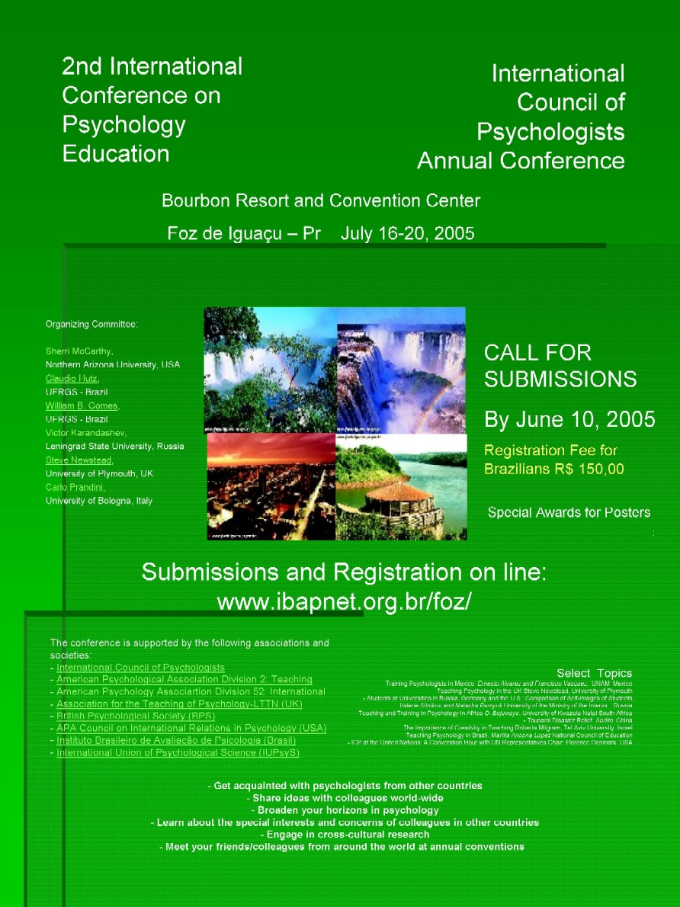
The second International Conference on Psychology Education
was held in Foz de Iguaçu, Brazil, in July 16-20, 2005.

Slide 22

The Third International Conference on Teaching of Psychology (ICTP-2008)
St.- Petersburg, Russia
We plan to launch an international web site where the resource on the teaching of psychology from international perspective will be available

Slide 23
Acknowledgements
INTERNATIONAL PROGRAM COMMITTEE
INTERNATIONAL ADVISORY COMMITTEE
INTERNATIONAL ORGANIZATIONAL COMMITTEE

Slide 24
The conference is grateful for the supporting grants from:
Association for Psychological Science (APS) - Fund for Teaching and Public Understanding of Psychological Science
American Psychological Association (APA) Committee on International Relations in Psychology (CIRP) - Scientific Meeting Support Fund

