Slide 1
CENG 477
Introduction to Computer Graphics
Ray Tracing: Geometry

Slide 2
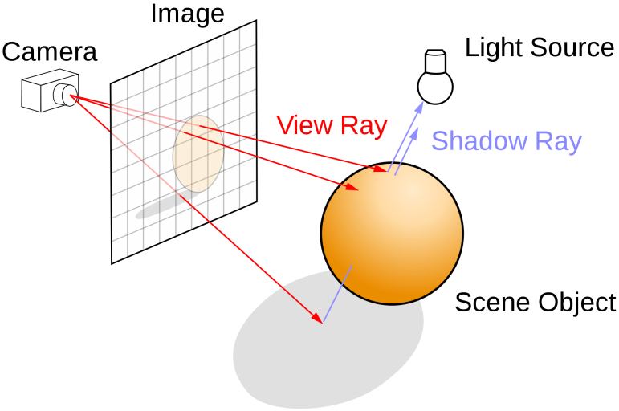
Ray Tracing
In ray tracing, we model the propagation of light and its interaction with materials to create realistic images
Different from reality, we assume that the rays originate from the eye (or the camera)
This allows us to avoid processing rays that will not be visible to the eye (or the camera)
wikipedia.com

Slide 3
Components
In RT, we have the following components:
  Camera (or eye)
  Image plane
  Objects
  Light sources
  and lots of rays!

Slide 4
Camera
Camera represents the origin of the rays that we will trace
It is represented by a position (e) and orientation (u, v, w)
These vectors are orthogonal to each other
v
The position and the orientation are defined with respect to a global (or world) coordinate system
This global system has origin at (0, 0, 0) and its three axis are: (1, 0, 0), (0, 1, 0), (0, 0, 1)
e
w
u

Slide 5
Camera
The u, v, w vectors of the camera have the following meaning:
  v: up vector
  w: opposite of gaze vector
  u: v x w with x representing cross-product
v
e
w
u

Slide 6
Image Plane
Image plane is a surface on which the final image is formed
It is divided into pixels through which rays will be cast
It is represented by its:
  Resolution (n_{x}, n_{y})
  Distance to the camera
  Left, right, top, bottom coordinates
(0, 0)
t
l
The image plane is typically centered and orthogonal with respect to the camera
r
v
b
e
distance
w
u
(n_{x} - 1, n_{y} - 1)

Slide 7
Image Plane
Image plane is a surface on which the final image is formed
It is divided into pixels through which rays will be cast
It is represented by its:
  Resolution (n_{x}, n_{y})
  Distance to the camera
  Left, right, top, bottom coordinates
(0, 0)
t
l
l, r, t, b are with coordinates with respect to the camera coordinate system (not the world coordinate system)
r
v
b
e
distance
w
u
(n_{x} - 1, n_{y} - 1)

Slide 8
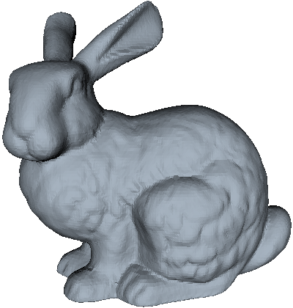

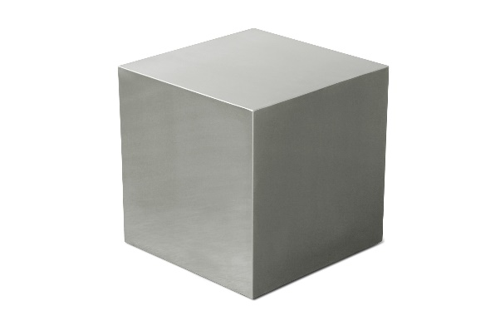
Objects
Objects consist of mathematically defined geometrical shapes or meshes made up of triangles

Slide 9
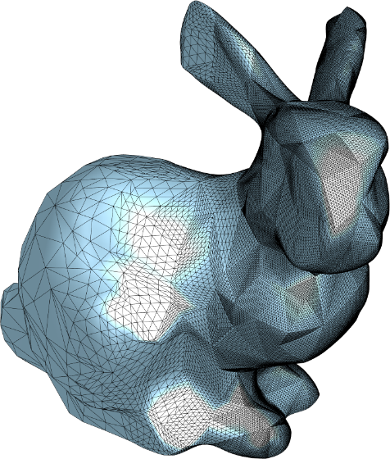
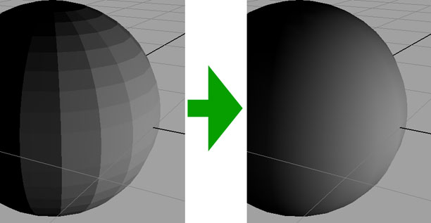
Objects
It is possible to model complex shapes using a large number of small triangles or quadrilaterals
gamedev.ru
cr4.globalspec.com/

Slide 10
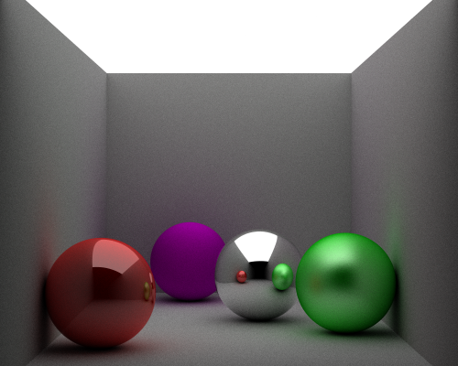
Objects
Objects may have different materials that affect their appearance
James P. O’Shea
Left to right: High-gloss, diffuse, mirrored, semi-gloss

Slide 11
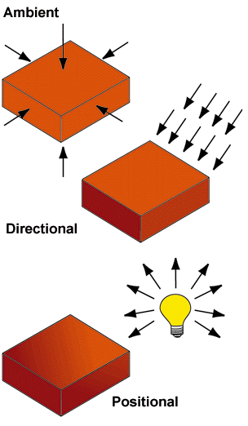
Light Sources
Light sources provide the illumination in the scene
The geometrical relationship between objects and light sources may produce shadows
Typically, three types of light sources are used:
  Ambient
  Directional
  Positional (Point)

Slide 12


Rays
A ray, or half-line, is a 3D parametric line with a half-open interval, usually $[0,∞)$
Both o and d are elements of $ℝ^{3}$ and t is in range $[0,∞)$
For a fixed t, r(t) represents a point on this line
$$r\left(t\right)=o+td$$
origin
direction
parameter

Slide 13
Ray Tracing
The basic algorithm:
for each pixel do
compute viewing (eye, primary) rays
find the first object hit by ray and its surface normal n
set pixel color to value computed from hit point, light, and n

Slide 14
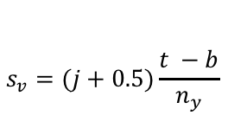
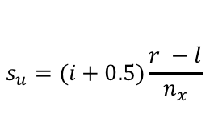
Computing Eye Rays
(0, 0)
q
t
s_{u}
s_{v}
m = e + -wdistance
l
s(i,j)
s = q + s_{u}u - s_{v}v
q = m + lu + tv
m
How to find s_{u} and s_{v}?
r
$$s_{u}=(i+0.5)\frac{r −l}{n_{x}}$$
v
b
$$s_{v}=(j+0.5)\frac{t −b}{n_{y}}$$
e
w
u
distance
(n_{x} - 1, n_{y} - 1)
How to write the final eye ray equation?
r(t) = e + (s – e)t = e + dt
e: location of the camera
distance: camera-image plane distance
n_{x}: image width
n_{y}: image height
u, v, w: camera vectors
r, l, t, b: image plane borders (in uvw space)
What information did we use to derive this?

Slide 15
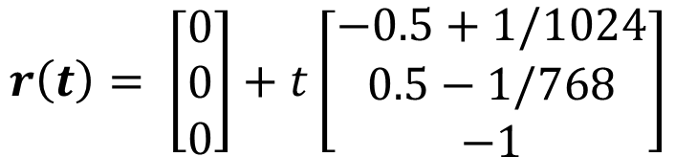
Some Example Values
u = (1, 0, 0)
v = (0, 1, 0)
e = (0, 0, 0)
n_{x} = 1024
n_{y} = 768
l = -1, r = 1
b = -1, t = 1
distance = 1
Compute the ray equation passing
through the pixel (256, 192):
$$r\left(t\right)= \left[\begin{matrix}0 \\ 0 \\ 0\end{matrix}\right]+t\left[\begin{matrix}−0.5+1/1024 \\ 0.5−1/768 \\ −1\end{matrix}\right]$$
Where is this ray at t = 0, t = 1, t = 2?

Slide 16
Ray-Object Intersections
Goal: To decide at what point, if any, a 3D line (ray) intersects a 3D surface

Slide 17
Parametric Lines
A 2D line can be represented as: y – mx – b = 0. This is called the implicit form
A parametric 2D line can be represented as:
A 3D parametric line (ray) can be written as:
Alternatively, in vector form, we can write r(t) = o + td where o = (2, 1, 3) and d = (7, 2, -5)
x(t) = 2 + 7t
y(t) = 1 + 2t
x(t) = 2 + 7t
y(t) = 1 + 2t
z(t) = 3 – 5t

Slide 18
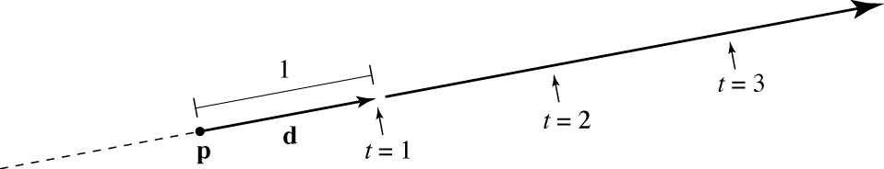
Ray (Reminder)
A ray is a half-line represented by r(t) = o + td with t ≥ 0.
We want to know if a ray intersects an object with t in the interval [t_{min}, t_{max}]
  If t < t_{min}, the object is too close (maybe in front of the image plane).
  If t > t_{max}, the object is too far (outside the range we want to consider).

Slide 19
Implicit Surfaces
Rays will intersect surfaces, so we need to know how to represent surfaces
In implicit form a surface can be written as f(x, y, z) = 0
Why is it called implicit?
  You can test whether a point is on the surface, but you cannot generate points on the surface
Another way to write: f(p) = 0 where p = (x, y, z)
A ray will intersect this surface if:
f(r(t)) = f(o + td) = 0

Slide 20
Ray-Plane Intersection
Consider the plane equation written in vector form as:
Here, a is a point on the plane, n is the normal vector of the plane
a and n, are known quantities and p is the variable.
(p – a).n = 0
If you expand this, you’ll get the familiar Ax + By + Cz + D = 0 equation
a
n

Slide 21
Ray-Plane Intersection
Simply plug r(t) = o + td into the previous equation:
Solving for t, we get:
If t is in [tmin, tmax], the ray hits the plane and it is within the limits of our desired viewing range
What if d.n = 0?
(o + td – a).n = 0
t = (a – o).n / (d.n)

Slide 22
Ray-Sphere Intersection
A sphere can be represented as:
where c = (c_{x}, c_{y}, c_{z}) is the center and R is the radius
In vector form, we can rewrite this as:
Again, plug in the ray equation to find t:
(x – c_{x})² + (y – c_{y})² + (z – c_{z})² – R² = 0
(p – c).(p – c) – R² = 0
(o + td – c).(o + td – c) – R² = 0

Slide 23
Ray-Sphere Intersection
This gives:
Note that, this is a quadratic equation in t:
The solution is:
What if the discriminant is less than zero?
(d.d)t² + 2d.(o – c)t + (o – c).(o – c) – R² = 0
At² + Bt + C = 0
t₂
t₁

Slide 24
Ray-Triangle Intersection
So far, we have been using implicit equations to represent surfaces: f(x, y, z) = 0
Ray-triangle intersection is more efficient if the triangle is represented using a parametric form:
x = f(u, v)
y = g(u, v)
z = h(u, v)

Slide 25
Ray-Triangle Intersection
Two techniques are possible:
  Lengthy but simple
  Shorter but somewhat more complex

Slide 26


Lengthy But Simple Method
First, intersect the ray with the plane of the triangle:
  The plane normal can be found by cross product
  The plane equation can be found from the normal and a point
a
n
$$n=\left(c −b\right) x (a −b)$$
$$f\left(p\right)=\left(p−a\right).n=0$$
c
b

Slide 27

Lengthy But Simple Method
If the ray intersects triangle’s plane, we need to determine if it is inside the triangle
  How to make an inside check?
a
If $p$ is on the same side of $\overline{ab}$ as $c$ and
If $p$ is on the same side of $\overline{bc}$ as $a$ and
If $p$ is on the same side of $\overline{ac}$ as $b$
Then $p$ is inside the triangle
Otherwise, it is outside the triangle
p'
p
c
b

Slide 28


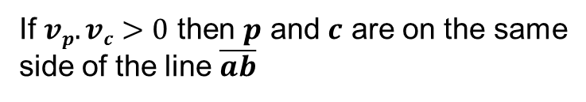
Lengthy But Simple Method
To check this, we use cross and dot products
$$vp=\left(p −b\right) x (a −b)$$
v_{p}
a
$$vc=\left(c −b\right) x (a −b)$$
v_{c}
If $vp.vc>0$ then $p$ and $c$ are on the same
side of the line $\overline{ab}$
p'
p
Repeat this process for all sides of the
triangle!
c
Pay attention to the order of the terms in cross-products!
b

Slide 29
Barycentric Coordinates
The alternative method uses barycentric coordinates
Any point inside the triangle plane can be parametrized by these three coordinates with the following conditions:
a
p(α, β, γ) = αa + βb + γc
with the constraints
0 < α < 1
0 < β < 1
0 < γ < 1
p(α, β, γ)
c
b

Slide 30
Barycentric Coordinates
The coordinates can be computed from area ratios:
a
α = A_{a} / A
β = A_{b} / A
γ = A_{c} / A
where
A = A_{a} + A_{b} + A_{c}
A_{b}
A_{c}
p(α, β, γ)
c
A_{a}
b

Slide 31
Barycentric Coordinates
Outside points also have barycentric coordinates but they can be negative (an outside area is considered to be a negative area):
a
α = A_{a} / A
β = A_{b} / A
γ = A_{c} / A
where
A = A_{a} + A_{b} + A_{c}
A_{b}
p(α, β, γ)
A_{c}
A_{a}
c
b

Slide 32
Barycentric Coordinates
Barycentric coordinates can be shown on a grid that is aligned with the edges of the triangles
a
c
b

Slide 33










Barycentric Coordinates
Any point on this grid is characterized by two coordinates
$$β=−2$$
$$β=−1$$
$$α=2$$
$$β=0$$
$$β=1$$
$$α=1$$
$$β=2$$
a
$$α=0$$
c
$$α=−1$$
b
$$α=−2$$

Slide 34






Barycentric Coordinates
Zooming into our triangle:
$$α=1$$
$$β=0$$
$$β=0.5$$
a
$$α=0.5$$
$$β=1$$
$$α=0$$
c
b

Slide 35

Barycentric Coordinates
If $0≤α≤1$ and $0≤β≤1$ then we are in this region:
$$α=1$$
$$β=0$$
$$β=0.5$$
a
$$α=0.5$$
$$β=1$$
$$α=0$$
c
b

Slide 36







Barycentric Coordinates
Furthermore, if $0≤α+β≤1$ and $0≤α$ and $0≤β$ then we are inside the triangle
$$β=0$$
$$α=1$$
$$β=0.5$$
a
$$β=1$$
$$α=0.5$$
$$α=0$$
c
b

Slide 37




Barycentric Coordinates
Note that there is also a third coordinate, $γ$:
$$α=1$$
$$β=0$$
$$β=0.5$$
a
$$α=0.5$$
$$β=1$$
$$α=0$$
c
b
$$γ=−1$$
$$γ=1$$
$$γ=0$$

Slide 38

Barycentric Coordinates
As a rule, $α+β+γ=1$
$$α=1$$
$$β=0$$
$$β=0.5$$
a
$$α=0.5$$
$$β=1$$
$$α=0$$
c
b
$$γ=−1$$
$$γ=1$$
$$γ=0$$

Slide 39
Back to Intersection
Note that we can eliminate one of the parameters:
The point p is inside (or on) the triangle if and only if:
Plug the ray equation r(t) = o + td into p:
α = 1 – β – γ
p(β, γ) = a + β(b – a) + γ(c – a)
β + γ ≤ 1
0 ≤ β
0 ≤ γ
o + td = a + β(b – a) + γ(c – a)

Slide 40
Ray-Triangle Intersection
How to solve for t?
Expand from the vector form into individual coordinates:
The unknowns here are t, β, and γ
We have 3 equations and 3 unknowns
o_{x} + td_{x} = a_{x} + β(b_{x} – a_{x}) + γ(c_{x} – a_{x})
o_{y} + td_{y} = a_{y} + β(b_{y} – a_{y}) + γ(c_{y} – a_{y})
o_{z} + td_{z} = a_{z} + β(b_{z} – a_{z}) + γ(c_{z} – a_{z})

Slide 41
Ray-Triangle Intersection
Rewrite this system in matrix form:
And solve for t, β, and γ using Cramer’s rule

Slide 42
Ray-Triangle Intersection
Cramer’s rule:
where |.| denotes the determinant

Slide 43
Finding the Determinant
If A is equal to:
Then |A| is given by:

Slide 44
Ray-triangle Intersection
Use this to find the determinants of the other terms and compute t, β, and γ.
The ray will intersect the triangle if:
Ray-triangle intersection is the most important as any complex object can be represented using a set of triangles
t_{min} ≤ t ≤ t_{max}
β + γ ≤ 1
0 ≤ β
0 ≤ γ

Slide 45
Ray Tracing Algorithm
The basic algorithm (reminder):
for each pixel do
compute viewing (eye, primary) rays
find the first object hit by ray and its surface normal n
set pixel color to value computed from hit point, light, and n

Slide 46
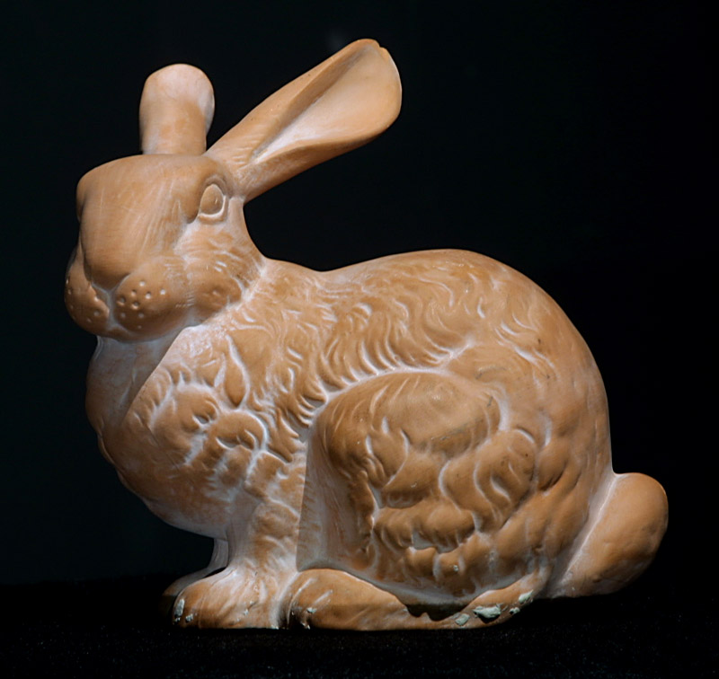
Complex Models
Bunny model composed of 725,000 triangles
From Stanford University

Slide 47
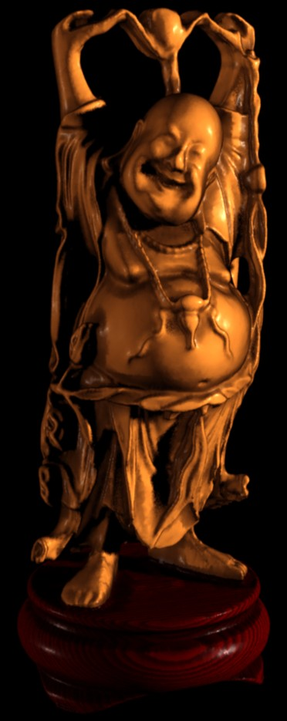
Complex Models
Buddha model composed of 9,200,000 triangles
From Stanford University

Slide 48
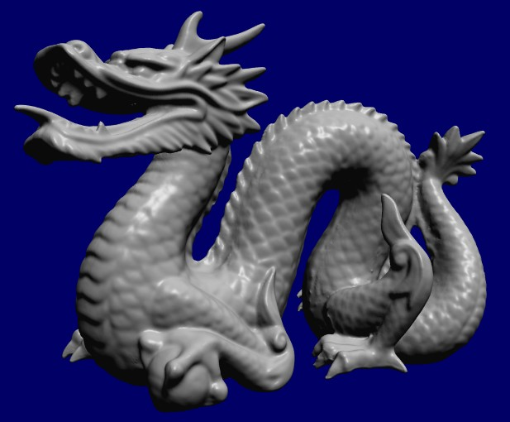
Complex Models
Dragon model composed of 5,500,000 triangles
From Stanford University

Slide 49
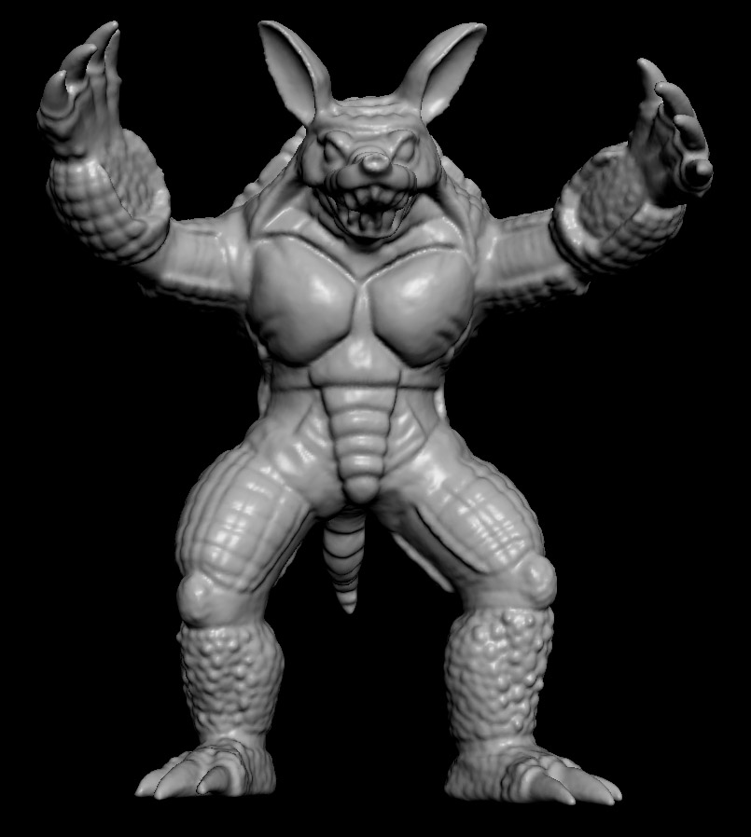
Complex Models
Armadillo model composed of 7,500,000 triangles
From Stanford University

Slide 50
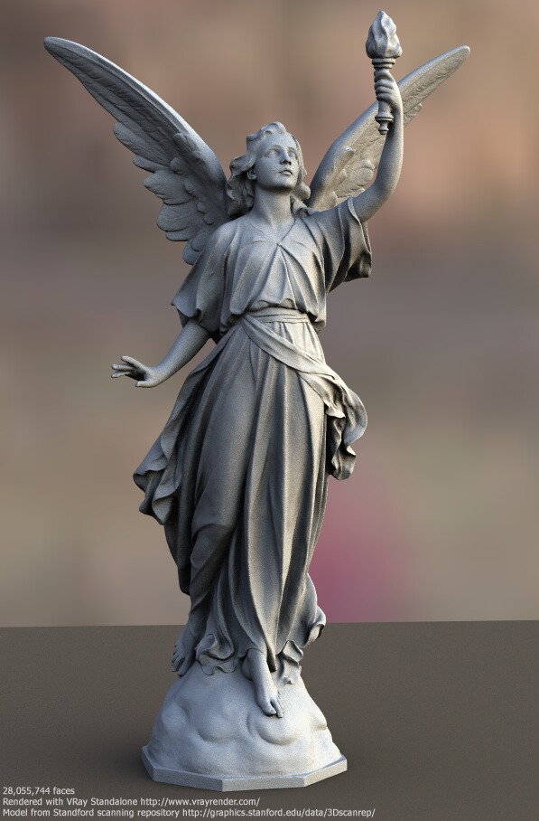
Complex Models
Lucy model composed of 116,000,000 triangles
From Stanford University

Slide 51
Intersection Cost
Let’s compute how many intersection tests we need to perform to render a model composed of 1,000,000 triangles with an image size of 1024x1024
1,000,000 * 1024 * 1024 ≈ 1,000,000,000,000 (one trillion)
And this is just the intersection – realistic shading is generally more costly (next week)
That’s why ray tracing is very slow
However, ray tracing can be accelerated by using:
  Multiple computers
  GPUs
  Acceleration structures

Slide 52
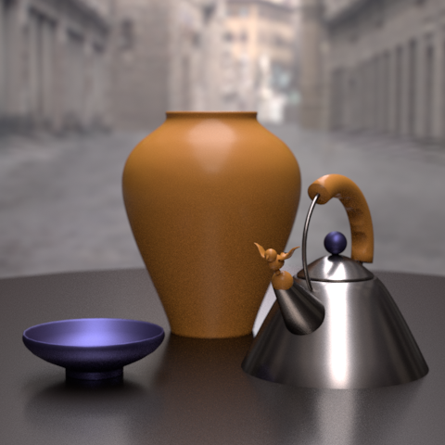
Realism
Intersection tests give us the surface position that is hit by a ray
To create realistic images, we need to compute realistic models of light-surface interaction at that point on the surface
This will be the topic of the next week
From ACM Siggraph

