Slide 1
CENG 477
Introduction to Computer Graphics
Forward Rendering Pipeline
Clipping and Culling

Slide 2
Rendering Pipeline
Sequence of operations that are used to draw primitives defined in a 3D coordinate system on a 2D window
Can be implemented on hardware or software
Two notable APIs: OpenGL and D3D
Not static: Constantly evolving to meet the demands of the industry
Rendering
Pipeline
2D Window
3D World

Slide 3
Rendering Pipeline
Official versions of OpenGL released to date are 1.0, 1.1, 1.2, 1.2.1, 1.3, 1.4, 1.5, 2.0, 2.1, 3.0, 3.1, 3.2, 3.3, 4.0, 4.1, 4.2, 4.3, 4.4, 4.5, 4.6 (2017)
4.6 is still the latest version
Rendering
Pipeline
2D Window
3D World

Slide 4
Rendering Pipeline – Overview
Vertices
Pixels
Get vertices in specific order and connectivity information
Process (transform) vertices
Create primitives from connected vertices
Clip and cull primitives to eliminate invisible ones
Transform primitives to screen space (preserve z)
Rasterize primitives to obtain fragments
Process fragments to obtain visible pixels with color
Vertex Processing
Fragment Processing
Transformed vertices
Fragments
Primitive Assembly
Rasterization
Primitives
Clipping and Culling
Primitives with 2D
coordinates and z
Viewport Transform
Visible primitives

Slide 5
Rendering Pipeline – Overview
Vertices
Pixels
Vertex Processing
Fragment Processing
We learned about vertex processing
  Modeling transformations
  Camera transformations
  Projection transformations
Transformed vertices
Fragments
Primitive Assembly
Rasterization
Primitives
Clipping and Culling
Primitives with 2D
coordinates and z
Viewport Transform
Visible primitives

Slide 6
Rendering Pipeline – Overview
Vertices
Pixels
Vertex Processing
Fragment Processing
Primitive assembly is the process of grouping of vertices to create primitives
  Lines
  Triangles
  Quadrangles
  …
This is just logical grouping, no actual objects are visible at this point
Transformed vertices
Fragments
Primitive Assembly
Rasterization
Primitives
Clipping and Culling
Primitives with 2D
coordinates and z
Viewport Transform
Visible primitives

Slide 7
Rendering Pipeline – Overview
Vertices
Pixels
Vertex Processing
Fragment Processing
During clipping and culling, primitives outside the CVV must be culled
Primitives partially inside the CVV must be clipped
  May produce new vertices
Transformed vertices
Fragments
Primitive Assembly
Rasterization
Primitives
Clipping and Culling
Primitives with 2D
coordinates and z
Viewport Transform
Visible primitives

Slide 8
Rendering Pipeline – Overview
Vertices
Pixels
Vertex Processing
Fragment Processing
With viewport transform, all surviving (and potentially clipped) primitives acquire viewport coordinates
  We work on integer pixel coordinates from this point on
  Depth can be fixed point or floating point number in [0, 1] range (unless changed by glDepthRange)
Transformed vertices
Fragments
Primitive Assembly
Rasterization
Primitives
Clipping and Culling
Primitives with 2D
coordinates and z
Viewport Transform
Visible primitives

Slide 9
Rendering Pipeline – Overview
Vertices
Pixels
Vertex Processing
Fragment Processing
Rasterization is the process of determining the pixels (fragments) that make up a primitive
  Different algorithms for lines, triangles, etc.
Transformed vertices
Fragments
Primitive Assembly
Rasterization
Primitives
Clipping and Culling
Primitives with 2D
coordinates and z
Viewport Transform
Visible primitives

Slide 10
Rendering Pipeline – Overview
Vertices
Pixels
Vertex Processing
Fragment Processing
Finally, each fragment may be further processed before being a visible pixel on the screen (or being written to a memory buffer)
  Depth testing
  Alpha blending
  …
This has a pipeline on its own
Transformed vertices
Fragments
Primitive Assembly
Rasterization
Primitives
Clipping and Culling
Primitives with 2D
coordinates and z
Viewport Transform
Visible primitives

Slide 11
Until Now
Vertices
Pixels
Vertex Processing
Fragment Processing
We learned about vertex processing
  Modeling trans.
  Viewing trans.
  Projection trans.
  Viewport trans.
We will now focus on
  Clipping & Culling
  Rasterization
  Fragment processing
Transformed vertices
Fragments
Primitive Assembly
Rasterization
Primitives
Clipping and Culling
Primitives with 2D
coordinates and z
Viewport Transform
Visible primitives

Slide 12
Clipping
In modern graphics API, there are essentially three kinds of primitives: points, lines, and triangles
Point clipping: straightforward
  Reject a point if its coordinates are outside the viewing volume
Line clipping
  Cohen-Sutherland algorithm
  Liang-Barsky algorithm
Polygon clipping
  Sutherland-Hodgeman algorithm

Slide 13

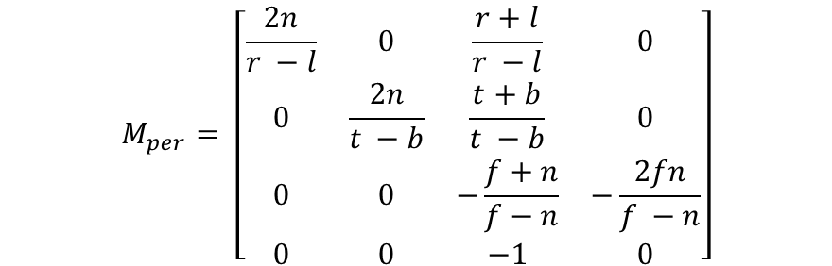
Clipping
Clipping is done in the clip space which is a result of applying projection (orthographic or perspective) transformation
After perspective transformation the w component of a point becomes equal to –z
After orthographic it remains as 1
$$M_{per}= \left[\begin{matrix}\frac{2n}{r −l} & 0 & \frac{r+l}{r −l} & 0 \\ 0 & \frac{2n}{t −b} & \frac{t+b}{t −b} & 0 \\ 0 & 0 & −\frac{f+n}{f−n} & −\frac{2fn}{f −n} \\ 0 & 0 & −1 & 0\end{matrix}\right]$$
$$M_{orth}= \left[\begin{matrix}\frac{2}{r −l} & 0 & 0 & −\frac{r+l}{r −l} \\ 0 & \frac{2}{t −b} & 0 & −\frac{t+b}{t −b} \\ 0 & 0 & −\frac{2}{f−n} & −\frac{f+n}{f −n} \\ 0 & 0 & 0 & 1\end{matrix}\right]$$

Slide 14



Clipping Location
In the pipeline, clipping is done before the perspective divide:
Original z value in range [-n, -f]
$$M_{p2o}$$
z mapped to [-n², -f²]
$$M_{per}$$
$$M_{orth}$$
z mapped to [-n, f]
Clipping done here
z mapped to [0, 1]
Perspective divide
z mapped to [-1, 1]
Viewport transform

Slide 15


Clipping Location
If clipping was done after perspective divide, we would clip against [-1, 1] range in all axis
In clip space, clipping is done against [-w, w]
  Clipping may produce new vertices at the clip boundaries
  Outside vertices may be discarded
After clipping all vertices are transformed to the canonical viewing volume (aka normalized device coordinates in [-1, 1])
$$P=\left[\begin{matrix}x \\ y \\ z \\ 1\end{matrix}\right]$$
Perspective
(or orthographic)
Transform
$$\left[\begin{matrix}x′ \\ y′ \\ z′ \\ w\end{matrix}\right]$$
w = -z in case of perspective
w = 1 in case of orthographic

Slide 16
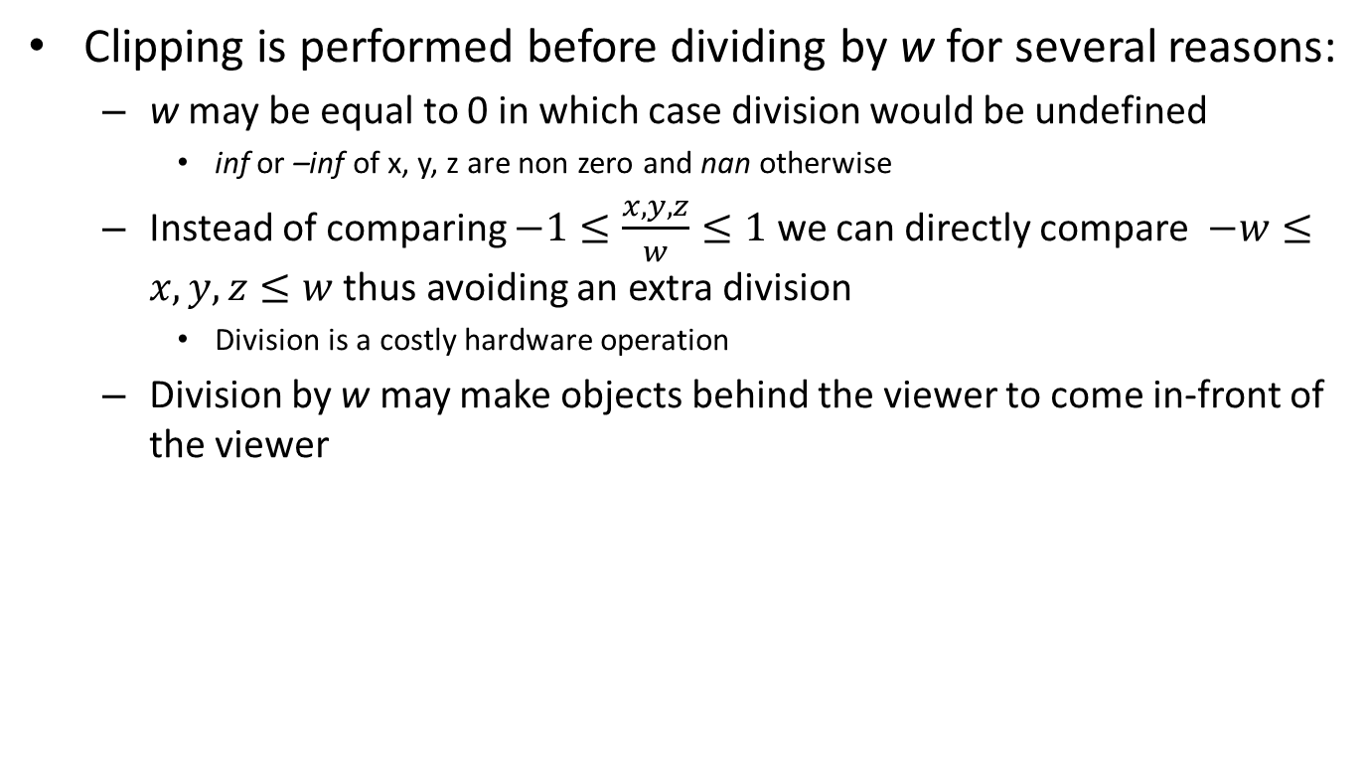
Clipping Location
Clipping is performed before dividing by w for several reasons:
  w may be equal to 0 in which case division would be undefined
    inf or –inf of x, y, z are non zero and nan otherwise
  Instead of comparing $−1≤\frac{x,y,z}{w}≤1$ we can directly compare $−w≤x,y,z≤w$ thus avoiding an extra division
    Division is a costly hardware operation
  Division by w may make objects behind the viewer to come in-front of the viewer
Before perspective divide
After perspective divide
B
C
A
A
C
B
z
z
near
near
far
far
Clipping the AB line should produce AC (clip point on the near plane)
After the divide the clip point goes to the far plane, which is wrong

Slide 17
Clipping Location
Clipping is performed before dividing by w for several reasons:
  w may be equal to 0 in which case division would be undefined
    inf or –inf of x, y, z are non zero and nan otherwise
  Instead of comparing $−1≤\frac{x,y,z}{w}≤1$ we can directly compare $−w≤x,y,z≤w$ thus avoiding an extra division
    Division is a costly hardware operation
  Division by w may make objects behind the viewer to come in-front of the viewer
  That is why in the following we don’t clip against -1 and 1 but against arbitrary numbers (it is also possible to define user clip planes which may have arbitrary values)
Before perspective divide
After perspective divide
B
C
A
A
C
B
z
z
Clipping the AB line should produce AC (clip point on the near plane)
After the divide the clip point goes to the far plane, which is wrong

Slide 18
Clipping
For simplicity, however, in the following we assume that clipping is performed against a 2D box with coordinates between [x_{min}, x_{max}] and [y_{min}, y_{max}]
The same ideas can be easily generalized to 3D
Line clipping:
  Cohen-Sutherland Algorithm
  Liang-Barsky Algorithm
Polygon clipping:
  Sutherland-Hodgeman Algorithm

Slide 19
Cohen-Sutherland Algorithm
Assign outcodes to the end points of lines:
  Bit0 = 1 if region is to the left of left edge, 0 otherwise
  Bit1 = 1 if region is to the right of right edge, 0 otherwise
  Bit2 = 1 if region is below the bottom edge, 0 otherwise
  Bit3 = 1 if region is above the top edge, 0 otherwise
1001
1000
1010
How many regions
would we have in
3D?
Outcodes for this line
are: 0101 and 1010
0001
0000
0010
How bits would we
need?
0101
0100
0110
Notes:
We have 27 regions in three 3D
So at minimum we need 5 bits. But to apply the exact same algorithm we need 6 bits because each bit indicates whether we are inside or outside with respect to a given face. And we have 6 faces of our viewing volume.

Slide 20
Cohen-Sutherland Algorithm
Handle trivial accept and trivial rejects first:
  If both outcodes are zero (i.e. their BITWISE OR is zero) accept the line as it is
  If BITWISE AND of outcodes are non-zero, reject the line entirely
Trivial accept/reject lines
Non-trivial cases

Slide 21
Cohen-Sutherland Algorithm
For non-trivial cases, iteratively subdivide lines until all parts can be trivially accepted and rejected
  Iteration follows a fixed order (e.g. left, right, bottom, top)

Slide 22
Cohen-Sutherland Algorithm
Non-trivial cases:
  Step 1: Pick an outside endpoint (v = v0 or v1)
  Step 2: Pick an edge for which v is outside
  Step 3: Intersect the line with that edge creating a new endpoint v’
  Step 4: Recompute the outcode of v’ and go to step 1 unless trivial reject or trivial accept is possible
1001
1000
1010
v1
1001
1000
1010
v1
0001
0000
0010
0001
v'0
0000
0010
v0
v0
0101
0100
0110
0101
0100
0110

Slide 23
Cohen-Sutherland Algorithm
v1
v1
1001
1000
1010
1001
1000
1010
v'1
0001
v'0
0000
0010
0001
v'0
0000
0010
0101
0100
0110
0101
0100
0110
1001
1000
1010
v'1
0001
v'0
0000
0010
0101
0100
0110

Slide 24
Cohen-Sutherland Algorithm
May perform needless clipping:
left
v0
v0
1001
1000
1010
1001
1000
1010
v1
v1
0001
0000
0010
0001
0000
0010
0101
0100
0110
0101
0100
0110

Slide 25
Cohen-Sutherland Algorithm
May perform needless clipping:
v0
v0
1001
1000
1010
1001
1000
1010
top
v1
v1
0001
0000
0010
0001
0000
0010
0101
0100
0110
0101
0100
0110
Trivial reject
at the next step

Slide 26
Cohen-Sutherland Algorithm
Another example:
  Bitwise OR not zero (cannot trivially accept)
  Bitwise AND not one (cannot trivially reject)
B
1001
1000
1010
0001
0000
0010
0101
0100
0110
A

Slide 27
Cohen-Sutherland Algorithm
Pick an outside vertex, A
Pick an edge that is outside of: 0101 => left
B
1001
1000
1010
0001
0000
0010
0101
0100
0110
A

Slide 28
Cohen-Sutherland Algorithm
Intersect to find C
B
1001
1000
1010
0001
0000
0010
0101
C
0100
0110
A

Slide 29
Cohen-Sutherland Algorithm
Discard the A-C segment, C is your new endpoint
Its outcode is 0100
Cannot trivially accept or reject C-B
B
1001
1000
1010
0001
0000
0010
0101
C
0100
0110

Slide 30
Cohen-Sutherland Algorithm
Now pick an outside point, C for example
Pick an edge that is outside of, 0100 => bottom
B
1001
1000
1010
0001
0000
0010
0101
C
0100
0110

Slide 31
Cohen-Sutherland Algorithm
Intersect to find D
B
1001
1000
1010
0001
0000
0010
D
0101
C
0100
0110

Slide 32
Cohen-Sutherland Algorithm
Discard C-D, D is your new endpoint
Its outcode is 0000
Cannot trivially accept or reject D-B
B
1001
1000
1010
0001
0000
0010
D
0101
0100
0110

Slide 33
Cohen-Sutherland Algorithm
Now pick B as your only outside point
Pick an edge that is outside of, 1010 => right
B
1001
1000
1010
0001
0000
0010
D
0101
0100
0110

Slide 34
Cohen-Sutherland Algorithm
Intersect to find E
Discard E-B, E is your new endpoint
E’s outcode is 0000
We can now trivially accept D-E as our clipped line
1001
1000
1010
E
0001
0000
0010
D
0101
0100
0110

Slide 35






Line Intersections
In 2D, we need to intersect a line with other lines
In 3D, we need to intersect a line with planes
We may use parametric form in both cases (similar to ray tracing)
$$v_{0}=\left[\begin{matrix}x_{0} \\ y_{0} \\ z_{0}\end{matrix}\right]$$
$$x\left(t\right)= x_{0}+dt$$
$$d=\left[\begin{matrix}x_{1}−x_{0} \\ y_{1}−y_{0} \\ z_{1}−z_{0}\end{matrix}\right]$$
$$y\left(t\right)= y_{0}+dt$$
where
$$v_{1}=\left[\begin{matrix}x_{1} \\ y_{1} \\ z_{1}\end{matrix}\right]$$
$$z\left(t\right)= z_{0}+dt$$

Slide 36
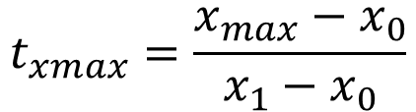
Line Intersections
To find the intersection point, compute t corresponding to the given edge (or face) and then find the remaining values:
v₁
$$t_{xmax}=\frac{x_{max}−x_{0}}{x_{1}−x_{0}}$$
x_{max}
The intersection point is at:
(x_{max}, y(t_{xmax}), z(t_{xmax}))
v₀

Slide 37
Cohen-Sutherland Algorithm
Advantages:
  If the chances of trivial accept/reject are high, this is a very fast algorithm
  This can happen if the clipping rectangle is very large or very small
Disadvantages:
  Non-trivial lines can take several iterations to clip
  Because testing and clipping are done in a fixed order, the algorithm will sometimes perform needless clipping

Slide 38
Liang-Barsky Algorithm
Uses the idea of parametric lines
Classifies lines as potentially entering and potentially leaving to speed up computation (approximately 40% speed-up over Cohen-Sutherland Alg.)
v₁ = (x₁, y₁)
y_{max}
Goal: Given the line v0, v1 determine:
- The part of the line is inside the viewing rectangle.
p = (x, y)
v₀ = (x₀, y₀)
Note: p = v0 + (v1-v0)t
y_{min}
x_{min}
x_{max}

Slide 39
Liang-Barsky Algorithm
Potentially entering (PE) and leaving (PV):
Why do we say potentially?
v₀,v₁ is potentially entering
the left edge as x₁ – x₀ > 0
v₂,v₃ is potentially leaving
the left edge as x₃ – x₂ < 0
v₃
v₇
v₁
v₅
The situation is reversed for
the right edge:
v₀
v₂
v₆
v₄
v₄,v₅ is potentially leaving
the right edge as x₅ – x₄ > 0
v₆,v₇ is potentially entering
the right edge as x₇ – x₆ < 0
Left
Right
Notes:
We say potentially because, we are intersecting the line with the extended edges. Intersecting with an extended edge does not mean that it is actually entering the clip rectangle.

Slide 40
Liang-Barsky Algorithm
Similar for bottom and top edges:
v₆
v₀,v₁ is potentially entering
the bottom edge as y₁ – y₀ > 0
v₂,v₃ is potentially leaving
the bottom edge as y₃ – y₂ < 0
Top
v₅
The situation is reversed for
the top edge:
v₄
v₇
v₂
v₁
Bottom
v₄,v₅ is potentially leaving
the top edge as y₅ – y₄ > 0
v₆,v₇ is potentially entering
the top edge as y₇ – y₆ < 0
v₀
v₃

Slide 41
Liang-Barsky Algorithm
Observation: If a line is first leaving then entering, it cannot be visible
PE
v₁
v₁
PE
PL
PL
v₀
v₀
v₁
v₁
PE
PE
PL
PL
v₀
v₀

Slide 42
Liang-Barsky Algorithm
Visible lines are first entering then leaving:
PL
v₁
v₁
PL
PE
PE
v₀
v₀
v₁
v₁
PL
PL
PE
PE
v₀
v₀

Slide 43
Liang-Barsky Algorithm
Also note that for a 2D clipping rectangle, each line will enter and leave twice:
PL
PL
PE
PE

Slide 44
Liang-Barsky Algorithm
Also note that for a 2D clipping rectangle, each line will enter and leave twice:
If the first leave happens before
the last entrance, the line cannot
be visible
PL
PE
PL
PE

Slide 45
Liang-Barsky Algorithm
Mathematical interpretation:
So at intersection points, we need to compute the t value as well as whether the line is PE or PL at that point
where t_{PL} is the t value for the first
leaving intersection and t_{PE} is the t
value for the last entering intersection
if (t_{PL} < t_{PE}):
visible = false;
PE
v₁
v₁
PL
v₁
v₁
PL
PL
PE
PL
PE
PE
v₀
v₀
v₀
v₀
v₁
v₁
PL
PL
v₁
v₁
PE
PE
PE
PE
v₀
v₀
PL
PL
v₀
v₀

Slide 46
Liang-Barsky Algorithm
Computing t value at every edge:
But this does not help us to know if line is entering or leaving at that point. Solution: look at the sign of dx, dy:
x_{left} = x0 + (x1-x0)t ➔ t = (x_{left} – x0) / (x1 – x0)
x_{right} = x0 + (x1-x0)t ➔ t = (x_{right} – x0) / (x1 – x0)
y_{bottom} = y0 + (y1-y0)t ➔ t = (y_{bottom} – y0) / (y1 – y0)
y_{top} = y0 + (y1-y0)t ➔ t = (y_{top} – y0) / (y1 – y0)
v₀,v₁ is potentially entering
the left edge if dx = (x₁ – x₀) > 0
v₀,v₁ is potentially entering
the right edge if dx = (x₁ – x₀) < 0
or –dx > 0
v₀,v₁ is potentially entering
the bottom edge if dy = (y₁ – y₀) > 0
v₀,v₁ is potentially entering
the top edge if dy = (y₁ – y₀) < 0
or –dy > 0

Slide 47
Liang-Barsky Algorithm
Finding intersection type:
  Entering left edge if dx > 0.
  Entering right edge if -dx > 0.
  Entering bottom edge if dy > 0.
  Entering top edge if -dy > 0.
Finding t:
  For left edge: t = (x_{left} – x₀) / (x₁ – x₀) = (x_{left} – x₀) / dx
  For right edge: t = (x_{right} – x₀) / (x₁ – x₀) = (x_{right} – x₀) / dx
  = (x0 – x_{right}) / (-dx)
  For bottom edge: t = (y_{bottom} – y₀) / (y₁ – y₀) = (y_{left} – y₀) / dy
  For top edge: t = (y_{top} – y₀) / (y₁ – y₀) = (y_{top} – y₀) / dy
  = (y0 – y_{top}) / (-dy)

Slide 48
Liang-Barsky Algorithm
For lines parallel to edges:
if d_{x} == 0 and x_{min} – x₀ > 0: // left
reject;
else if d_{x} == 0 and x₀ - x_{max} > 0: // right
reject;
else if d_{y} == 0 and y_{min} – y₀ > 0: // bottom
reject;
else if d_{y} == 0 and y₀ - y_{max} > 0: // top
reject;
v₁ = (x₁, y₁)
y_{max}
v₀ = (x₀, y₀)
y_{min}
x_{min}
x_{max}

Slide 49
Liang-Barsky Algorithm
Putting it all together:
bool visible(den, num, t_{E}, t_{L}):
if (den > 0): // potentially entering
t = num / den;
if (t > t_{L}):
return false;
if (t > t_{E})
t_{E} = t;
else if (den < 0): // potentially leaving
t = num / den;
if (t < t_{E}):
return false;
if (t < t_{L})
t_{L} = t;
else if num > 0: // line parallel to edge
return false;
return true;
t_{E} = 0; t_{L} = 1;
visible = false;
if visible(d_{x}, x_{min} – x₀, t_{E}, t_{L}): // left
if visible (-d_{x}, x₀ – x_{max}, t_{E}, t_{L}): // right
if visible (d_{y}, y_{min} – y₀, t_{E}, t_{L}): // bottom
if visible (-d_{y}, y₀ – y_{max}, t_{E}, t_{L}): // top
visible = true;
if (t_{L} < 1):
x₁ = x₀ + d_{x}t_{L};
y₁ = y₀ + d_{y}t_{L};
if (t_{E} > 0):
x₀ = x₀ + d_{x}t_{E};
y₀ = y₀ + d_{y}t_{E};
Update t_{E}
Update t_{L}

Slide 50
Liang-Barsky Algorithm
3D extension is straightforward:
t_{E} = 0; t_{L} = 1;
visible = false;
if visible(d_{x}, x_{min} – x₀, t_{E,} t_{L}): // left
if visible (-d_{x}, x₀ – x_{max}, t_{E}, t_{L}): // right
if visible (d_{y}, y_{min} – y₀, t_{E}, t_{L}): // bottom
if visible (-d_{y}, y₀ – y_{max}, t_{E}, t_{L}): // top
if visible (d_{z}, z_{min} – z₀, t_{E}, t_{L}): // front
if visible (-d_{z}, z₀ – z_{max}, t_{E}, t_{L}): // back
visible = true;
if (t_{L} < 1):
x₁ = x₀ + d_{x}t_{L}; y₁ = y₀ + d_{y}t_{L}; z₁ = z₀ + d_{z}t_{L};
if (t_{E} > 0):
x₀ = x₀ + d_{x}t_{E}; y₀ = y₀ + d_{y}t_{E}; z₀ = z₀ + d_{y}t_{E};
This part is used for
efficient ray-bounding
volume intersections in
acceleration structures
we learned earlier!

Slide 51
Example
Left Edge
v₁
v₁
v₀
v₀
PE with small positive t (t_{E} = t)
Right Edge
v₁
PL with large positive t (t_{L} = t)
v₀

Slide 52
Example
Bottom Edge
v₁
v₁
v₀
v₀
PE with negative t (t_{E} not updated)
Top Edge
PL with t > 1 (t_{L} not updated)
v₁
v₀

Slide 53
Example
Result
v₁
Smallest t_{L}
v₀
Largest t_{E}

Slide 54
Polygon Clipping – Sutherland Hodgeman Algorithm
Difficult problem as we need to deal with many cases:

Slide 55
Sutherland Hodgeman Algorithm
Divide and conquer approach makes it manageable:
  Solve a series of simple and identical problems
  When combined, the overall problem is solved
Here, the simple problem is to clip a polygon against a single clip edge:
Clip against right edge

Slide 56
Sutherland Hodgeman Algorithm
Clip against bottom edge
Clip against left edge

Slide 57
Sutherland Hodgeman Algorithm
Clip against top edge

Slide 58
Sutherland Hodgeman Algorithm
This is accomplished by visiting the input vertices from v₀ to v_{N} and then back to v₀ for each clip boundary
At every step we add 0, 1, or 2 vertices to the output:
Inside
Outside
Inside
Outside
Inside
Outside
Inside
Outside
v_{i}
v_{i}
v_{i}
v_{i+1}
v_{i+1}
v_{i}
v'_{i+1}
v'_{i+1}
v_{i+1}
v_{i+1}
Add v_{i+1} to output
Add v’_{i+1} to output
Add nothing to output
Add v’_{i+1} and v_{i+1}to output

Slide 59
Example
v3
Initial vertex list: {v0, v1, v2, v3}
Step 1: Right Edge
v0 -> v1: Add v1’
v1 -> v2: Add v2’ and v2
v2 -> v3: Add v3’
v3 -> v0: Add v0’ and v0
v0
v2
v1
v0'
V3’
v0
v2
v2'
v1'

Slide 60
Example
v0'
Current vertex list: {v0, v1’, v2’, v2, v3’, v0’}
v3’
Step 2: Bottom Edge
v0 -> v1’: Add v1’’
v1’ -> v2’: Add v2’’ and v2’
v2’ -> v2: Add v2
v2 -> v3’: Add v3’
v3’ -> v0’: Add v0’
v0’ -> v0: Add v0
v0
v2
v2'
v1'
v0'
v3’
v0
v2
v2'
v2’’
v1’’

Slide 61
Example
v0'
Current vertex list: {v0, v1’’, v2’’, v2’, v2, v3’, v0’}
v3’
Step 3: Left Edge
v0 -> v1’’: Add v1’’’ and v1’’
v1’’ -> v2’’: Add v2’’
v2’’ -> v2’: Add v2’
v2’ -> v2: Add v2
v2 -> v3’: Add v3’
v3’ -> v0’: Add v0’
v0’ -> v0’’: Add v0’’
v0
v2
v2'
v2’’
v1’’
v0'
v3'
v0’’
v2
v1’’’
v2’
v1’’
v2’’

Slide 62
Example
v0'
Current vertex list: {v0’’, v1’’’, v1’’, v2’’, v2’, v2, v3’, v0’}
v3'
Step 4: Top Edge
v0’’ -> v1’’’: Add v1’’’
v1’’’ -> v1’’: Add v1’’
v1’’ -> v2’’: Add v2’’
v2’’ -> v2’: Add v2’
v2’ -> v2: Add v2
v2 -> v3’: Add v3’
v3’ -> v0’: Add v0’’’
v0’ -> v0’’: Add v0’’’’ and v0’’
v0’’
v2
v1’’’
v2’
v1’’
v2’’
v0’’’’
v0’’’
v3'
v0’’
v2
v1’’’
v2’
v1’’
v2’’

Slide 63
Example
Final vertex list: {v0’’, v1’’’, v1’’, v2’’, v2’, v2, v3’, v0’’’, v0’’’’}
v0’’’’
v0’’’
v3'
v0’’
v2
v1’’’
v2’
v1’’
v2’’
This object can be tessellated and rendered as multiple triangles
v0’’’’
v0’’’
v3'
v0’’
v2
v1’’’
v2’
v1’’
v2’’

Slide 64
Culling
Complex scenes contains many objects
Objects closer to the camera occlude objects further away
Rendering time can be saved if these invisible objects are culled (i.e. eliminated, discarded, thrown away)
Three common culling strategies are:
  View volume (frustum) culling
  Backface culling
  Occlusion culling

Slide 65
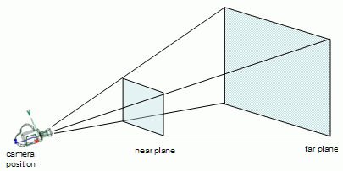
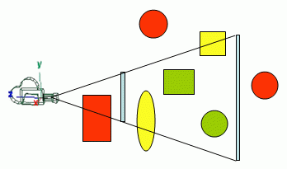
View Volume (Frustum) Culling
The removal of geometry outside the viewing volume
No OpenGL support: it is the programmer’s responsibility to cull what is outside.
From lighthouse3d.com

Slide 66
View Volume (Frustum) Culling
First determine the equations of the planes that make up the boundary of the view volume (6 planes):
Here, a is a point on the plane and n is the normal (pointing outside from the face)
Plug the vertices of each primitive for p. If we get:
for any plane, the vertex is outside
If all vertices are outside w.r.t. the same plane, then the primitive is outside and can be culled
Using a bounding box or bounding sphere for complex models (i.e. meshes) is a better solution
Plane equation: (p – a).n = 0
(p – a).n > 0

Slide 67
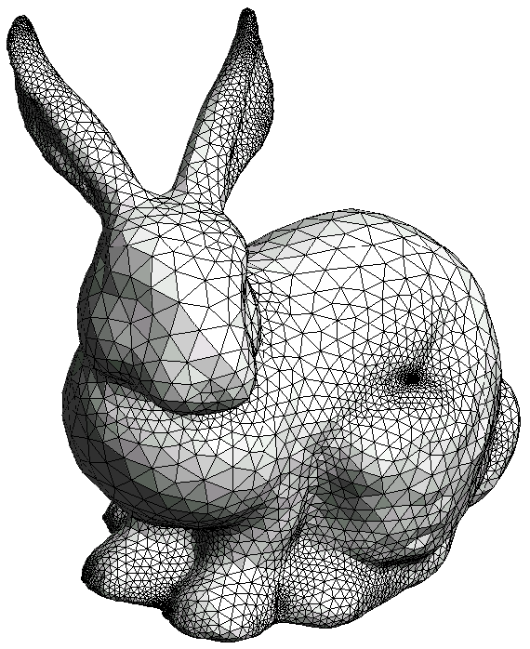
Backface Culling
For closed polygon models, back facing polygons are guaranteed to be occluded by front facing polygons (so they don’t need to be rendered)
OpenGL supports backface culling: glCullFace(GL_BACK) and glEnable(GL_CULL_FACE)

Slide 68
Backface Culling
Polygons whose normals face away from the eye are called back facing polygons
v₂
v₀
-w
-w
v
n
v
eye
eye
n
v
v
v₁
v₁
v₀
v₂
Front facing triangle
n.v < 0
Back facing triangle
n.v > 0

Slide 69
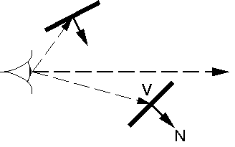
Backface Culling
Note the v is the vector from the eye to any point on the polygon (you can take the polygon center). You cannot use the view (gaze) vector!
Should not be culled
-w
Can be culled
From http://omega.di.unipi.it

Slide 70
Occlusion Culling
The removal of geometry that is within the view volume but is occluded by other geometry closer to the camera:
OpenGL supports occlusion queries to assist the user in occlusion culling
By a fast rendering pass, it counts how many pixels of the tested object will be rendered
This is commonly used in games
w
Bunny is occluded
by the blue triangle
eye

Slide 71
Occlusion Culling in OpenGL
Create a query.
Disable rendering to screen (set the color mask of all channels to False).
Disable writing to depth buffer (just test against, but don't update, the depth buffer).
Issue query begin (which resets the counter of visible pixels).
"Render" the object's bounding box (it'll only do depth testing; pixels that pass depth testing will not be rendered on-screen because rendering and depth writing were disabled).
End query (stop counting visible pixels).
Enable rendering to screen.
Enable depth writing (if required).
Get query result (the number of "visible" pixels).
If the number of visible pixels is greater than 0 (or some threshold),
  Render the complete object.
For details see: http://http.developer.nvidia.com/GPUGems/gpugems_ch29.html

Slide 72
Summary
Clipping and culling stages take a set of vertices defined in clip space and connectivity information
They output a potentially modified set of vertices also in clip space
In case of polygon clipping, these vertices can be triangulated to create new primitives
The ensuing perspective divide brings everything to [-1, 1] range known as the canonical viewing volume or normalized device coordinates
The viewport transform brings everything to the screen coordinates while transforming z to [0, 1] range
The next stage, known as rasterization, actually determines which pixels belong to the primitive

Slide 73
Clipping Details
For the curious
In practice clipping is done by comparing each of the x, y, z coordinates with the w coordinate of the point
Let’s visualize in 1D
Find the t values by intersecting the AB line with x = -w and x = w lines
Repeat for y and z updating t_{Lmin} and t_{Emax}
Once the line (or the edge) is determined to be crossing the boundary, (t_{Emax} < t_{Lmin}), compute A’ and B’ by interpolating all of the homogeneous coordinates
w
x = -w
x = w
B’
B = (x_{1c}, w_{1c})
A = (x_{0c}, w_{0c})
A’
x

