Slide 1
CENG – 477
Introduction to Computer Graphics
Fragment Processing

Slide 2
Fragment Processing
The previous stages of the pipeline (up to rasterization) is generally known as the vertex pipeline
Rasterization creates a set of fragments that make up the interior region of the primitive
The rest of the pipeline which operates on these fragments is called the fragment pipeline
Fragment pipeline is comprised of several operations
The end result of fragment processing is the update of corresponding locations in the framebuffer

Slide 3
Fragment Processing
Vertices
Vertex
Pipeline
Rasterization
Fragment Pipeline
Framebuffer
Color
Buffer
Depth
Buffer
Stencil
Buffer

Slide 4
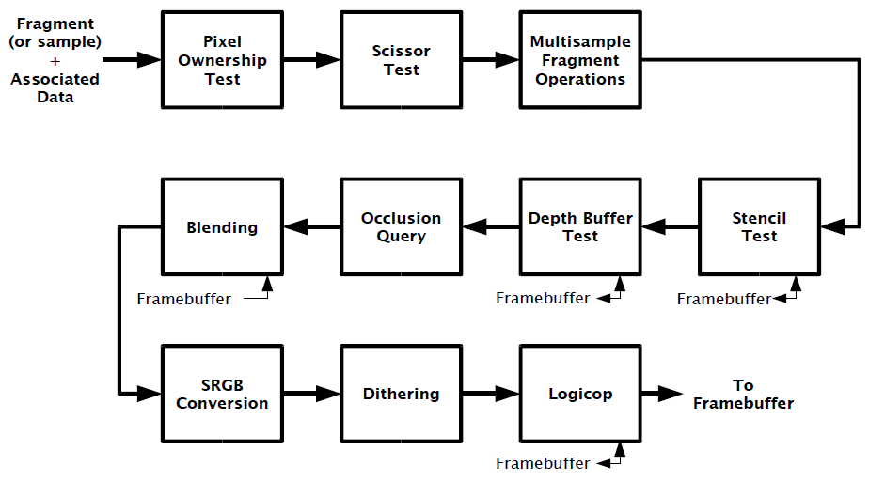
Fragment Processing
Fragment pipeline is comprised of many stages:
  Following is OpenGL’s handling of the fragment pipeline
  Different renderers may implement a different set of stages
See: https://www.khronos.org/opengl/wiki/Per-Sample_Processing

Slide 5
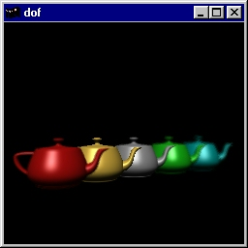
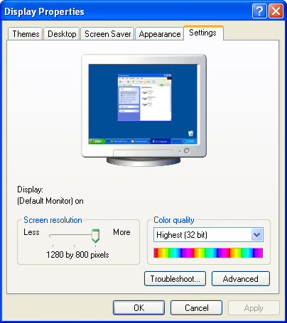
Pixel Ownership Test
Does the renderer (e.g. OpenGL) has the ownership of the current framebuffer pixel?
These pixels are owned
by other windows
These pixels are owned
by OpenGL

Slide 6
Scissor Test
Scissor test is a per-fragment operation that discards fragments outside a certain rectangular region
Without scissor
Scissor rectangle
Result
In OpenGL, glScissor
command is used for this
purpose
Note that this operation
is different from clipping

Slide 7
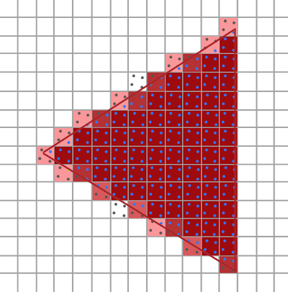
Multi-Sample Operations
Each framebuffer pixel may contain multiple samples. This allows a smoother border of primitives at the cost of extra processing and memory
https://learnopengl.com/Advanced-OpenGL/Anti-Aliasing

Slide 8
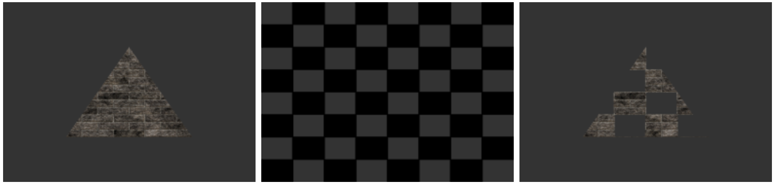
Stencil Test
While scissor test can be used to mask out rectangles, stencil test can be used to mask arbitrary fragments
Requires a different buffer known as the stencil buffer
Original
Stencil Buffer
Result
From research.ncl.ac.uk

Slide 9
Stencil Test
Typically depth and stencil buffers are combined to produce single buffer made of 24-bit depth and 8-bit stencil information for each pixel
Pixel 0
Pixel 1
D
S
D
S
D
S
…
D
S
D
S
D
S
…
D
S
D
S
D
S
…
D
S
D
S
D
S
…
…

Slide 10
Stencil Test
Stencil buffer and stencil test can also be used to implement one type of shadowing algorithms (we’ll learn this later)
Doom 3

Slide 11
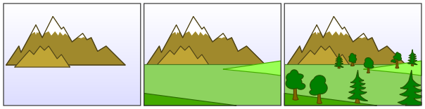
Depth Buffer Test
Among these, the depth buffer test is very important to render primitives in correct order
Without depth buffer, the programmer must ensure to render primitives in a back to front order
  Known as painter’s algorithm:
From wikipedia.com

Slide 12
Depth Buffer Test
Binary space partitioning (BSP) trees may be used for this purpose
2
1
3
C
4
5
Corresponding BSP tree

Slide 13
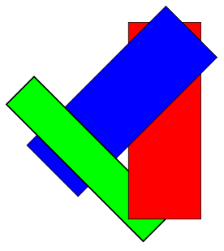
Depth Buffer Test
However, they are costly to generate and may require splitting primitives due to impossible ordering cases:
From wikipedia.com

Slide 14
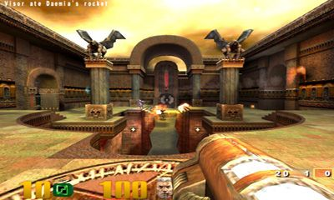
Depth Buffer Test
When memory was a very valuable resource, such algorithms were implemented
Quake3 was one of the main games that used painter’s algorithm using BSP trees
Each game level was stored as a huge BSP tree
  Read more at: https://www.bluesnews.com/abrash/chap64.shtml

Slide 15
Depth Buffer Test
Main Idea:
  At each pixel, keep track of the distance to the closest fragment that has been drawn in a separate buffer
  Discard fragments that are further away than that distance
  Otherwise, draw the fragment and update the z-buffer value with the z value of that fragment
Requires an extra memory region, called the depth buffer, to implement this solution
At the beginning of every frame, the depth buffer is reset to infinity (1.0f in practice if the depth range is [0.0f,1.0f])
Depth buffer is also known as z-buffer

Slide 16
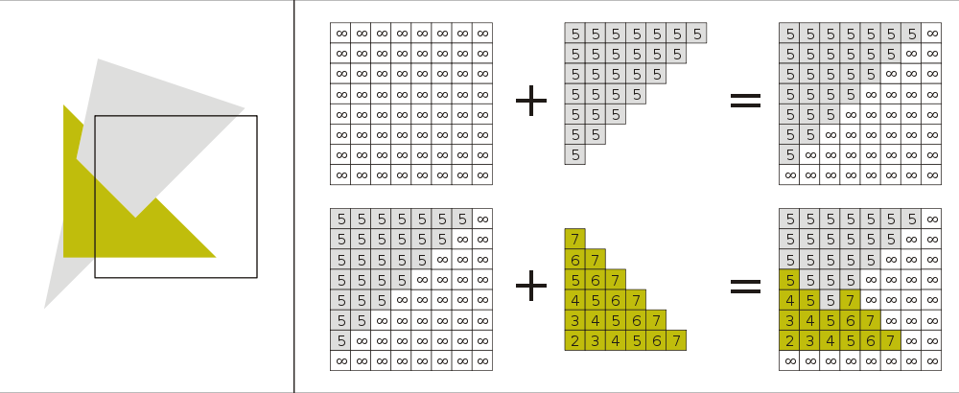
Example
Initial state
of depth buffer
z-values of the
first triangle
Resulting
depth buffer
wikipedia.com
z-values of the
second triangle
Resulting
depth buffer

Slide 17
Depth Range
The range of values written to the depth buffer can generally be controlled by the programmer
In OpenGL, the command glDepthRange(zMin, zMax) is used
The default depth range is [0, 1]
The z-value in the canonical viewing volume (CVV), which is in range [-1, 1] is scaled to this range during the viewport transform
glDepthRange is to the z-values what glViewport(x, y, width, height) is to the x- and y-values

Slide 18
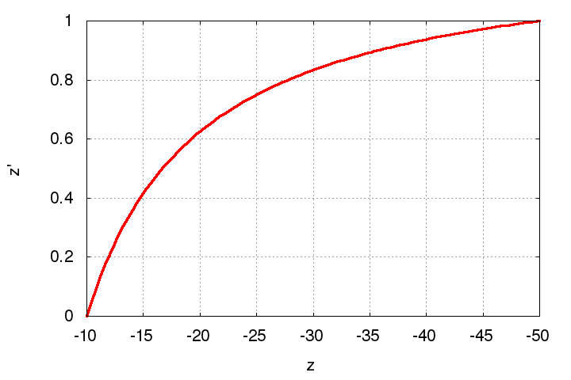
Z-Fighting
Remember that the z-values get compressed to [0, 1] range from the [-n:-f] range after projection and viewport transforms
Observe how it looks for n = 10 and f = 50

Slide 19
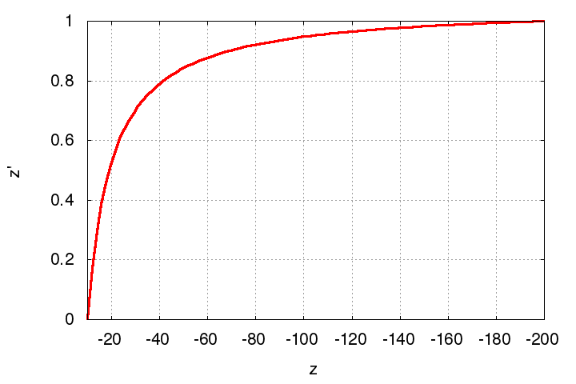
Z-Fighting
Remember that the z-values get compressed to [0, 1] range from the [-n:-f] range after projection and viewport transforms
Observe the same for n = 10 and f = 200

Slide 20
Z-Fighting
With a limited precision depth buffer, fragments that are close in depth may get mapped to the same z-value

Slide 21
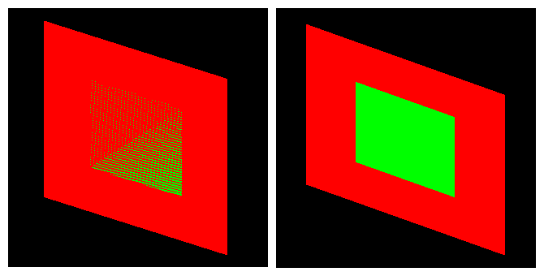
Z-Fighting
The compression is more severe for with larger depth range
This may cause a problem known as z-fighting:
  Objects with originally different (but close) z-values get mapped to the same final z-value (due to limited precision) making it impossible to distinguish which one is in front and which one is behind

Slide 22
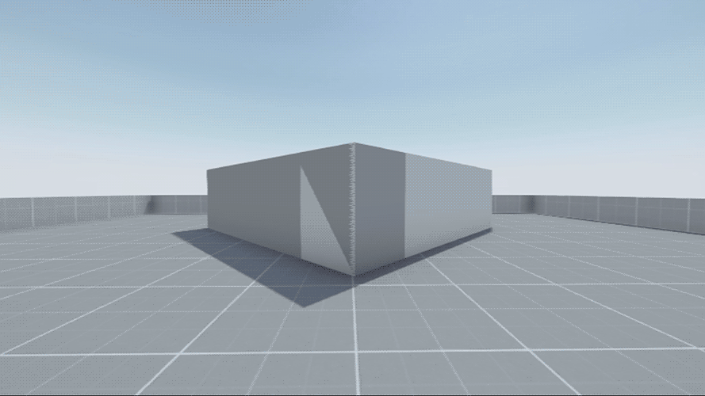
Z-Fighting
http://wiki.reflexfiles.com/

Slide 23
Z-Fighting
To avoid z-fighting, the separation of the far and near planes should be kept as small as possible for keeping the compression less severe
Alternatively, a floating point depth buffer can used
  Unavailable in older hardware
  Supported in all modern GPUs
Finally, the command glPolygonOffset can be used to push and pull polygons a little to avoid z-fighting

Slide 24
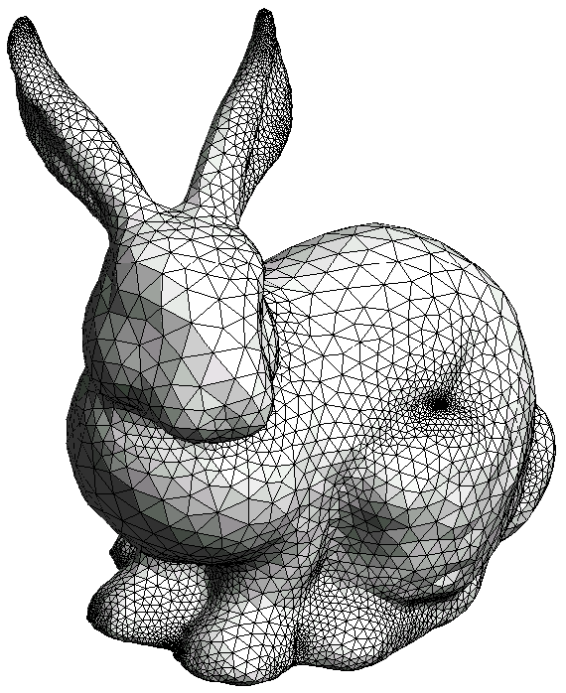
Occlusion Culling
The removal of geometry that is within the view volume but is occluded by other geometry closer to the camera:
OpenGL supports occlusion queries to assist the user in occlusion culling
By a fast rendering pass, it counts how many pixels of the tested object will be rendered
This is commonly used in games
w
Bunny is occluded
by the blue triangle
eye

Slide 25
Occlusion Culling in OpenGL
Create a query.
Disable rendering to screen (set the color mask of all channels to False).
Disable writing to depth buffer (just test against, but don't update, the depth buffer).
Issue query begin (which resets the counter of visible pixels).
"Render" the object's bounding box (it'll only do depth testing; pixels that pass depth testing will not be rendered on-screen because rendering and depth writing were disabled).
End query (stop counting visible pixels).
Enable rendering to screen.
Enable depth writing (if required).
Get query result (the number of "visible" pixels).
If the number of visible pixels is greater than 0 (or some threshold),
  Render the complete object.
For details see: http://http.developer.nvidia.com/GPUGems/gpugems_ch29.html

Slide 26
Alpha Blending
Alpha blending is another fragment operation in which new objects can be blended with the existing contents of the color buffer for a variety of effects
Without blending
With blending

Slide 27
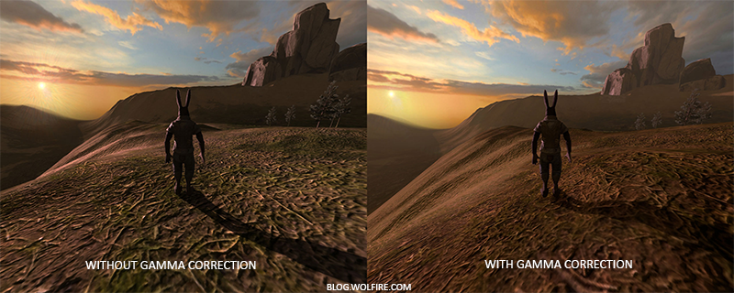
sRGB Conversion
The fragment values are converted to the sRGB color space before being written to the framebuffer. Serves the purpose of gamma correction

Slide 28
Summary
At the end of the pipeline, input vertices with connectivity information end up populating certain regions of the framebuffer
This pipeline can be implemented on the software (CPU), hardware (GPU) or both (CPU + GPU)
Vertex
Pipeline
Rasterization
Fragment Pipeline
Framebuffer
Vertices
Color
Buffer
Depth
Buffer
Stencil
Buffer

