Slide 1
CENG 477
Introduction to Computer Graphics
OpenGL and Programmable Shaders

Slide 2
Shaders
A shader is:
  Programmable logical unit on the GPU which can replace the “fixed” functionality of OpenGL with user-generated code
By using custom shaders, the user can now override the existing implementation of core per-vertex and per-pixel behavior
Some tasks such as clipping and rasterization will still be performed automatically

Slide 3
Shaders
Written using GPU language
  Low-level: assembly language
  High-level: Cg (Nvidia only) or GLSL (general)
Run on the GPU while the application runs at the same time on the CPU
This allows CPU for computations other than graphics
Shaders can create a variety of visual effects

Slide 4

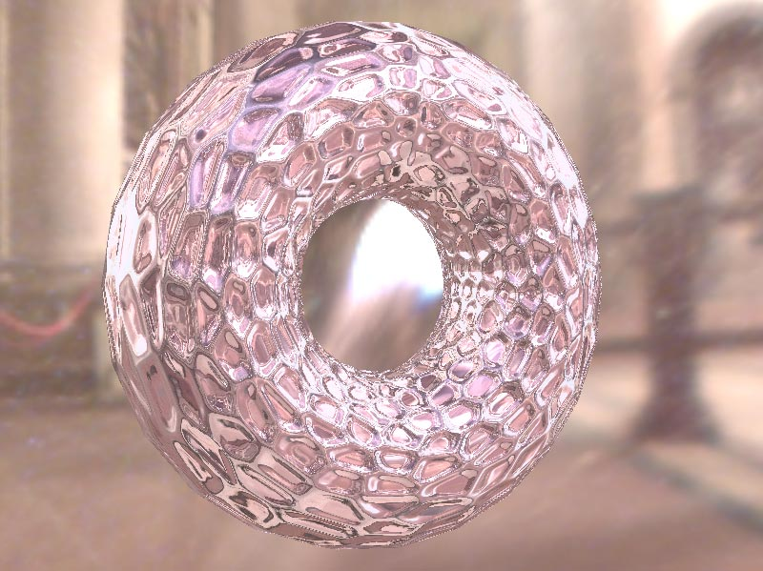

Shader Gallery I
Above: Demo of Microsoft’s XNA game platform
Right: Product demos by Nvidia (top) and AMD (bottom)

Slide 5
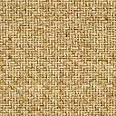
What are we targeting?
OpenGL shaders give the user control over each vertex and each fragment interpolated between vertices.

Slide 6
What are we targeting?
Each vertex is passed to vertex shader
After vertices are processed, polygons are rasterized. During rasterization, values like position, color, depth, and other attributes are interpolated across the polygon. The interpolated values are passed to fragment shader
Vertex
Fragment

Slide 7
What can you do in a shader?
Per vertex:
  Vertex transformation
  Normal transformation and normalization
  Texture coordinate assignment/transformation
  Per-vertex lighting
  Material application
  …
Per fragment:
  Operations on interpolated values
  Texture access
  Texture application
  Fog
  Color summation
  Per-fragment lighting
  Scale and bias
  Color table lookup
  Convolution
  …

Slide 8
Parallelism
Shader source codes are read by the CPU program and given to OpenGL for compilation
They execute on the GPU at draw time
  No other way to execute a shader by other than drawing something
A shader executes simultaneously on its data
All processed simultaneously (up to the physical limit allowed by the GPU)
So we don’t loop over vertices in a vertex shader
The same applies for the fragement shader as well

Slide 9
Shading languages
There are several popular languages for describing shaders, such as:
  HLSL, the High Level Shading Language
    Author: Microsoft
    DirectX 8+
  Cg
    Author: Nvidia
  GLSL, the OpenGL Shading Language
    Author: the Khronos Group, a self-sponsored group of industry affiliates from various vendors (AMD, Nvidia, Intel, Apple, …)

Slide 10
Vertex processor – inputs and outputs
Color
Normal
Position
Texture coord
etc…
Vertex
Processor
Color
Position
Texture data
Custom variables
Modelview matrix
Material data
Light data
etc…
Custom variables
Per-vertex attributes

Slide 11
Vertex Processor
Vertex shader is executed once for each vertex
Vertex position is usually transformed using the modelview and projection matrices
Normals are transformed with the appropriate matrix
Texture coordinates may be generated, passed along, or transformed
Lighting computations may be done for each vertex
Vertex positions may be modified based on texture values, etc.
Notes:
no connectivity information
at least write variable gl_Position
can access lighting, materials, textures
no access to frame buffer

Slide 12
Fragment processor – inputs and outputs
Color
Texture coords
Fragment coords
Front facing
Fragment
Processor
Fragment color
Fragment depth
Texture data
Modelview matrix
Material
Lighting
etc…
Custom variables

Slide 13
Fragment Processor
Fragment shader is executed once for each fragment
Lighting may be computed at each fragment using interpolated normals
Texture data may be fetched from the texture image
Effects such as fog, blur, etc. may be added
Fragments can be killed, their depth values can be altered
Various post-processing effects can be applied
Notes:
operates on single fragments - no neighbor information
can’t change pixel coordinate but has access to it
depth can be written
no access to frame buffer (blending occurs after fragment shader)

Slide 14
Activating a Shader
Step 1: Create a shader program
  (Gluint) glCreateProgram()
Step 2: Create vertex and fragment shaders
  (Gluint) glCreateShader(GL_VERTEX_SHADER)
  (Gluint) glCreateShader(GL_FRAGMENT_SHADER)
Step 3: Provide the source code
  glShaderSource(vertexShaderId, …)
  glShaderSource(fragmentShaderId, …)
Step 4: Compile the shaders
  glCompileShader(vertexShaderId)
  glCompileShader(fragmentShaderId)

Slide 15
Activating a Shader
Step 5: Attach the shader to the shader program:
  glAttachShader(programId, vertexShaderId)
  glAttachShader(programId, fragmentShaderId)
Step 6: Link the program:
  glLinkProgram(programId)
Step 7: Activate the program:
  glUseProgram(programId)

Slide 16
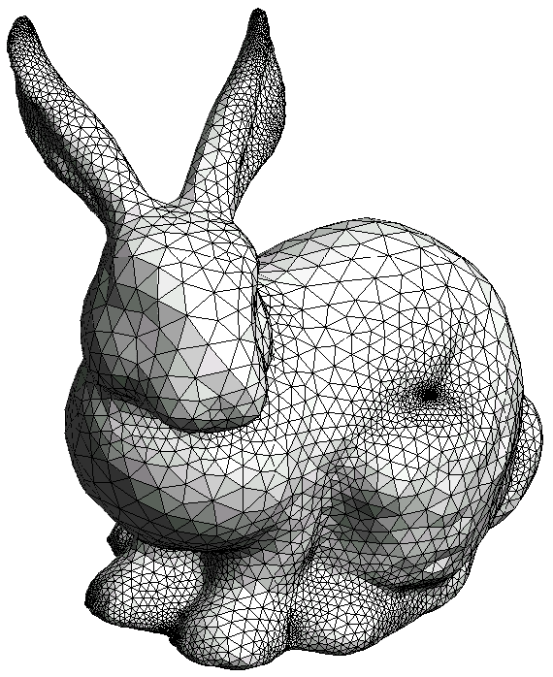
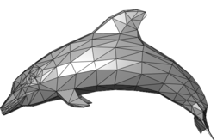
Activating a Shader
Many shader programs may be linked but only one can be active at a time (i.e. for a single draw)
It is possible to draw different models using different shader programs
glUseProgram(prg1);
glDrawElements(…); // bunny
glUseProgram(prg2);
glDrawElements(…); // dolphin

Slide 17
Activating a Shader
Once a shader program is activated, certain operations will no longer be done for you
It’s up to you to replace it!
  You’ll have to transform each vertex into canonical viewing volume manually (i.e. multiply with modelviewprojection matrix)
  You’ll have to shade each vertex or fragment manually (i.e. perform lighting computations)
The installed program replaces all OpenGL fixed functionality for all renders until you remove it with glUseProgram(0)

Slide 18
Communicating with Shadrs
OpenGL
Program
Shader
Program
Uniform
Vertex
Shader
Fragment
Shader
Varying
CPU Side
Memory Buffers
GPU Side

Slide 19
Communicating with Shaders
OpenGL program can send data to shaders through uniform variables or by using memory buffers
Vertex shader can send data to a fragment shader but not vice-versa (dataflow is one-way only)
Vertex and fragment shaders can write data to memory buffers which can be read back by the OpenGL program

Slide 20
Communicating with Shaders
There are three types of shader parameter in GLSL
Uniform parameters
  Set from the CPU program
  Think of them as global variables
Attribute parameters
  Set per vertex
  E.g. position, color, normal, …
Varying parameters
  Passed from vertex processor to fragment processor
  E.g. rasterized position, color, …
Attributes
Vertex
Processor
Uniform
params
Varying
params
Fragment
Processor

Slide 21
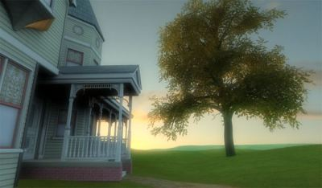
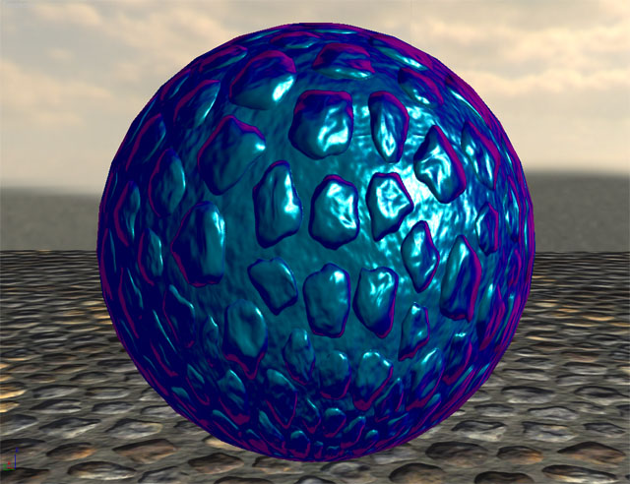
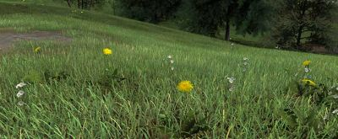
Shader Gallery II
Above: Kevin Boulanger (PhD thesis, “Real-Time Realistic Rendering of Nature Scenes with Dynamic Lighting”, 2005)
Above: Ben Cloward (“Car paint shader”)

Slide 22
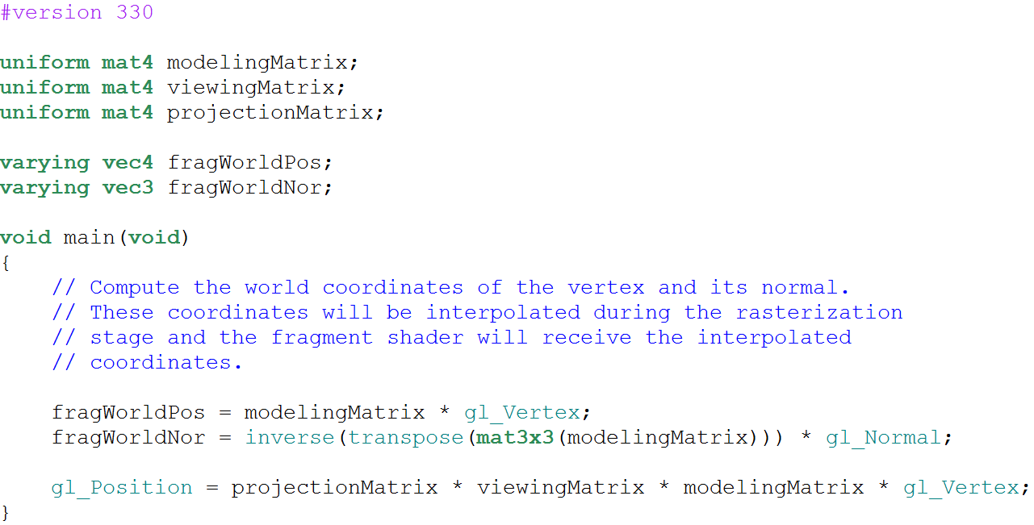
A Sample Vertex Shader
Version string
Uniform variables that must
be set by the OpenGL program
Varying variables that will
be rasterized for each fragment
Attribute variables
fetched from buffers

Slide 23
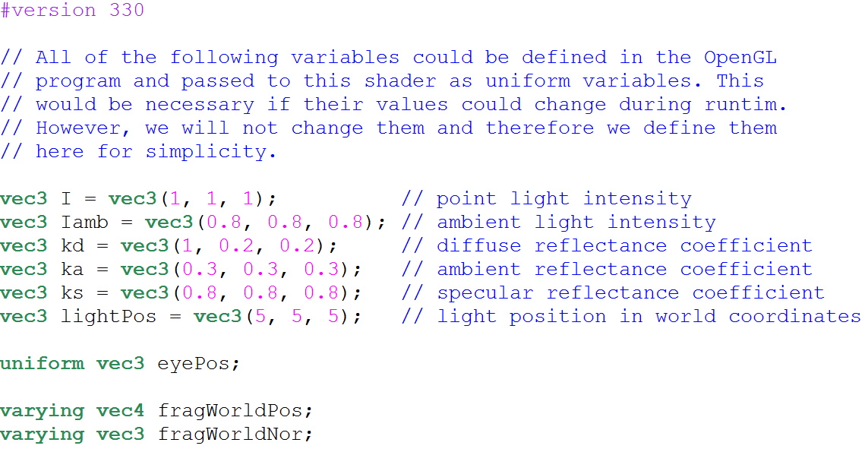
A Sample Fragment Shader (1)
Uniform variable
Local variables
Variables declared as varying in VS
must also be declared as varying in FS

Slide 24
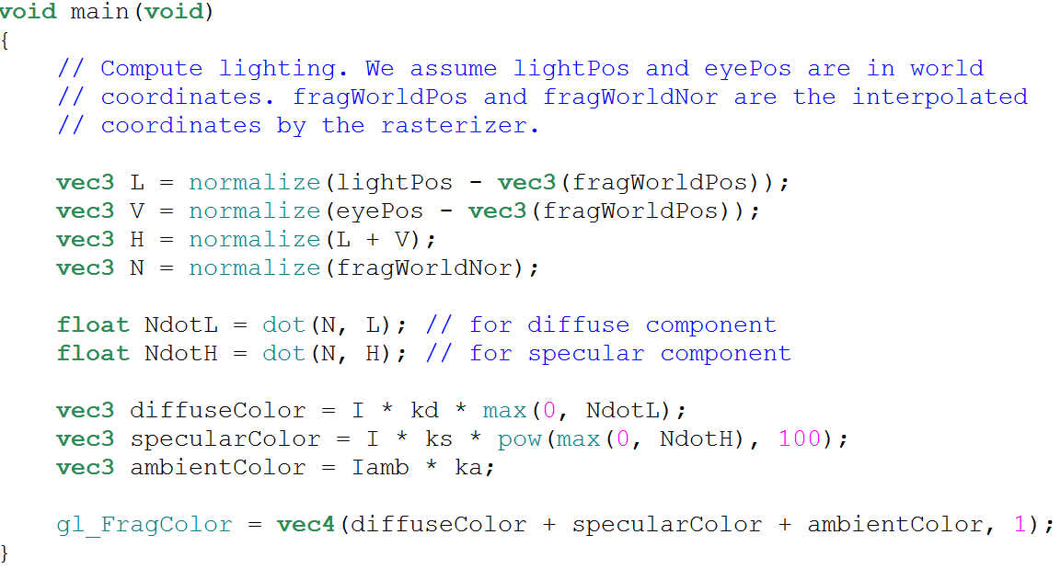
A Sample Fragment Shader (2)
Special value indicating pixel color

Slide 25
Setting Values of Uniforms
Uniform variables must be set by the main program
Step 1: Query their location
  (Glint) glGetUniformLocation(programId, “variableName”)
Step 2: Make the program current:
  glUseProgram(programId)
Step 3: Set the variable using the proper command based on the type of the variable:
  glUniform1f(location, v1); // v1 is a float
  glUniform3fv(location, 1, v2); // v2 is float v2[3]
  glUniformMatrix4fv(location, 1, GL_FALSE, v3); // upload one 4x4 matrix in column major order (16 values are taken from v3)

Slide 26
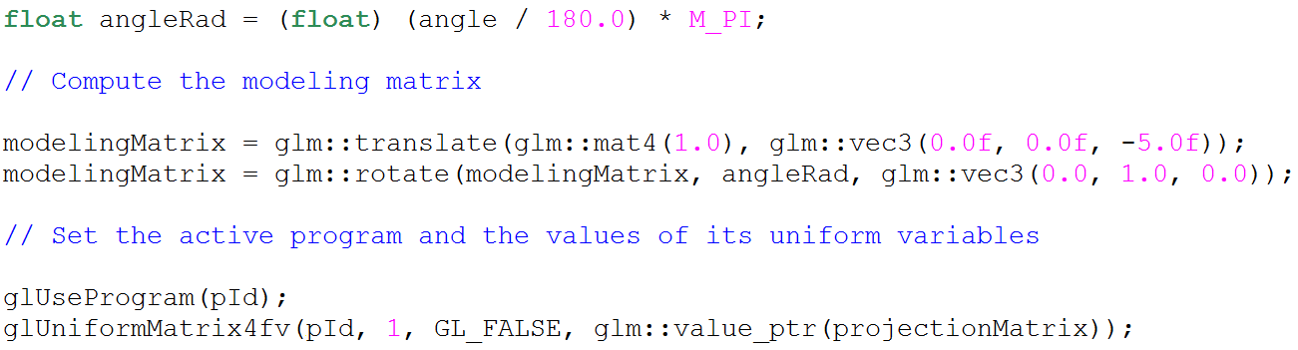
Setting Values of Uniforms
Uniform variables are sticky
The last set value remains valid until you change it
  No need to reupload at each draw (or frame) if the value does not change
GLM library facilitates setting matrix values:

Slide 27
Phong Shading
The previous shaders implement a shading scheme what is known as Phong shading (do not confuse it with Phong Exponent in ray tracing)
Basic idea:
  Interpolate per-vertex normal
  Perform shading per-fragment using interpolated normals

Slide 28
Gouraud Shading
An alternative method is known as Gouraud shading
Basic idea:
  Compute shading per-vertex using vertex normal
  Interpolate the resulting color

Slide 29
Flat Shading
An even simpler method is known as flat shading
Basic idea:
  Compute shading at a single vertex of a primitive
  Set the entire primitive color to the resulting value

Slide 30
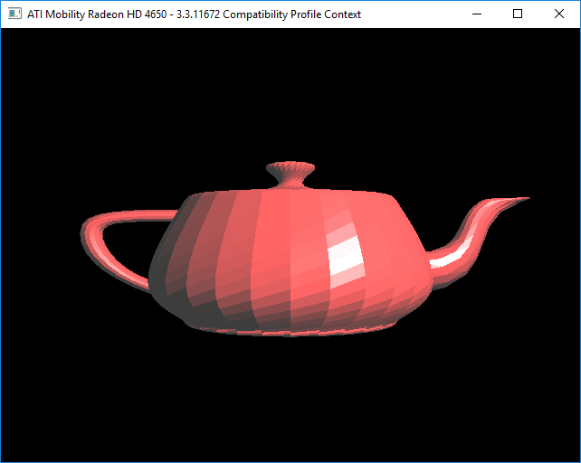
Comparison - Flat

Slide 31

Comparison - Gouraud

Slide 32

Comparison - Phong

Slide 33
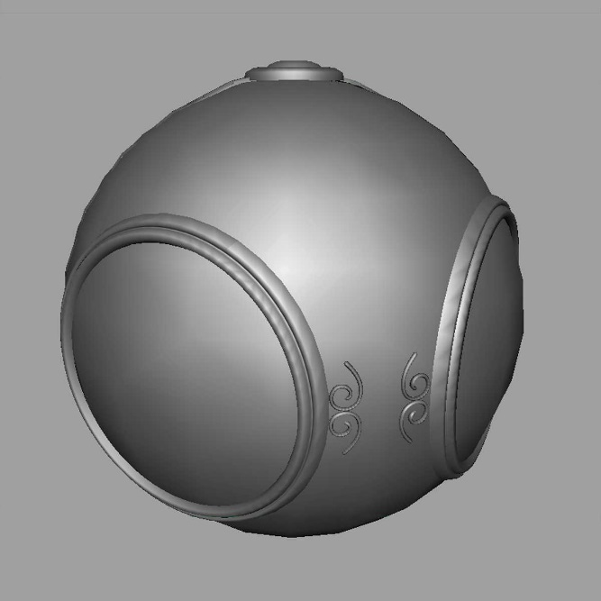

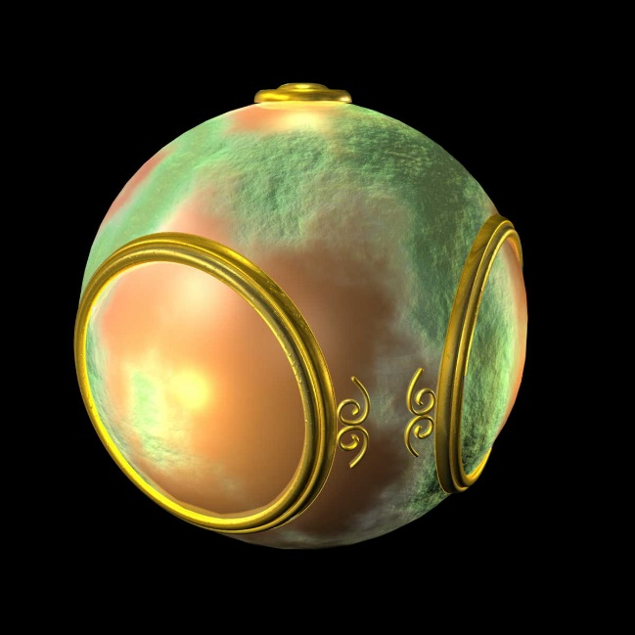
Shader Gallery III
Various fragment shading results
smooth shading
environment
mapping
bump mapping

Slide 34
Learning GLSL
GLSL looks like C in terms of syntax
There are many special vector algebra functions
There is no print function!
Debugging typically involves converting the value of interest to a color and visually looking at it
There are many good GLSL tutorials online:
  E.g. http://www.lighthouse3d.com/tutorials/glsl-tutorial/
In general, we only use a subset of the language
Therefore, learning it in entirety is not required for this course

