Slide 1
Processor Architecture: Pipelined Implementation

Slide 2
SEQ Stages
newPC
PC
valE
,
valM
Write back
valM
Fetch
  Read instruction from instruction memory
Decode
  Read program registers
Execute
  Compute value or address
Memory
  Read or write data
Write Back
  Write program registers
PC
  Update program counter
Data
Memory
Data
memory
memory
Addr
, Data
valE
CC
CC
ALU
Execute
Cnd
ALU
aluA
,
aluB
valA
,
valB
Decode
srcA
,
srcB
A
A
B
dstA
,
dstB
B
M
Register
M
Register
Register
Register
file
file
file
file
E
E
icode
rA
,
ifun
valP
,
rB
valC
Instruction
PC
Instruction
PC
Fetch
memory
increment
memory
increment
PC

Slide 3
Overview
General Principles of Pipelining
  Goal
  Difficulties
Creating a Pipelined Y86-64 Processor
  Rearranging SEQ
  Inserting pipeline registers
  Problems with data and control hazards

Slide 4


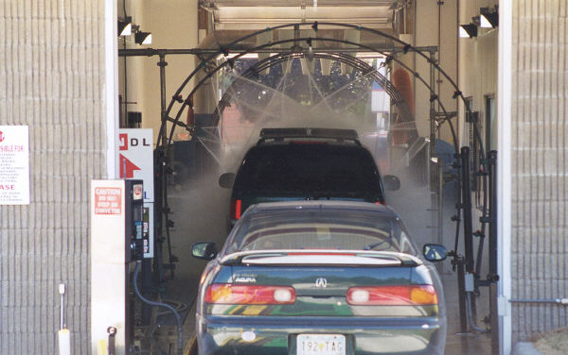
Real-World Pipelines: Car Washes
Sequential
Parallel
Pipelined
Idea
  Divide process into independent stages
  Move objects through stages in sequence
  At any given times, multiple objects being processed

Slide 5
Computational Example
300 ps
20 ps
Combinational
logic
R
e
g
Delay = 320 ps
Throughput = 3.12 GIPS
Clock
System
  Computation requires total of 300 picoseconds
  Additional 20 picoseconds to save result in register
  Must have clock cycle of at least 320 ps

Slide 6
3-Way Pipelined Version
100 ps
20 ps
100 ps
20 ps
100 ps
20 ps
Comb.
logic
A
R
e
g
Comb.
logic
B
R
e
g
Comb.
logic
C
R
e
g
Delay = 360 ps
Throughput = 8.33 GIPS
Clock
System
  Divide combinational logic into 3 blocks of 100 ps each
  Can begin new operation as soon as previous one passes through stage A.
    Begin new operation every 120 ps
  Overall latency increases
    360 ps from start to finish

Slide 7
Pipeline Diagrams
Unpipelined
  Cannot start new operation until previous one completes
3-Way Pipelined
  Up to 3 operations in process simultaneously
OP1
OP2
OP3
Time
OP1
A
B
C
OP2
A
B
C
OP3
A
B
C
Time

Slide 8
Operating a Pipeline
239
241
300
359
Clock
OP1
A
B
C
OP2
A
B
C
OP3
A
B
C
0
120
240
360
480
640
Time
100 ps
20 ps
100 ps
20 ps
100 ps
20 ps
100 ps
100 ps
100 ps
20 ps
20 ps
20 ps
100 ps
100 ps
100 ps
20 ps
20 ps
20 ps
100 ps
100 ps
100 ps
20 ps
20 ps
20 ps
Comb.
logic
A
R
e
g
Comb.
logic
B
R
e
g
Comb.
logic
C
Comb.
logic
A
R
e
g
Comb.
logic
B
R
e
g
Comb.
logic
C
R
e
g
Comb.
logic
A
Comb.
logic
A
R
e
g
R
e
g
Comb.
logic
B
Comb.
logic
B
R
e
g
R
e
g
Comb.
logic
C
Comb.
logic
C
R
e
g
R
e
g
R
e
g
Clock
Clock
Clock
Clock

Slide 9
Limitations: Nonuniform Delays
50 ps
20 ps
150 ps
20 ps
100 ps
20 ps
Comb.
logic
A
R
e
g
Comb.
logic
B
R
e
g
Comb.
logic
C
R
e
g
Delay = 510 ps
Throughput = 5.88 GIPS
Clock
OP1
A
B
C
OP2
A
B
C
OP3
A
B
C
Time
  Throughput limited by slowest stage
  Other stages sit idle for much of the time
  Challenging to partition system into balanced stages

Slide 10
Limitations: Register Overhead
50 ps
20 ps
50 ps
20 ps
50 ps
20 ps
50 ps
20 ps
50 ps
20 ps
50 ps
20 ps
Comb.
logic
R
e
g
Comb.
logic
R
e
g
Comb.
logic
R
e
g
Comb.
logic
R
e
g
Comb.
logic
R
e
g
Comb.
logic
R
e
g
Clock
Delay = 420 ps, Throughput = 14.29 GIPS
  As try to deepen pipeline, overhead of loading registers becomes more significant
  Percentage of clock cycle spent loading register:
    1-stage pipeline: 6.25%
    3-stage pipeline: 16.67%
    6-stage pipeline: 28.57%
  High speeds of modern processor designs obtained through very deep pipelining

Slide 11

Data Dependencies
Combinational
logic
R
e
g
Clock
OP1
OP2
OP3
Time
System
  Each operation depends on result from preceding one

Slide 12

Data Hazards
Comb.
logic
A
R
e
g
Comb.
logic
B
R
e
g
Comb.
logic
C
R
e
g
Clock
OP1
A
B
C
OP2
A
B
C
OP3
A
B
C
OP4
A
B
C
Time
  Result does not feed back around in time for next operation
  Pipelining has changed behavior of system

Slide 13
Data Dependencies in Processors
1 irmovq $50, %rax
2 addq %rax , %rbx
3 mrmovq 100( %rbx ), %rdx
  Result from one instruction used as operand for another
    Read-after-write (RAW) dependency
  Very common in actual programs
  Must make sure our pipeline handles these properly
    Get correct results
    Minimize performance impact

Slide 14
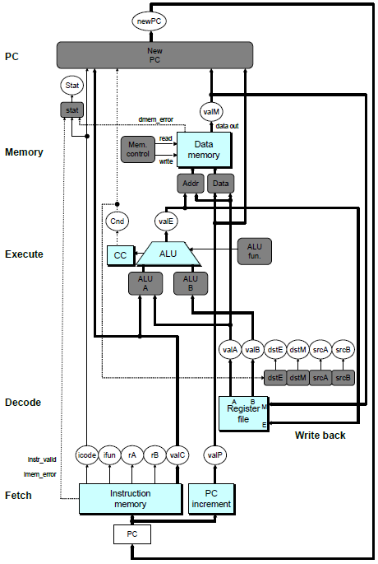
SEQ Hardware
  Stages occur in sequence
  One operation in process at a time

Slide 15
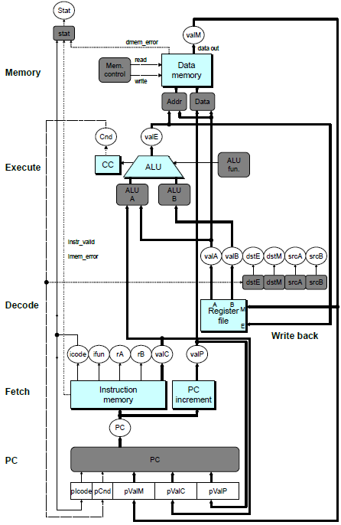
SEQ+ Hardware
  Still sequential implementation
  Reorder PC stage to put at beginning
PC Stage
  Task is to select PC for current instruction
  Based on results computed by previous instruction
Processor State
  PC is no longer stored in register
  But, can determine PC based on other stored information

Slide 16
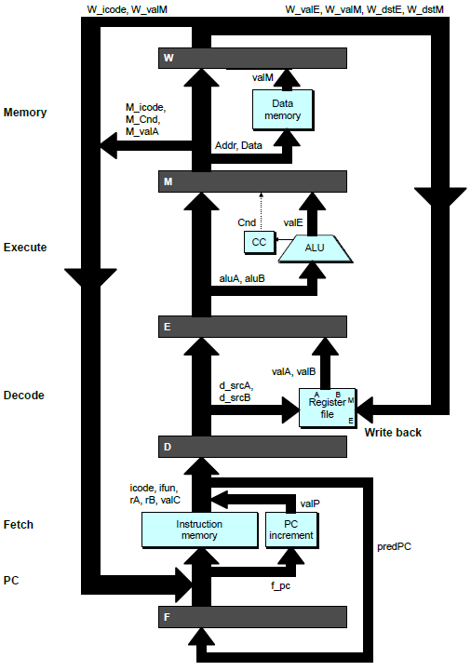
Adding Pipeline Registers
PC
newPC
valE
,
valM
Write back
valM
Data
Memory
Data
memory
memory
Addr
, Data
valE
CC
CC
ALU
Execute
Cnd
ALU
aluA
,
aluB
valA
,
valB
Decode
srcA
,
srcB
A
A
B
dstA
,
dstB
B
M
Register
M
Register
Register
Register
file
file
file
file
E
E
icode
,
ifun
valP
rA
,
rB
valC
Instruction
PC
Instruction
PC
Fetch
memory
increment
memory
increment
PC

Slide 17
Pipeline Stages
Fetch
  Select current PC
  Read instruction
  Compute incremented PC
Decode
  Read program registers
Execute
  Operate ALU
Memory
  Read or write data memory
Write Back
  Update register file

Slide 18
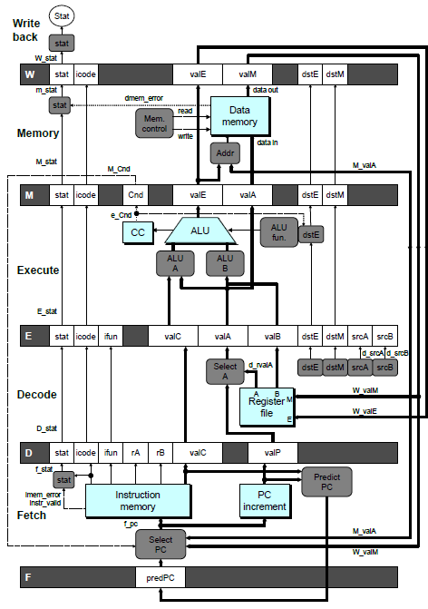
PIPE- Hardware
  Pipeline registers hold intermediate values from instruction execution
Forward (Upward) Paths
  Values passed from one stage to next
  Cannot jump past stages
    e.g., valC passes through decode

Slide 19
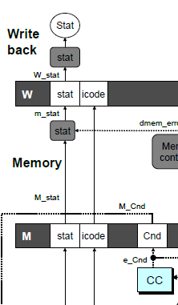
Signal Naming Conventions
S_Field
  Value of Field held in stage S pipeline register
s_Field
  Value of Field computed in stage S

Slide 20
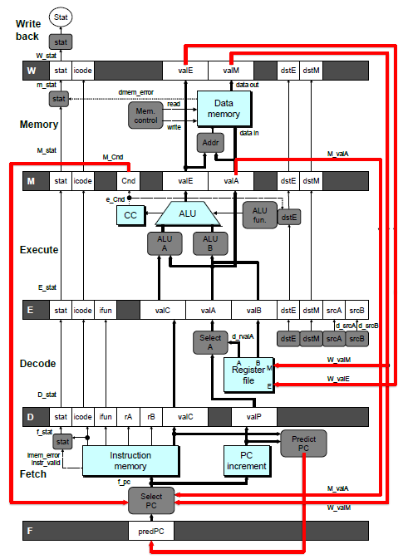
Feedback Paths
Predicted PC
  Guess value of next PC
Branch information
  Jump taken/not-taken
  Fall-through or target address
Return point
  Read from memory
Register updates
  To register file write ports

Slide 21
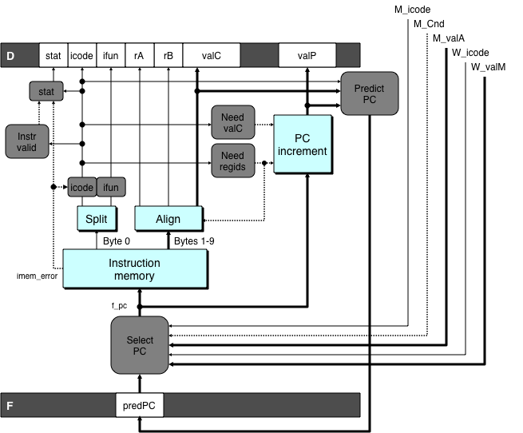
Predicting the PC
  Start fetch of new instruction after current one has completed fetch stage
    Not enough time to reliably determine next instruction
  Guess which instruction will follow
    Recover if prediction was incorrect

Slide 22
Our Prediction Strategy
Instructions that Don’t Transfer Control
  Predict next PC to be valP
  Always reliable
Call and Unconditional Jumps
  Predict next PC to be valC (destination)
  Always reliable
Conditional Jumps
  Predict next PC to be valC (destination)
  Only correct if branch is taken
    Typically right 60% of time
Return Instruction
  Don’t try to predict

Slide 23
Recovering from PC Misprediction
  Mispredicted Jump
    Will see branch condition flag once instruction reaches memory stage
    Can get fall-through PC from valA (value M_valA)
  Return Instruction
    Will get return PC when ret reaches write-back stage (W_valM)

Slide 24
Pipeline Demonstration
1
2
3
4
5
6
7
8
9
irmovq $1,%rax #I1
F
D
E
M
W
irmovq $2,%rcx #I2
F
D
E
M
W
irmovq $3,%rdx #I3
F
D
E
M
W
irmovq $4,%rbx #I4
F
D
E
M
W
halt #I5
F
D
E
M
W
Cycle 5
File: demo-basic.ys
W
I1
M
I2
E
I3
D
I4
F
I5

Slide 25
Data Dependencies: 3 Nop’s
# demo-h3.ys
1
2
3
4
5
6
7
8
9
10
11
F
F
D
D
E
E
M
M
W
0x000:
irmovq
$10,%
rdx
W
F
F
D
D
E
E
M
M
W
0x00a:
irmovq
$3,%
rax
W
F
F
D
D
E
E
M
M
W
0x014:
nop
W
F
F
D
D
E
E
M
M
W
0x015:
nop
W
F
F
D
D
E
E
M
M
W
0x016:
nop
W
F
F
D
D
E
E
M
M
W
0x017:
addq
%
rdx
,%
rax
W
F
F
D
D
E
E
M
M
W
0x019: halt
W
Cycle 6
W
W
f
R[
f
R[
]
]
3
%
3
%
rax
rax
Cycle 7
D
D
f
valA
f
valA
R[
R[
]
]
=
=
10
%
10
%
rdx
rdx
f
valB
f
valB
R[
R[
]
]
=
=
3
%
3
%
rax
rax

Slide 26
Data Dependencies: 2 Nop’s
# demo-h2.ys
1
2
3
4
5
6
7
8
9
10
F
F
D
D
E
E
M
M
W
0x000:
irmovq
$10,%
rdx
W
F
F
D
D
E
E
M
M
W
0x00a:
irmovq
$3,%
rax
W
F
F
D
D
E
E
M
M
W
0x014:
nop
W
F
F
D
D
E
E
M
M
W
0x015:
nop
W
F
F
D
D
E
E
M
M
W
0x016:
addq
%
rdx
,%
rax
W
F
F
D
D
E
E
M
M
W
0x018: halt
W
Cycle 6
W
W
W
f
f
R[
f
R[
R[
]
]
]
3
3
%
3
%
%
rax
rax
rax
•
•
•
•
•
•
D
D
D
f
f
valA
f
valA
valA
R[
R[
R[
]
]
]
=
=
=
10
10
%
10
Error
%
%
rdx
rdx
rdx
f
f
valB
f
valB
valB
R[
R[
R[
]
]
]
=
=
=
0
0
%
0
%
%
rax
rax
rax

Slide 27
Data Dependencies: 1 Nop
# demo-h1.ys
1
2
3
4
5
6
7
8
9
0x000:
irmovq
$10,%
rdx
F
D
E
M
W
0x00a:
irmovq
$3,%
rax
F
D
E
M
W
F
F
D
D
E
E
M
M
W
0x014:
nop
W
F
F
D
D
E
E
M
M
W
0x015:
addq
%
rdx
,%
rax
W
F
F
D
D
E
E
M
M
W
0x017: halt
W
Cycle 5
W
W
f
R[
f
R[
]
]
10
%
10
%
rdx
rdx
M
M_
valE
= 3
M_
dstE
=
%
rax
•
•
•
D
D
Error
f
valA
f
valA
R[
R[
]
]
=
=
0
%
0
%
rdx
rdx
f
valB
f
valB
R[
R[
]
]
=
=
0
%
0
%
rax
rax

Slide 28
Data Dependencies: No Nop
# demo-h0.ys
1
2
3
4
5
6
7
8
0x000:
irmovq
$10,%
rdx
F
D
E
M
W
0x00a:
irmovq
$3,%
rax
F
D
E
M
W
0x014:
addq
%
rdx
,%
rax
F
D
E
M
W
0x016: halt
F
D
E
M
W
Cycle 4
M
M_
valE
= 10
M_
dstE
=
%
rdx
E
e_
valE
f
0 + 3 = 3
E_
dstE
=
%
rax
D
D
Error
f
valA
f
valA
R[
R[
]
]
=
=
0
%
0
%
rdx
rdx
f
valB
f
valB
R[
R[
]
]
=
=
0
%
0
%
rax
rax

Slide 29
Branch Misprediction Example
demo-j.ys
0x000: xorq %rax,%rax
0x002: jne t # Not taken
0x00b: irmovq $1, %rax # Fall through
0x015: nop
0x016: nop
0x017: nop
0x018: halt
0x019: t: irmovq $3, %rdx # Target (Should not execute)
0x023: irmovq $4, %rcx # Should not execute
0x02d: irmovq $5, %rdx # Should not execute
  Should only execute first 8 instructions

Slide 30
Branch Misprediction Trace
# demo
-
j
1
2
3
4
5
6
7
8
9
0x000:
xorq
%
F
D
E
M
W
rax
,%
rax
0x002:
jne
t # Not taken
F
D
E
M
W
0x019: t:
irmovq
$3, %
rdx
# Target
F
D
E
M
W
0x023:
irmovq
$4, %
rcx
# Target+1
F
D
E
M
W
F
F
D
D
E
E
M
M
W
0x00b:
irmovq
$1, %
rax
# Fall Through
W
Cycle 5
  Incorrectly execute two instructions at branch target
M
M_Cnd =
0
M_
valA
= 0x007
E
E
f
valE
f
valE
3
3
dstE
dstE
=
=
%
%
rdx
rdx
D
D
valC
valC
=
=
4
4
dstE
dstE
=
=
%
%
ecx
rcx
F
F
f
valC
f
valC
1
1
f
rB
f
rB
%
%
rax
rax

Slide 31
Return Example
demo-ret.ys
0x000: irmovq Stack,%rsp # Intialize stack pointer
0x00a: nop # Avoid hazard on %rsp
0x00b: nop
0x00c: nop
0x00d: call p # Procedure call
0x016: irmovq $5,%rsi # Return point
0x020: halt
0x020: .pos 0x20
0x020: p: nop # procedure
0x021: nop
0x022: nop
0x023: ret
0x024: irmovq $1,%rax # Should not be executed
0x02e: irmovq $2,%rcx # Should not be executed
0x038: irmovq $3,%rdx # Should not be executed
0x042: irmovq $4,%rbx # Should not be executed
0x100: .pos 0x100
0x100: Stack: # Initial stack pointer
  Require lots of nops to avoid data hazards

Slide 32
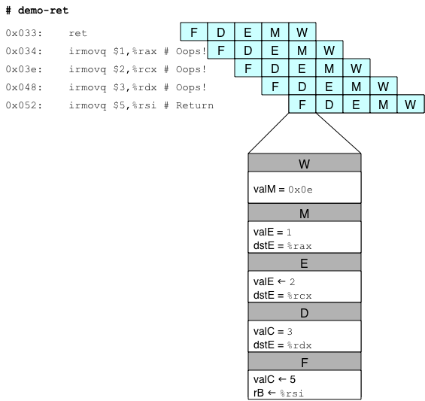
Incorrect Return Example
  Incorrectly execute 3 instructions following ret

Slide 33
Pipeline Summary
Concept
  Break instruction execution into 5 stages
  Run instructions through in pipelined mode
Limitations
  Can’t handle dependencies between instructions when instructions follow too closely
  Data dependencies
    One instruction writes register, later one reads it
  Control dependency
    Instruction sets PC in way that pipeline did not predict correctly
    Mispredicted branch and return
Fixing the Pipeline
  We’ll do that next time

Slide 34
Processor Architecture: Pipelined Implementation: 2

Slide 35
Overview
  Make the pipelined processor work!
Data Hazards
  Instruction having register R as source follows shortly after instruction having register R as destination
  Common condition, don’t want to slow down pipeline
Control Hazards
  Mispredict conditional branch
    Our design predicts all branches as being taken
    Naïve pipeline executes two extra instructions
  Getting return address for ret instruction
    Naïve pipeline executes three extra instructions
Making Sure It Really Works
  What if multiple special cases happen simultaneously?

Slide 36
Pipeline Stages
Fetch
  Select current PC
  Read instruction
  Compute incremented PC
Decode
  Read program registers
Execute
  Operate ALU
Memory
  Read or write data memory
Write Back
  Update register file

Slide 37
PIPE- Hardware
  Pipeline registers hold intermediate values from instruction execution
Forward (Upward) Paths
  Values passed from one stage to next
  Cannot jump past stages
    e.g., valC passes through decode

Slide 38
Data Dependencies: 2 Nop’s
# demo-h2.ys
1
2
3
4
5
6
7
8
9
10
F
F
D
D
E
E
M
M
W
0x000:
irmovq
$10,%
rdx
W
F
F
D
D
E
E
M
M
W
0x00a:
irmovq
$3,%
rax
W
F
F
D
D
E
E
M
M
W
0x014:
nop
W
F
F
D
D
E
E
M
M
W
0x015:
nop
W
F
F
D
D
E
E
M
M
W
0x016:
addq
%
rdx
,%
rax
W
F
F
D
D
E
E
M
M
W
0x018: halt
W
Cycle 6
W
W
W
f
f
R[
f
R[
R[
]
]
]
3
3
%
3
%
%
rax
rax
rax
•
•
•
•
•
•
D
D
D
f
f
valA
f
valA
valA
R[
R[
R[
]
]
]
=
=
=
10
10
%
10
Error
%
%
rdx
rdx
rdx
f
f
valB
f
valB
valB
R[
R[
R[
]
]
]
=
=
=
0
0
%
0
%
%
rax
rax
rax

Slide 39
Data Dependencies: No Nop
# demo-h0.ys
1
2
3
4
5
6
7
8
0x000:
irmovq
$10,%
rdx
F
D
E
M
W
0x00a:
irmovq
$3,%
rax
F
D
E
M
W
0x014:
addq
%
rdx
,%
rax
F
D
E
M
W
0x016: halt
F
D
E
M
W
Cycle 4
M
M_
valE
= 10
M_
dstE
=
%
rdx
E
e_
valE
f
0 + 3 = 3
E_
dstE
=
%
rax
D
D
Error
f
valA
f
valA
R[
R[
]
]
=
=
0
%
0
%
rdx
rdx
f
valB
f
valB
R[
R[
]
]
=
=
0
%
0
%
rax
rax

Slide 40
Stalling for Data Dependencies
# demo-h2.ys
1
2
3
4
5
6
7
8
9
10
11
0x000: irmovq $10,%rdx
F
D
E
M
W
0x00a: irmovq $3,%rax
F
D
E
M
W
0x014: nop
F
D
E
M
W
0x015: nop
F
D
E
M
W
bubble
E
M
W
0x016: addq %rdx,%rax
F
D
D
E
M
W
0x018: halt
F
F
D
E
M
W
  If instruction follows too closely after one that writes register, slow it down
  Hold instruction in decode
  Dynamically inject nop into execute stage

Slide 41
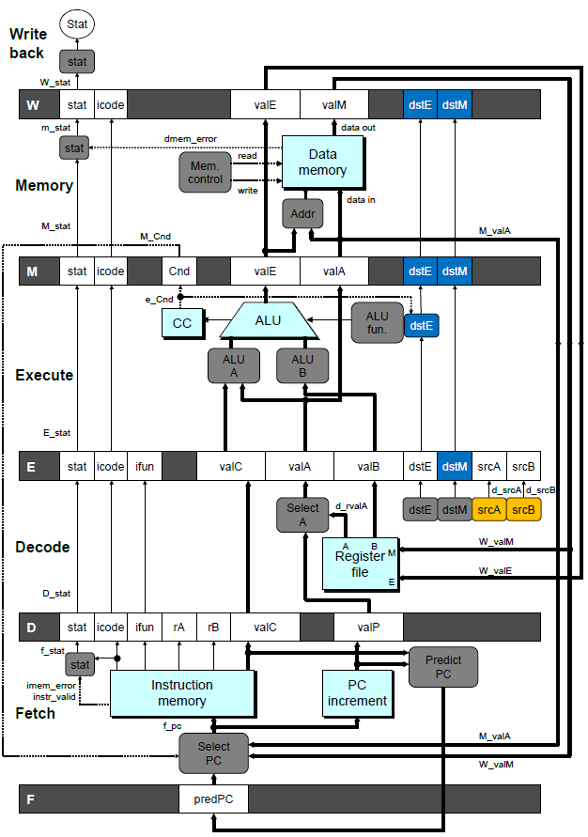
Stall Condition
Source Registers
  srcA and srcB of current instruction in decode stage
Destination Registers
  dstE and dstM fields
  Instructions in execute, memory, and write-back stages
Special Case
  Don’t stall for register ID 15 (0xF)
    Indicates absence of register operand
    Or failed cond. move

Slide 42
Detecting Stall Condition
# demo-h2.ys
1
2
3
4
5
6
7
8
9
10
11
0x000: irmovq $10,%rdx
F
D
E
M
W
0x00a: irmovq $3,%rax
F
D
E
M
W
0x014: nop
F
D
E
M
W
0x015: nop
F
D
E
M
W
bubble
E
M
W
0x016: addq %rdx,%rax
F
D
D
E
M
W
0x018: halt
F
F
D
E
M
W
Cycle 6
W
W_dstE = %rax
W_valE = 3
•
•
•
D
srcA = %rdx
srcB = %rax

Slide 43
Stalling X3
# demo-h0.ys
1
2
3
4
5
6
7
8
9
10
11
0x000: irmovq $10,%rdx
F
D
E
M
W
0x00a: irmovq $3,%rax
F
D
E
M
W
bubble
E
M
W
bubble
E
M
W
bubble
E
M
W
0x014: addq %rdx,%rax
F
D
D
D
D
E
M
W
0x016: halt
F
F
F
F
D
E
M
W
Cycle 6
W
Cycle 5
W_dstE = %rax
M
Cycle 4
M_dstE = %rax
•
•
•
E
•
•
•
e_dstE = %rax
D
D
D
srcA = %rdx
srcB = %rax
srcA = %rdx
srcB = %rax
srcA = %rdx
srcB = %rax

Slide 44
What Happens When Stalling?
# demo-h0.ys
Cycle 4
Cycle 5
Cycle 6
Cycle 7
Cycle 8
0x000: irmovq $10,%rdx
0x000: irmovq $10,%rdx
0x00a: irmovq $3,%rax
bubble
Write Back
bubble
0x00a: irmovq $3,%rax
0x000: irmovq $10,%rdx
0x00a: irmovq $3,%rax
bubble
bubble
Memory
bubble
0x014: addq %rdx,%rax
0x00a: irmovq $3,%rax
bubble
bubble
bubble
Execute
0x014: addq %rdx,%rax
0x016: halt
0x014: addq %rdx,%rax
0x014: addq %rdx,%rax
0x014: addq %rdx,%rax
0x014: addq %rdx,%rax
Decode
0x016: halt
0x016: halt
0x016: halt
0x016: halt
Fetch
0x016: halt
  Stalling instruction held back in decode stage
  Following instruction stays in fetch stage
  Bubbles injected into execute stage
    Like dynamically generated nop’s
    Move through later stages

Slide 45
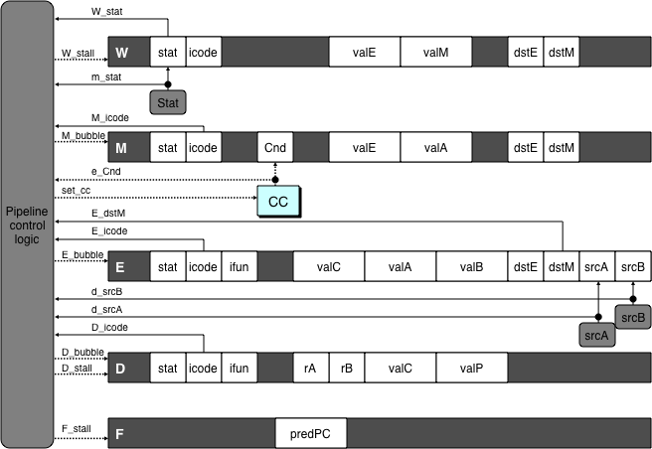
Implementing Stalling
Pipeline Control
  Combinational logic detects stall condition
  Sets mode signals for how pipeline registers should update
Pipeline
control
logic
Pipeline
control
logic
Pipeline
control
logic
Pipeline
control
logic

Slide 46
Pipeline Register Modes
Rising
Rising
Input = y
Output = x
_
clock
_
Output = y
clock
Normal
x
x
y
y
stall
bubble
= 0
= 0
Rising
Rising
Input = y
Output = x
_
clock
_
Output = x
clock
Stall
x
x
x
x
stall
bubble
= 1
= 0
Rising
Rising
Input = y
Output = x
_
clock
_
Output =
nop
clock
n
Bubble
x
x
o
p
stall
bubble
= 0
= 1

Slide 47
Data Forwarding
Naïve Pipeline
  Register isn’t written until completion of write-back stage
  Source operands read from register file in decode stage
    Needs to be in register file at start of stage
Observation
  Value generated in execute or memory stage
Trick
  Pass value directly from generating instruction to decode stage
  Needs to be available at end of decode stage

Slide 48
Data Forwarding Example
# demo-h2.ys
1
2
3
4
5
6
7
8
9
10
F
F
D
D
E
E
M
M
W
0x000:
irmovq
$10,%
rdx
W
F
F
D
D
E
E
M
M
W
0x00a:
irmovq
$3,%
rax
W
F
F
D
D
E
E
M
M
W
0x014:
nop
W
F
F
D
D
E
E
M
M
W
0x015:
nop
W
F
F
D
D
E
E
M
M
W
0x016:
addq
%
rdx
,%
rax
W
F
F
D
D
E
E
M
M
W
0x018: halt
W
  irmovq in write-back stage
  Destination value in W pipeline register
  Forward as valB for decode stage
Cycle 6
W
W_
dstE
=
%
rax
R[
%
rax
]
f
3
W_
valE
= 3
•
•
•
D
srcA
=
%
rdx
valA
f
R[
%
rdx
]
=
10
srcB
=
%
rax
valB
f
W_
valE
=
3

Slide 49
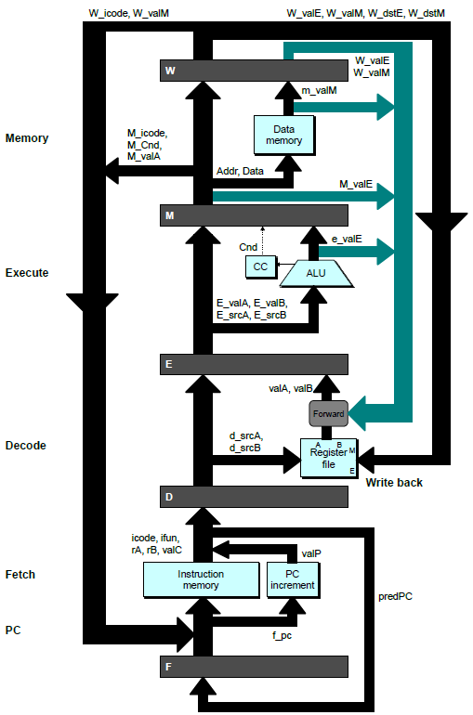
Bypass Paths
Decode Stage
  Forwarding logic selects valA and valB
  Normally from register file
  Forwarding: get valA or valB from later pipeline stage
Forwarding Sources
  Execute: valE
  Memory: valE, valM
  Write back: valE, valM

Slide 50
Data Forwarding Example #2
# demo-h0.ys
1
2
3
4
5
6
7
8
0x000: irmovq $10,%rdx
F
D
E
M
W
0x00a: irmovq $3,%rax
F
D
E
M
W
0x014: addq %rdx,%rax
F
D
E
M
W
0x016: halt
F
D
E
M
W
Register %rdx
  Generated by ALU during previous cycle
  Forward from memory as valA
Register %rax
  Value just generated by ALU
  Forward from execute as valB
Cycle 4
M
M_dstE = %rdx
M_valE = 10
E
E_dstE = %rax
e_valE f 0 + 3 = 3
D
srcA = %rdx
srcB = %rax
valA f M_valE = 10
valB f e_valE = 3

Slide 51
Forwarding Priority
# demo-priority.ys
1
2
3
4
5
6
7
8
9
10
F
F
D
D
E
E
M
M
W
0x000: irmovq $1, %rax
W
F
F
D
D
E
E
M
M
W
0x00a: irmovq $2, %rax
W
F
F
D
D
E
E
M
M
W
0x014: irmovq $3, %rax
W
F
F
D
D
E
E
M
M
W
0x01e: rrmovq %rax, %rdx
W
F
F
D
D
E
E
M
M
W
0x020: halt
W
Multiple Forwarding Choices
  Which one should have priority
  Match serial semantics
  Use matching value from earliest pipeline stage
Cycle 5
W
W
f
R[
f
R[
]
]
3
%
1
%
rax
rax
W
M
f
R[
f
R[
]
]
3
%
2
%
rax
rax
W
E
f
R[
f
R[
]
]
3
%
3
%
rax
rax
D
D
D
f
f
valA
f
valA
valA
R[
R[
R[
]
]
]
=
=
=
10
10
%
?
%
%
rax
rdx
rdx
f
f
valB
f
valB
valB
R[
R[
0
%
rax
]
=
0

Slide 52
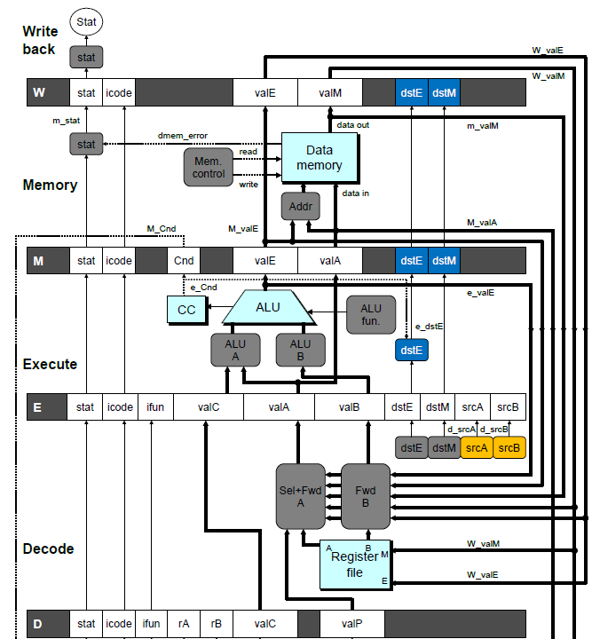
Implementing Forwarding
  Add additional feedback paths from E, M, and W pipeline registers into decode stage
  Create logic blocks to select from multiple sources for valA and valB in decode stage

Slide 53
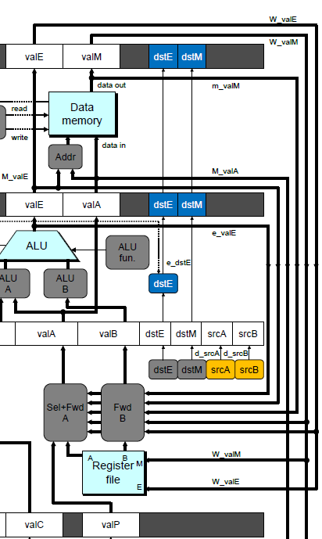
Implementing Forwarding
## What should be the A value?
int d_valA = [
# Use incremented PC
D_icode in { ICALL, IJXX } : D_valP;
# Forward valE from execute
d_srcA == e_dstE : e_valE;
# Forward valM from memory
d_srcA == M_dstM : m_valM;
# Forward valE from memory
d_srcA == M_dstE : M_valE;
# Forward valM from write back d_srcA == W_dstM : W_valM;
# Forward valE from write back
d_srcA == W_dstE : W_valE;
# Use value read from register file
1 : d_rvalA;
];

Slide 54
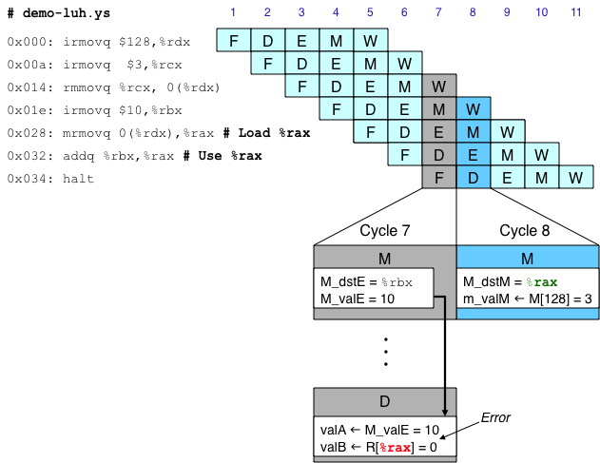
Limitation of Forwarding
Load-use dependency
  Value needed by end of decode stage in cycle 7
  Value read from memory in memory stage of cycle 8

Slide 55
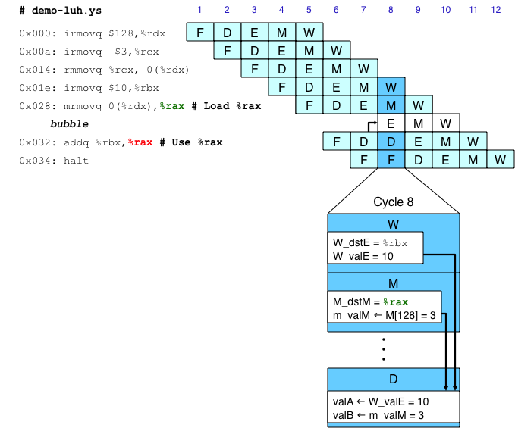
Avoiding Load/Use Hazard
  Stall using instruction for one cycle
  Can then pick up loaded value by forwarding from memory stage

Slide 56
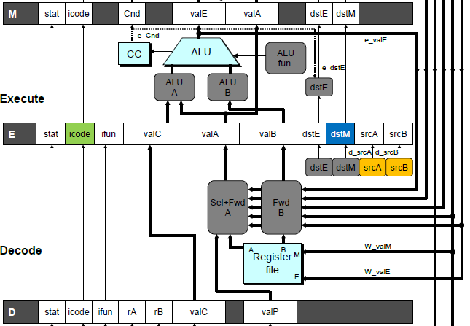
Detecting Load/Use Hazard
Condition | Trigger
Load/Use Hazard | E_icode in { IMRMOVQ, IPOPQ } && E_dstM in { d_srcA, d_srcB }

Slide 57
Control for Load/Use Hazard
# demo
-
luh
.
ys
1
2
3
4
5
6
7
8
9
10
11
12
F
F
D
D
E
E
M
M
W
0x000:
irmovq
$128,%
rdx
W
F
F
D
D
E
E
M
M
W
0x00a:
irmovq
$3,%
rcx
W
F
F
D
D
E
E
M
M
W
0x014:
rmmovq
%
rcx
, 0(%
rdx
)
W
F
F
D
D
E
E
M
M
W
0x01e:
irmovq
$10,%
ebx
W
%
rax
# Load %
rax
F
F
F
D
D
D
E
E
E
M
M
M
W
W
0x028:
mrmovq
0(%
rdx
),
W
bubble
E
M
W
0x032:
addq
%
ebx
,
%
rax
# Use %
rax
F
D
D
E
M
W
0x034: halt
F
F
D
E
M
W
  Stall instructions in fetch and decode stages
  Inject bubble into execute stage
Condition | F | D | E | M | W
Load/Use Hazard | stall | stall | bubble | normal | normal

Slide 58
Branch Misprediction Example
demo-j.ys
0x000: xorq %rax,%rax
0x002: jne t # Not taken
0x00b: irmovq $1, %rax # Fall through
0x015: nop
0x016: nop
0x017: nop
0x018: halt
0x019: t: irmovq $3, %rdx # Target
0x023: irmovq $4, %rcx # Should not execute
0x02d: irmovq $5, %rdx # Should not execute
  Should only execute first 8 instructions

Slide 59
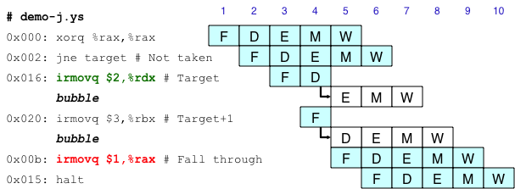
Handling Misprediction
Predict branch as taken
  Fetch 2 instructions at target
Cancel when mispredicted
  Detect branch not-taken in execute stage
  On following cycle, replace instructions in execute and decode by bubbles
  No side effects have occurred yet

Slide 60
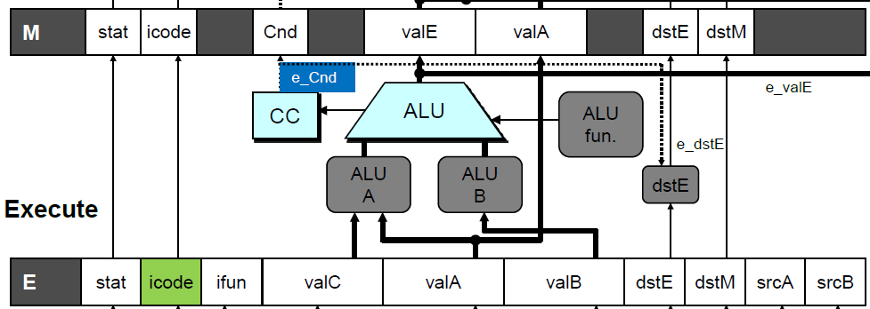
Detecting Mispredicted Branch
Condition | Trigger
Mispredicted Branch | E_icode = IJXX & !e_Cnd

Slide 61
Control for Misprediction
Condition | F | D | E | M | W
Mispredicted Branch | normal | bubble | bubble | normal | normal

Slide 62
Return Example
demo-retb.ys
0x000: irmovq Stack,%rsp # Intialize stack pointer
0x00a: call p # Procedure call
0x013: irmovq $5,%rsi # Return point
0x01d: halt
0x020: .pos 0x20
0x020: p: irmovq $-1,%rdi # procedure
0x02a: ret
0x02b: irmovq $1,%rax # Should not be executed
0x035: irmovq $2,%rcx # Should not be executed
0x03f: irmovq $3,%rdx # Should not be executed
0x049: irmovq $4,%rbx # Should not be executed
0x100: .pos 0x100
0x100: Stack: # Stack: Stack pointer
  Previously executed three additional instructions

Slide 63
Correct Return Example
# demo
-
retb
0x026: ret
F
D
E
M
W
bubble
F
D
E
M
W
bubble
F
D
E
M
W
bubble
F
D
E
M
W
F
F
D
D
E
E
M
M
W
0x013:
irmovq
$5,%
rsi
# Return
W
  As ret passes through pipeline, stall at fetch stage
    While in decode, execute, and memory stage
  Inject bubble into decode stage
  Release stall when reach write-back stage
W
W
valM
valM
=
=
0x0b
0x013
•
•
•
F
F
f
valC
f
valC
5
5
f
rB
f
rB
%
%
rsi
esi

Slide 64
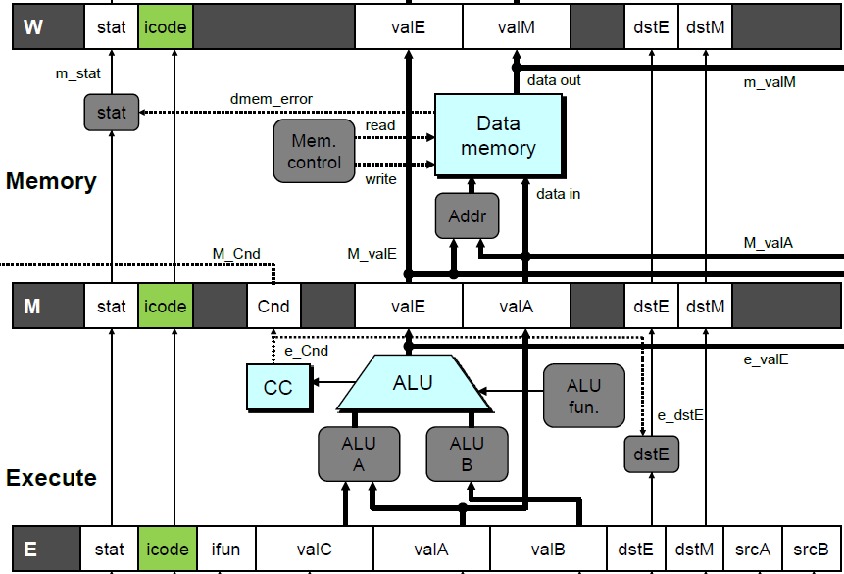
Detecting Return
Condition | Trigger
Processing ret | IRET in { D_icode, E_icode, M_icode }

Slide 65
Control for Return
# demo
-
retb
0x026: ret
F
D
E
M
W
bubble
F
D
E
M
W
bubble
F
D
E
M
W
bubble
F
D
E
M
W
F
F
D
D
E
E
M
M
W
0x014:
irmovq
$5,%
rsi
# Return
W
Condition | F | D | E | M | W
Processing ret | stall | bubble | normal | normal | normal

Slide 66
Special Control Cases
Detection
Action (on next cycle)
Condition | Trigger
Processing ret | IRET in { D_icode, E_icode, M_icode }
Load/Use Hazard | E_icode in { IMRMOVQ, IPOPQ } && E_dstM in { d_srcA, d_srcB }
Mispredicted Branch | E_icode = IJXX & !e_Cnd
Condition | F | D | E | M | W
Processing ret | stall | bubble | normal | normal | normal
Load/Use Hazard | stall | stall | bubble | normal | normal
Mispredicted Branch | normal | bubble | bubble | normal | normal

Slide 67
Implementing Pipeline Control
  Combinational logic generates pipeline control signals
  Action occurs at start of following cycle

Slide 68
Initial Version of Pipeline Control
bool F_stall =
# Conditions for a load/use hazard
E_icode in { IMRMOVQ, IPOPQ } && E_dstM in { d_srcA, d_srcB } ||
# Stalling at fetch while ret passes through pipeline
IRET in { D_icode, E_icode, M_icode };
bool D_stall =
# Conditions for a load/use hazard
E_icode in { IMRMOVQ, IPOPQ } && E_dstM in { d_srcA, d_srcB };
bool D_bubble =
# Mispredicted branch
(E_icode == IJXX && !e_Cnd) ||
# Stalling at fetch while ret passes through pipeline
IRET in { D_icode, E_icode, M_icode };
bool E_bubble =
# Mispredicted branch
(E_icode == IJXX && !e_Cnd) ||
# Load/use hazard
E_icode in { IMRMOVQ, IPOPQ } && E_dstM in { d_srcA, d_srcB };

Slide 69
Control Combinations
  Special cases that can arise on same clock cycle
Combination A
  Not-taken branch
  ret instruction at branch target
Combination B
  Instruction that reads from memory to %rsp
  Followed by ret instruction

Slide 70
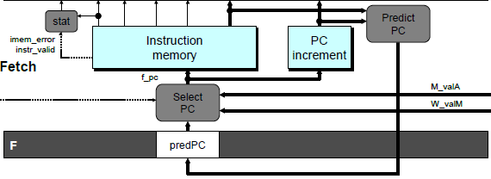
Control Combination A
1
1
Mispredict
1
Mispredict
ret
ret
ret
M
M
M
M
M
JXX
E
JXX
E
E
E
E
ret
ret
D
ret
D
D
D
D
Combination A
Condition | F | D | E | M | W
Processing ret | stall | bubble | normal | normal | normal
Mispredicted Branch | normal | bubble | bubble | normal | normal
Combination | stall | bubble | bubble | normal | normal
  Should handle as mispredicted branch
  Stalls F pipeline register
  But PC selection logic will be using M_valM anyhow

Slide 71
Control Combination B
1
1
Load/use
ret
1
ret
ret
M
M
M
M
E
Load
E
E
E
Use
ret
ret
D
D
ret
D
D
Combination B
Condition | F | D | E | M | W
Processing ret | stall | bubble | normal | normal | normal
Load/Use Hazard | stall | stall | bubble | normal | normal
Combination | stall | bubble + stall | bubble | normal | normal
  Would attempt to bubble and stall pipeline register D
  Signaled by processor as pipeline error

Slide 72
Handling Control Combination B
1
1
Load/use
ret
1
ret
ret
M
M
M
M
E
Load
E
E
E
Use
ret
ret
D
D
ret
D
D
Combination B
Condition | F | D | E | M | W
Processing ret | stall | bubble | normal | normal | normal
Load/Use Hazard | stall | stall | bubble | normal | normal
Combination | stall | stall | bubble | normal | normal
  Load/use hazard should get priority
  ret instruction should be held in decode stage for additional cycle

Slide 73
Corrected Pipeline Control Logic
bool D_bubble =
# Mispredicted branch
(E_icode == IJXX && !e_Cnd) ||
# Stalling at fetch while ret passes through pipeline
IRET in { D_icode, E_icode, M_icode }
# but not condition for a load/use hazard
&& !(E_icode in { IMRMOVQ, IPOPQ }
&& E_dstM in { d_srcA, d_srcB });
Condition | F | D | E | M | W
Processing ret | stall | bubble | normal | normal | normal
Load/Use Hazard | stall | stall | bubble | normal | normal
Combination | stall | stall | bubble | normal | normal
  Load/use hazard should get priority
  ret instruction should be held in decode stage for additional cycle

Slide 74
Pipeline Summary
Data Hazards
  Most handled by forwarding
    No performance penalty
  Load/use hazard requires one cycle stall
Control Hazards
  Cancel instructions when detect mispredicted branch
    Two clock cycles wasted
  Stall fetch stage while ret passes through pipeline
    Three clock cycles wasted
Control Combinations
  Must analyze carefully
  First version had subtle bug
    Only arises with unusual instruction combination

Slide 75
Processor Architecture: Wrap-up

Slide 76
Overview
Wrap-Up of PIPE Design
  Exceptional conditions
  Performance analysis
  Fetch stage design
Modern High-Performance Processors
  Out-of-order execution

Slide 77
Exceptions
  Conditions under which processor cannot continue normal operation
Causes
  Halt instruction (Current)
  Bad address for instruction or data (Previous)
  Invalid instruction (Previous)
Typical Desired Action
  Complete some instructions
    Either current or previous (depends on exception type)
  Discard others
  Call exception handler
    Like an unexpected procedure call
Our Implementation
  Halt when instruction causes exception

Slide 78
Exception Examples
Detect in Fetch Stage
jmp $-1 # Invalid jump target
.byte 0xFF # Invalid instruction code
halt # Halt instruction
Detect in Memory Stage
irmovq $100,%rax
rmmovq %rax,0x10000(%rax) # invalid address

Slide 79
Exceptions in Pipeline Processor #1
# demo-exc1.ys
irmovq $100,%rax
rmmovq %rax,0x10000(%rax) # Invalid address
nop
.byte 0xFF # Invalid instruction code
1
2
3
4
5
0x000: irmovq $100,%rax
F
D
E
M
W
Exception detected
0x00a: rmmovq %rax,0x1000(%rax)
F
D
E
M
0x014: nop
F
D
E
0x015: .byte 0xFF
F
D
Exception detected
Desired Behavior
  rmmovq should cause exception
  Following instructions should have no effect on processor state

Slide 80
Exceptions in Pipeline Processor #2
# demo-exc2.ys
0x000: xorq %rax,%rax # Set condition codes
0x002: jne t # Not taken
0x00b: irmovq $1,%rax
0x015: irmovq $2,%rdx
0x01f: halt
0x020: t: .byte 0xFF # Target
1
2
3
4
5
6
7
8
9
0x000: xorq %rax,%rax
F
D
E
M
W
0x002: jne t
F
D
E
M
0x020: t: .byte 0xFF
F
D
E
M
W
0x???: (I’m lost!)
F
D
E
M
W
0x00b: irmovq $1,%rax
F
D
E
M
W
Exception detected
Desired Behavior
  No exception should occur

Slide 81
Maintaining Exception Ordering
W
stat
icode
valE
valM
dstE
dstM
M
stat
icode
Cnd
valE
valA
dstE
dstM
E
stat
icode
ifun
valC
valA
valB
dstE
dstM
srcA
srcB
D
stat
icode
ifun
rA
rB
valC
valP
F
predPC
  Add status field to pipeline registers
  Fetch stage sets to either “AOK,” “ADR” (when bad fetch address), “HLT” (halt instruction) or “INS” (illegal instruction)
  Decode & execute pass values through
  Memory either passes through or sets to “ADR”
  Exception triggered only when instruction hits write back

Slide 82
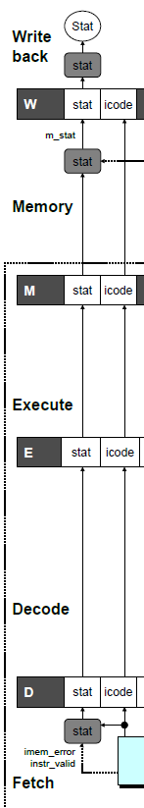
Exception Handling Logic
Fetch Stage
Memory Stage
Writeback Stage
dmem_error
# Determine status code for fetched instruction
int f_stat = [
imem_error: SADR;
!instr_valid : SINS;
f_icode == IHALT : SHLT;
1 : SAOK;
];
# Update the status
int m_stat = [
dmem_error : SADR;
1 : M_stat;
];
int Stat = [
# SBUB in earlier stages indicates bubble
W_stat == SBUB : SAOK;
1 : W_stat;
];

Slide 83
Side Effects in Pipeline Processor
# demo-exc3.ys
irmovq $100,%rax
rmmovq %rax,0x10000(%rax) # invalid address
addq %rax,%rax # Sets condition codes
1
2
3
4
5
0x000: irmovq $100,%rax
F
D
E
M
W
Exception detected
0x00a: rmmovq %rax,0x1000(%rax)
F
D
E
M
0x014: addq %rax,%rax
F
D
E
Condition code set
Desired Behavior
  rmmovq should cause exception
  No following instruction should have any effect

Slide 84
Avoiding Side Effects
Presence of Exception Should Disable State Update
  Invalid instructions are converted to pipeline bubbles
    Except have stat indicating exception status
  Data memory will not write to invalid address
  Prevent invalid update of condition codes
    Detect exception in memory stage
    Disable condition code setting in execute
    Must happen in same clock cycle
  Handling exception in final stages
    When detect exception in memory stage
      Start injecting bubbles into memory stage on next cycle
    When detect exception in write-back stage
      Stall excepting instruction
  Included in HCL code

Slide 85
Control Logic for State Changes
Setting Condition Codes
Stage Control
  Also controls updating of memory
# Should the condition codes be updated?
bool set_cc = E_icode == IOPQ &&
# State changes only during normal operation
!m_stat in { SADR, SINS, SHLT }
&& !W_stat in { SADR, SINS, SHLT };
# Start injecting bubbles as soon as exception passes through memory stage
bool M_bubble = m_stat in { SADR, SINS, SHLT }
|| W_stat in { SADR, SINS, SHLT };
# Stall pipeline register W when exception encountered
bool W_stall = W_stat in { SADR, SINS, SHLT };

Slide 86
Rest of Real-Life Exception Handling
Call Exception Handler
  Push PC onto stack
    Either PC of faulting instruction or of next instruction
    Usually pass through pipeline along with exception status
  Jump to handler address
    Usually fixed address
    Defined as part of ISA
Implementation
  Haven’t tried it yet!

Slide 87
Performance Metrics
Clock rate
  Measured in Gigahertz
  Function of stage partitioning and circuit design
    Keep amount of work per stage small
Rate at which instructions executed
  CPI: cycles per instruction
  On average, how many clock cycles does each instruction require?
  Function of pipeline design and benchmark programs
    E.g., how frequently are branches mispredicted?

Slide 88
CPI for PIPE
CPI ≈ 1.0
  Fetch instruction each clock cycle
  Effectively process new instruction almost every cycle
    Although each individual instruction has latency of 5 cycles
CPI > 1.0
  Sometimes must stall or cancel branches
Computing CPI
  C clock cycles
  I instructions executed to completion
  B bubbles injected (C = I + B)
  CPI = C/I = (I+B)/I = 1.0 + B/I
  Factor B/I represents average penalty due to bubbles

Slide 89
CPI for PIPE (Cont.)
  B/I = LP + MP + RP
  LP: Penalty due to load/use hazard stalling
    Fraction of instructions that are loads 0.25
    Fraction of load instructions requiring stall 0.20
    Number of bubbles injected each time 1
    ⇒ LP = 0.25 * 0.20 * 1 = 0.05
  MP: Penalty due to mispredicted branches
    Fraction of instructions that are cond. jumps 0.20
    Fraction of cond. jumps mispredicted 0.40
    Number of bubbles injected each time 2
    ⇒ MP = 0.20 * 0.40 * 2 = 0.16
  RP: Penalty due to ret instructions
    Fraction of instructions that are returns 0.02
    Number of bubbles injected each time 3
    ⇒ RP = 0.02 * 3 = 0.06
  Net effect of penalties 0.05 + 0.16 + 0.06 = 0.27
    ⇒ CPI = 1.27 (Not bad!)
Typical Values

Slide 90
Fetch Logic Revisited
During Fetch Cycle
  Select PC
  Read bytes from instruction memory
  Examine icode to determine instruction length
  Increment PC
Timing
  Steps 2 & 4 require significant amount of time

Slide 91
Standard Fetch Timing
Select PC
need_regids, need_valC
Mem. Read
Increment
1 clock cycle
  Must Perform Everything in Sequence
  Can’t compute incremented PC until know how much to increment it by

Slide 92
A Fast PC Increment Circuit
incrPC
High-order 60 bits
Low-order 4 bits
MUX
carry
0
1
60-bit
incre-
menter
4-bit adder
Slow
Fast
need_regids
0
High-order 60 bits
need_ValC
Low-order 4 bits
PC

Slide 93
Modified Fetch Timing
need_regids, need_valC
Select PC
4-bit add
Mem. Read
MUX
Incrementer
Standard cycle
1 clock cycle
60-Bit Incrementer
  Acts as soon as PC selected
  Output not needed until final MUX
  Works in parallel with memory read

Slide 94
More Realistic Fetch Logic
Bytes 1-9
Fetch Box
  Integrated into instruction cache
  Fetches entire cache block (16 or 32 bytes)
  Selects current instruction from current block
  Works ahead to fetch next block
    As reaches end of current block
    At branch target

Slide 95
Modern CPU Design

Slide 96
Instruction Control
Grabs Instruction Bytes From Memory
  Based on Current PC + Predicted Targets for Predicted Branches
  Hardware dynamically guesses whether branches taken/not taken and (possibly) branch target
Translates Instructions Into Operations
  Primitive steps required to perform instruction
  Typical instruction requires 1–3 operations
Converts Register References Into Tags
  Abstract identifier linking destination of one operation with sources of later operations

Slide 97
Execution
Unit
Register
Prediction
Operations
Updates
OK?
Integer/
General
FP
FP
Load
Store
Functional
Branch
Integer
Add
Mult
/Div
Units
Operation Results
Addr
.
Addr
.
Data
Data
Data
Cache
Execution
Execution
  Multiple functional units
    Each can operate in independently
  Operations performed as soon as operands available
    Not necessarily in program order
    Within limits of functional units
  Control logic
    Ensures behavior equivalent to sequential program execution

Slide 98
CPU Capabilities of Intel Haswell
Multiple Instructions Can Execute in Parallel
  2 load
  1 store
  4 integer
  2 FP multiply
  1 FP add / divide
Some Instructions Take > 1 Cycle, but Can be Pipelined
  Instruction Latency Cycles/Issue
  Load / Store 4 1
  Integer Multiply 3 1
  Integer Divide 3—30 3—30
  Double/Single FP Multiply 5 1
  Double/Single FP Add 3 1
  Double/Single FP Divide 10—15 6—11

Slide 99
Haswell Operation
Translates instructions dynamically into “Uops”
  ~118 bits wide
  Holds operation, two sources, and destination
Executes Uops with “Out of Order” engine
  Uop executed when
    Operands available
    Functional unit available
  Execution controlled by “Reservation Stations”
    Keeps track of data dependencies between uops
    Allocates resources

Slide 100
High-Performance Branch Prediction
Critical to Performance
  Typically 11–15 cycle penalty for misprediction
Branch Target Buffer
  512 entries
  4 bits of history
  Adaptive algorithm
    Can recognize repeated patterns, e.g., alternating taken–not taken
Handling BTB misses
  Detect in ~cycle 6
  Predict taken for negative offset, not taken for positive
    Loops vs. conditionals

Slide 101
Example Branch Prediction
Branch History
  Encode information about prior history of branch instructions
  Predict whether or not branch will be taken
State Machine
  Each time branch taken, transition to right
  When not taken, transition to left
  Predict branch taken when in state Yes! or Yes?
NT
NT
NT
T
Yes!
Yes?
No?
No!
NT
T
T
T

Slide 102
Processor Summary
Design Technique
  Create uniform framework for all instructions
    Want to share hardware among instructions
  Connect standard logic blocks with bits of control logic
Operation
  State held in memories and clocked registers
  Computation done by combinational logic
  Clocking of registers/memories sufficient to control overall behavior
Enhancing Performance
  Pipelining increases throughput and improves resource utilization
  Must make sure to maintain ISA behavior

