Slide 1
The Memory Hierarchy :
Memory Hierarchy - Cache

Slide 2
Storage Trends
SRAM
Metric 1980 1985 1990 1995 2000 2005 2010 2020 2020:1980
$/MB 19,200 2,900 320 256 100 75 60 ? <320
access (ns) 300 150 35 15 3 2 1.5 0.4 200
DRAM
Metric 1980 1985 1990 1995 2000 2005 2010 2020 2020:1980
$/MB 8,000 880 100 30 1 0.1 0.06 0.001 8,000,000
access (ns) 375 200 100 70 60 50 40 10 37.5
typical size (MB) 0.064 0.256 4 16 64 2,000 8,000 8,000 125,000
Disk
Metric 1980 1985 1990 1995 2000 2005 2010 2020 2020:1980
$/MB 500 100 8 0.30 0.01 0.005 0.0003 0.000015 33,300,000
access (ms) 87 75 28 10 8 4 3 3ms 29
typical size (MB) 1 10 160 1,000 20,000 160,000 1,500,000 4,000,000 4,000,000

Slide 3
CPU Clock Rates
Inflection point in computer history
when designers hit the “Power Wall”
1980 1990 1995 2000 2003 2005 2010 2010:1980
CPU 8080 386 Pentium P-III P-4 Core 2 Core i7 ---
Clock
rate (MHz) 1 20 150 600 3300 2000 2500 2500
Cycle
time (ns) 1000 50 6 1.6 0.3 0.50 0.4 2500
Cores 1 1 1 1 1 2 4 4
Effective
cycle 1000 50 6 1.6 0.3 0.25 0.1 10,000
time (ns)

Slide 4
The CPU-Memory Gap
The gap widens between DRAM, disk, and CPU speeds.
Disk
SSD
DRAM
CPU

Slide 5
Locality to the Rescue!
The key to bridging this CPU-Memory gap is a fundamental property of computer programs known as locality

Slide 6
Locality
Principle of Locality: Programs tend to use data and instructions with addresses near or equal to those they have used recently
Temporal locality:
  Recently referenced items are likely
  to be referenced again in the near future
Spatial locality:
  Items with nearby addresses tend
  to be referenced close together in time

Slide 7
Locality Example
sum = 0;
for (i = 0; i < n; i++)
sum += a[i];
return sum;
Data references
  Reference array elements in succession (stride-1 reference pattern).
  Reference variable sum each iteration.
Instruction references
  Reference instructions in sequence.
  Cycle through loop repeatedly.
Spatial locality
Temporal locality
Spatial locality
Temporal locality

Slide 8
Qualitative Estimates of Locality
Claim: Being able to look at code and get a qualitative sense of its locality is a key skill for a professional programmer.
Question: Does this function have good locality with respect to array a?
int sum_array_rows(int a[M][N])
{
int i, j, sum = 0;
for (i = 0; i < M; i++)
for (j = 0; j < N; j++)
sum += a[i][j];
return sum;
}

Slide 9
Locality Example
Question: Does this function have good locality with respect to array a?
int sum_array_cols(int a[M][N])
{
int i, j, sum = 0;
for (j = 0; j < N; j++)
for (i = 0; i < M; i++)
sum += a[i][j];
return sum;
}

Slide 10
Locality Example
Question: Can you permute the loops so that the function scans the 3-d array a with a stride-1 reference pattern (and thus has good spatial locality)?
int sum_array_3d(int a[M][N][N])
{
int i, j, k, sum = 0;
for (i = 0; i < M; i++)
for (j = 0; j < N; j++)
for (k = 0; k < N; k++)
sum += a[k][i][j];
return sum;
}

Slide 11
Memory Hierarchies
Some fundamental and enduring properties of hardware and software:
  Fast storage technologies cost more per byte, have less capacity, and require more power (heat!).
  The gap between CPU and main memory speed is widening.
  Well-written programs tend to exhibit good locality.
These fundamental properties complement each other beautifully.
They suggest an approach for organizing memory and storage systems known as a memory hierarchy.

Slide 12
An Example Memory Hierarchy
L0:
CPU registers hold words retrieved from L1 cache
Registers
L1:
L1 cache
(SRAM)
Smaller,
faster,
costlier
per byte
L1 cache holds cache lines retrieved from L2 cache
L2:
L2 cache
(SRAM)
L2 cache holds cache lines retrieved from main memory
L3:
Larger,
slower,
cheaper
per byte
Main memory
(DRAM)
Main memory holds disk blocks retrieved from local disks
L4:
Local secondary storage
(local disks)
Local disks hold files retrieved from disks on remote network servers
Remote secondary storage
(tapes, distributed file systems, Web servers)
L5:

Slide 13
Caches
Cache: A smaller, faster storage device that acts as a staging area for a subset of the data in a larger, slower device.
Fundamental idea of a memory hierarchy:
  For each k, the faster, smaller device at level k serves as a cache for the larger, slower device at level k+1.
Why do memory hierarchies work?
  Because of locality, programs tend to access the data at level k more often than they access the data at level k+1.
  Thus, the storage at level k+1 can be slower, and thus larger and cheaper per bit.
Big Idea: The memory hierarchy creates a large pool of storage that costs as much as the cheap storage near the bottom, but that serves data to programs at the rate of the fast storage near the top.

Slide 14
General Cache Concepts
Smaller, faster, more expensive
memory caches a subset of
the blocks
Cache
8
4
9
14
10
3
Data is copied in block-sized transfer units
4
10
Larger, slower, cheaper memory
viewed as partitioned into “blocks”
Memory
0
1
2
3
4
4
5
6
7
8
9
10
10
11
12
13
14
15

Slide 15
General Cache Concepts: Hit
Request: 14
Data in block b is needed
Block b is in cache:
Hit!
Cache
8
9
14
3
14
Memory
0
1
2
3
4
5
6
7
8
9
10
11
12
13
14
15

Slide 16
General Cache Concepts: Miss
Request: 12
Data in block b is needed
Block b is not in cache:
Miss!
Cache
8
9
14
3
12
Block b is fetched from
memory
12
Request: 12
Block b is stored in cache
Placement policy:
determines where b goes
Replacement policy:
determines which block
gets evicted (victim)
Memory
0
1
2
3
4
5
6
7
8
9
10
11
12
12
13
14
15

Slide 17
Examples of Caching in the Hierarchy
Cache Type
What is Cached?
Where is it Cached?
Latency (cycles)
Managed By
Registers
4-8 bytes words
CPU core
0
Compiler
TLB
Address translations
On-Chip TLB
0
Hardware
L1 cache
64-bytes block
On-Chip L1
1
Hardware
L2 cache
64-bytes block
On/Off-Chip L2
10
Hardware
Virtual Memory
4-KB page
Main memory
100
Hardware + OS
Buffer cache
Parts of files
Main memory
100
OS
Disk cache
Disk sectors
Disk controller
100,000
Disk firmware
Network buffer cache
Parts of files
Local disk
10,000,000
AFS/NFS client
Browser cache
Web pages
Local disk
10,000,000
Web browser
Web cache
Web pages
Remote server disks
1,000,000,000
Web proxy server

Slide 18
Summary
The speed gap between CPU, memory and mass storage continues to widen.
Well-written programs exhibit a property called locality.
Memory hierarchies based on caching close the gap by exploiting locality.

Slide 19
Cache
Cache memory organization and operation
Performance impact of caches
  The memory mountain
  Rearranging loops to improve spatial locality
  Using blocking to improve temporal locality

Slide 20
Cache Memories
Cache memories are small, fast SRAM-based memories managed automatically in hardware.
  Hold frequently accessed blocks of main memory
CPU looks first for data in caches (e.g., L1, L2, and L3), then in main memory.
Typical system structure:
CPU chip
Register file
ALU
Cache
memories
System bus
Memory bus
Main
memory
Bus interface
I/O
bridge

Slide 21
General Cache Organization (S, E, B)
E = 2e lines per set
set
line
S = 2^{s} sets
Cache size:
C = S x E x B data bytes
v
tag
0
1
2
B-1
valid bit
B = 2^{b} bytes per cache block (the data)

Slide 22
Cache Read
Locate set
Check if any line in set
has matching tag
Yes + line valid: hit
Locate data starting
at offset
E = 2e lines per set
Address of word:
t bits
s bits
b bits
S = 2^{s} sets
tag
set
index
block
offset
data begins at this offset
v
tag
0
1
2
B-1
valid bit
B = 2^{b} bytes per cache block (the data)

Slide 23
Example: Direct Mapped Cache (E = 1)
Direct mapped: One line per set
Assume: cache block size 8 bytes
Address of int:
v
tag
0
1
2
3
4
5
6
7
t bits
0…01
100
v
tag
0
1
2
3
4
5
6
7
find set
S = 2^{s} sets
v
tag
0
1
2
3
4
5
6
7
v
tag
0
1
2
3
4
5
6
7

Slide 24
Example: Direct Mapped Cache (E = 1)
Direct mapped: One line per set
Assume: cache block size 8 bytes
match: assume yes = hit
Address of int:
valid? +
t bits
0…01
100
v
tag
0
1
2
3
4
5
6
7
tag
block offset

Slide 25
Example: Direct Mapped Cache (E = 1)
Direct mapped: One line per set
Assume: cache block size 8 bytes
match: assume yes = hit
Address of int:
valid? +
t bits
0…01
100
v
tag
0
1
2
3
4
5
6
7
block offset
int (4 Bytes) is here
No match: old line is evicted and replaced

Slide 26
Direct-Mapped Cache Simulation
t=1
s=2
b=1
M=16 byte addresses, B=2 bytes/block,
S=4 sets, E=1 Blocks/set
Address trace (reads, one byte per read):
0 [0000₂],
1 [0001₂],
7 [0111₂],
8 [1000₂],
0 [0000₂]
x
xx
x
miss
hit
miss
miss
miss
v
Tag
Block
Set 0
0
?
?
1
1
1
0
1
0
M[0-1]
M[8-9]
M[0-1]
Set 1
Set 2
Set 3
1
0
M[6-7]

Slide 27
A Higher Level Example
Ignore the variables sum, i, j
assume: cold (empty) cache,
a[0][0] goes here
int sum_array_rows(double a[16][16])
{
int i, j;
double sum = 0;
for (i = 0; i < 16; i++)
for (j = 0; j < 16; j++)
sum += a[i][j];
return sum;
}
int sum_array_cols(double a[16][16])
{
int i, j;
double sum = 0;
for (j = 0; j < 16; j++)
for (i = 0; i < 16; i++)
sum += a[i][j];
return sum;
}
32 B = 4 doubles

Slide 28
E-way Set Associative Cache (Here: E = 2)
E = 2: Two lines per set
Assume: cache block size 8 bytes
Address of short int:
t bits
0…01
100
v
tag
0
1
2
3
4
5
6
7
v
tag
0
1
2
3
4
5
6
7
v
tag
0
1
2
3
4
5
6
7
v
tag
0
1
2
3
4
5
6
7
find set
v
tag
0
1
2
3
4
5
6
7
v
tag
0
1
2
3
4
5
6
7
v
tag
0
1
2
3
4
5
6
7
v
tag
0
1
2
3
4
5
6
7

Slide 29
E-way Set Associative Cache (Here: E = 2)
E = 2: Two lines per set
Assume: cache block size 8 bytes
Address of short int:
compare both
t bits
0…01
100
valid? +
match: yes = hit
v
tag
0
1
2
3
4
5
6
7
tag
v
tag
0
1
2
3
4
5
6
7
block offset

Slide 30
E-way Set Associative Cache (Here: E = 2)
E = 2: Two lines per set
Assume: cache block size 8 bytes
Address of short int:
compare both
t bits
0…01
100
valid? +
match: yes = hit
v
tag
0
1
2
3
4
5
6
7
v
tag
0
1
2
3
4
5
6
7
block offset
short int (2 Bytes) is here
No match:
One line in set is selected for eviction and replacement
Replacement policies: random, least recently used (LRU), …

Slide 31
2-Way Set Associative Cache Simulation
t=2
s=1
b=1
xx
x
x
M=16 byte addresses, B=2 bytes/block,
S=2 sets, E=2 blocks/set
Address trace (reads, one byte per read):
0 [0000₂],
1 [0001₂],
7 [0111₂],
8 [1000₂],
0 [0000₂]
miss
hit
miss
miss
hit
v
Tag
Block
0
?
?
Set 0
1
00
M[0-1]
1
10
M[8-9]
0
1
01
M[6-7]
Set 1
0
0

Slide 32
A Higher Level Example
Ignore the variables sum, i, j
assume: cold (empty) cache,
a[0][0] goes here
int sum_array_rows(double a[16][16])
{
int i, j;
double sum = 0;
for (i = 0; i < 16; i++)
for (j = 0; j < 16; j++)
sum += a[i][j];
return sum;
}
32 B = 4 doubles
int sum_array_rows(double a[16][16])
{
int i, j;
double sum = 0;
for (j = 0; j < 16; j++)
for (i = 0; i < 16; i++)
sum += a[i][j];
return sum;
}

Slide 33
What about writes?
Multiple copies of data exist:
  L1, L2, Main Memory, Disk
What to do on a write-hit?
  Write-through (write immediately to memory)
  Write-back (defer write to memory until replacement of line)
    Need a dirty bit (line different from memory or not)
What to do on a write-miss?
  Write-allocate (load into cache, update line in cache)
    Good if more writes to the location follow
  No-write-allocate (writes immediately to memory)
Typical
  Write-through + No-write-allocate
  Write-back + Write-allocate

Slide 34
Intel Core i7 Cache Hierarchy
Processor package
Core 0
Core 3
L1 i-cache and d-cache:
  32 KB, 8-way,
  Access: 4 cycles
L2 unified cache:
  256 KB, 8-way,
  Access: 11 cycles
L3 unified cache:
  8 MB, 16-way,
  Access: 30-40 cycles
Block size: 64 bytes for all caches.
Regs
Regs
L1
d-cache
L1
i-cache
L1
d-cache
L1
i-cache
…
L2 unified cache
L2 unified cache
L3 unified cache
(shared by all cores)
Main memory

Slide 35
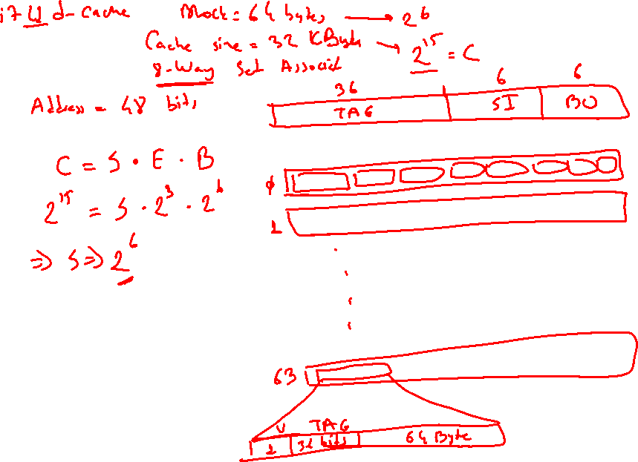

Slide 36
General Cache Organization (S, E, B)
E = 2e lines per set
set
line
S = 2^{s} sets
Cache size:
C = S x E x B data bytes
v
tag
0
1
2
B-1
valid bit
B = 2^{b} bytes per cache block (the data)

Slide 37
Cache Read
Locate set
Check if any line in set
has matching tag
Yes + line valid: hit
Locate data starting
at offset
E = 2e lines per set
Address of word:
t bits
s bits
b bits
S = 2^{s} sets
tag
set
index
block
offset
data begins at this offset
v
tag
0
1
2
B-1
valid bit
B = 2^{b} bytes per cache block (the data)

Slide 38
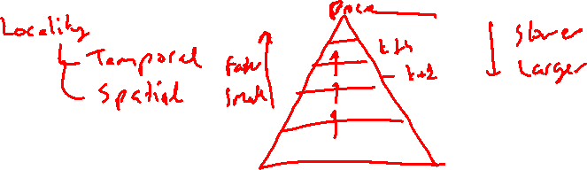

Slide 39
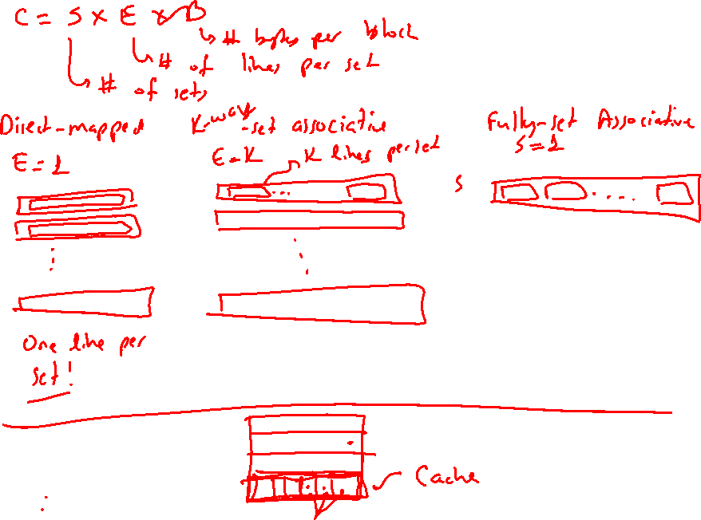

Slide 40
General Caching Concepts:
Types of Cache Misses
Cold (compulsory) miss
  Cold misses occur because the cache is empty.
Conflict miss
  Most caches limit blocks at level k+1 to a small subset (sometimes a singleton) of the block positions at level k.
    E.g. Block i at level k+1 must be placed in block (i mod 4) at level k.
  Conflict misses occur when the level k cache is large enough, but multiple data objects all map to the same level k block.
    E.g. Referencing blocks 0, 8, 0, 8, 0, 8, ... would miss every time.
Capacity miss
  Occurs when the set of active cache blocks (working set) is larger than the cache.

Slide 41
Cache Performance Metrics
Miss Rate
  Fraction of memory references not found in cache (misses / accesses)
  = 1 – hit rate
  Typical numbers (in percentages):
    3-10% for L1
    can be quite small (e.g., < 1%) for L2, depending on size, etc.
Hit Time
  Time to deliver a line in the cache to the processor
    includes time to determine whether the line is in the cache
  Typical numbers:
    1-2 clock cycle for L1
    5-20 clock cycles for L2
Miss Penalty
  Additional time required because of a miss
    typically 50-200 cycles for main memory (Trend: increasing!)

Slide 42
Lets think about those numbers
Huge difference between a hit and a miss
  Could be 100x, if just L1 and main memory
Would you believe 99% hits is twice as good as 97%?
  Consider:
  cache hit time of 1 cycle
  miss penalty of 100 cycles
  Average access time:
  97% hits: 1 cycle + 0.03 * 100 cycles = 4 cycles
  99% hits: 1 cycle + 0.01 * 100 cycles = 2 cycles
This is why “miss rate” is used instead of “hit rate”

Slide 43
Writing Cache Friendly Code
Make the common case go fast
  Focus on the inner loops of the core functions
Minimize the misses in the inner loops
  Repeated references to variables are good (temporal locality)
  Stride-1 reference patterns are good (spatial locality)
Key idea: Our qualitative notion of locality is quantified through our understanding of cache memories.

Slide 44
Today
Cache organization and operation
Performance impact of caches
  The memory mountain
  Rearranging loops to improve spatial locality
  Using blocking to improve temporal locality

Slide 45
The Memory Mountain
Read throughput (read bandwidth)
  Number of bytes read from memory per second (MB/s)
Memory mountain: Measured read throughput as a function of spatial and temporal locality.
  Compact way to characterize memory system performance.

Slide 46
Memory Mountain Test Function
/* The test function */
void test(int elems, int stride) {
int i, result = 0;
volatile int sink;
for (i = 0; i < elems; i += stride)
result += data[i];
sink = result; /* So compiler doesn't optimize away the loop */
}
/* Run test(elems, stride) and return read throughput (MB/s) */
double run(int size, int stride, double Mhz)
{
double cycles;
int elems = size / sizeof(int);
test(elems, stride); /* warm up the cache */
cycles = fcyc2(test, elems, stride, 0); /* call test(elems,stride) */
return (size / stride) / (cycles / Mhz); /* convert cycles to MB/s */
}

Slide 47
The Memory Mountain
Intel Core i7
32 KB L1 i-cache
32 KB L1 d-cache
256 KB unified L2 cache
8M unified L3 cache
All caches on-chip

Slide 48
The Memory Mountain
Intel Core i7
32 KB L1 i-cache
32 KB L1 d-cache
256 KB unified L2 cache
8M unified L3 cache
All caches on-chip
Slopes of
spatial
locality

Slide 49
The Memory Mountain
Intel Core i7
32 KB L1 i-cache
32 KB L1 d-cache
256 KB unified L2 cache
8M unified L3 cache
All caches on-chip
Ridges of
Temporal
locality
Slopes of
spatial
locality

Slide 50
Today
Cache organization and operation
Performance impact of caches
  The memory mountain
  Rearranging loops to improve spatial locality
  Using blocking to improve temporal locality

Slide 51
Miss Rate Analysis for Matrix Multiply
Assume:
  Block size = 32B (big enough for four 64-bit words)
  Matrix dimension (N) is very large
    Approximate 1/N as 0.0
  Cache is not even big enough to hold multiple rows
Analysis Method:
  Look at access pattern of inner loop
k
j
j
i
k
i
A
B
C

Slide 52
Matrix Multiplication Example
Variable sum
held in register
Description:
  Multiply N x N matrices
  O(N³) total operations
  N reads per source element
  N values summed per destination
    but may be able to hold in register
/* ijk */
for (i=0; i<n; i++) {
for (j=0; j<n; j++) {
sum = 0.0;
for (k=0; k<n; k++)
sum += a[i][k] * b[k][j];
c[i][j] = sum;
}
}

Slide 53
Layout of C Arrays in Memory (review)
C arrays allocated in row-major order
  each row in contiguous memory locations
Stepping through columns in one row:
  for (i = 0; i < N; i++)
    sum += a[0][i];
  accesses successive elements
  if block size (B) > 4 bytes, exploit spatial locality
    compulsory miss rate = 4 bytes / B
Stepping through rows in one column:
  for (i = 0; i < n; i++)
    sum += a[i][0];
  accesses distant elements
  no spatial locality!
    compulsory miss rate = 1 (i.e. 100%)

Slide 54
Matrix Multiplication (ijk)
/* ijk */
for (i=0; i<n; i++) {
for (j=0; j<n; j++) {
sum = 0.0;
for (k=0; k<n; k++)
sum += a[i][k] * b[k][j];
c[i][j] = sum;
}
}
Inner loop:
(*,j)
(i,j)
(i,*)
A
B
C
Row-wise
Column-
wise
Fixed
Misses per inner loop iteration:
  A B C
  0.25 1.0 0.0

Slide 55
Matrix Multiplication (jik)
/* jik */
for (j=0; j<n; j++) {
for (i=0; i<n; i++) {
sum = 0.0;
for (k=0; k<n; k++)
sum += a[i][k] * b[k][j];
c[i][j] = sum
}
}
Inner loop:
(*,j)
(i,j)
(i,*)
A
B
C
Row-wise
Column-
wise
Fixed
Misses per inner loop iteration:
  A B C
  0.25 1.0 0.0

Slide 56
Matrix Multiplication (kij)
/* kij */
for (k=0; k<n; k++) {
for (i=0; i<n; i++) {
r = a[i][k];
for (j=0; j<n; j++)
c[i][j] += r * b[k][j];
}
}
Inner loop:
(i,k)
(k,*)
(i,*)
A
B
C
Fixed
Row-wise
Row-wise
Misses per inner loop iteration:
  A B C
  0.0 0.25 0.25

Slide 57
Matrix Multiplication (ikj)
/* ikj */
for (i=0; i<n; i++) {
for (k=0; k<n; k++) {
r = a[i][k];
for (j=0; j<n; j++)
c[i][j] += r * b[k][j];
}
}
Inner loop:
(i,k)
(k,*)
(i,*)
A
B
C
Fixed
Row-wise
Row-wise
Misses per inner loop iteration:
  A B C
  0.0 0.25 0.25

Slide 58
Matrix Multiplication (jki)
Inner loop:
/* jki */
for (j=0; j<n; j++) {
for (k=0; k<n; k++) {
r = b[k][j];
for (i=0; i<n; i++)
c[i][j] += a[i][k] * r;
}
}
(*,k)
(*,j)
(k,j)
A
B
C
Column-
wise
Fixed
Column-
wise
Misses per inner loop iteration:
  A B C
  1.0 0.0 1.0

Slide 59
Matrix Multiplication (kji)
/* kji */
for (k=0; k<n; k++) {
for (j=0; j<n; j++) {
r = b[k][j];
for (i=0; i<n; i++)
c[i][j] += a[i][k] * r;
}
}
Inner loop:
(*,k)
(*,j)
(k,j)
A
B
C
Column-
wise
Fixed
Column-
wise
Misses per inner loop iteration:
  A B C
  1.0 0.0 1.0

Slide 60
Summary of Matrix Multiplication
for (i=0; i<n; i++) {
for (j=0; j<n; j++) {
sum = 0.0;
for (k=0; k<n; k++)
sum += a[i][k] * b[k][j];
c[i][j] = sum;
}
}
ijk (& jik):
  2 loads, 0 stores
  misses/iter = 1.25
for (k=0; k<n; k++) {
for (i=0; i<n; i++) {
r = a[i][k];
for (j=0; j<n; j++)
c[i][j] += r * b[k][j];
}
}
kij (& ikj):
  2 loads, 1 store
  misses/iter = 0.5
for (j=0; j<n; j++) {
for (k=0; k<n; k++) {
r = b[k][j];
for (i=0; i<n; i++)
c[i][j] += a[i][k] * r;
}
}
jki (& kji):
  2 loads, 1 store
  misses/iter = 2.0

Slide 61
Core i7 Matrix Multiply Performance
jki / kji
ijk / jik
kij / ikj

Slide 62
Today
Cache organization and operation
Performance impact of caches
  The memory mountain
  Rearranging loops to improve spatial locality
  Using blocking to improve temporal locality

Slide 63
Example: Matrix Multiplication
c = (double *) calloc(sizeof(double), n*n);
/* Multiply n x n matrices a and b */
void mmm(double *a, double *b, double *c, int n) {
int i, j, k;
for (i = 0; i < n; i++)
for (j = 0; j < n; j++)
for (k = 0; k < n; k++)
c[i*n+j] += a[i*n + k]*b[k*n + j];
}
j
c
a
b
=
*
i

Slide 64
Cache Miss Analysis
Assume:
  Matrix elements are doubles
  Cache block = 8 doubles
  Cache size C << n (much smaller than n)
First iteration:
  n/8 + n = 9n/8 misses
  Afterwards in cache:
  (schematic)
n
=
*
=
*
8 wide

Slide 65
Cache Miss Analysis
Assume:
  Matrix elements are doubles
  Cache block = 8 doubles
  Cache size C << n (much smaller than n)
Second iteration:
  Again:
  n/8 + n = 9n/8 misses
Total misses:
  9n/8 * n² = (9/8) * n³
n
=
*
8 wide

Slide 67
Blocked Matrix Multiplication
c = (double *) calloc(sizeof(double), n*n);
/* Multiply n x n matrices a and b */
void mmm(double *a, double *b, double *c, int n) {
int i, j, k;
for (i = 0; i < n; i+=B)
for (j = 0; j < n; j+=B)
for (k = 0; k < n; k+=B)
/* B x B mini matrix multiplications */
for (i1 = i; i1 < i+B; i++)
for (j1 = j; j1 < j+B; j++)
for (k1 = k; k1 < k+B; k++)
c[i1*n+j1] += a[i1*n + k1]*b[k1*n + j1];
}
j1
c
a
b
c
=
*
+
i1
Block size B x B

Slide 68
Cache Miss Analysis
Assume:
  Cache block = 8 doubles
  Cache size C << n (much smaller than n)
  Three blocks fit into cache: 3B² < C
First (block) iteration:
  B²/8 misses for each block
  2n/B * B²/8 = nB/4
  (omitting matrix c)
  Afterwards in cache
  (schematic)
n/B blocks
=
*
Block size B x B
=
*

Slide 69
Cache Miss Analysis
Assume:
  Cache block = 8 doubles
  Cache size C << n (much smaller than n)
  Three blocks fit into cache: 3B² < C
Second (block) iteration:
  Same as first iteration
  2n/B * B²/8 = nB/4
Total misses:
  nB/4 * (n/B)² = n³/(4B)
n/B blocks
=
*
Block size B x B

Slide 70
Summary
No blocking: (9/8) * n³
Blocking: 1/(4B) * n³
Suggest largest possible block size B, but limit 3B² < C!
Reason for dramatic difference:
  Matrix multiplication has inherent temporal locality:
    Input data: 3n², computation 2n³
    Every array elements used O(n) times!
  But program has to be written properly

Slide 71
Concluding Observations
Programmer can optimize for cache performance
  How data structures are organized
  How data are accessed
    Nested loop structure
    Blocking is a general technique
All systems favor “cache friendly code”
  Getting absolute optimum performance is very platform specific
    Cache sizes, line sizes, associativities, etc.
  Can get most of the advantage with generic code
    Keep working set reasonably small (temporal locality)
    Use small strides (spatial locality)

